Slide 1
Subject Selections
2023
Parent Information Evening Tuesday July 26th Web Preferences close Friday Aug 12
8 into 9 and 9 into 10 6pm-7pm
10 into 11 and 11 into 12 7pm-8pm
Brigidine Centre

Slide 2
Introduction
Over the past 12 months staff have been involved in a review of key areas of the school, including the timetable, assessment and electives.
This has led to changes for 2023. The time to create whole junior, middle and senior school handbooks for subject selection has not been available.
The following slideshow and booklet are an overview, explaining 2023.
These are available on our Website.

Slide 3
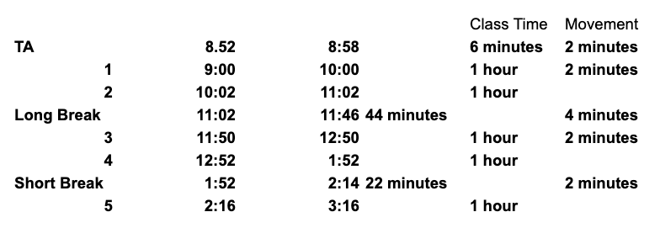
Bell Times

Slide 4
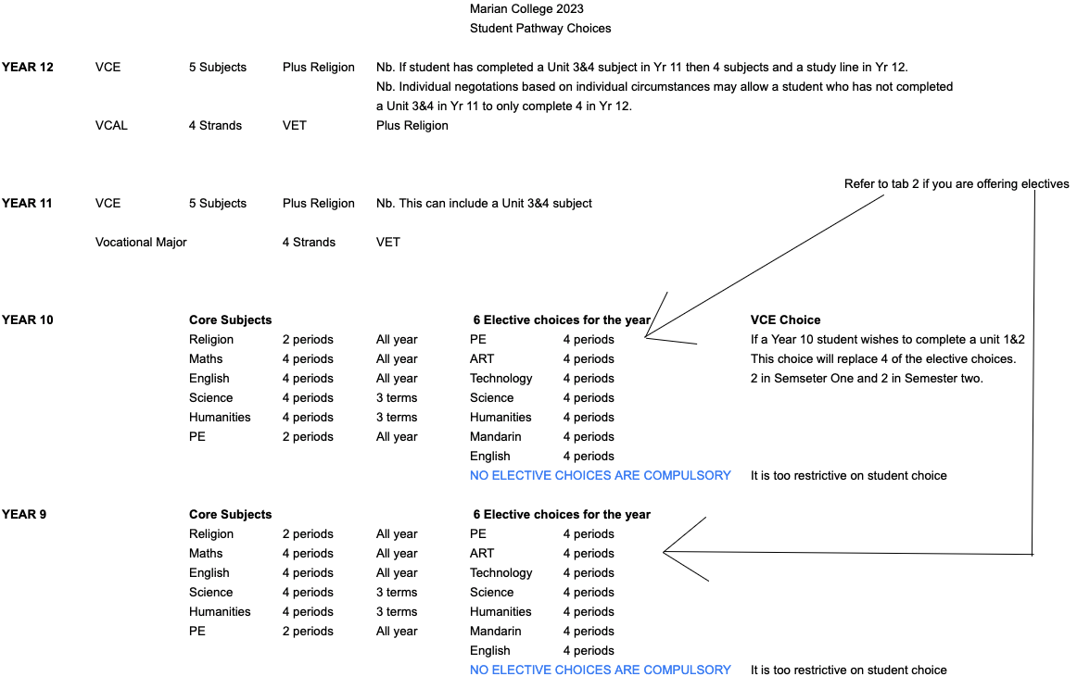

Slide 5
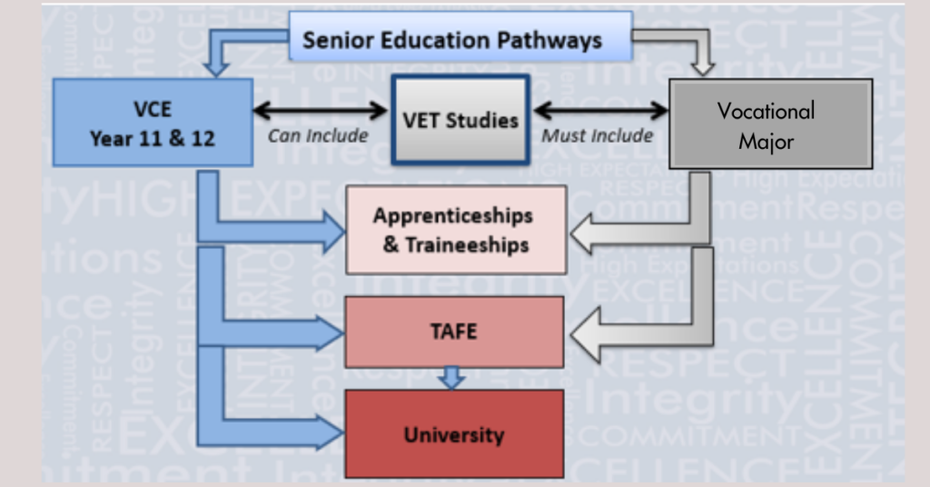
2023 VCE Options and Pathways

Slide 6
VCE & the Victorian Pathways Certificate (previously VCAL)
The Victorian Certificate of Education (VCE) is Victoria’s senior secondary qualification. It opens pathways to university, higher-level TAFE or VET certificate courses, apprenticeships, traineeships and the workforce.
The VCE is expanding to include the Vocational Major, a 2-year vocational and applied learning program. It will replace Senior and Intermediate VCAL from 2023.
Year 12 VCAL will remain the same in 2023 with current VCAL students attaining their senior VCAL Certificate and relevant VET certificate.

Slide 7
VCE Vocational Major (replacing VCAL for Year 11)
To be eligible to receive the VCE VM, students must satisfactorily complete a minimum of 16 units over two years including:
3 VCE VM Literacy or VCE English units (including a Unit 3–4 sequence)
2 VCE VM Numeracy or VCE Mathematics units
2 VCE VM Work Related Skills units
2 VCE VM Personal Development Skills units, and
2 VET credits at Certificate II level or above (180 nominal hours) School Based Apprenticeships and Traineeships can replace VET requirements
VM - Video

Slide 8
VCE
Year 11
Students choose 5 VCE or VET subjects at Units 1&2, plus Religion. One of these 5 must be either English or Literature.
The option of studying a Unit 3&4 is available. Not only to those students who studied a Unit 1&2 in Year 10
Nb. If a student in Year 10 chooses to study a Unit 1&2 subject this will replace 4 of their 6 elective choices.

Slide 9
VCE Cont.
Year 12
Students choose 5 subjects at Units 3&4, plus Religion. One of these 5 must be either English or Literature.
As previously stated individual circumstances will be taken into consideration. For eg those students who in Year 11 have already completed a Unit 3&4 subject.
VCE Video

Slide 10
Vocational Education Training (VCE VET)
VET is a key element of the VCE, and compulsory for students studying VCE Vocational Major. From 2023, students will have access to a priority set of VET programs. Students must choose their VET carefully as they will need to remain in their VET for the two years of VCE VM.
There are 6 priority pathways aligned to areas of high jobs growth and 5 flexible VET subjects.
Many VCE VET programs offer a scored option for gaining an ATAR score.
At Marian, we attempt to offer as many VET subjects as possible at school or within our local School cluster with Ararat College and Stawell Secondary. Other VET programs can be chosen from the Ballarat VET cluster, however they will require a payment plan with extra fees/costs and independent transport to and from course.

Slide 11
Priority VET Pathways
Health
Certificate III in Allied Health Assistance (Ararat College)
Community Services & Early Childhood Education
Certificate III in Community Services incorporating Certificate II in Community Services (Marian College)
Certificate III in Early Childhood Education and Care (Marian College) (Not Atar Scored)
Building and Construction
Certificate II in Building and Construction (Marian or Ballarat Cluster) (Not Atar Scored)
Certificate II in Plumbing (Ballarat Cluster) (Not Atar Scored)

Slide 12
Priority VET Pathways (continued)
Digital Media and Technologies
Certificate II in Applied Digital Technologies (Ballarat Cluster) Not ATAR scored
Certificate III in Information Technology (Ballarat Cluster)
Hospitality
Certificate II in Kitchen Operations (Ararat College)
Engineering
Certificate II in Engineering Studies (Ballarat Cluster)

Slide 13
Flexible VET options
Automotive
Certificate II in Automotive Vocational Preparation (Stawell Secondary TBC) Not ATAR scored
Agriculture and Environment
Certificate II in Agriculture (Stawell Secondary) Not ATAR scored
Certificate II in Horticulture (Ballarat Cluster) Not ATAR scored
Certificate II in Animal Care (Ballarat Cluster) Not ATAR scored
Hair and Beauty
Certificate II in Salon Assistant (Stawell Secondary) Not ATAR scored

Slide 14
Flexible VET options (continued)
Creative industries
Certificate II in Creative Industries (Ballarat Cluster) Not ATAR scored
Certificate III in Screen and Media (Ballarat Cluster)
Certificate II in Applied Fashion Design and Technology (Ballarat Cluster) Not ATAR scored
Certificate II in Music (Marian College) Not ATAR scored
Certificate III in Music (Performance or Sound Production) (Marian College)
Sport and Recreation
Certificate III in Sport and Recreation (Marian College)
Business
Certificate III in Business (Marian College)

Slide 15
Pathways via Faculty information
Please be aware that elective choices are based on the number of students who select an elective.
We cannot guarantee that your elective choices will run.

Slide 16
Marian College Religious Education PATHWAY
Year 11
Year 12
Unit 1
Religion and Society
Internal Religious Education Program
Year 7 Religion
Year 8 Religion
Year 9 Religion
Year 10 Religion

Slide 17
Marian College VISUAL ARTS PATHWAY
Year 10 CERAMICS
Year 9 CERAMICS
Year 11
Year 12
Year 9 ART
Year 10 ART
VCE Art Making and Exhibiting
UNIT 1&2
VCE Art Making and Exhibiting
UNIT 3&4
Year 7 ART
Year 8 ART
Year 9 PHOTO
Year 10 PHOTO
We also offer Piano and Singing lesson privately

Slide 18
Marian College MUSIC PATHWAY
Year 9 Popular Music
Year 11
Year 12
Year 10 Music performance and composition
Year 9 Music Technology
VCE MUSIC Performance
VCE MUSIC
Performance
Year 7 Music
Year 8 Music
Year 10 Dance
VET MUSIC
VET MUSIC
Year 9 Dance
* We also offer Piano and Singing lesson privately

Slide 19
Marian College DRAMA PATHWAY
Year 11
Year 12
Year 7 Drama
Year 8 Drama
Year 9 Drama
Year 10 Drama
VCE DRAMA
VCE DRAMA
VCE THEATRE STUDIES
VCE THEATRE STUDIES
We also offer Piano and Singing lesson privately

Slide 20
Yr 9 Arts Electives
Art
Students make and respond to visual artworks, adapt ideas, visual images and practises from selected artists and use them to inspire and inform their own personal aesthetic.
Ceramics
Ceramics students will create both pottery and modelled ceramic sculptural artworks.
Photography
Students learn the basics of digital photography in the creation of a folio of photographic images.
Drama
This course will incorporate dramatic skills such as auditioning, script reading and characterisation, as well as playmaking techniques.

Slide 21
Yr 9 Arts Electives Cont.
Popular Music
Students explore the history and development of popular music in western culture, focusing particularly on the development of Ragtime, Blues, Swing, Jazz, Rock ‘n’ Roll and beyond.
Dance
Students explore the movement of the body in a rhythmic way, usually to music and within a given space.
DJ/Music Technology
Music Technology explores the study of music using technology in different formats. Students study music through the use of different music programs, particularly working with Garageband & Audacity, Pro Tools, Sibelius, and Notion.

Slide 22
Year 10 Arts Electives
Photography
Students will increase skills in the use of digital compact and SLR cameras. They will explore techniques in creating successful imagery through lighting and composition.
Ceramics
Ceramics comprises both pottery and modelled ceramic sculpture and introduces the very basics of ceramic chemistry and the physics of the ceramic process.
Studio Art
Students explore the visual art practises and styles as inspiration to develop a personal style and themes in artworks.

Slide 23
Yr 10 Art Electives cont.
Drama and Production
The study of drama involves the exploration of a range of dramatic elements including the development of improvisation and acting skills, script-writing and individual and group performance skills, with an emphasis on the student as actor.
Music Performance and Composition.
This unit involves the study of performance and composition techniques, focusing particularly on the student’s individual instrument/s.
Dance
Creating music videos through dance.

Slide 24
Marian College English and Languages PATHWAY
Year 11
Year 12
Year 10 English
Unit 1 & 2
English
English Literature
Chinese
Unit 3&4
English
English Literature
Chinese
Year 7 English
Year 8 English
Year 9 English
Year 7 Chinese
Year 8 Chinese
Year 9 Elective Chinese
Year 10 Elective
Chinese
Year 9 Elective
Creative Writing
Year 10 Elective
Creative Writing

Slide 25
Yr 10 English Electives cont.
Chinese Year 9
Students focus on developing language skills needed for daily living and travelling (including holidays). Students also learn about Chinese culture through studying food and festivals, customs and popular holiday destinations and activities. It is strongly recommended that students have previously studied Mandarin at Year 8 level.
Chinese Year 10
Students develop their understanding of Chinese culture through the study of Chinese traditions, modern pop culture and history as well as developing conversational skills and language. Students will prepare for VCE Chinese through researching virtual communications and establishing connections with Chinese communities. It is strongly recommended that students have previously studied Mandarin at Year 9 level.

Slide 26
Yr 10 English Electives cont.
Year 9 Creative Writing
Students explore different genres and experiment with their own writing culminating in a creation of their own anthology of short pieces.
Year 10 Creative Writing
Students analyse short pieces of fiction and apply learnings to their own sustained creative writing pieces. Students are encouraged to hone their writing skills in the genre and style they are most comfortable with.

Slide 27
Marian College Health / PE PATHWAY
Core/Compulsory HPE:
Year 7 HPE
Year 8 HPE
Year 9 HPE
Year 10 HPE
Elective Options:
Year 11
Year 12
Year 9 Games of the World
Year 10 Exercise Science
Physical Education
Units 1&2
Physical Education
Units 3&4
Year 9 Netball Studies
Year 10 Outdoor Ed
Health & Human Development
Units 1&2
Health & Human Development
Units 3&4

Slide 28
Year 9 Health / PE Electives
Games of the World
Students investigate the variety of games and sports that are played in various parts of the world. Elements of geography, history & culture will be learnt along the journey and plenty of time for hands-on practical sessions of the various activities.
Netball Studies
Students will conduct an in-depth analysis of various aspects of the sport of netball including skill acquisition, coaching, officiating, tactics & strategy, fitness and performance enhancement. Practical sessions will be complemented by theoretical components of the course.

Slide 29
Year 10 Health / PE Electives
Exercise Science
Students will investigate and apply scientific and physiological concepts through participation in a range of sporting and fitness activities.
Outdoor Ed
Practical skills including navigation, orienteering, camp cooking, environmental issues, preparing for expeditions etc.

Slide 30
Marian College Humanities PATHWAY
Year 9 (Core)
Industrial Revolution & World War I
Year 10 (Core)
Legal Studies
Year 11
Year 12
Units 1&2
Business Management
History
Legal Studies
Units 3&4
Business Management
History
Legal Studies
Year 7 Humanities
Year 8 Humanities
Year 9 (Core)
Geography - Interconnection
Year 10 (Core)
World War II
Year 9 (Core)
Civics
Year 10 (Core) Business & Economics
Year 9 (Electives)
Hollywood vs History
Home & Away: Australia’s Pop Culture
Money Talks
Year 10 (Electives)
Hollywood vs History
Home & Away: Australia’s Pop Culture
Money Talks
Civil Rights & Freedoms
Political Crisis: The World at War
"Kids These Days" (Sociology)

Slide 31
Year 9 Humanities Electives
Hollywood vs History In this elective, we will explore how historical events have been portrayed in film and how they help us understand their significance.
‘Home & Away’: Australia’s Popular Culture This elective explores how developments in popular culture, including music, radio, tv, film and sport, have influenced Australia since World War Two. You will also examine the contributions Australia has made to international popular culture.
Money Talks This unit explores how people manage financial risks and rewards in the current Australian and global financial markets. You will explore financial risks such as scams and identity theft and consider strategies to avoid these, as well as the role of banks and other institutions, the difference between good and bad debt & how to manage debt, and identify ways consumers can protect themselves from risks.

Slide 32
Year 10 Humanities Electives
As well as choosing from the Year 9 Electives, Year 10 students can also choose from the following:
“Kids These Days” (Sociology) Sociology focuses on the study of human behaviour and social interaction to understand how societies are organised, develop and change. In this course, you will explore how and why the experience of being young is different across time and space. You will also examine a range of factors that lead to different experiences of youth, as well as the potential negative impacts of stereotypes.
Civil Rights & Freedoms This elective focuses on how humans have worked towards achieving freedom. Key events from the US Civil Rights movement will be explored and compared to the First Nations Civil Rights movement in Australia. You will also have the opportunity to explore other freedom and protest movements of recent and modern times.
Political Crisis: The World at War In this elective, we will focus on understanding why Australia has been involved in modern war including the Korean War, the Vietnam War and other international conflicts. There is an emphasis on understanding why we became involved in these conflicts and the impact they have had on Australia.
Money Talks This unit explores how people manage money as well as financial risks and rewards in the current Australian financial market. You will explore the importance of money (including bitcoin), budgeting, financial risks such as scams and identity theft and consider strategies to avoid these. You will also examine the role of banks and other institutions, the difference between good and bad debt & how to manage debt, and identify ways consumers can protect themselves from risks.

Slide 33
Marian College Maths PATHWAY
Year 9 Maths Methods Units
Year 10 Maths Methods Units
Year 11
Year 12
Year 8 Maths Methods
Units 1&2
Specialist Maths
Maths Methods
General Maths
Foundation Maths
Units 3&4
Specialist Maths
Maths Methods
General Maths
Foundation Maths
Year 7 Maths
Year 9 General Maths Units
Year 10 General Maths Units
Year 8 General Maths
Year 9 Foundation Maths Units
Year 10 Foundation Maths Units

Slide 34
Year 10 Mathematics
The College will run a variety of Maths units in 2023 which will cater for the different levels of skills and ambitions of our students. Students will be required to complete 4 units of maths over the year.
Mathematics students are asked to pick between the 3 Maths streams. Maths Methods, General Maths and Foundation Maths. The College will then work with students to create the best combination of units to match their selection.
10 Maths Methods: Advanced Algebra and Advanced Equations plus 2 General units
10 General Maths: General Algebra, General Number, General Measurement & Geometry and General Statistics & Probability
10 Foundation Maths: Foundation Algebra, Foundation Number, Foundation Measurement & Geometry and Foundation Statistics & Probability. These units could be integrated with other electives. Foundation units will be modified year 10 units.

Slide 35
Year 9 Mathematics
The College will run a variety of Maths units in 2023 which will cater for the different levels of skills and ambitions of our students. Students will be required to complete 4 units of maths over the year.
Mathematics students are asked to pick between the 3 Maths streams. Maths Methods, General Maths and Foundation Maths. The College will then work with students to create the best combination of units to match their selection.
9 Maths Methods: Advanced Algebra and Advanced Equations plus 2 General units
9 General Maths: General Algebra, General Number, General Measurement & Geometry and General Statistics & Probability
9 Foundation Maths: Foundation Algebra, Foundation Number, Foundation Measurement & Geometry and Foundation Statistics & Probability. These units could be integrated with other electives. Foundation units will be modified year 10 units.

Slide 36
Marian College Science PATHWAY
Year 11
Year 12
Year 9 Biology
Year 10 Biology
Units 1&2
Biology
Units 3&4
Biology
Year 7 Science
Year 8 Science
Year 9 Chemistry
Year 10 Chemistry
Units 1&2
Chemistry
Units 3&4
Chemistry
Year 9 Physics
Year 10 Physics
Units 1&2
Physics
Units 3&4
Physics
Year 9/10 Psychology/Biology
(Elective)
Year 9/10 Science Inquiry Skills
(Elective)
Units 1&2
Psychology
Units 3&4
Psychology
Year 9/10 Ag Studies
(Elective)

Slide 37
Year 9/10 Science Electives
Psychology/Biology
Students explain (using models, flow diagrams or simulations) how body systems work together to maintain a functioning body Students discover how an animal’s response to a stimulus is coordinated by its central nervous system (brain and spinal cord). They model neurons and simulate the transmission of electrical impulses and communication via synapses. You will learn that the study of psychology is a journey of discovery about you and your amazing brain. Through practical experiences, and research you will develop investigative and communication skills.
This elective will help you prepare for VCE Psychology.
Agricultural Studies
Students will apply their knowledge of ecosystems, biotic and abiotic components of the environment; matter and energy flow to small scale agricultural activities including propagation techniques for food and herb growing along with fruit production. They will consider how global systems, including the carbon cycle are involved in building soil nutrients, recycling matter and modern farming practices.
This elective introduces students to horticultural and primary production of food.

Slide 38
Year 9/10 Science Electives
Science Inquiry Skills
Through a series of experiments students will develop fundamental scientific Inquiry skills. Groups of students will plan and conduct their own investigations, collect and present data, critically evaluate experimental design methods and communicate their findings. They will debate the values and needs of contemporary society and how these can influence the focus of scientific research.
This elective is designed to prepare students for VCE Sciences. Including Chemistry, Biology and Psychology.

Slide 39
Marian College Technology PATHWAY
Year 10
Digital Media
Year 11
Year 12
Year 9
Cooking for Celebrations
Year 10
Computer Aided Design
Units 1&2
Food Studies
Units 3&4
Food Studies
Year 7
Home Economics
Year 8
Home Economics
Year 9
Multicultural Cooking
Year 10
Asian Foods
Units 1&2 Product Design & Technology (Textiles OR
Wood, Plastic & Metal)
Units 3&4
Product Design & Technology (Textiles OR Wood, Plastic & Metal)
Year 7
Textiles
Year 8
Textiles
Year 9
Jewellery Making
Year 10
Survival Foods
Year 7
Wood, Metal & Plastics
Year 8
Wood, Metal & Plastics
Year 9
Textiles: Clothing Solutions
Year 10
Foods for Fitness
Units 1&2
Systems
Engineering
Units 3&4
Systems
Engineering
Year 7
Digital Technology
Year 8
Digital Technology
Year 10
My Kitchen Hamper

Slide 40
Marian College Technology PATHWAY
Year 9
Digital Media
Year 10
Textiles: Weekend Away
Year 9
Computer Aided Design
Year 10
Textiles: Wearable Art
Year 10
Furniture Making
Year 9
Wood & Plastics
Year 10
Metal Engineering
Year 9
Metal & Engineering
Year 10
Metal, Wood & Plastics
Year 9
Systems Mechatronics
Year 10
Systems Mechatronics

Slide 41
Year 9 Technology Electives
Year 9 Cooking for Celebrations
This subject focuses on planning and preparing for a range of celebrations involving both traditional and non-traditional foods – Christmas, friend’s parties, family birthdays, etc. Sweet and savoury foods as well as cake decorating are included.
Year 9 Multicultural Cooking
Students study a variety of cultures which have influences on our eating patterns – Asian, Thai, Italian, French, Indian etc. Relevant cooking methods and reasons why certain foods are used are studied. Each week a typical meal from each country is prepared. In the other part of the semester students work in pairs to research a country of their choice.

Slide 42
Year 9 Technology Electives cont.
Year 9 Jewellery Making
This “hands on” subject will develop and expand students’ knowledge of a range of materials, fine motor skill development, attitudes to resources and recycling and cooperative work in a safe environment.
Year 9 Textiles: Clothing Solutions
In Year 9 textiles, students design, produce and evaluate a product according to an identified need or opportunity. They maintain a design folio with a criteria for success, including sustainability, considerations and use it to investigate, generate and produce a quality design solution.

Slide 43
Year 9 Technology Electives cont.
Year 9 Digital Media
Students are actively engaged in the process of analysing problems, designing, developing and evaluating digital solutions, and creating and sharing information using computers. Students learn to safely and ethically create digital solutions. These solutions and information are created through the application of computational, design and systems thinking, and technical skills.
Year 9 Computer Aided Design
CAD (Computer Aided Design) is an exciting STEM course that allows students to use their creativity to develop solutions to real world problems, needs and opportunities. CAD allows students to take an idea and turn it into reality faster than using manual production techniques and to a much higher standard.

Slide 44
Year 9 Technology Electives cont.
Year 9 Wood & Plastics
There are three phases involved in the technology process. These are: Investigating/Designing, Production and Analysing/Evaluating. Using this design process model, students explore various materials. They then design, produce and evaluate a range of products using hand and power tools.
Year 9 Metal Engineering
Students explore the social and environmental implications of using various materials. They start to recognize that the supply of some materials is limited, and examine possibilities for reusing and recycling. They use material tests to determine the appropriateness of materials for particular purposes. Students design and produce a range of products using hand and power tools and also a range of welding processes.
Year 9 Systems Mechatronics
Systems Mechatronics combines both Electronic and Mechanical principles. Students consider the principles, structure, logic and organisation of systems, and research how community and industrial standards affect the design and development of systems.

Slide 45
Year 10 Technology Electives
Year 10 Digital Media
Students learn advanced coding techniques using python to code chatbots and games like snake. Students look at web safety including HTML issues and limitations and why encryption occurs at banks. Students design solutions to these issues.
Year 10 Computer Aided Design
The software used in the CAD elective is industry standard and provides students with a workplace ready skill and the ability to easily move from one software platform to another in the industry, TAFE and University, giving students an edge in further education and training.

Slide 46
Year 10 Technology Electives cont.
Year 10 Asian Foods
This subject will focus on looking at a number of Asian cultures with particular emphasis on their foods, cultural events and cooking methods.
Year 10 Survival Foods
This subject aims to provide students with the necessary skills to enable them to look after themselves in terms of cooking when they leave home.
Year 10 Food for Fitness
This subject examines up to date nutritional information translated into recipes that are relatively easy to prepare and cover all food types and meals. The focus will be on preparing a wide variety of foods to provide for maximum energy and everyday fitness.

Slide 47
Year 10 Technology cont.
Year 10 My Kitchen Hamper
This subject is a ‘taster’ to Units 1&2 Food Studies and ‘The Design Process’ is studied in greater detail. Students are asked to research, design and then produce a ‘Hamper’. This must contain various food items that have been produced using various processes and methods learnt throughout the unit.
Year 10 Textiles: Weekend Away
Students design, produce and evaluate a product according to an identified need or opportunity. They maintain a design folio with a criteria for success, including sustainability, considerations and use it to investigate, generate and produce a quality design solution.
Year 10 Textiles: Wearable Art
Students design and produce a garment based on a theme. Students continue to develop their design skills, their understanding of the design elements and explore known and new materials and how they can be manipulated.

Slide 48
Year 10 Technology cont.
Year 10 Furniture Making
Students explore the social and environmental implications of using wooden materials. They start to recognize that the supply of some materials is limited, and examine possibilities for reusing and recycling materials. Students also use a range of woodworking tools and processes in building their project.
Year 10 Metal, Wood & Plastics
Students build a small and complex piece of furniture were they will be encouraged to incorporate other materials such as plastic and metal. They are required to design this project using various drawing techniques including CAD 3D.
Year 10 Metal Engineering
This elective aims to develop the students understanding of the interrelationships between technology, the individual, society and the environment, and to develop their ability to think creatively to devise solutions to practical problems. (This elective is a pathway to VCE/VET Engineering).

Slide 49
Year 10 Technology cont.
Year 10 Systems Mechatronics Advanced
Mechatronic systems combine both mechanical and electronic principles. Students consider the principles, structure, logic and organisation of systems, and research how community and industrial standards affect the design and development of systems.

Slide 50
Wellbeing
The Oak program is designed to specifically target the wellbeing needs of students at each Year level. A variety of concepts are explored, as at Marian college, we view the wellbeing of students being interconnected with their academic achievement. In addition to this, the OAK program enables students to develop an understanding of the importance of respectful relationships, a positive approach to education and finding the right balance in their lives.
At Marian College, our wellbeing vision statement states the following: We value and respect the dignity of our students. We believe that positive student wellbeing is central to student learning. We believe that positive relationships between students and their teachers is of the utmost importance. We commit to restorative practices wherein the voices of students and teachers are both heard and conflict is resolved calmly and fairly. We acknowledge the immense value of building strong connections with parents and families and believe this in turn aides in our students’ growth. We believe that the education we offer at Marian College shapes well-rounded, empathetic and inspired citizens

Slide 51
Subject Selection via Web Preferences
All students in Years 8-11 will receive an email that explains how they log into web preferences to complete their subject selections.
They will have five opportunities to make their choices.
Web Preferences will close on Friday Aug 12.

