Slide 1


Years 7-10 Religion
CORE SUBJECT

Slide 2
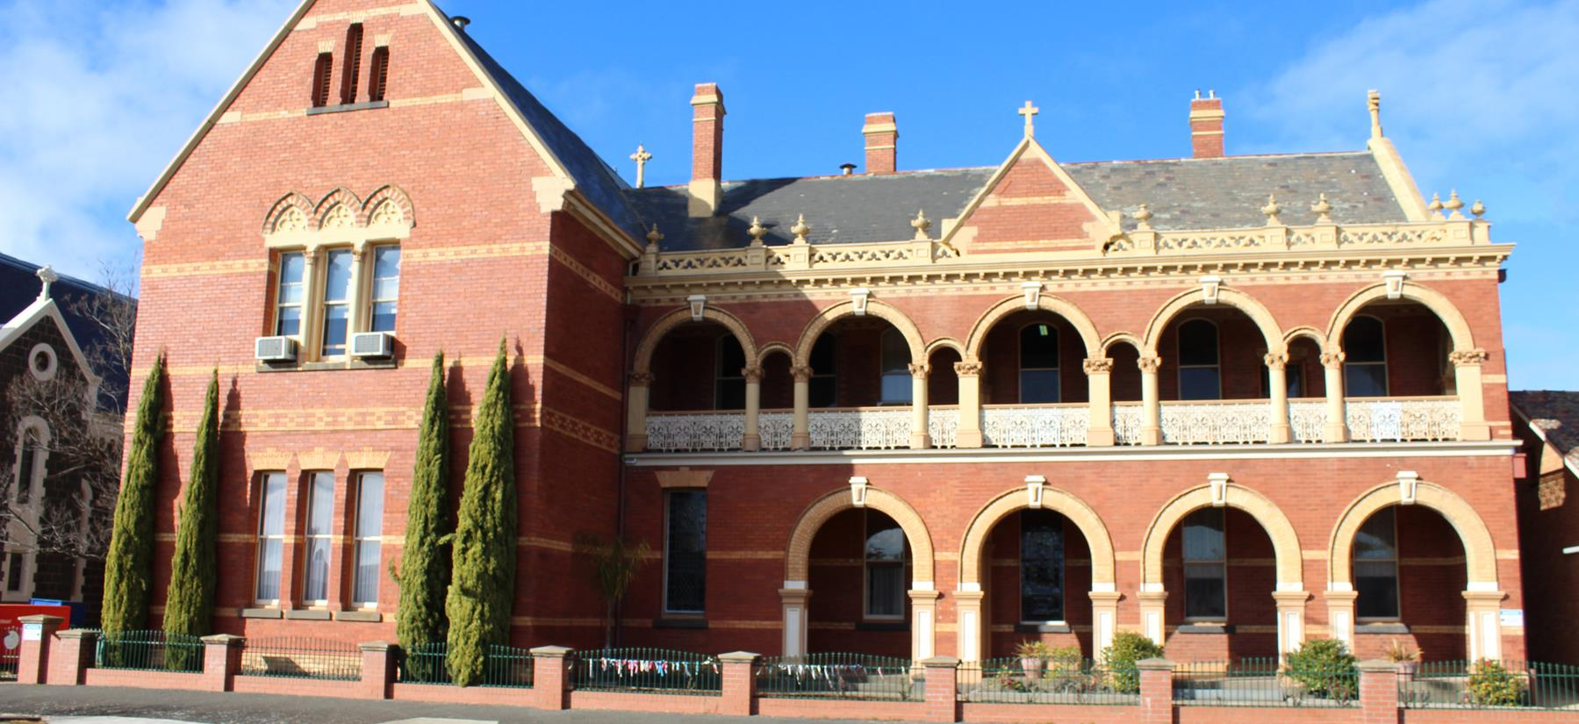
Religious Education at Marian College
Our Context:
Catholic School
Rural Area
Ballarat Diocese
Brigidine Sisters
Kildare Ministries
CONTEXT IS IMPORTANT AS IT HELPS TO SHAPE OUR IDENTITY, WHICH IS OUR STARTING POINT ON OUR SEARCH FOR MEANING IN A COMPLEX WORLD

Slide 3
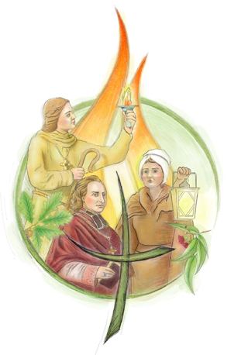

Our Brigidine and Kildare Ministries Identity
Brigidine Founders
Kildare Ministries Values

Slide 4
Ballarat Diocese- Awakenings
The Awakenings curriculum aims to provide students with an informed religious response to the search for meaning and the questions of life.
A supportive setting
Recognises and celebrates difference with dialogue
Opportunities to move from purely academic studies to an invitation to encounter the presence of God.

Slide 5
Awakenings- Strands
Each unit in RE will incorporate at least 2 “strands” to help guide the learning
Christian Ethics: Personal and Social | Church and Tradition | God, Religion and Society
Prayer, Liturgy and Sacraments | Scripture, Israel and Jesus

Slide 6
For further information
seast@mcararat.catholic.edu.au

