Slide 1
YEAR 9 TECHNOLOGIES
DESIGN & TECHNOLOGIES
DIGITAL TECHNOLOGIES

Slide 2
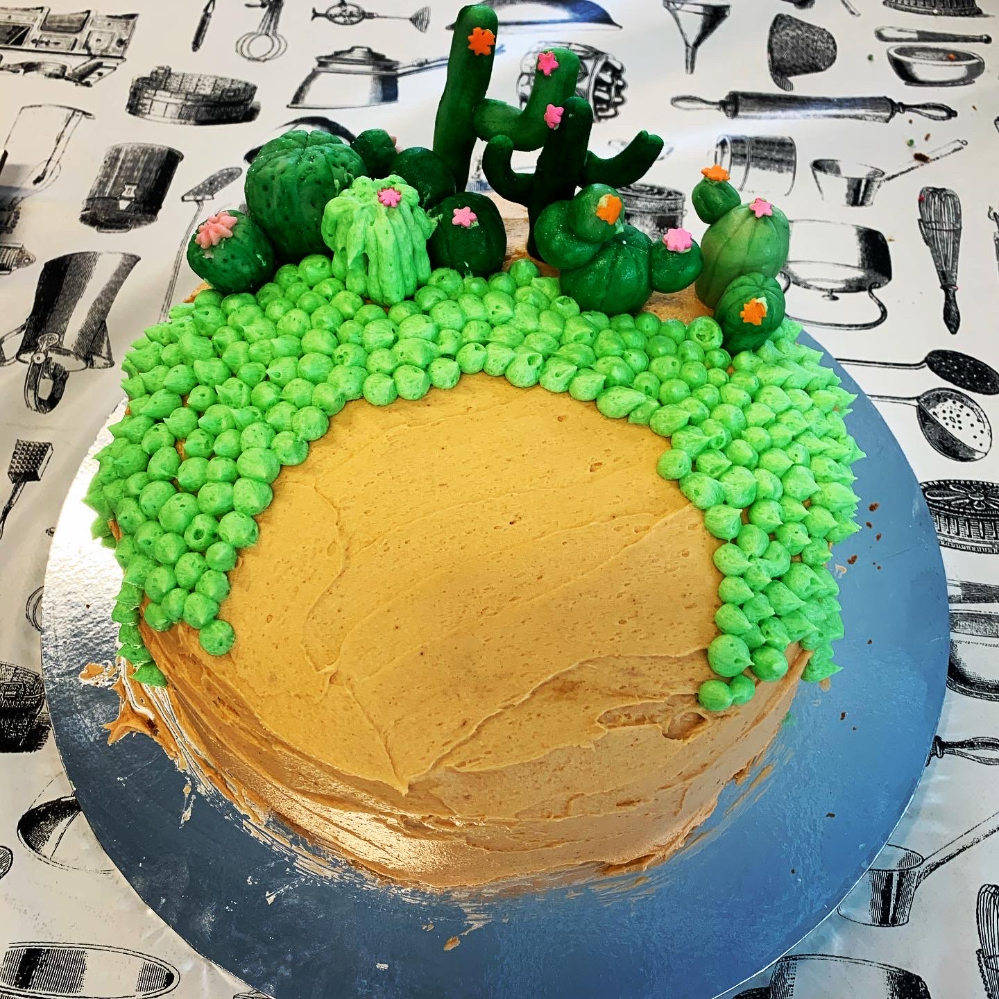
YEAR 9 - 2021
You must select ONE Art & ONE Technology Subject.
You then must select FOUR other electives from Arts, Technologies or General electives.
Electives follow the Design Process

Slide 3
TECHNOLOGIES ELECTIVES - YEAR 9
Computer Aided Design Jewellery Making
Digital Technologies Textiles: Clothing Solutions
Woodwork & Plastics 1 &/or 2 Cooking for Celebration
Metal Engineering 1 &/or 2 Multicultural Cooking
Systems Mechatronics

Slide 4
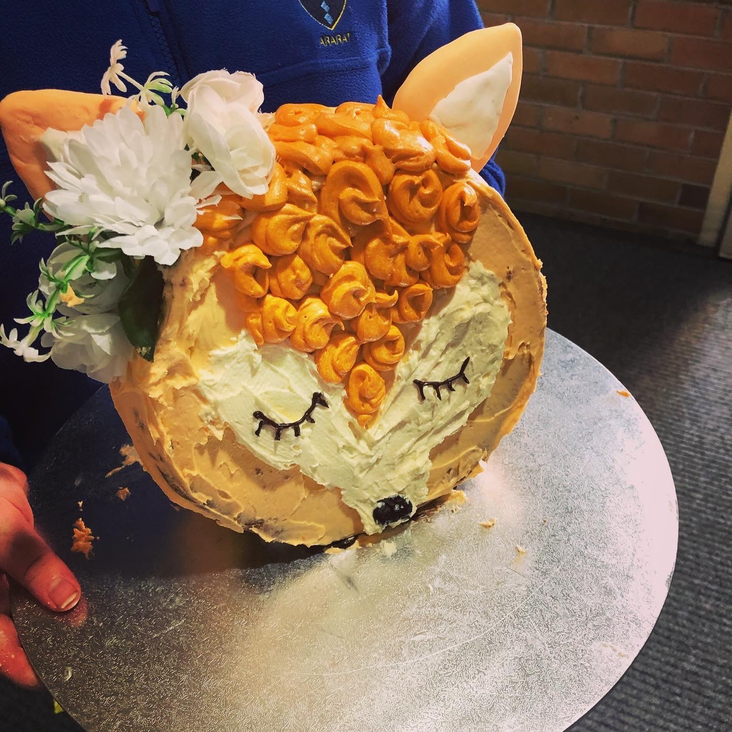
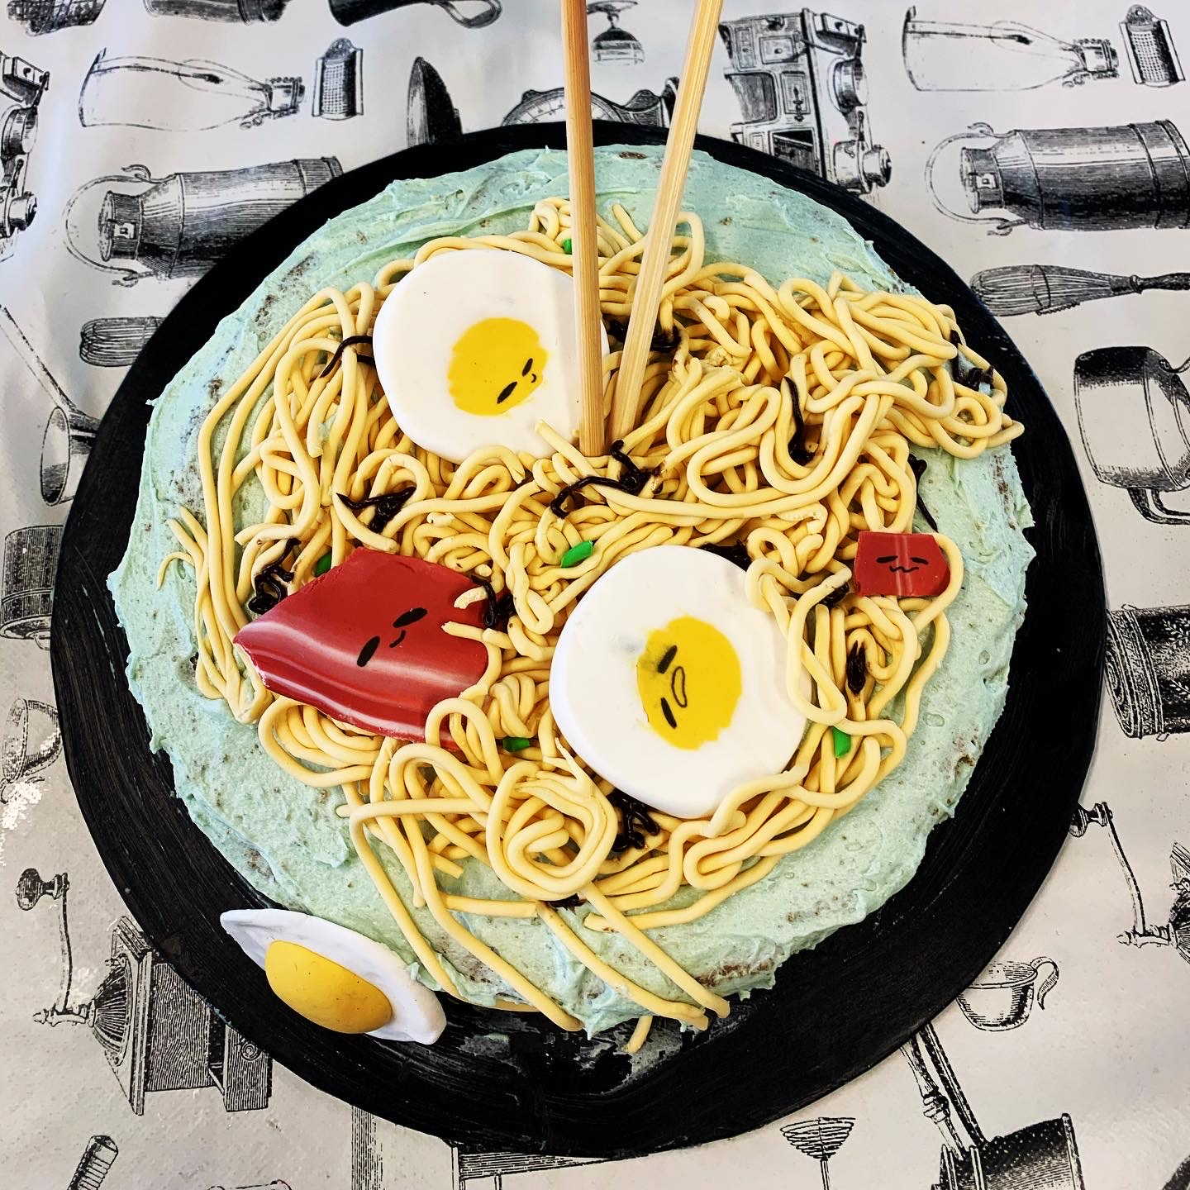
SAMPLE WORK

Slide 5
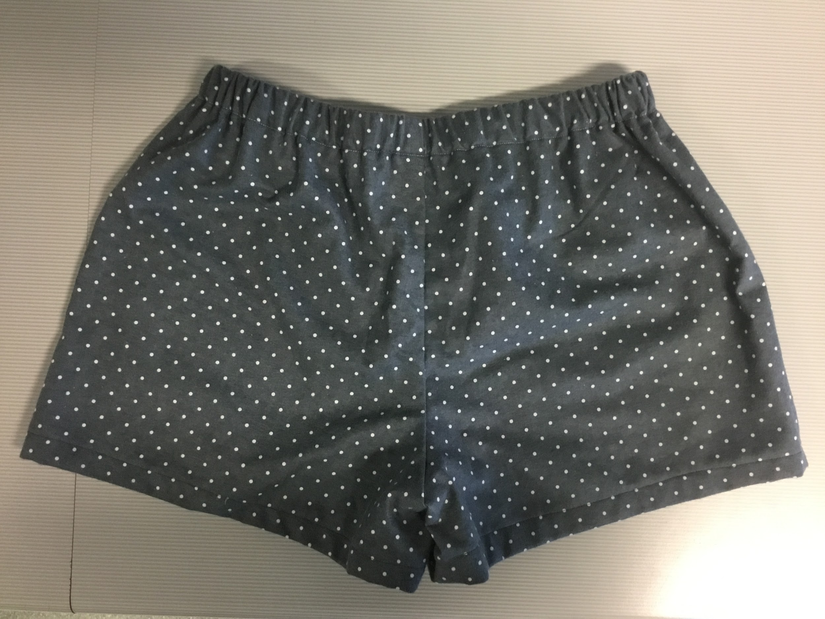
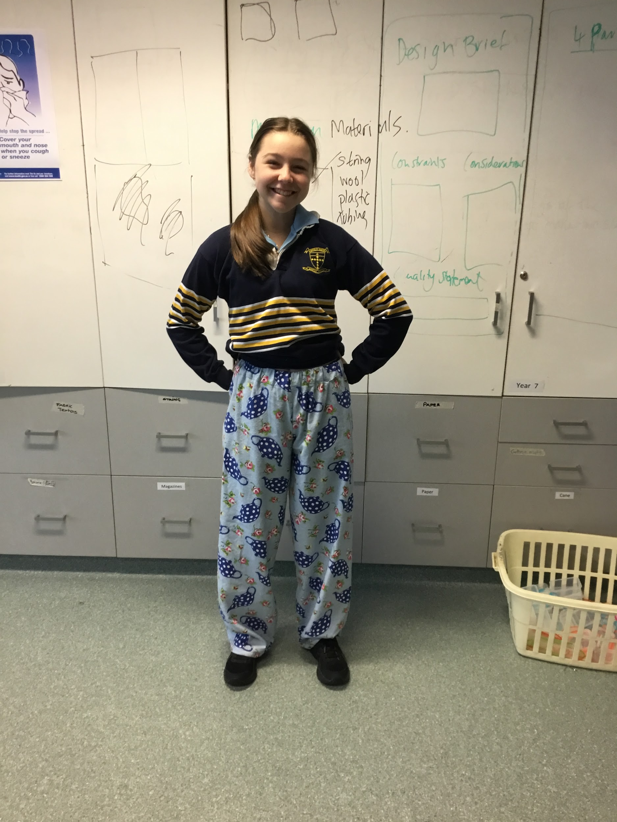
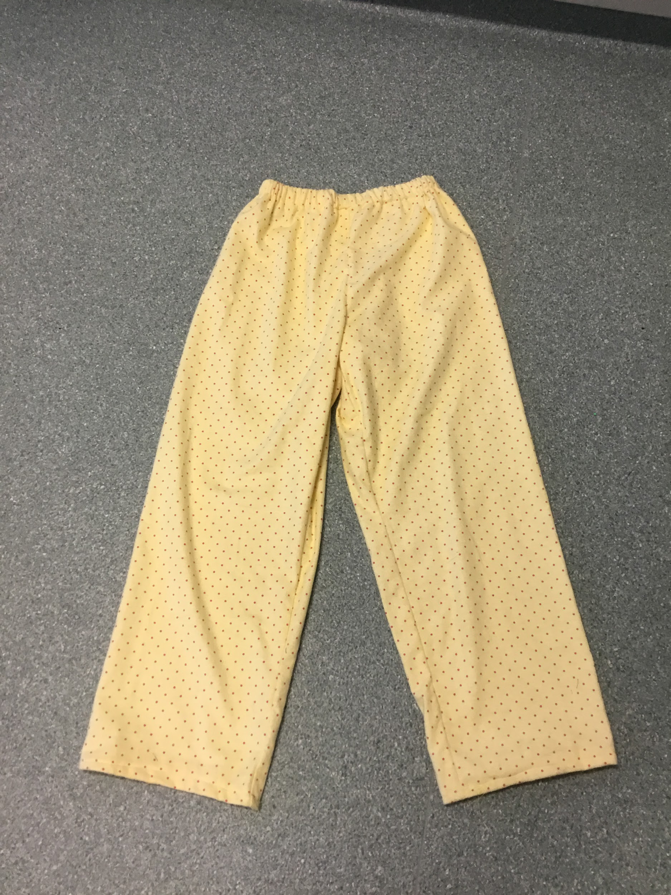
SAMPLE WORK

Slide 6
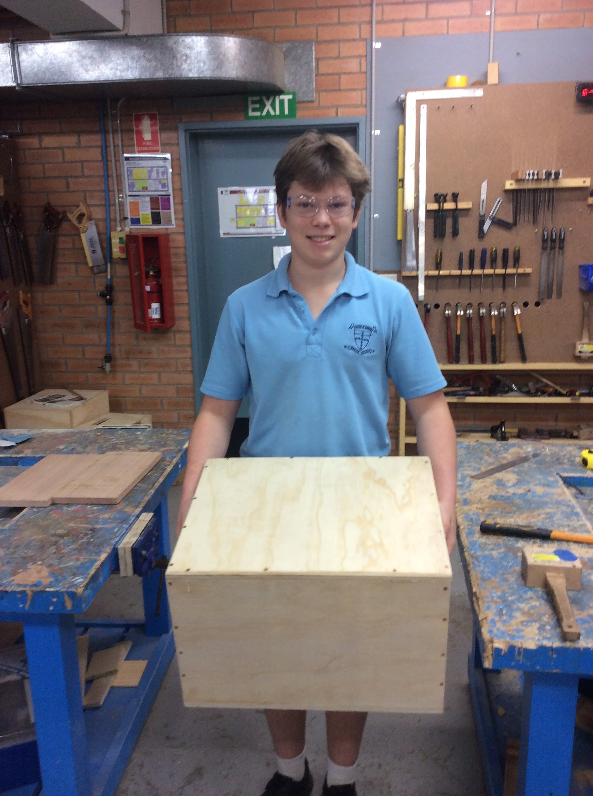
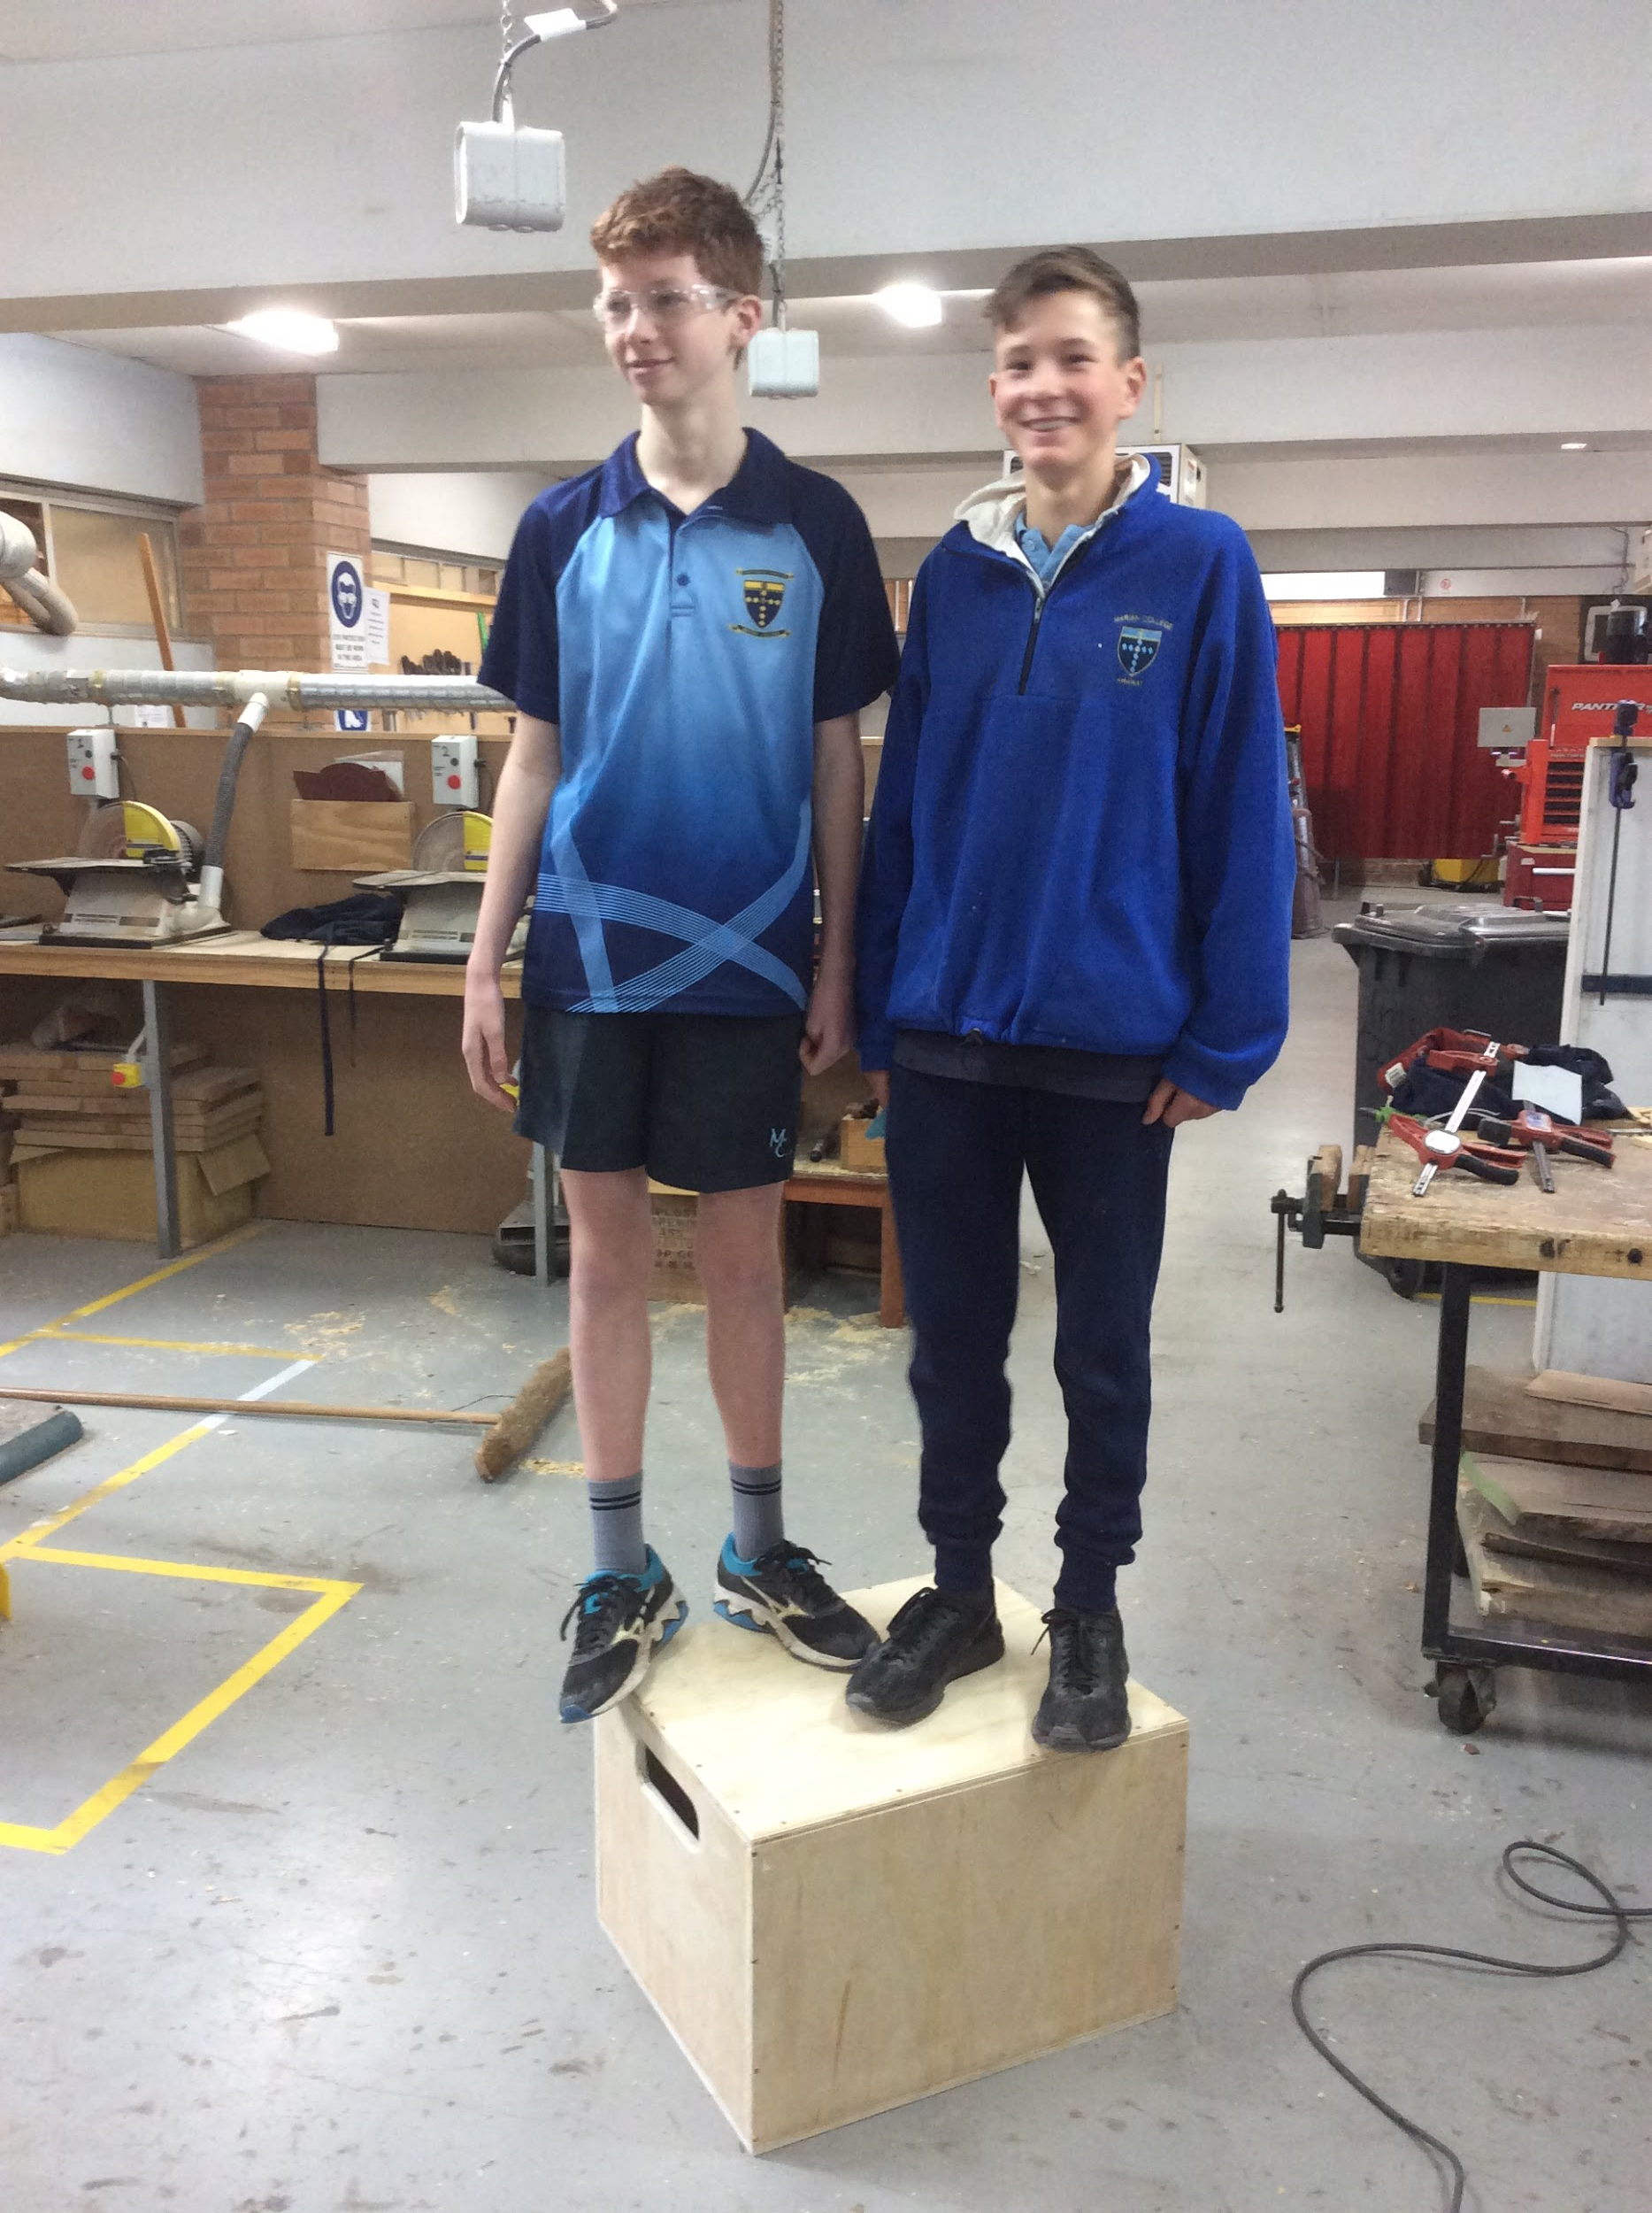
SAMPLE WORK

Slide 7
FURTHER INFORMATION
Megan Shea
Head of Technologies
sheam@mcararat.catholic.edu.au
Speak to: Year 9 Technology Teachers (Mrs Spalding, Mr Peatt, Mrs Shea, Mr Stewart, Mrs Venn, Mrs Whatley)
Refer to: Subject handbooks
Check us out on Instagram: foodandtechatmarianararat

