Slide 1


YEAR 9 Wellbeing
“Oak Wellbeing - Positive Education”.

Slide 2
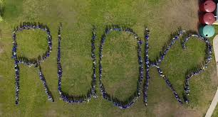
What is Positive Education?
Our Positive Education curriculum is explicitly designed to support your child to establish optimistic habits of mind that propel them forward in their learning, personal development and character. The Wellbeing Curriculum we implement at Year 7 teaches the skills of wellbeing to actively develop within our students optimism, resilience, grit and compassion.

Slide 3

Term 1 Oak Program - Positive Education
In Term 1, character strengths still feature, but with the main focus being the students’ own relationship with their world and those who inhabit it. The goal here is to put positive relationships at the front and centre of all we do and to show gratitude for what is good about ourselves and the world around us. The curriculum this year also encourages students to start thinking of the idea of leadership - what it is; what it means to them and how they can show it in their everyday lives.
Topics covered: Empathy and compassion
Leadership and Teamwork
Gratitude

Slide 4
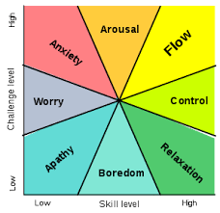
Term 2 Oak Program - Positive Education
In Term 2, students focus on those areas in life that give them joy - something crucial to our wellbeing! Among other things, we engage in some “active wellbeing” and introduce students to the concept of “Flow” which come from the field of positive psychology and involves being in the zone - or in a mental state in which a person performing an activity is fully immersed in a feeling of energized focus, full involvement and enjoyment.
Topics covered: Physical Wellbeing
Resilience
Creativity
Flow

Slide 5
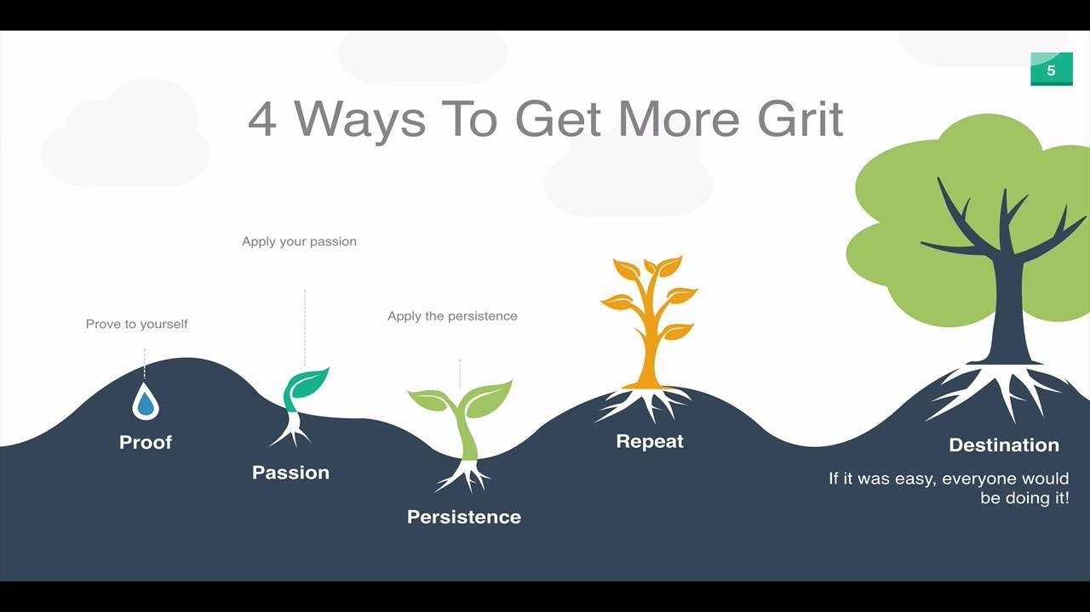
Term 3 Oak Program - Positive Education
This Term, students start focusing on personal fulfillment and goal setting - looking at strategies to achieve both in their own lives. This Term students also look at the two main requirements for achieving our goals - grit and perseverance.
Topics covered: Curiosity
Motivation
Goal Orientation
Grit and perseverance

Slide 6
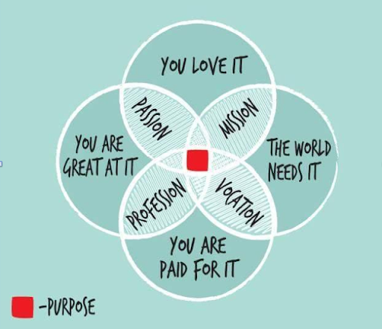
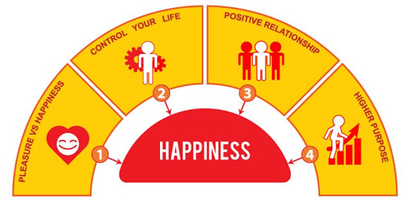
Term 4 Oak Program - Positive Education
In Term 4 students explore the idea of individual purpose and meaning in life.
Topics covered: Character Development
Core Values
Sense of Meaning

Slide 7

At the end of the Year 9 Oak Program - our hopes for our students.
We hope at the end of Year 9, that students enjoyed the experience of Oak Wellbeing and leave the year level being able draw upon some wellbeing strategies that can help them build positive relationships centred on compassion and respect. We also hope our students start thinking more about their passions, purpose and those areas in life that give them joy.

