Slide 1
YEAR 9 LANGUAGE
ELECTIVE:
CHINESE

Slide 2
YR 9 ELECTIVE: CHINESE
Year 9 Chinese is offered as a semester long elective.
Students interested in developing their Chinese are encouraged to choose Chinese for both Semester One and Semester Two.
Course content focuses on building upon knowledge about Chinese culture and customs and pronunciation of Pinyin.

Slide 3
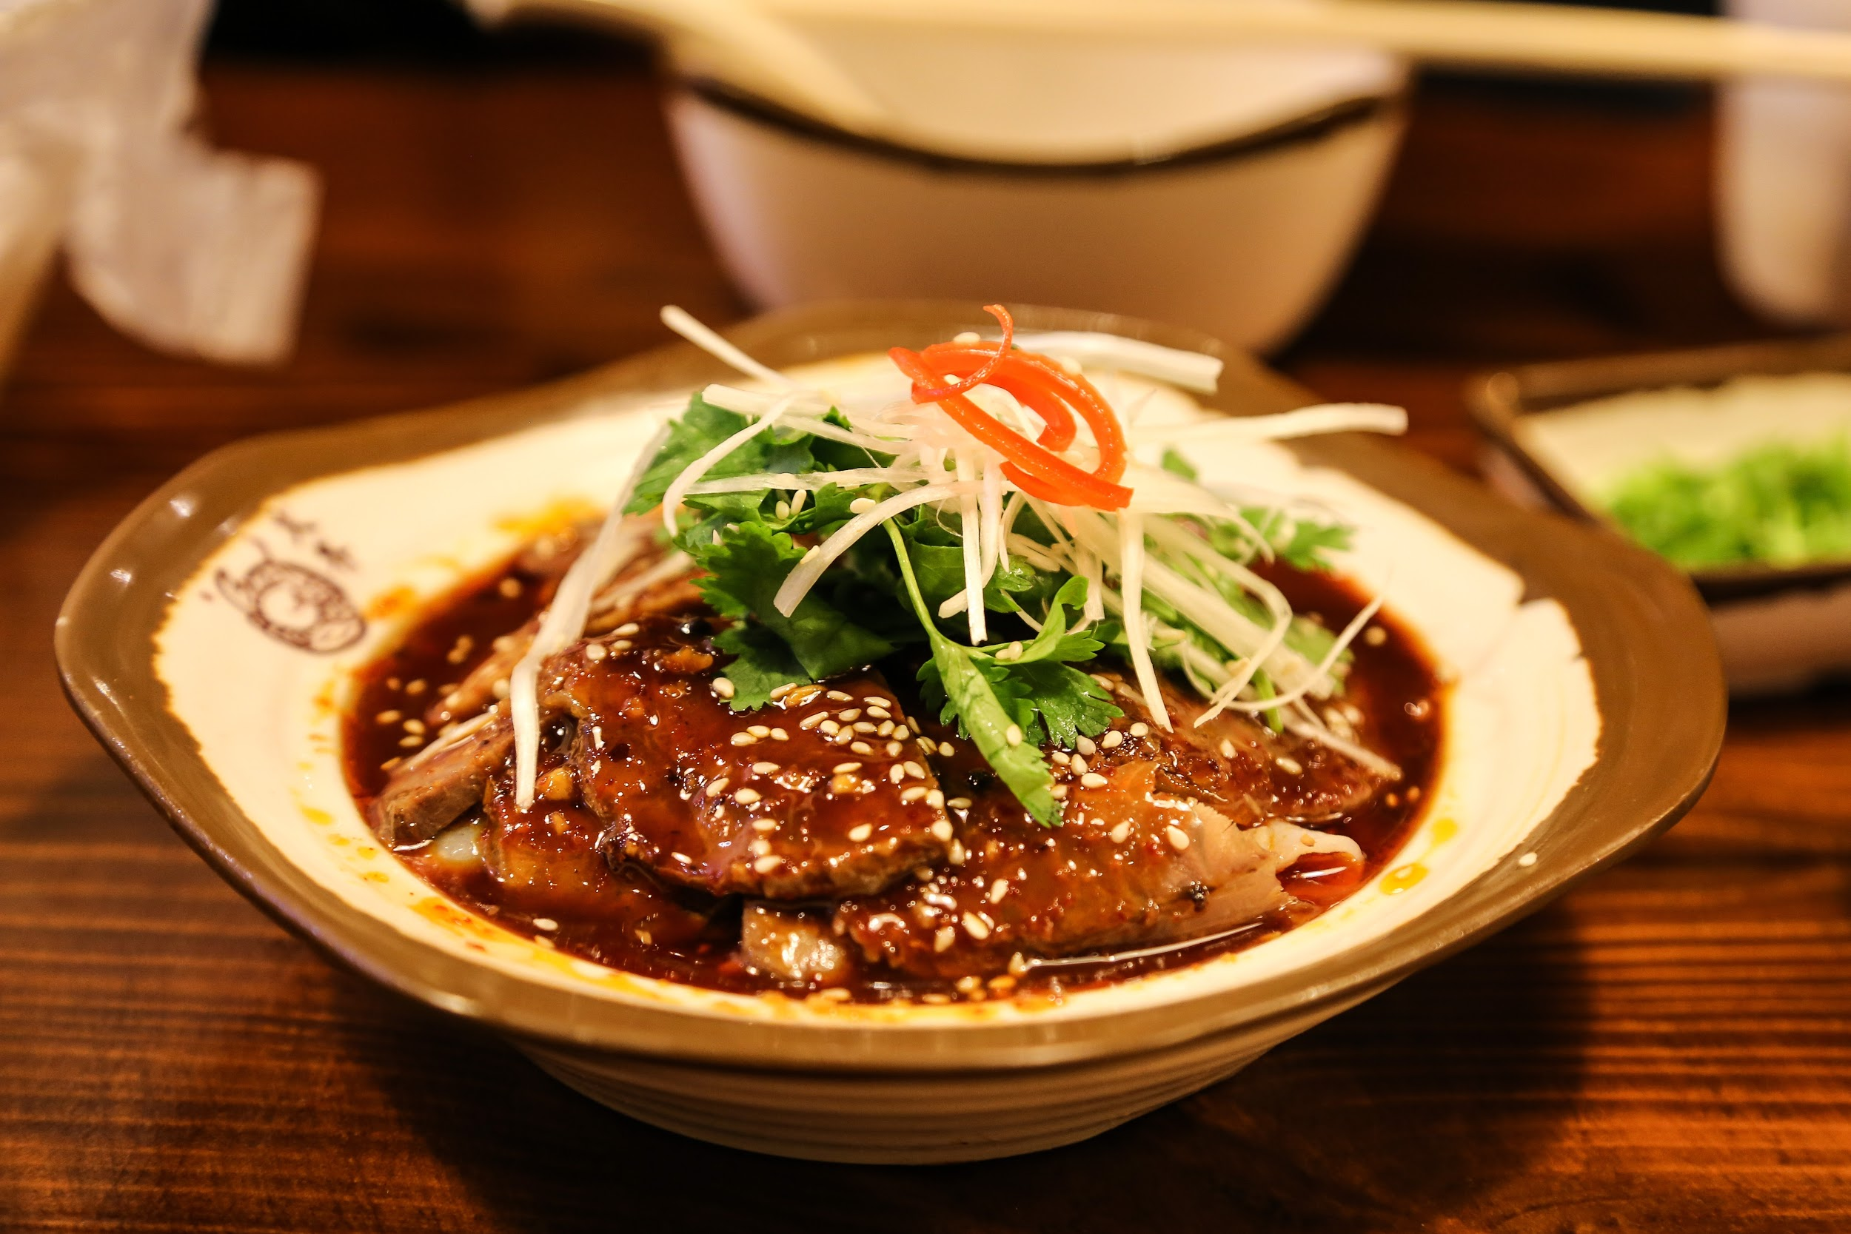
YR 9 ELECTIVE: CHINESE
Semester One: Food and Festivals:
Students develop the skills needed for daily living such as
purchasing food items and ordering in a restaurant.
There is a focus on learning about Chinese culture through the study of Chinese food festivals and foods associated with different festivals.
Students may participate in practical examples such as sampling or cooking Chinese food.

Slide 4
YR 9 ELECTIVE: CHINESE
Semester Two: Travel and Holidays
Students develop the language skills required for travelling such as asking for directions, purchasing items and planning for a holiday.
Students study popular Chinese holiday destinations and activities as well as learning about customs and visitors should adhere to.

Slide 5
Year 9 LANGUAGES
For more information about either the elective or core subject please contact:
Mrs Stephanie Mansell
Head of English and Languages
smansell@mcararat.catholic.edu.au
Or speak to Ms Guan (Chinese teacher)

