Slide 1
YEAR 8 TECHNOLOGIES
DESIGN & TECHNOLOGIES
DIGITAL TECHNOLOGIES

Slide 2
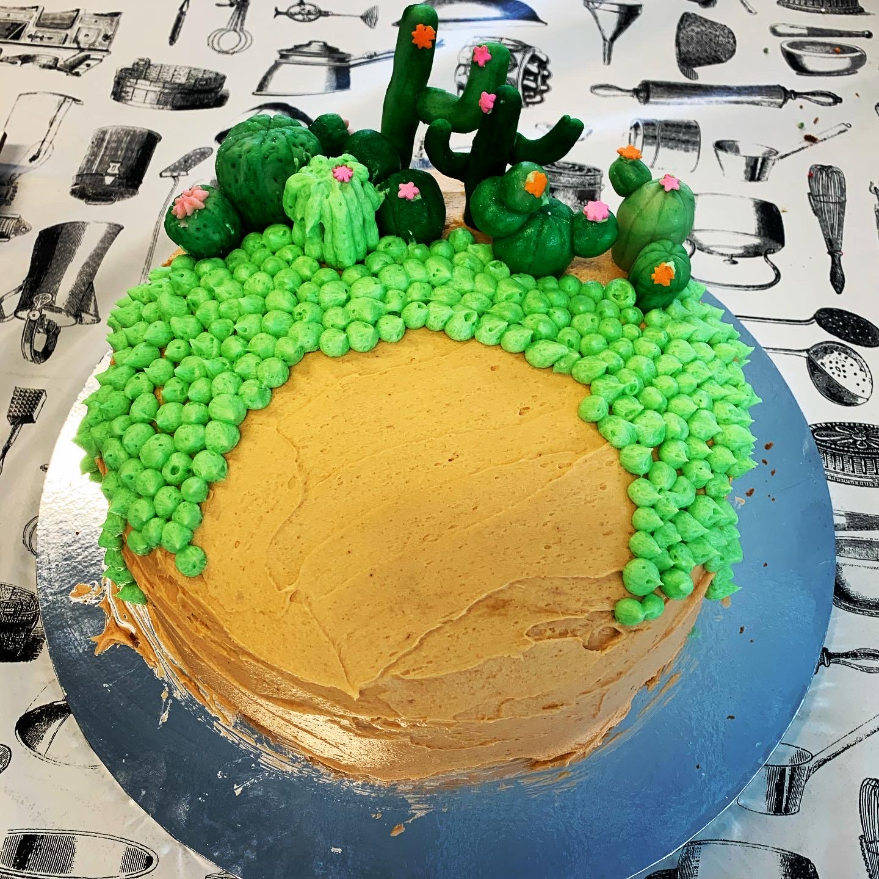
YEAR 8 - 2021
All Year 7 students participate in a variety of Technology subjects throughout the year.
There are four Technology subjects taught for a Semester only and run for a double period each week:
Digital Technology - Product Design
- Home Economics - Textiles

Slide 3
Digital Technologies
Students are actively engaged in the processes of analysing problems, designing, developing and evaluating digital solutions, and creating and sharing information using computers.
Students learn to safely and ethically create digital solutions. These solutions and information are created through the application of computational, design and systems thinking, and technical skills.

Slide 4
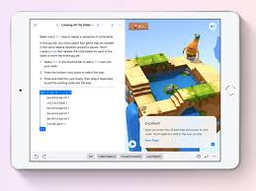
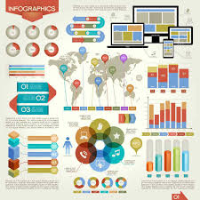
Digital Technologies: continued
Course Content:
Web design
Spreadsheets & Infographics
Coding with Swift

Slide 5
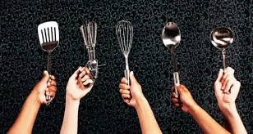
Home Economics
The focus for this subject is to extend the students from the basic principles of food preparation and production taught in Year 7. The emphasis is on practical application.
Course Content:
Safety in the kitchen

Slide 6
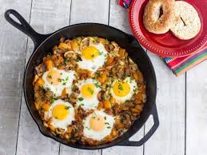
Home Economics
Practical sessions producing a range of savoury and sweet items. The recipes used add a progression from what was taught in Year 7.
Cooking terms and definitions.
Evaluation of practical sessions.
Home cooking as an extension of their practical work.

Slide 7
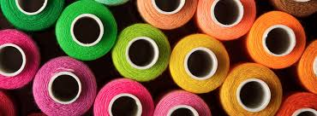
Textiles
Students continue to develop their fibre and fabric knowledge and skills, to design and produce a range of products.
They develop their sewing machine skills and knowledge, and basic construction processes to create useful products.
Their understanding of the design brief, the design process and the design elements continue to develop.

Slide 8
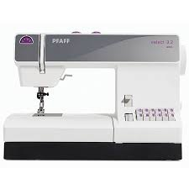
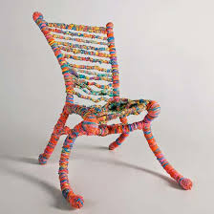
Textiles: continued
Course Content:
Fibre and fabric properties and characteristics
Basic sewing machine and construction
Surface embellishment
The design brief and specifications

Slide 9
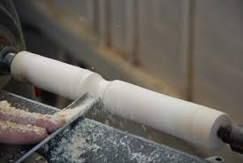
Product Design
This unit covers two areas of study – Materials and Systems. Students focus on the social and environmental implications of using various materials.
They use prior knowledge and a range of tools and equipment including some power tools to construct their products.

Slide 10
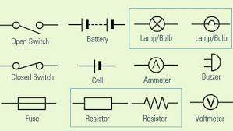
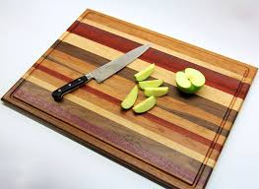
Product Design: continued
The Design brief and specifications. Students design, modify and construct a product for a client.
Students draw a simple circuit using recognisable symbols and then build a device that requires a circuit.

Slide 11
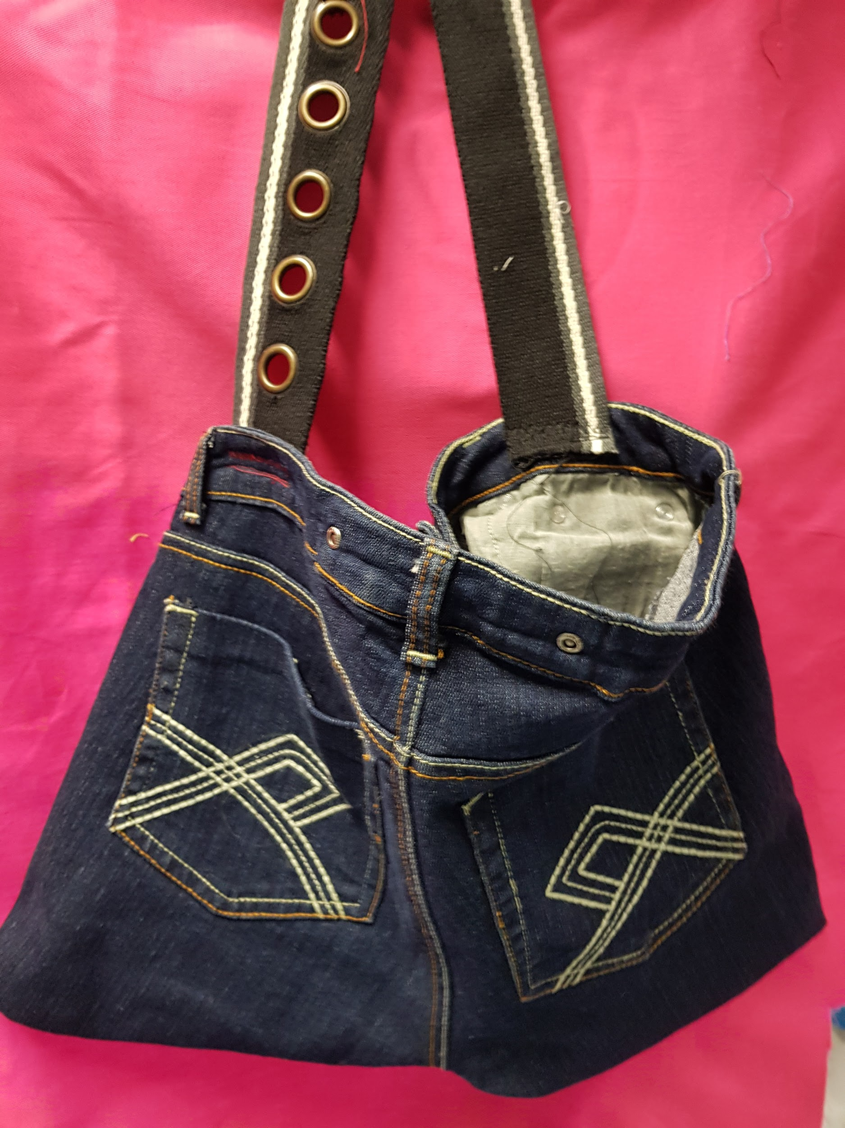
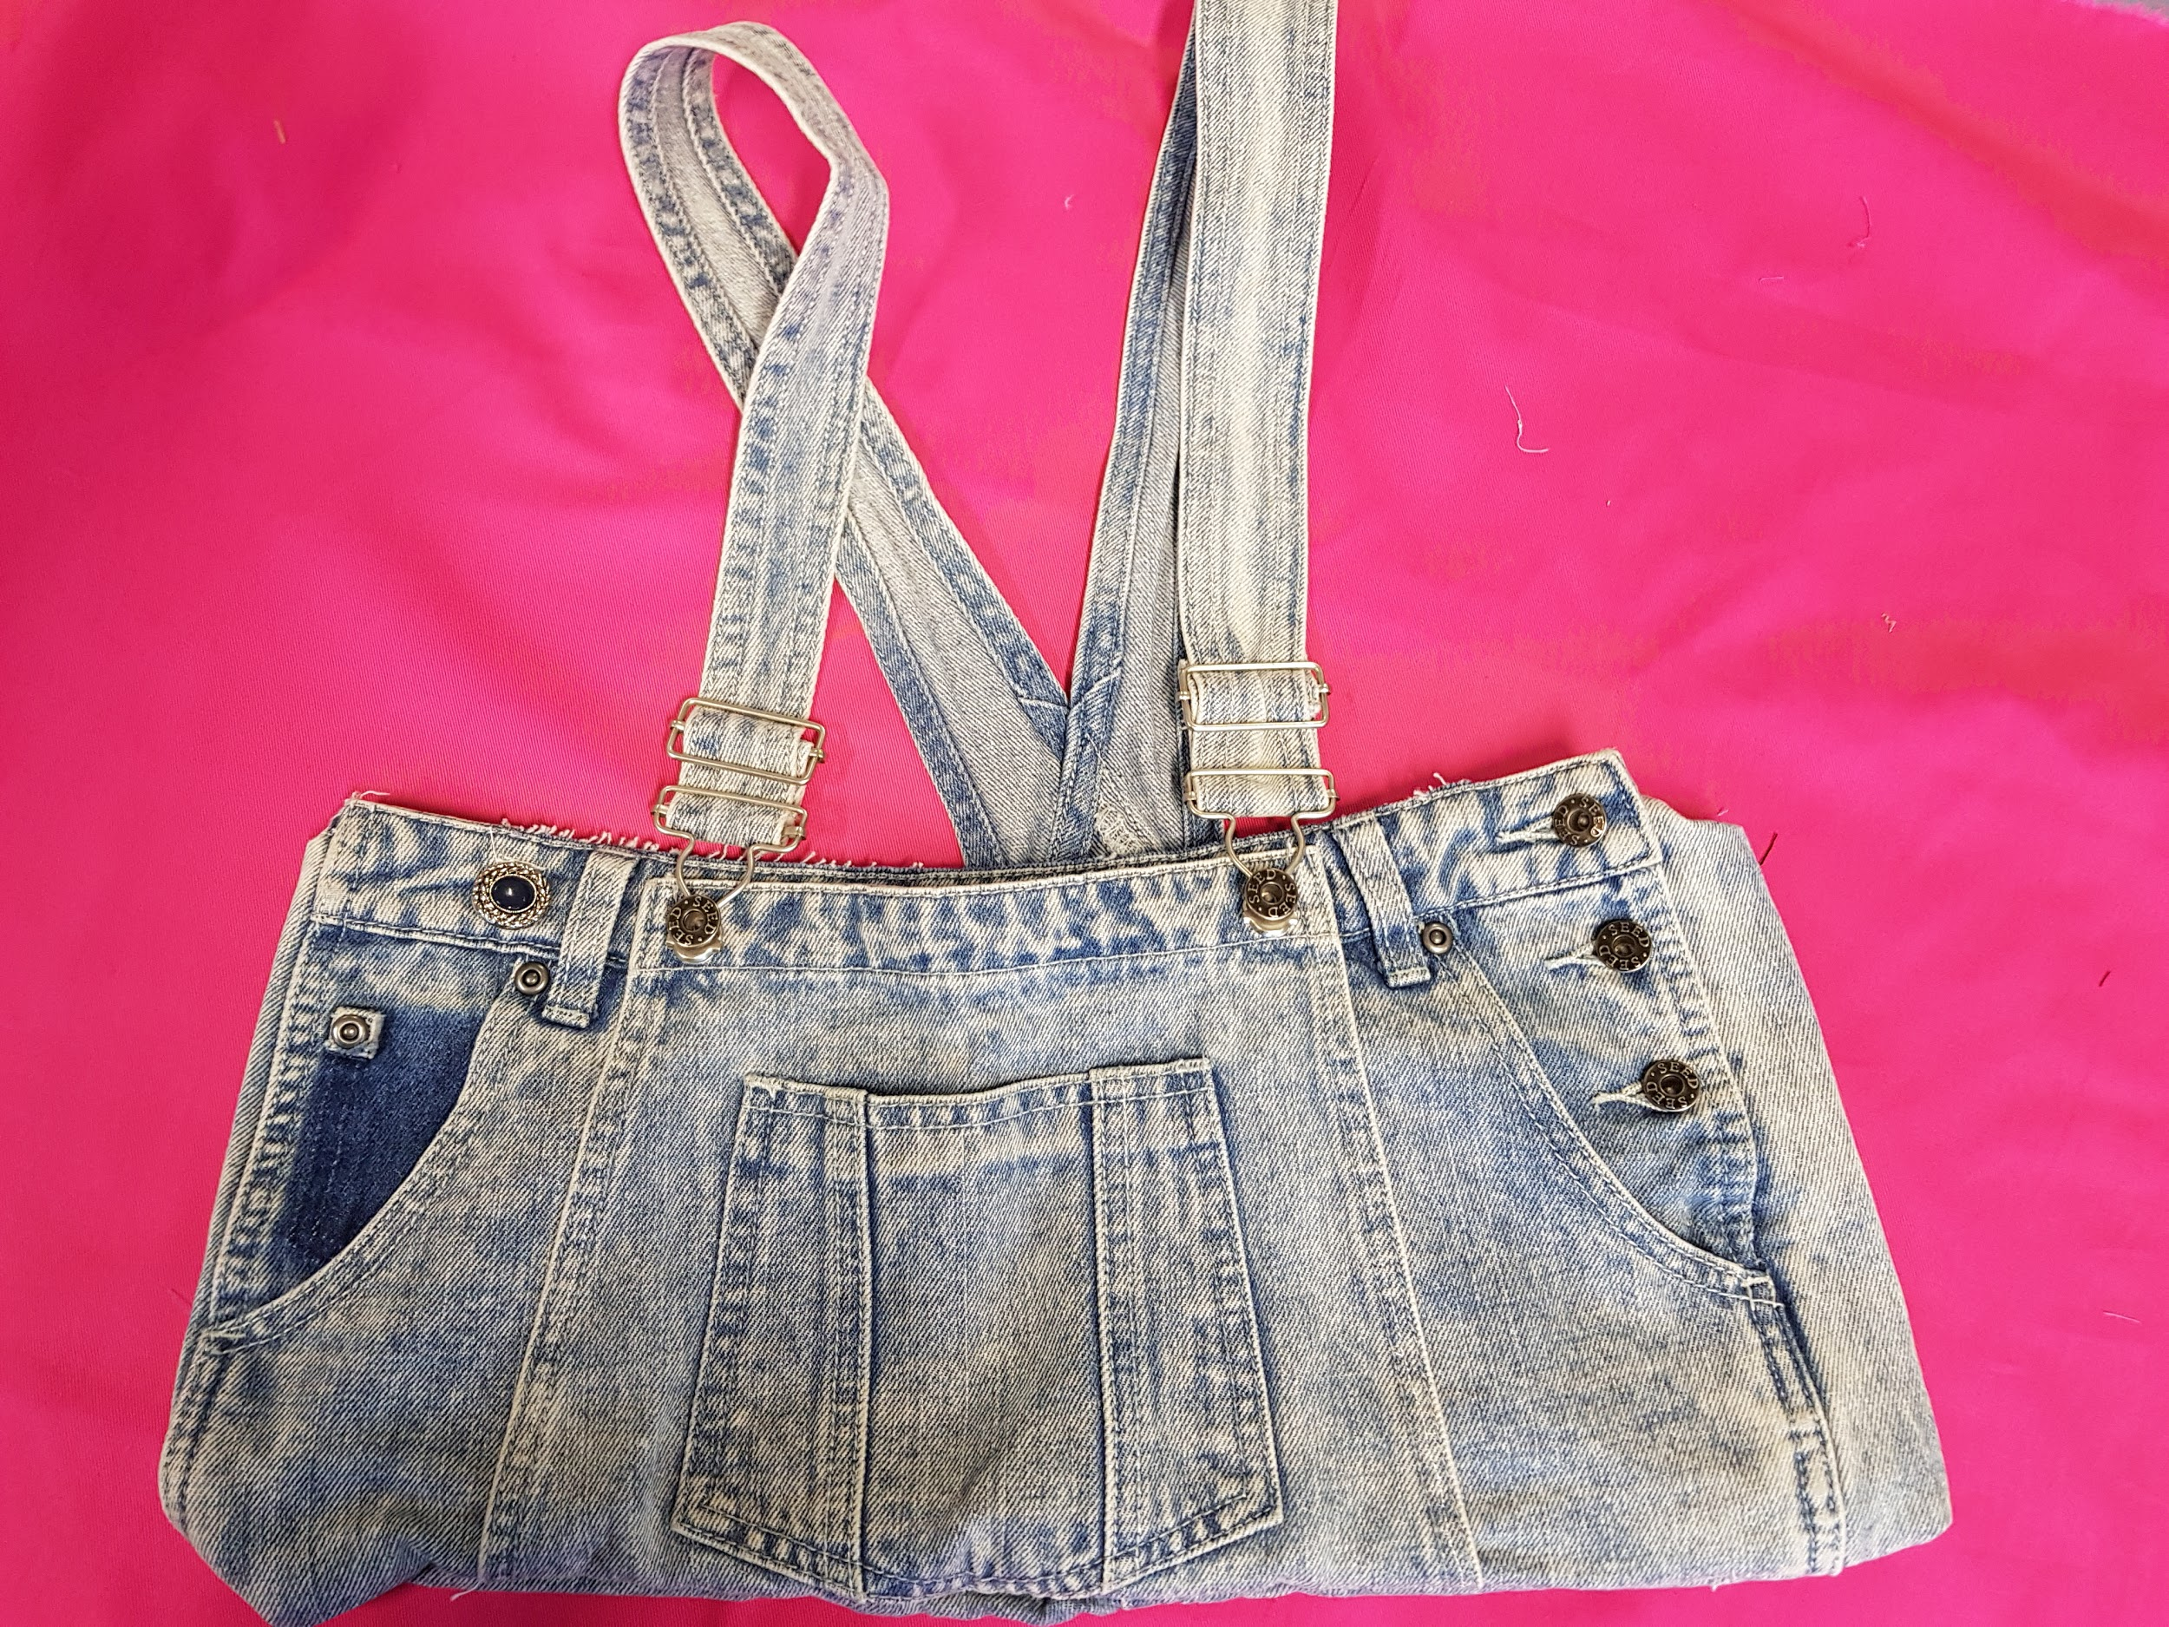
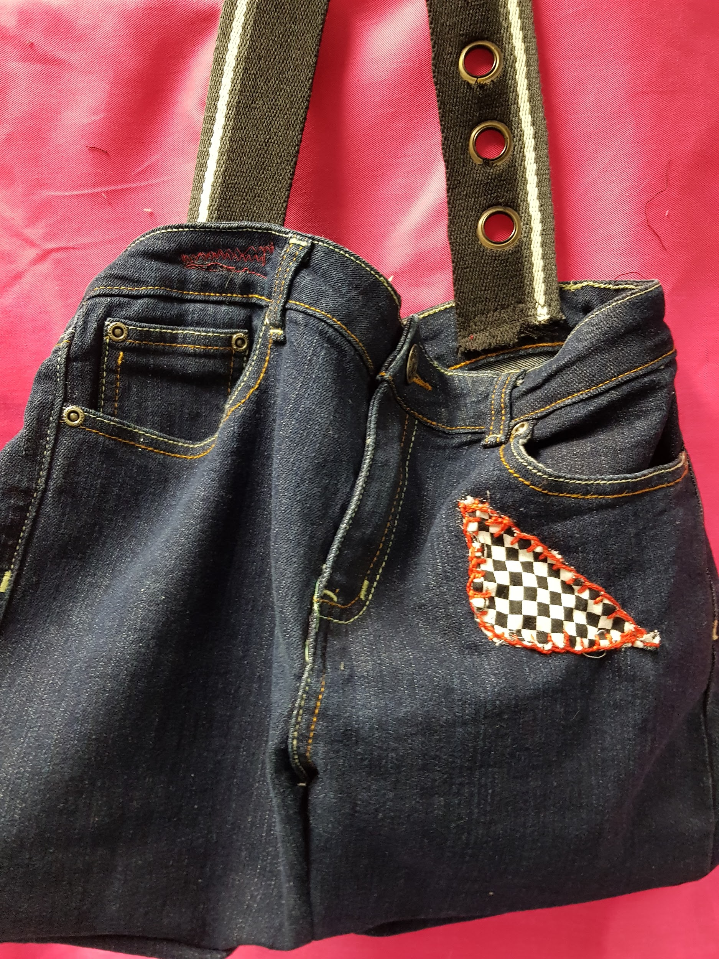
SAMPLE WORK

Slide 12
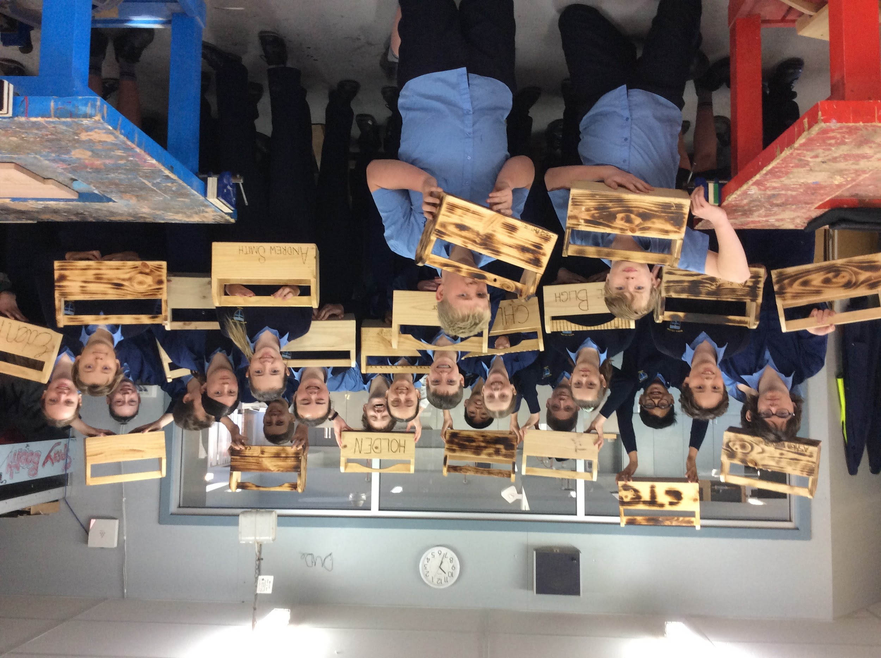
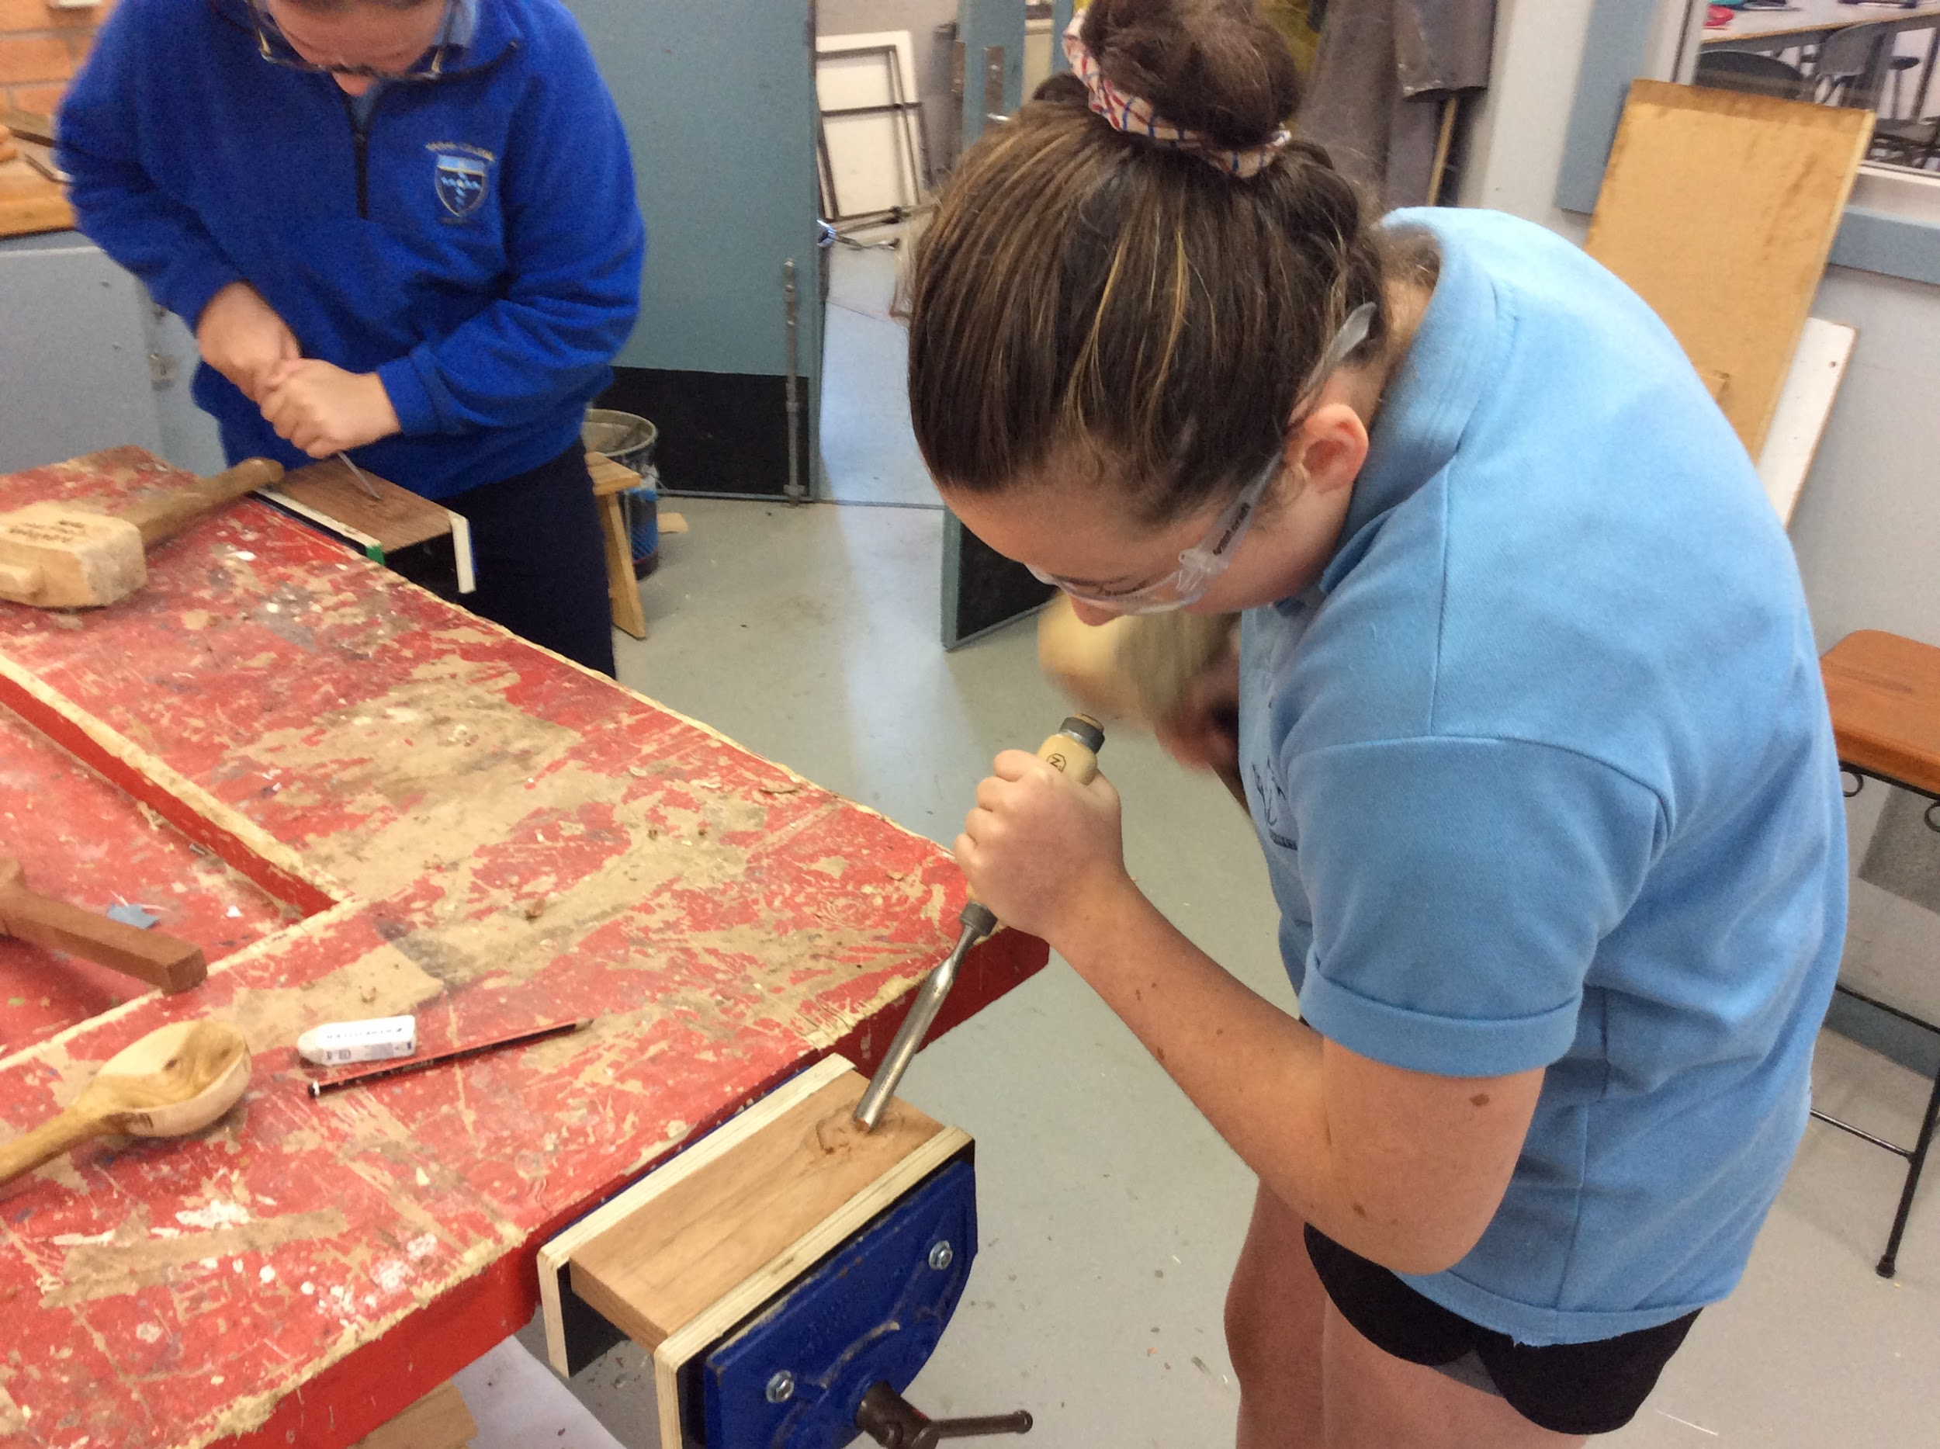
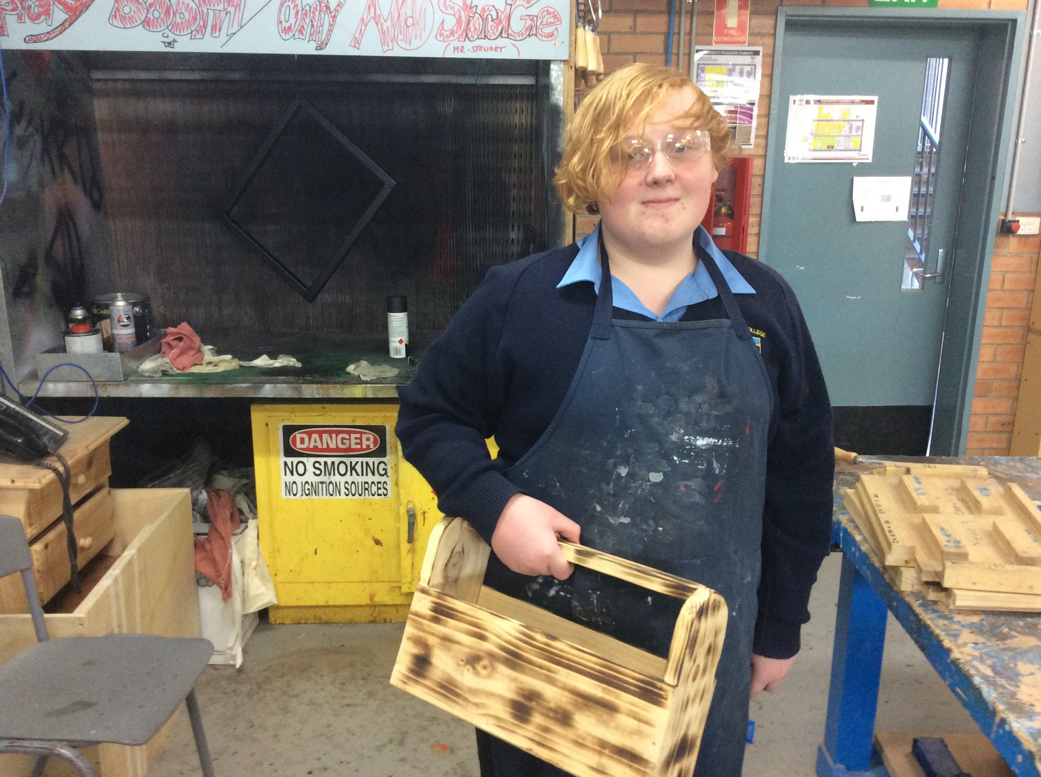
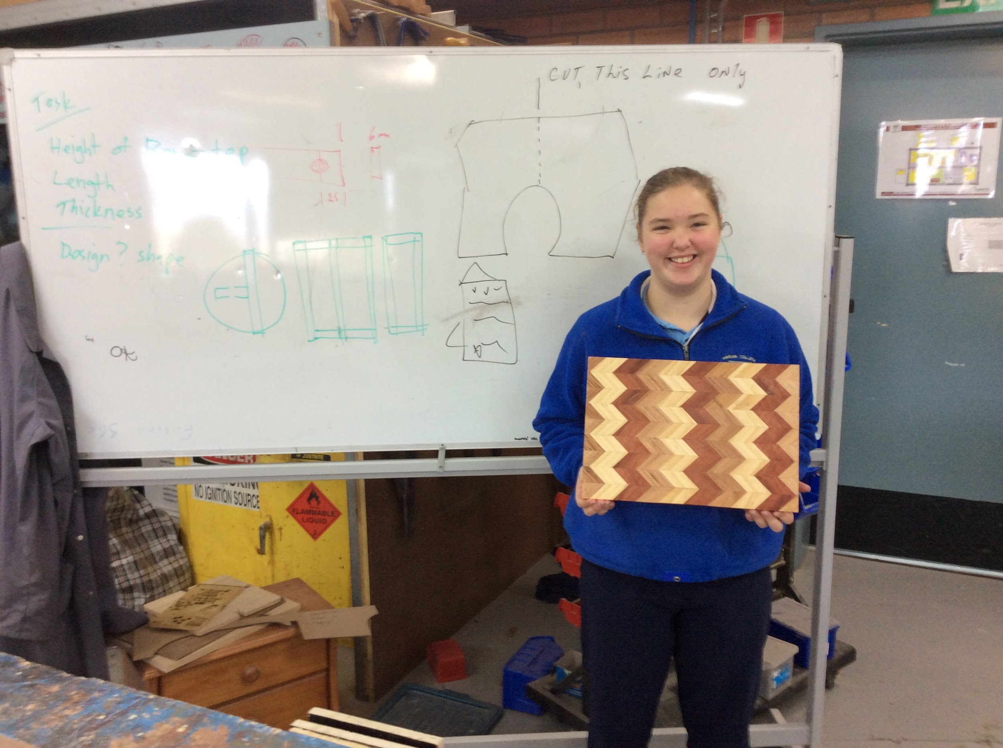
SAMPLE WORK

Slide 13
FURTHER INFORMATION
Megan Shea
Head of Technologies
sheam@mcararat.catholic.edu.au
Speak to: Year 8 Technology Teachers (Mrs North, Mr Peatt, Mrs Spalding, Mr Stewart, Mrs Venn, Mrs Wilson, Mrs Weir)
Refer to: Subject handbooks
Check us out on Instagram: foodandtechatmarianararat

