Slide 1
YEAR 8 Wellbeing
“Oak Wellbeing - Positive Education”.

Slide 2
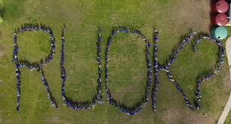
What is Positive Education?
Our Positive Education curriculum is explicitly designed to support your child to establish optimistic habits of mind that propel them forward in their learning, personal development and character. The Wellbeing Curriculum we implement at Year 7 teaches the skills of wellbeing to actively develop within our students optimism, resilience, grit and compassion.

Slide 3
Term 1 Oak Program - Positive Education
In Term 1, character strengths still feature, but with the main focus being the students’ own relationship with their world and those who inhabit it. The goal here is to put positive relationships at the front and centre of all we do.
Topics covered: Empathy and Compassion
Kindness Connections Positivity

Slide 4
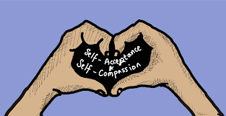
Term 2 Oak Program - Positive Education
In Term 2, students examine their relationship with themselves - identifying things about themselves such as: how they bounce back from adversity; what their own impulse control is like and what they admire about their own characters.
Topics covered:
Self Control
Resilience
Self Knowledge

Slide 5
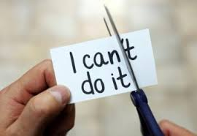
Term 3 Oak Program - Positive Education
This Term, students start focusing on personal fulfillment and goal setting - looking at strategies to achieve both in their own lives.
Topics covered: Curiosity Motivation
Goal Orientation

Slide 6
Term 4 Oak Program - Positive Education
Students also undertake a special project that enables them to explore an area of wellbeing that they would like to pursue further.

Slide 7
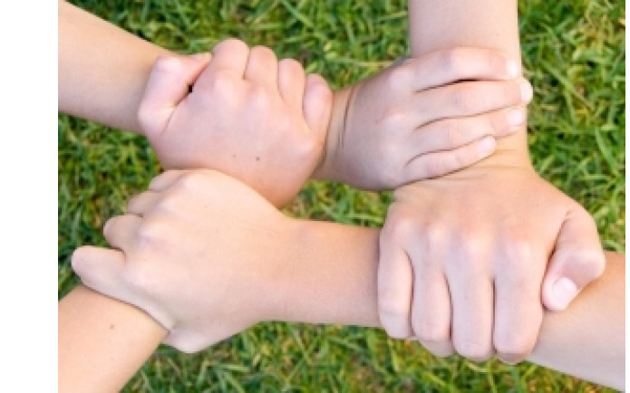
At the end of the Year 8 Oak Program - our hopes for our students.
We hope at the end of Year 8, that students enjoyed the experience of Oak Wellbeing and leave the year level being able draw upon some wellbeing strategies that can help them build positive relationships centred on compassion and respect. We also hope our students learn about their own thought processes and behaviours and how these can impact upon their wellbeing in different ways.

