Slide 1
YEAR 7 TECHNOLOGIES
DESIGN & TECHNOLOGIES
DIGITAL TECHNOLOGIES

Slide 2
YEAR 7 - 2021
All Year 7 students participate in a variety of Technology subjects throughout the year.
There are four Technology subjects taught for a Semester only and run for a double period each week:
-Digital Technology - Product Design
- Home Economics - Textiles
1 Health Class per week
1 Double Practical PE class per week

Slide 3
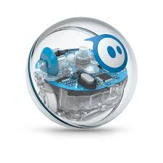
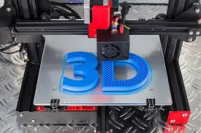
Digital Technologies
Students will develop knowledge in technology including how computer works and develop basic web design and coding skills. Students will work in teams to analyse problems, design and develop solutions and evaluate their work.
Course Content:
● How computers work
● Coding with Swift
● Coding with Spheros

Slide 4
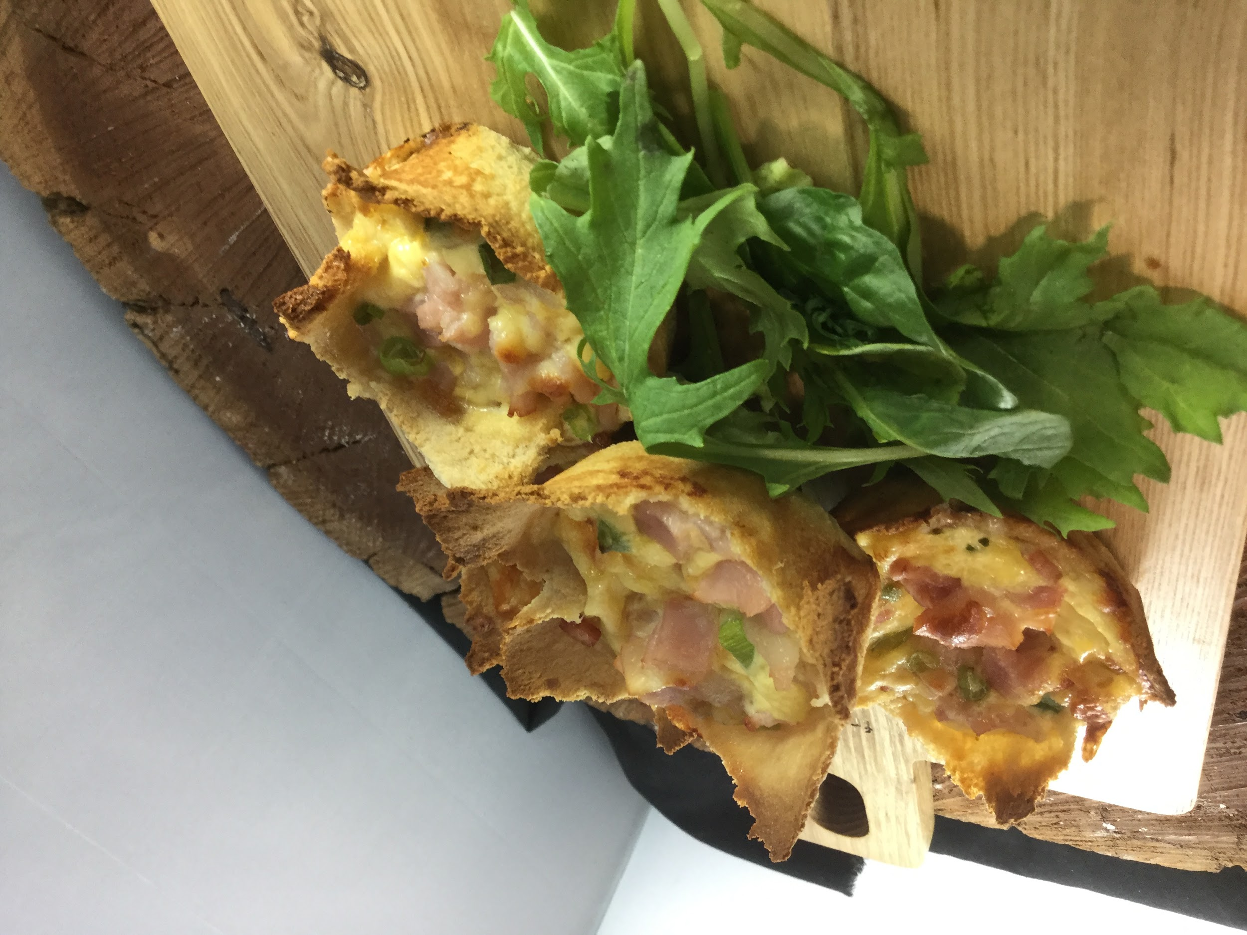
Home Economics
Students learn about the safe and hygienic handling and storage of food and the appropriate use of tools and equipment. They develop food preparation skills and prepare a range of products both savoury and sweet.
Recipes cover traditional cooking methods but are also updated to reflect contemporary eating trends.
Students use a food model such as the Healthy Diet Pyramid to make judgements about food selection.

Slide 5
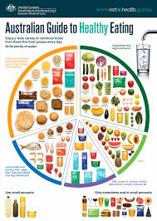
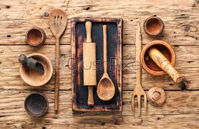
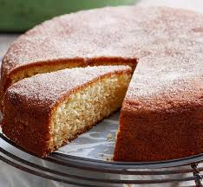
Home Economics: continued
Course Content:
● Safety and Hygiene in food preparation
● Using time, resources and equipment efficiently in the kitchen
● Basic food preparation skills
● Cooking terms and definitions
● Using food models to make healthy choices and modify recipes
● The Design Process

Slide 6
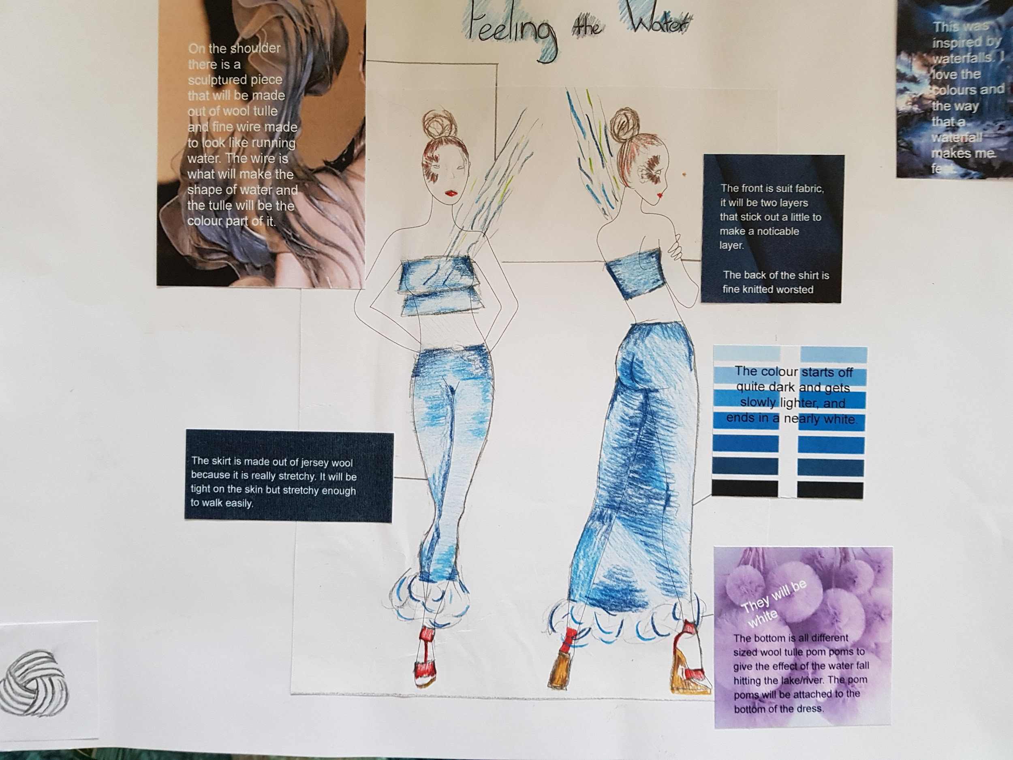
Textiles
Students develop their fibre and fabric knowledge and skills, to design and produce a range of small products. They develop hand sewing skills and sewing machine construction techniques to create their products. An understanding of the design process and the design elements is fostered.
● Benefits of recycling materials.

Slide 7
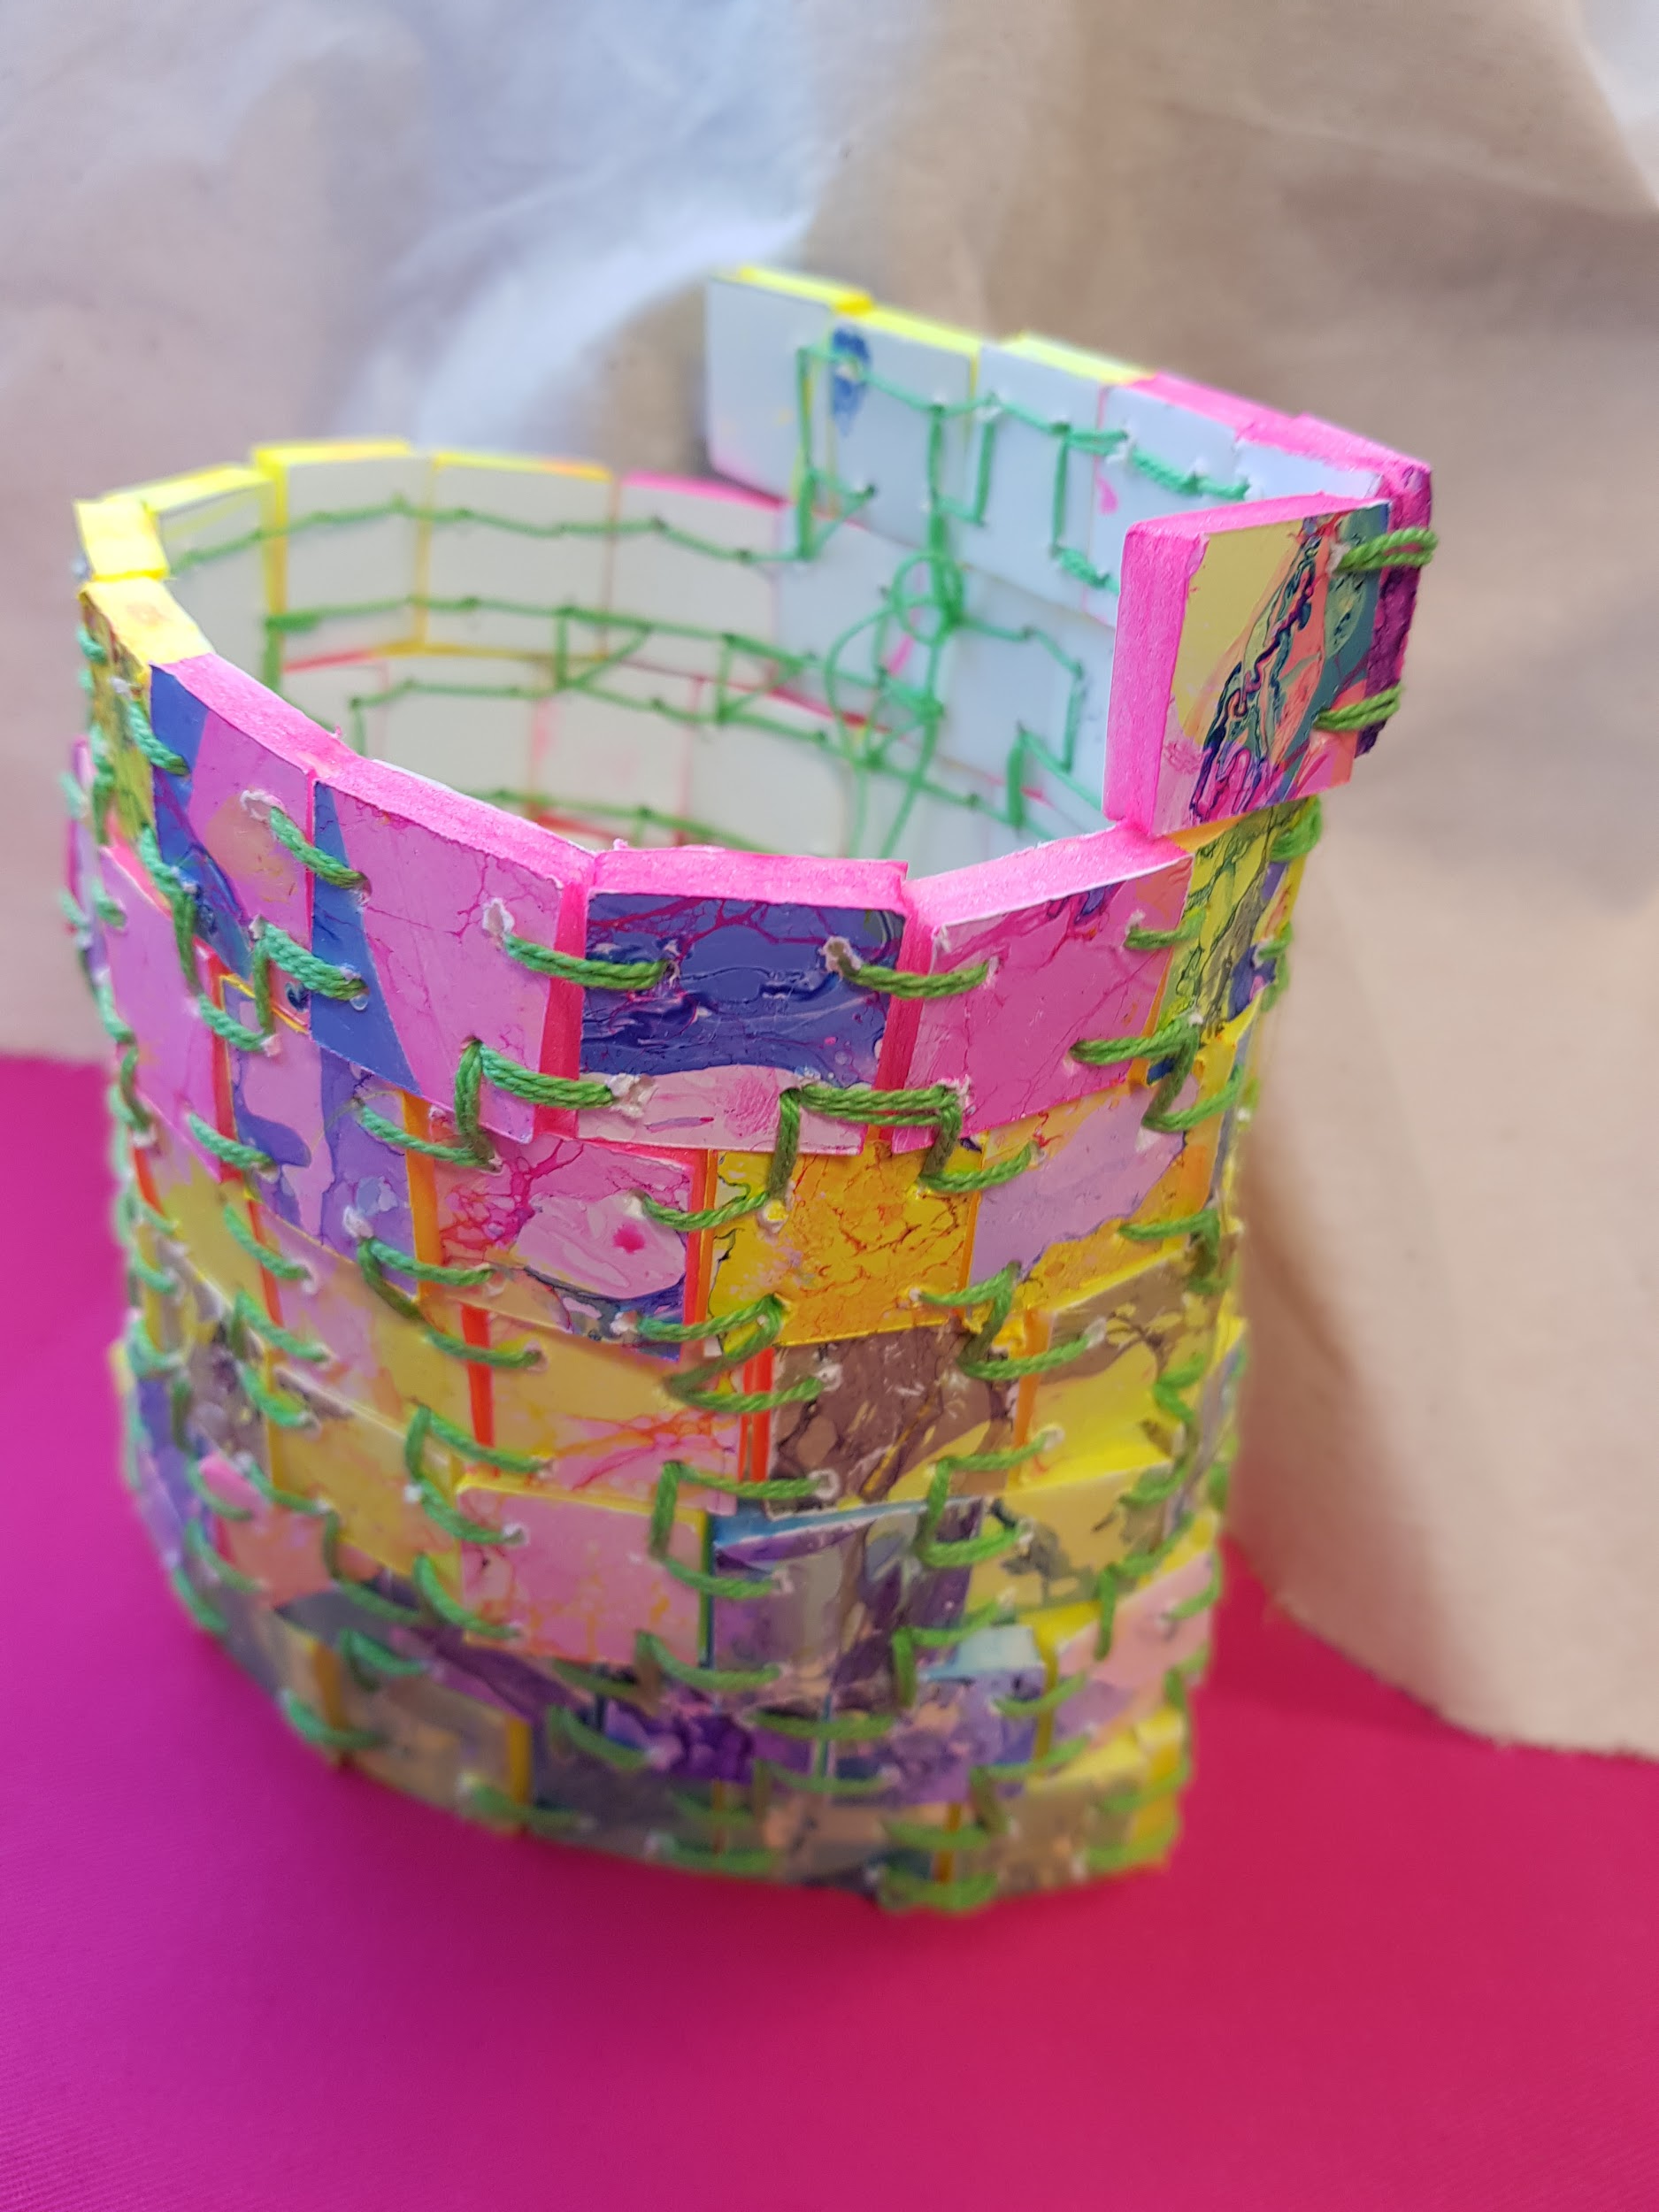
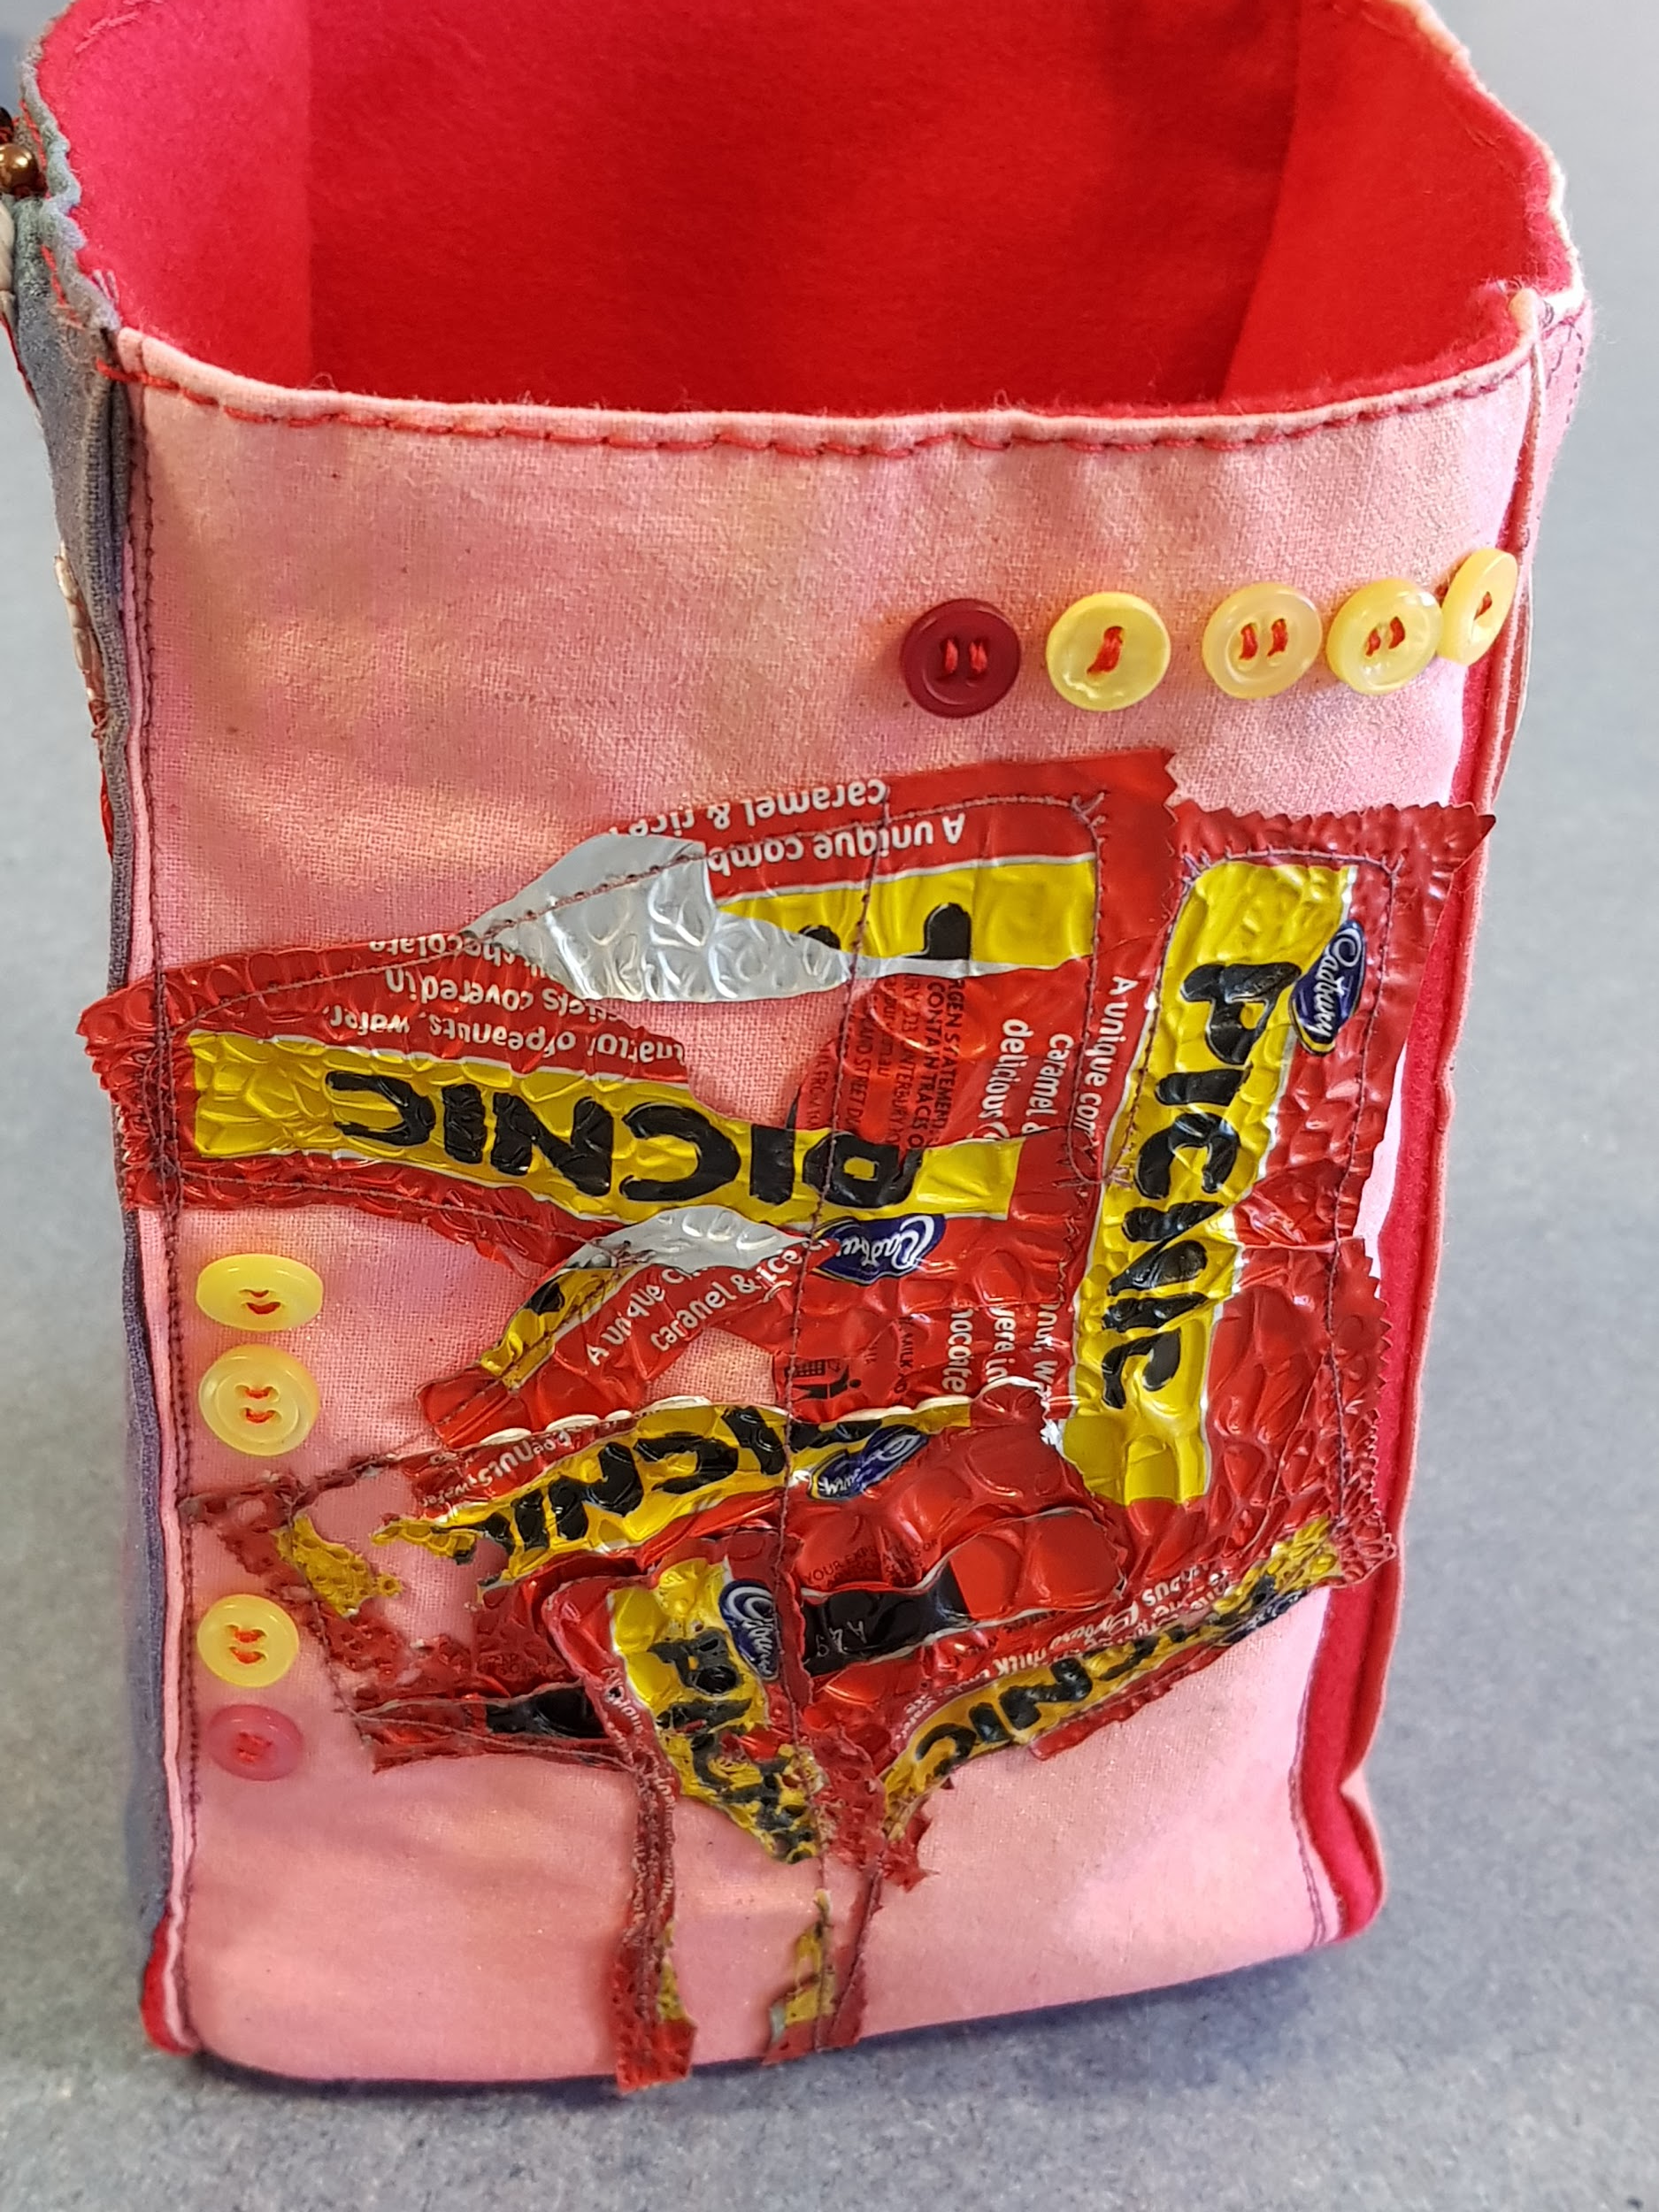
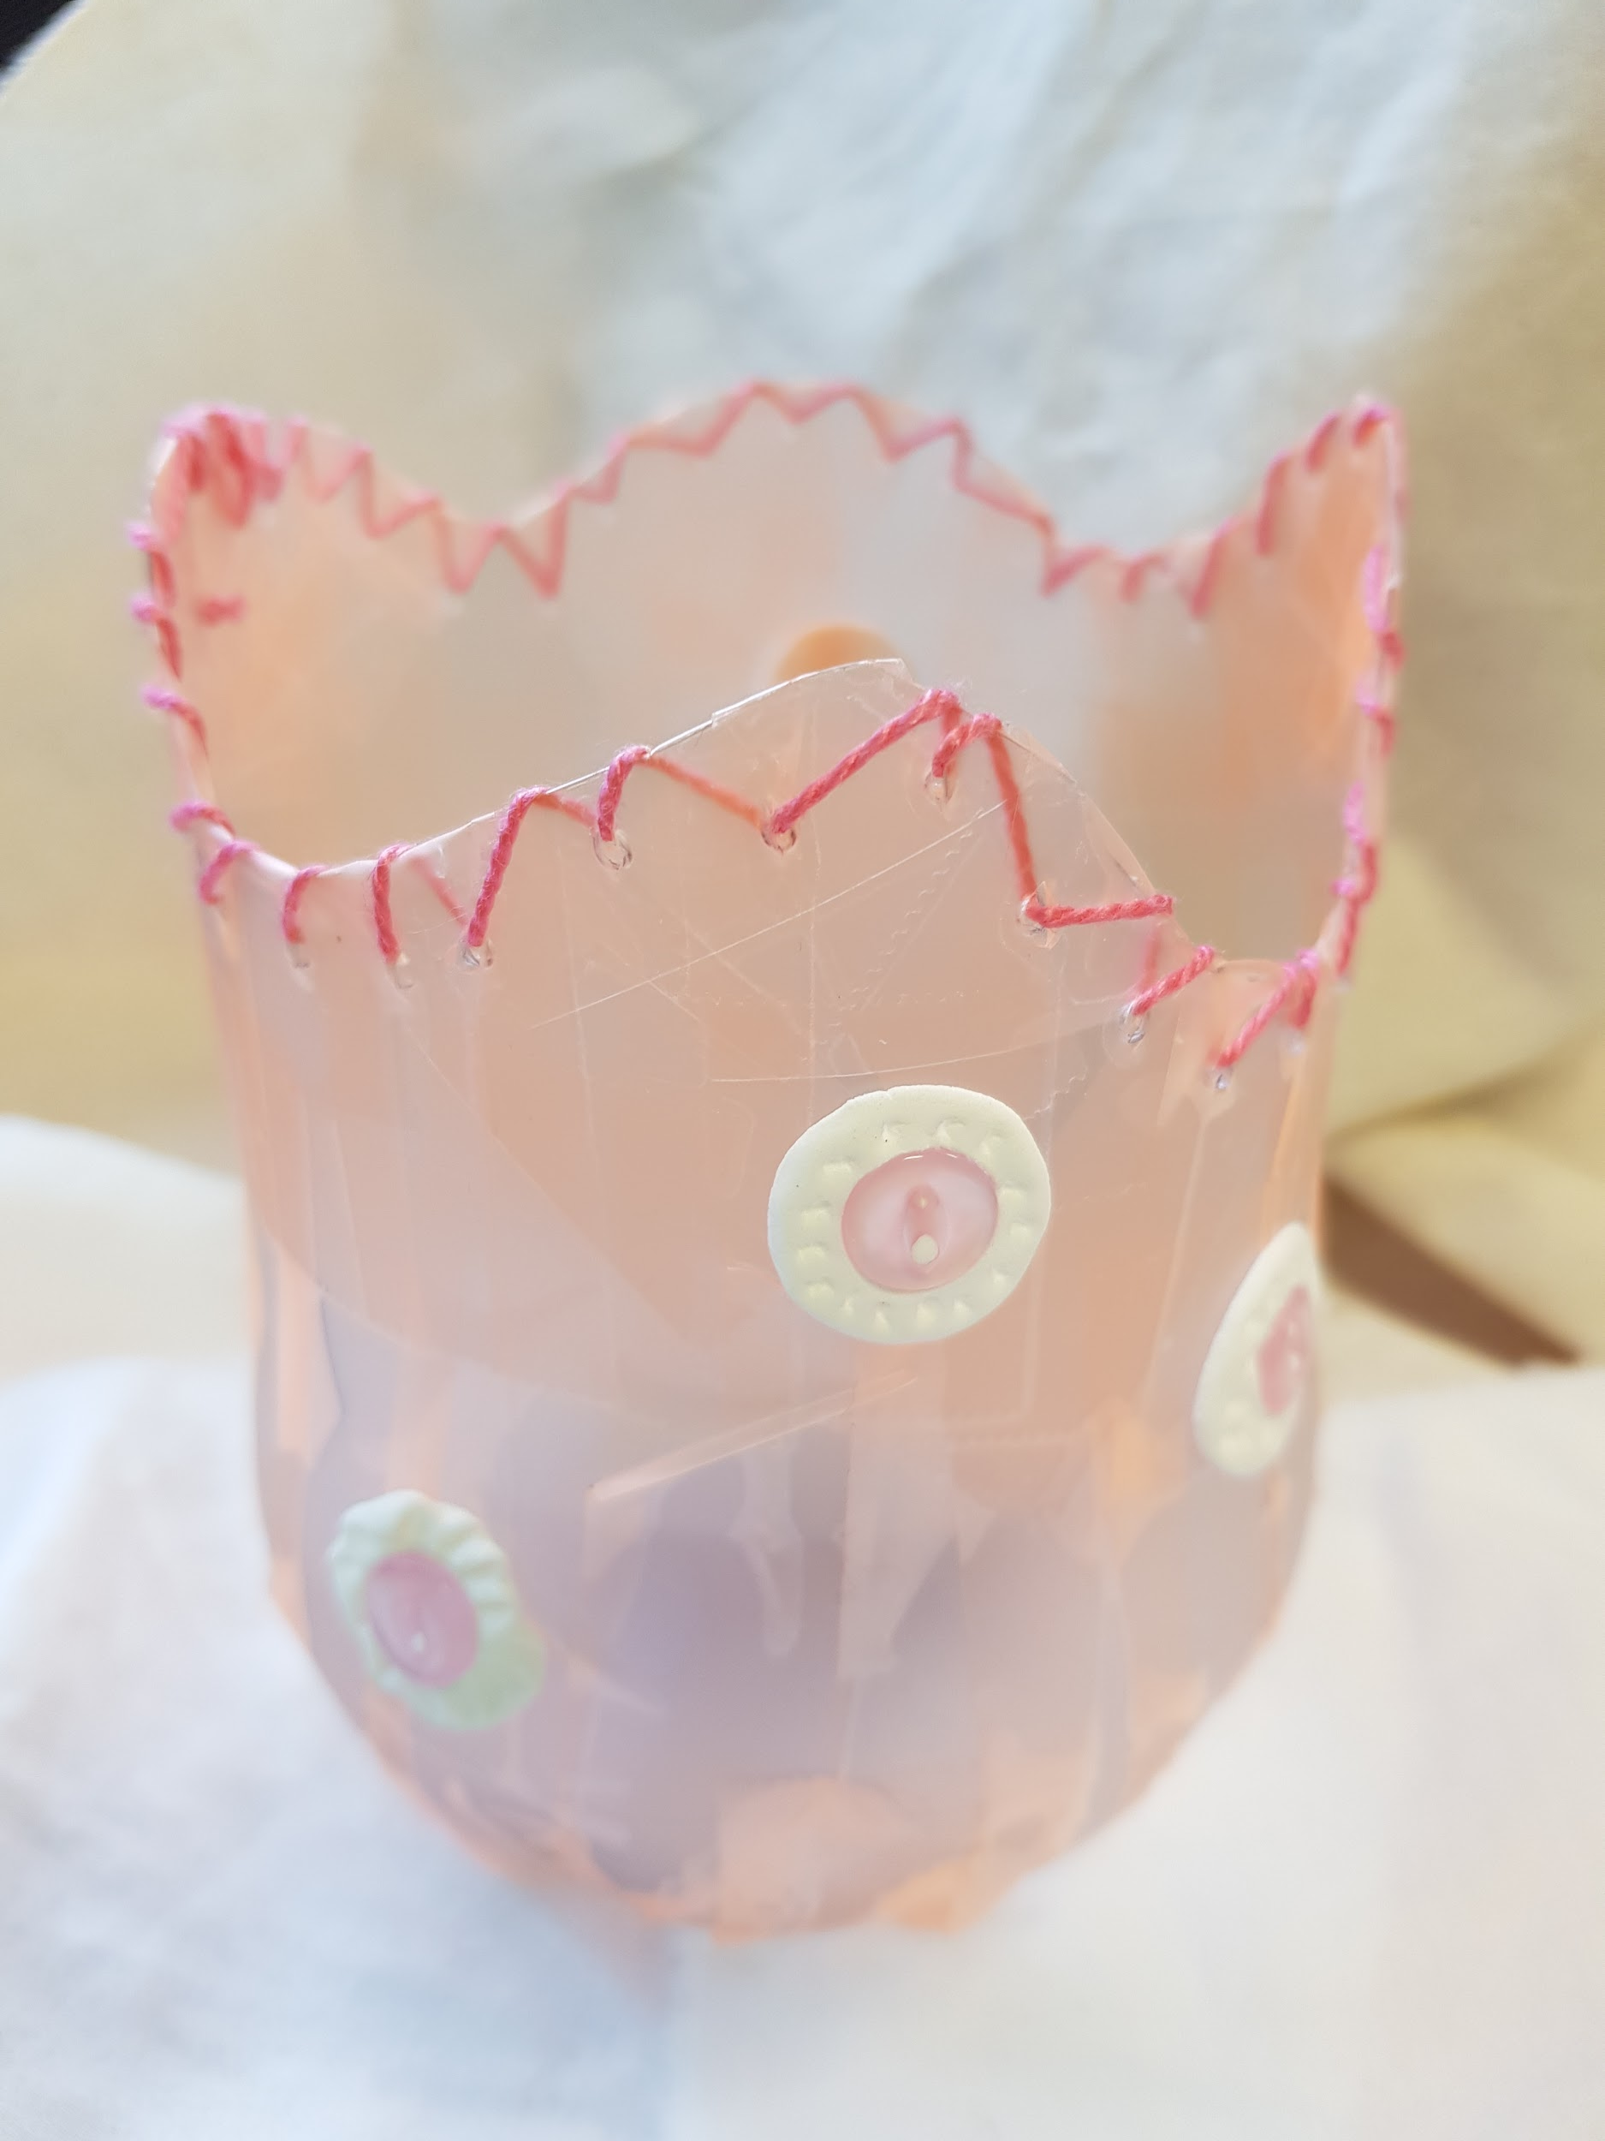
Textiles: continued
Course Content:
● Safety in the technology classroom
● Fibre and fabric properties & characteristics
● Construction skills development-hand and sewing machine
● Weaving/felting knowledge and skills
● The design plan
Benefits of recycling materials

Slide 8
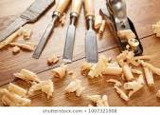
Product Design
Students learn the basic skills and concepts of working with various materials and processes.
The subject includes encouraging students to be competent with all hand tools, the elements of basic design, problem solving and constructing products to meet student needs.

Slide 9
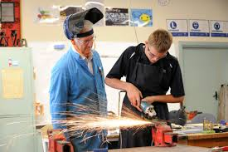
Product Design: continued
Course Content:
● Elements of design will be explained, for example - looking at how things function and aesthetics.
● Designing using isometric and computer aided design and 3D printing.
● Students will be shown the be exposed to safe and proper use of tools to make products that use a range of processes, materials and components.
Social and environmental products are explored.

Slide 10
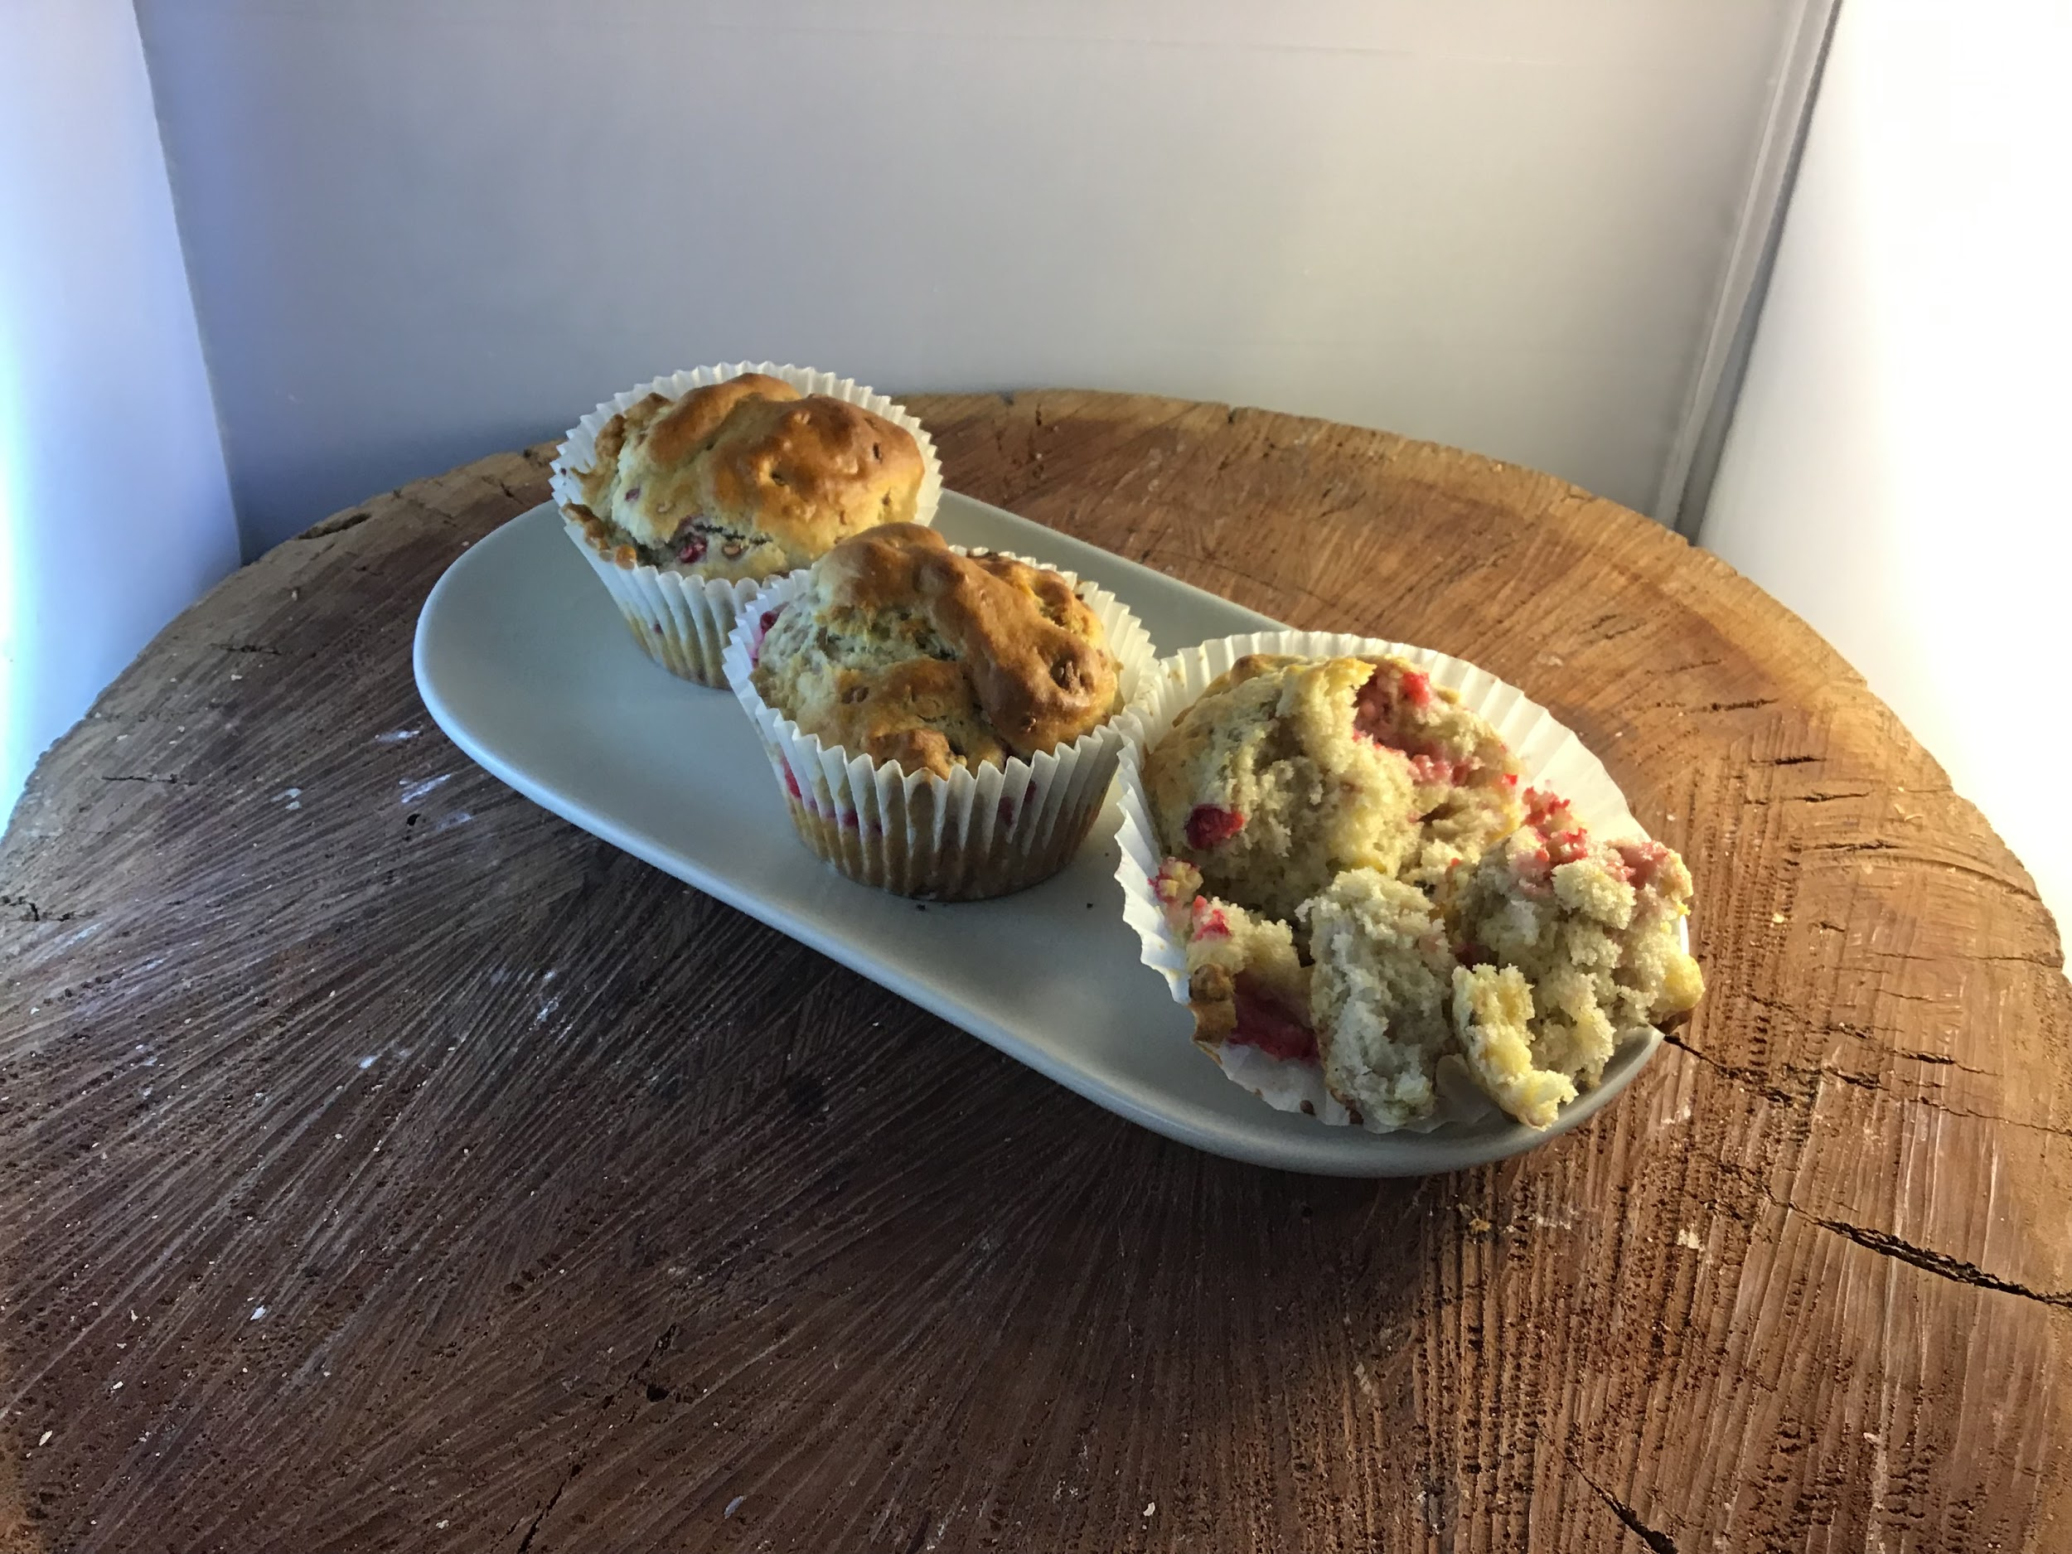
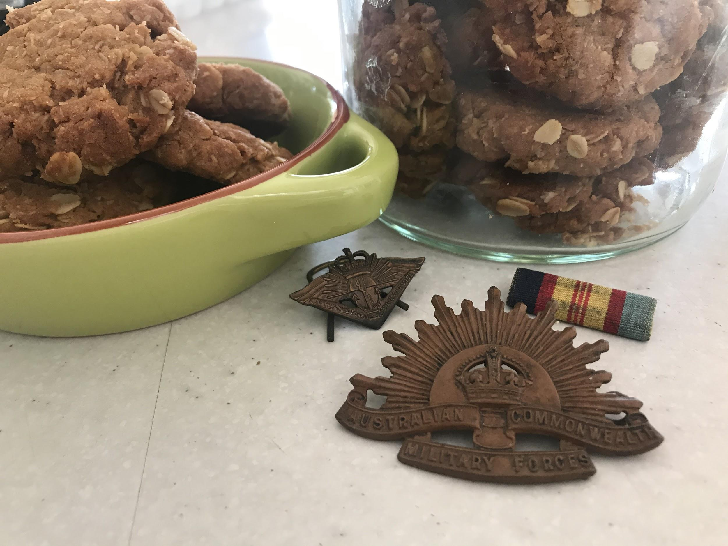
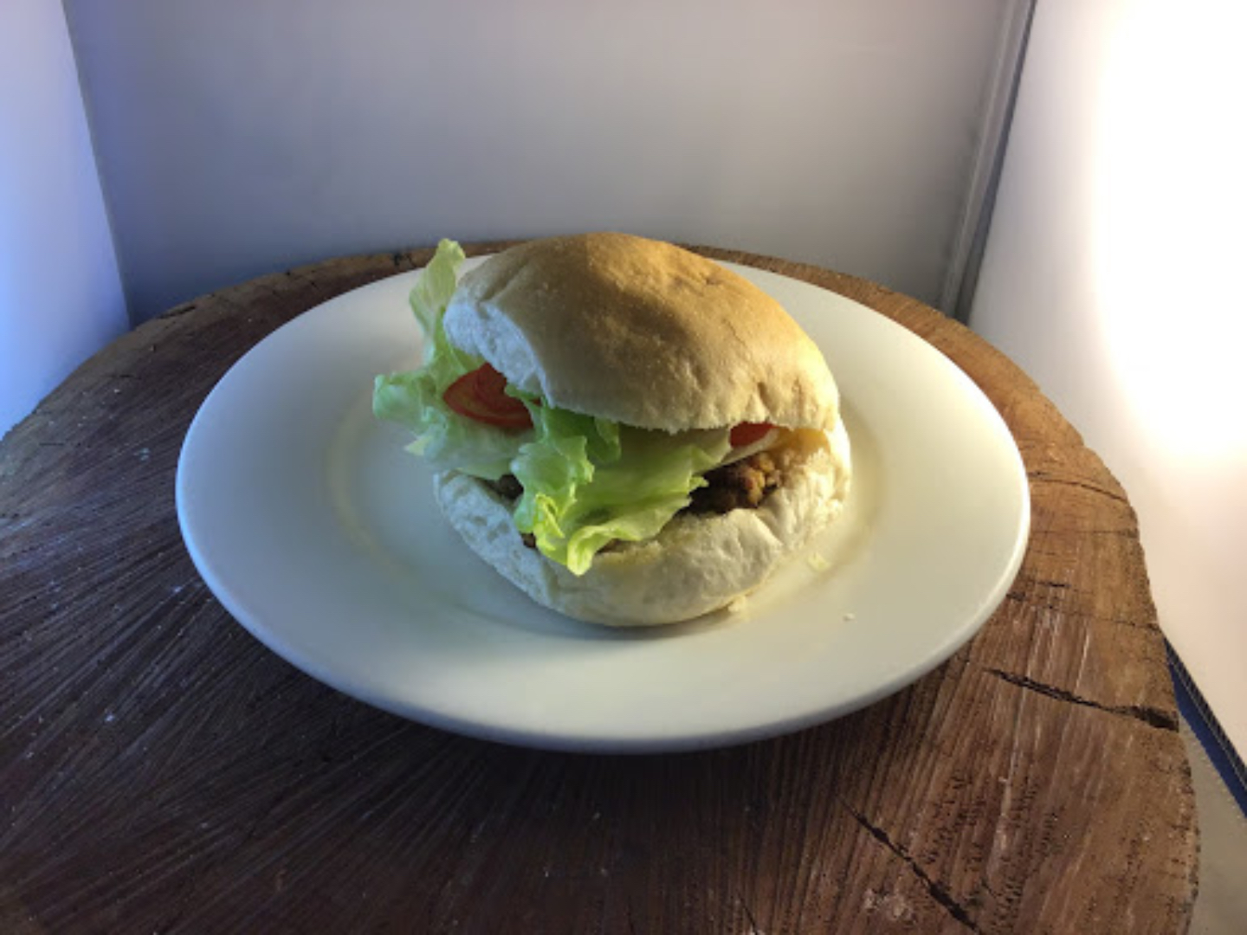
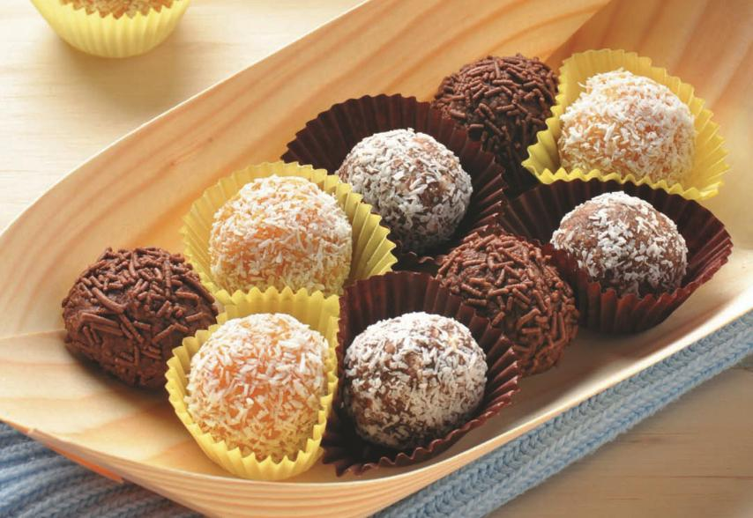
SAMPLE WORK

Slide 11
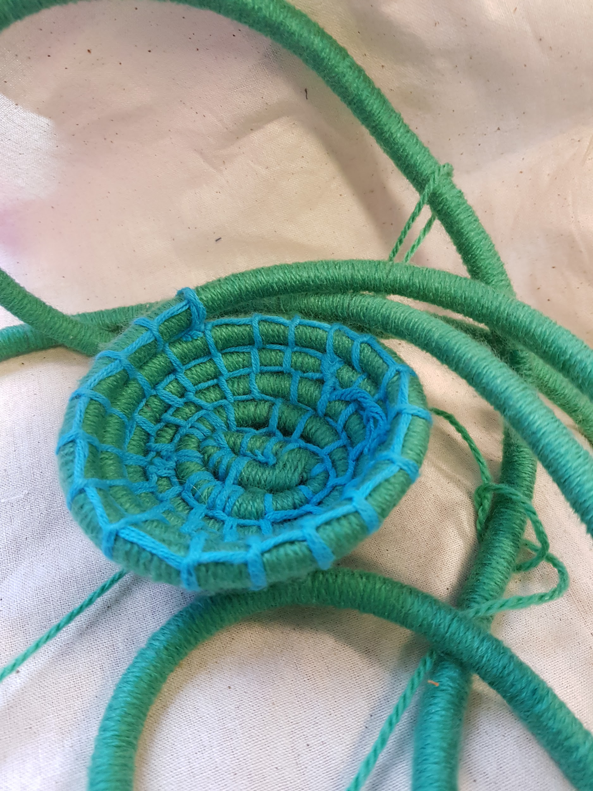
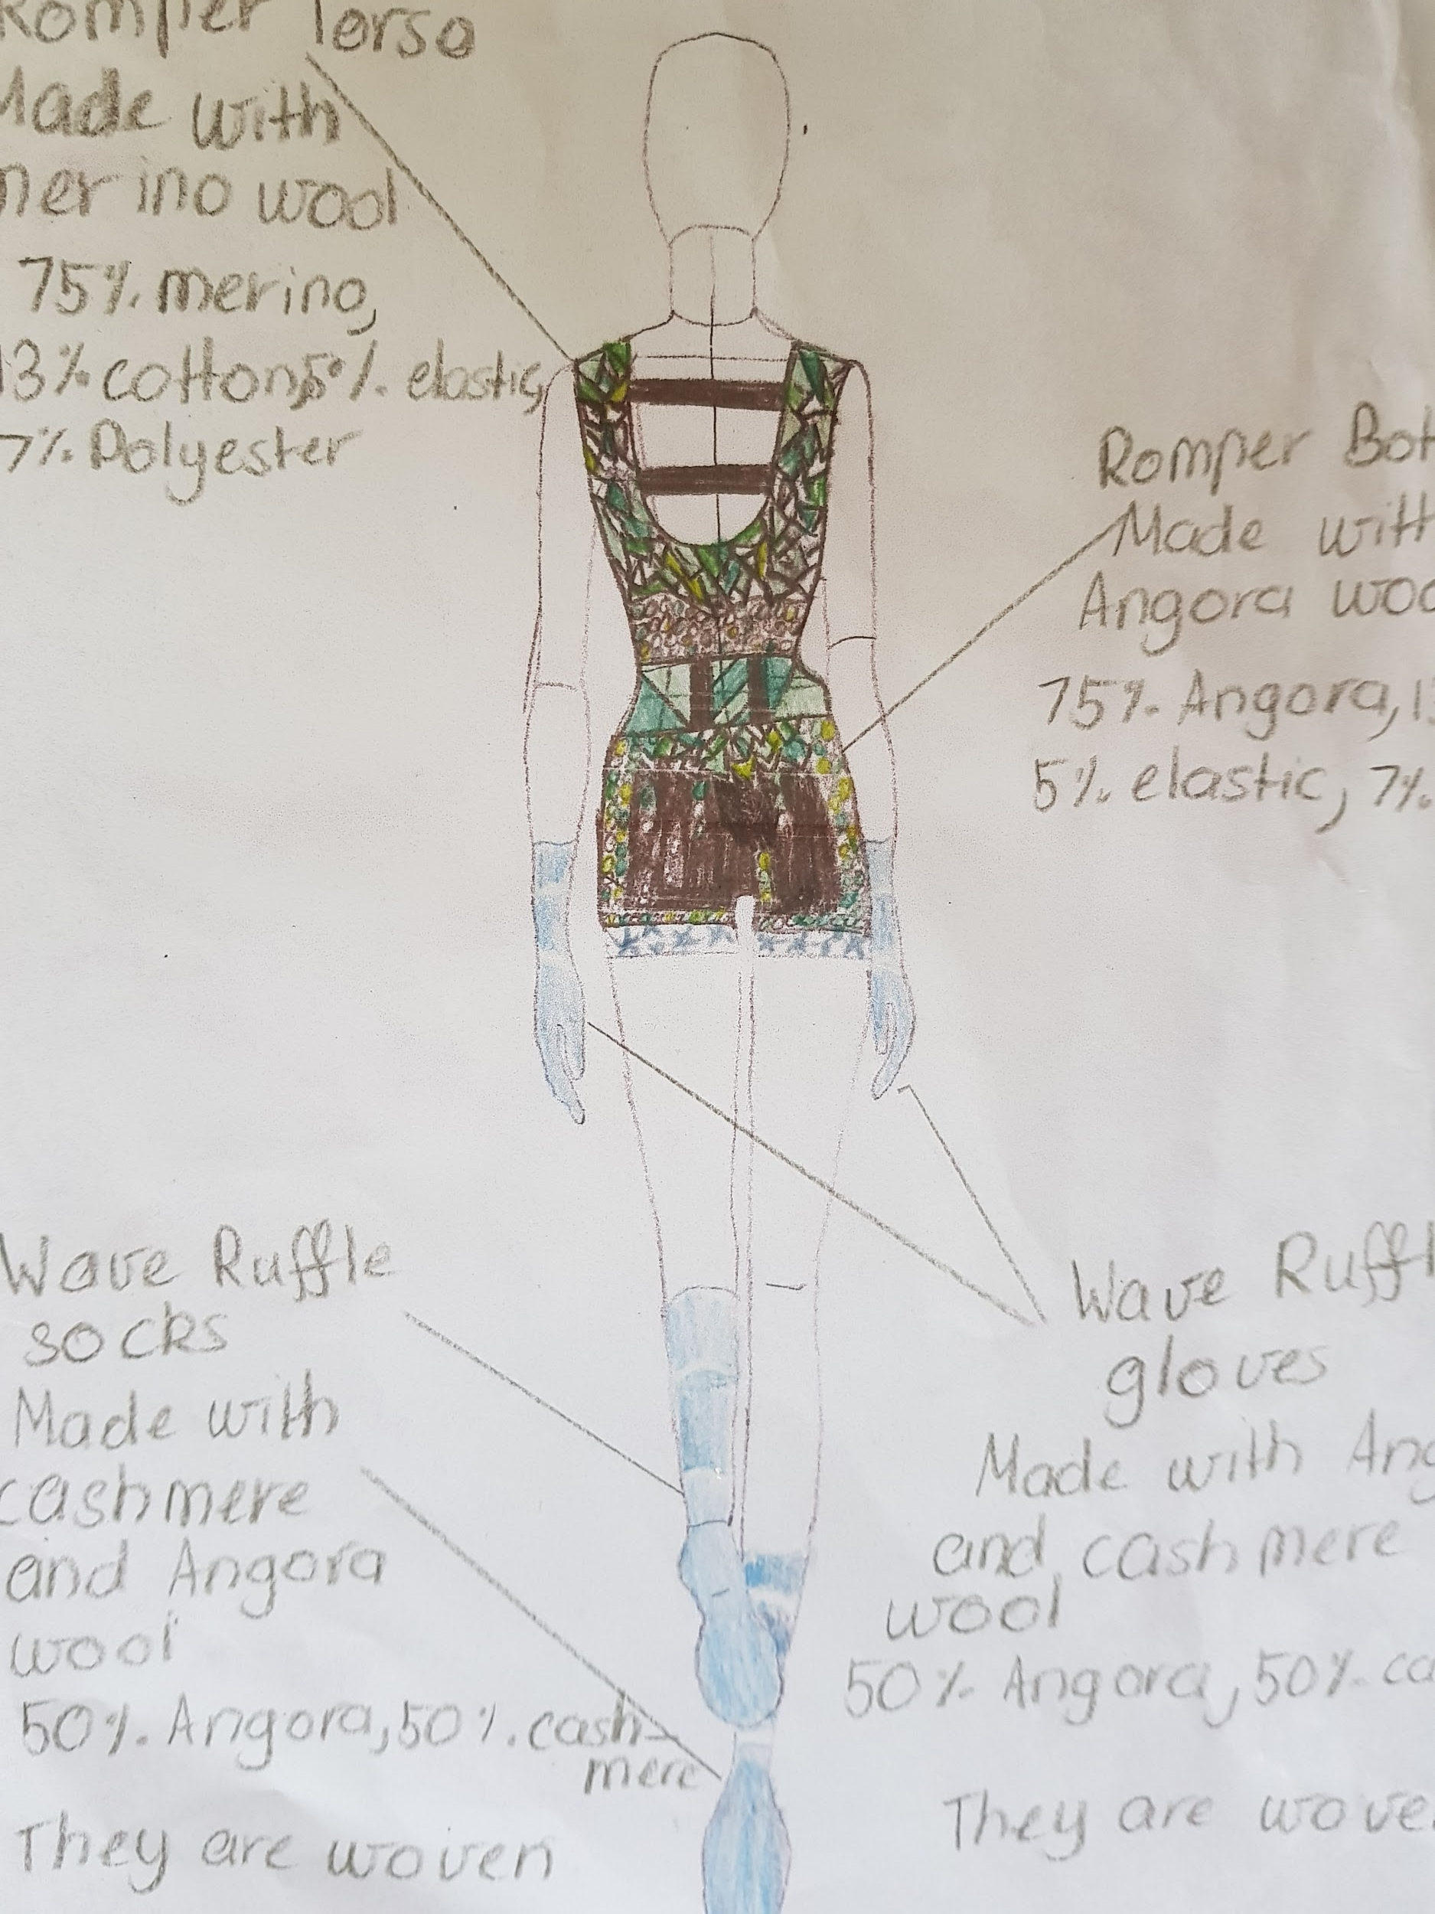
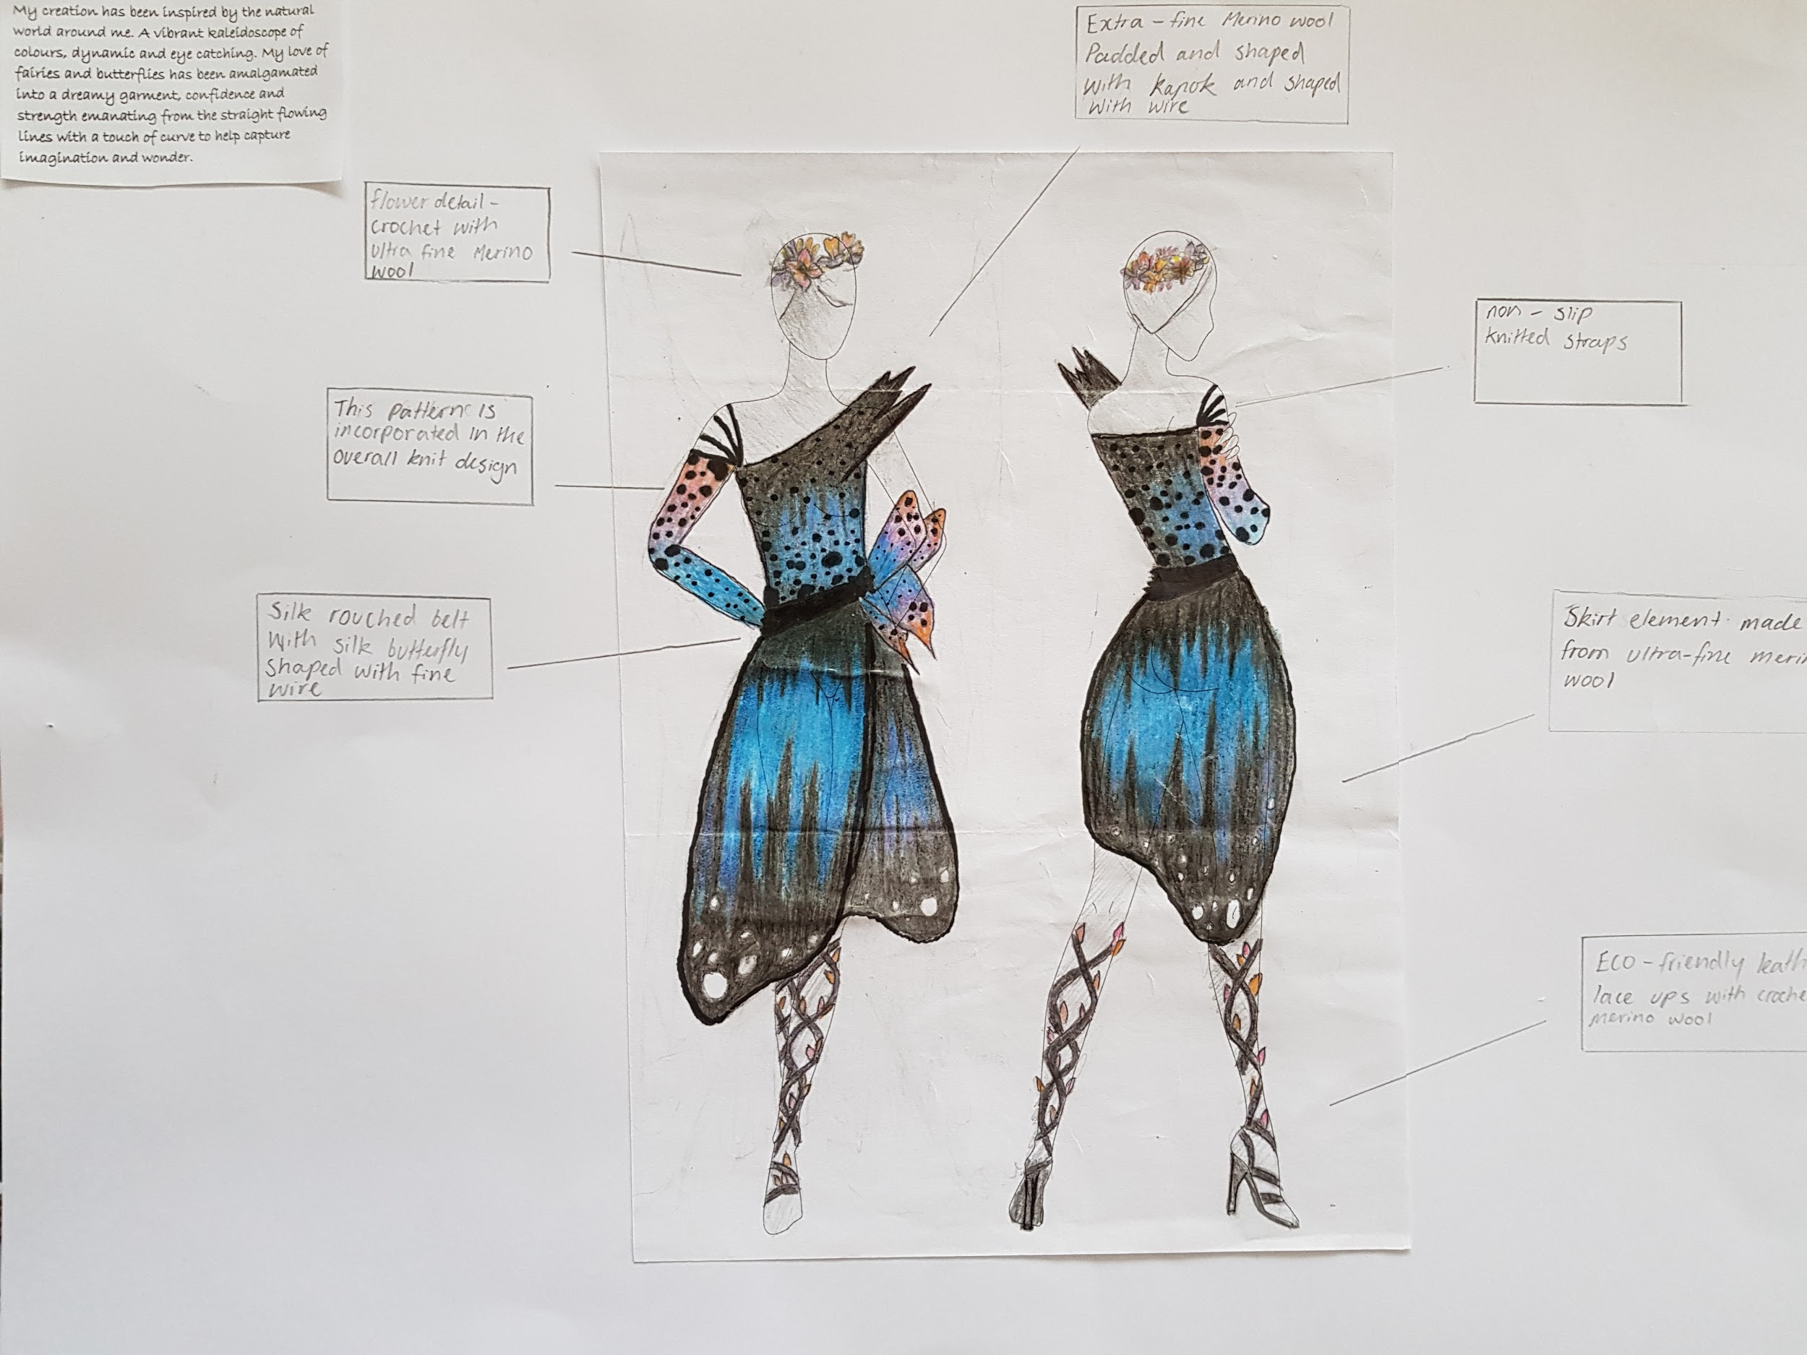
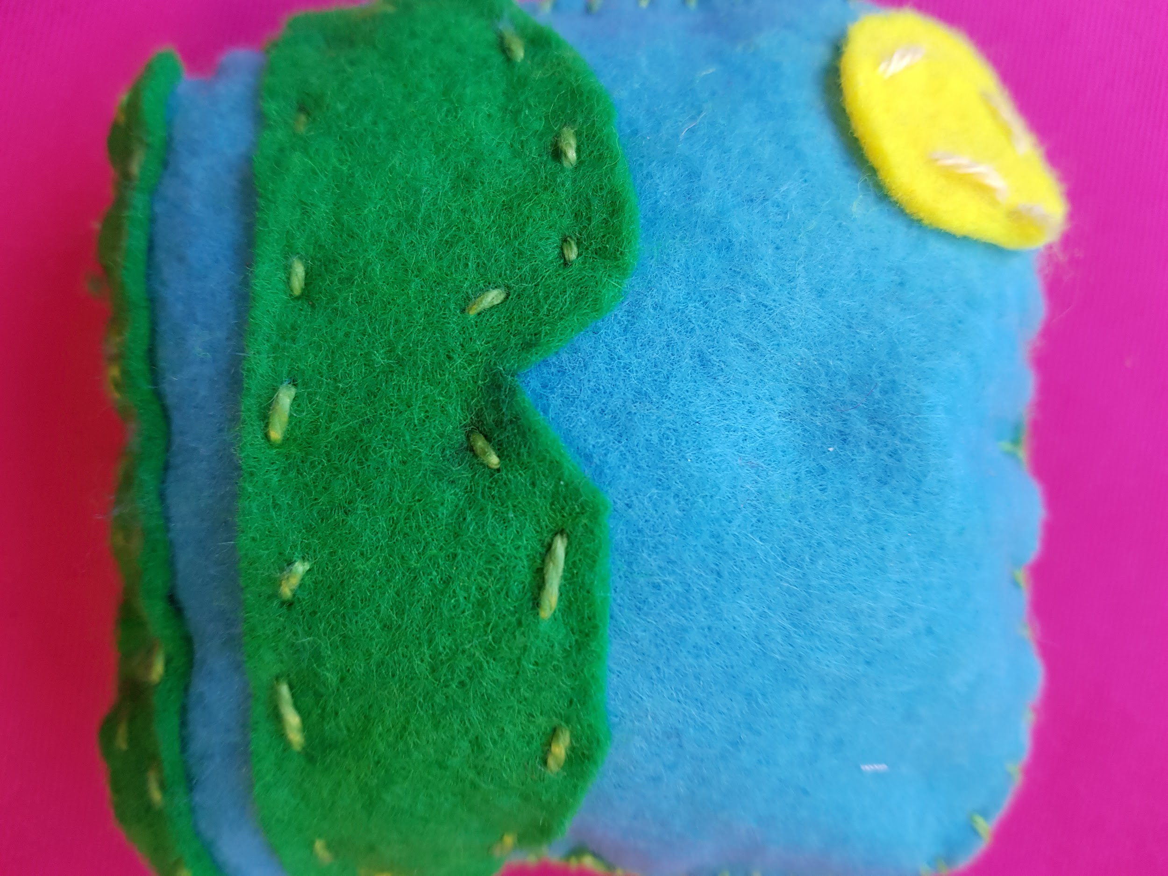
SAMPLE WORK

Slide 12
FURTHER INFORMATION
Megan Shea
Head of Technologies
sheam@mcararat.catholic.edu.au
Speak to: Year 7 Technology Teachers (Mrs North, Mr Peatt, Mrs Spalding, Mr Stewart, Mrs Wilson, Mrs Weir)
Refer to: Subject handbooks
Check us out on Instagram: foodandtechatmarianararat

