Slide 1


YEAR 12 Wellbeing
“Oak Wellbeing - Positive Education”.

Slide 2
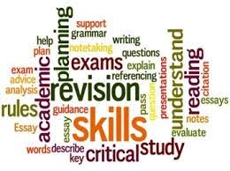
Term 1 Oak Program - Final Year
In Term 1, students self-reflect on their time as Marian College students and on what it has meant to them thus far to be education within the Brigidine Tradition. Students make short films that reflect their journeys and share them with the school. Students also undertake the Elevate Study Program - “Ace your Exams” - which focuses successful, evidence-based study skills that can be applied across all subject areas.
Topics covered: “I am Marian” - Videos.
Study skills - exam/SAC preparation skills

Slide 3
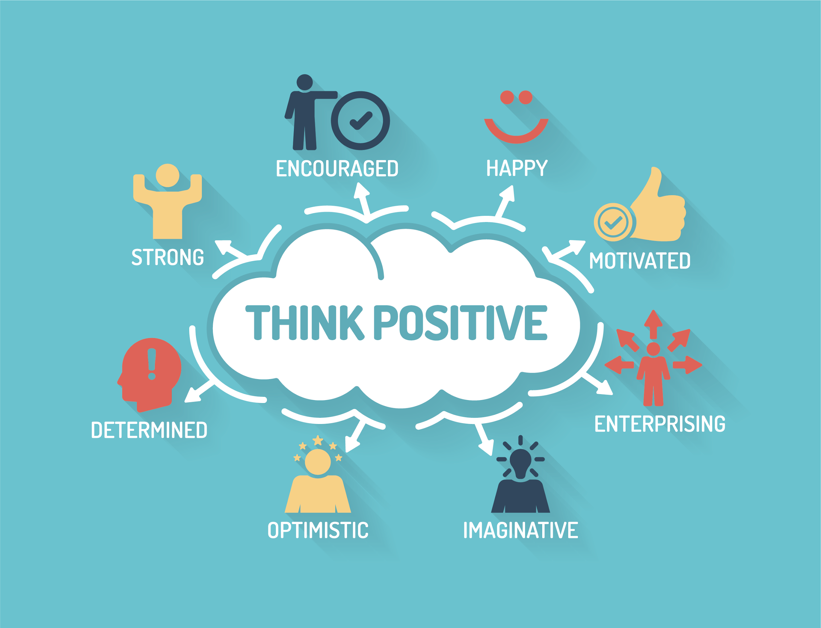
Term 2 Oak Program - The Final Year
In Term 2, students explore positive psychology interventions that can be used to improve one’s sense of optimism. Students also look at the connection between our thought processes and our bodies.
Topics covered: Positivity
Self Control
Mind Body Connections

Slide 4

Term 3 Oak Program - Connections Program
In Term 3 students undertake the Year 12 Connection Program, in which they explore various topics and listen to presenters speak on a variety of issues affecting them in their final year.
Topics covered (to name but a few): Growth Mindset; How to Study Smarter not Harder; Mindfulness Techniques; How To Succeed; Finding your calm.

Slide 5
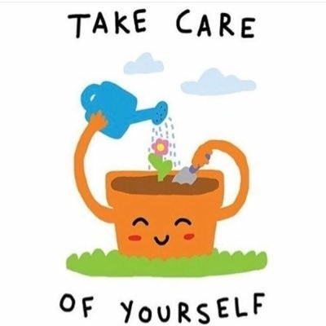

Term 4 Oak Program - The Final Stretch
This Term, students look at what academic and wellbeing strategies can be used to help them in their final leg of schooling. Students also undertake their final Elevate Study Skills session - “The Finishing Line” - in which the focus is finishing course work, exam preparation and self-care.

Slide 6
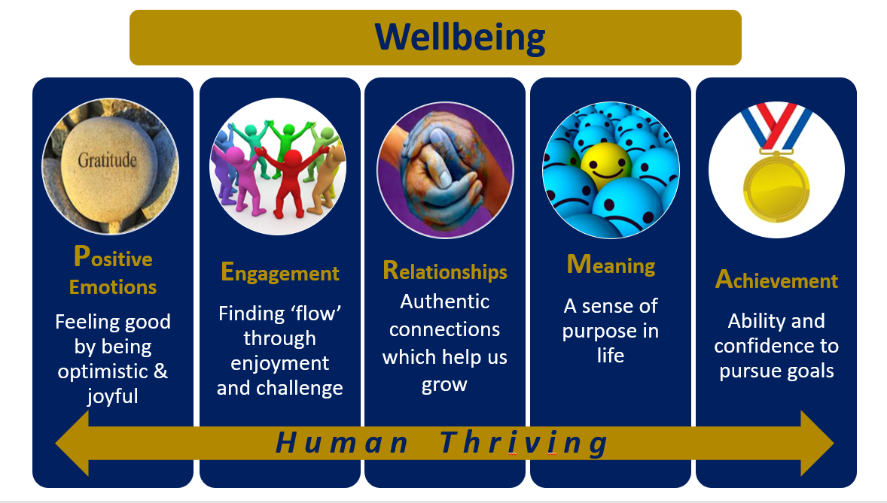
At the end of the Year 12 Oak Program - our hopes for our students.
We hope that our Year 12 students now have a range of personal wellbeing strategies to help them engage in life-long self-care practices, and to equip them with the ability to truly know and appreciate their own strengths. We hope that the emphasis on kindness and compassion, to self and others, is a message that our students carry with them through life.

