Slide 1
Year 11 Religion
Religion and Society 2

Slide 2
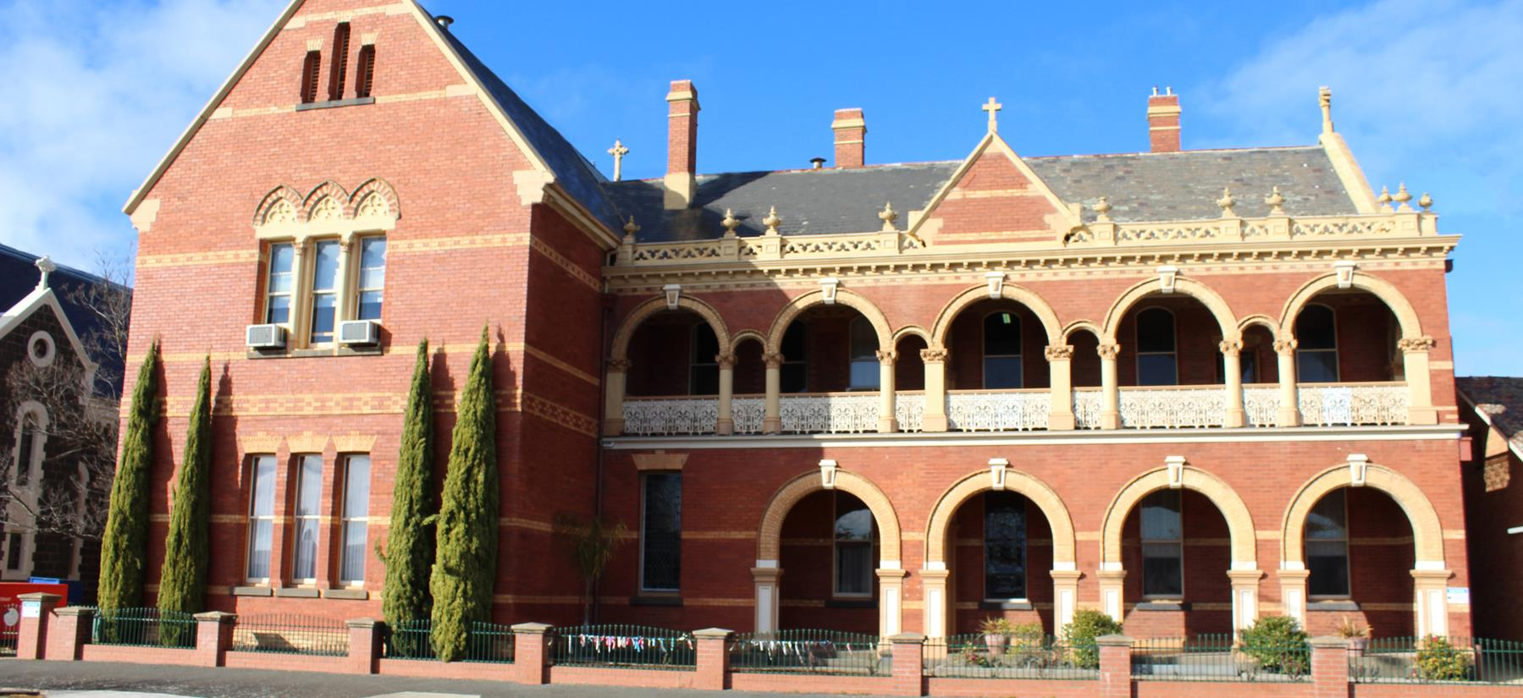
Religious Education at Marian College
Our Context:
Catholic School
Rural Area
Ballarat Diocese
Brigidine Sisters
Kildare Ministries
CONTEXT IS IMPORTANT AS IT HELPS TO SHAPE OUR IDENTITY, WHICH IS OUR STARTING POINT ON OUR SEARCH FOR MEANING IN A COMPLEX WORLD

Slide 3
Religion and Society 2- Religion and Ethics
Area of Study 1: Ethical Decision Making and Moral Judgement
Ethical and Moral Terms
Religions’ influence on ethical decision making
Ethical decision making methods
Students will be able to explain the variety of influences on ethical decision making and moral judgement in societies where multiple worldviews coexist.

Slide 4
Religion and Society 2- Religion and Ethics
Area of Study 2: Religion and Ethics
Leadership of Religious Traditions and their influence on informing ethical perspectives
Ethical decision making methods of Religious Traditions
Ethical perspectives of followers of Religious Traditions
Students will be able to explain how ethical perspectives and moral judgements are formed within at least two religious traditions, in societies in which multiple worldviews coexist.

Slide 5
Religion and Society 2- Religion and Ethics
Area of Study 3: Ethical Issues in Society
Issues that are ethical issues
Contributors to debates about ethical issues
Ethical perspectives, moral judgements etc within debates
Influences on contributors to ethical debates
Students will be able to explain two or more debates on ethical issues in societies in which multiple worldviews coexist

Slide 6
For further information
seast@mcararat.catholic.edu.au

