Slide 1
YEAR 11 Wellbeing
“Oak Wellbeing - Positive Education”.

Slide 2
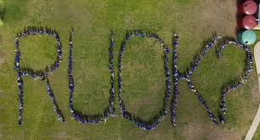
What is Positive Education?
Our Positive Education curriculum is explicitly designed to support your child to establish optimistic habits of mind that propel them forward in their learning, personal development and character. The Wellbeing Curriculum we implement at Year 7 teaches the skills of wellbeing to actively develop within our students optimism, resilience, grit and compassion.

Slide 3
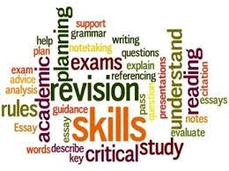
Term 1 Oak Program - Positive Education
In Term 1, in addition to focusing on positive relationships and leadership, students also engage in the Elevate Study Program - “Student Elevation” - which focuses successful, evidence-based study skills that can be applied across all subject areas.
Topics covered: Leadership and Teamwork
Kindness and Connections
Gratitude
Study

Slide 4
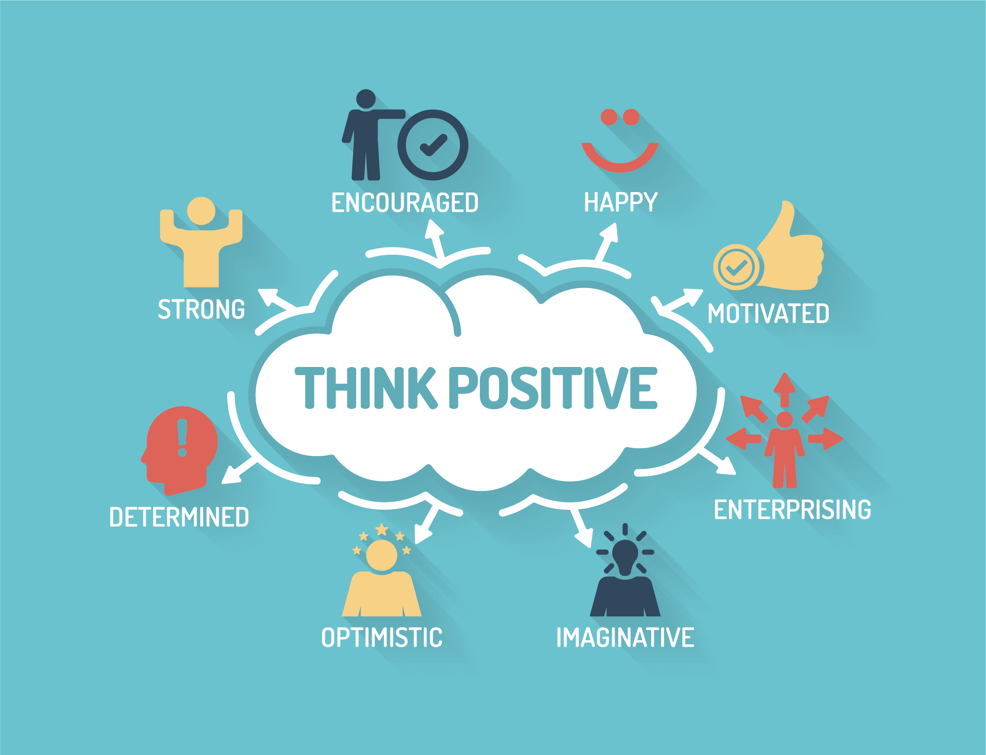
Term 2 Oak Program - Positive Education
In Term 2, students explore positive psychology interventions that can be used to improve one’s sense of optimism. Students also look at the connection between our thought processes and our bodies.
Topics covered: Positivity Self Control
Mind Body Connections

Slide 5
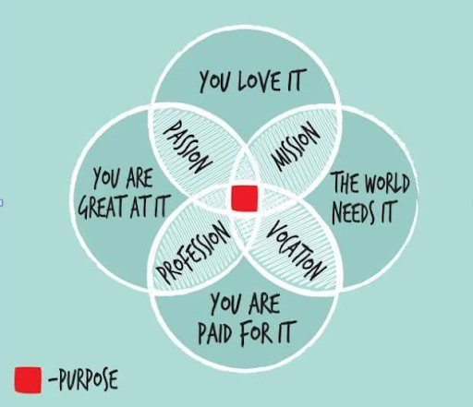
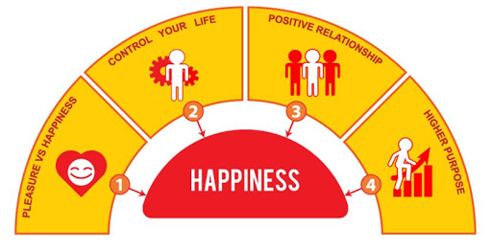
Term 3 Oak Program - Positive Education
In Term 4 students explore the idea of individual purpose and meaning in life.
Topics covered: Character Development
Core Values
Sense of Meaning

Slide 6
Term 4 Oak Program - Positive Education
This Term, students look at personal safety and decision-making
Topics covered:
Gambling vs Gaming
Reviewing Dangers for Youth

Slide 7
At the end of the Year 11 Oak Program - our hopes for our students.
We hope at the end of Year 11, that students enjoyed the experience of Oak Wellbeing and leave the year level equipped with the skills to navigate young-adult life with a maintained focus on self-care. We also hope they end this year’s program feeling prepared for the ups and downs of their final year, both academically and socially.

