Slide 1


YEAR 10 TECHNOLOGIES
DESIGN & TECHNOLOGIES
DIGITAL TECHNOLOGIES

Slide 2
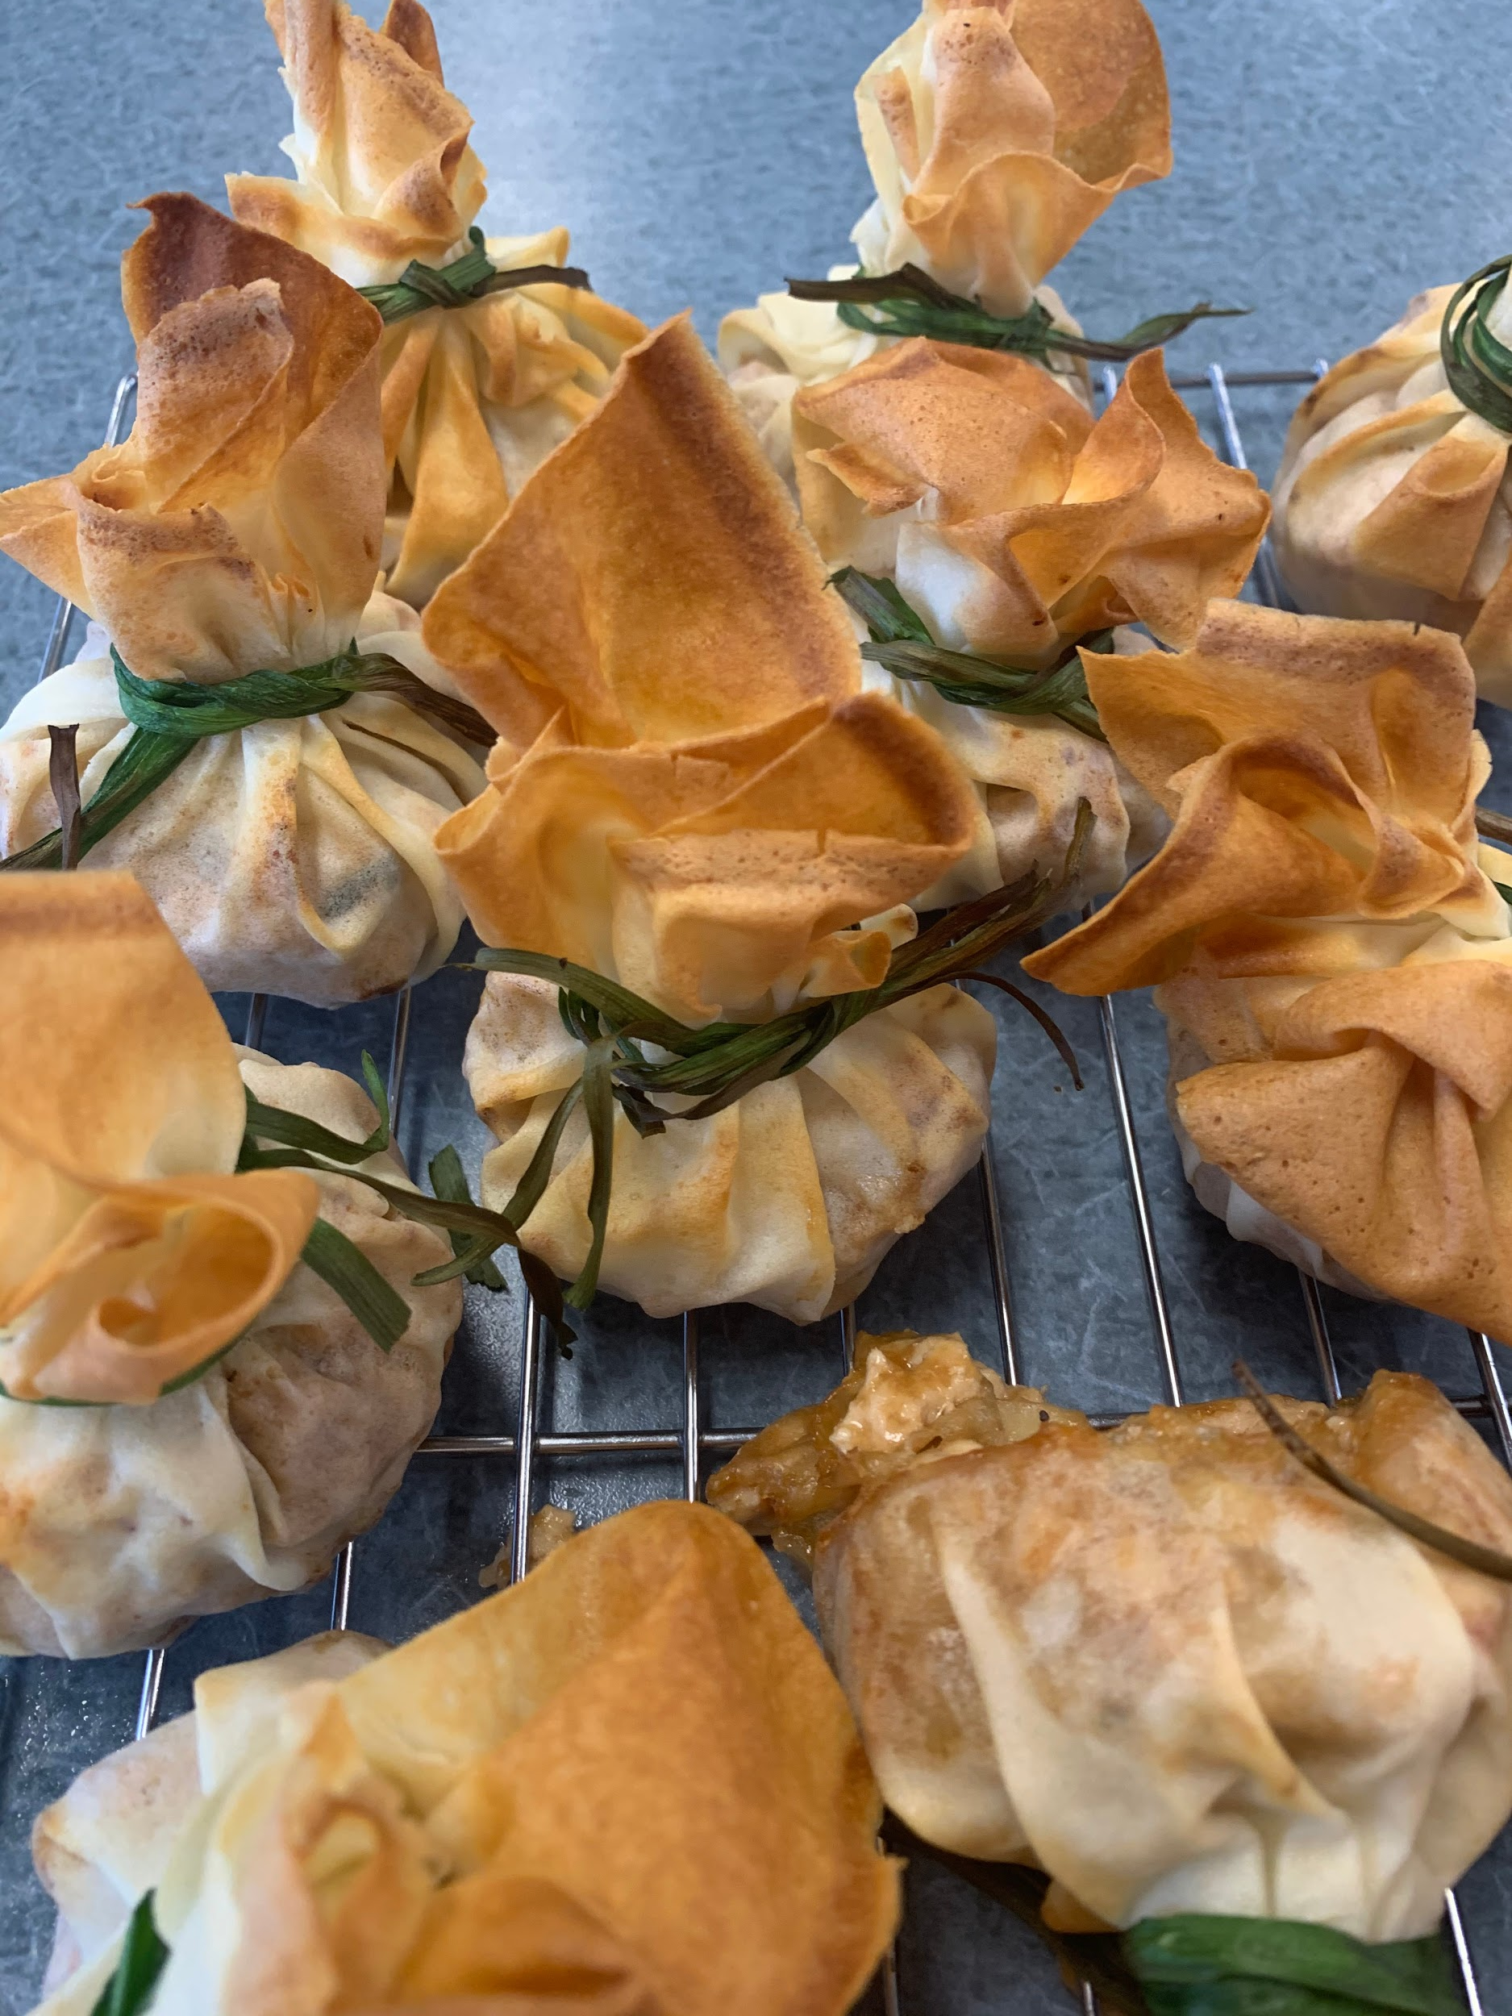
YEAR 10 - 2021
You are able to select up to 6 elective subjects after you have selected your Maths.
Reference Guides:
Year 10 Guide to VCE subjects selection for university entry in 2023.
VTAC Year 10 Guide: Choosing senior school studies for the right reasons VTAC Year 10 Guide

Slide 3
TECHNOLOGIES ELECTIVES - YEAR 10
Asian Foods Materials: Furniture Making
Survival Foods Materials: Woodwork & Plastics
1 &/or 2
Food for Fitness Systems: Mechatronics Advanced
My Kitchen Hamper Computer Aided Design
Textiles: Wearable Art Digital Technologies
Textiles: Weekend Away

Slide 4
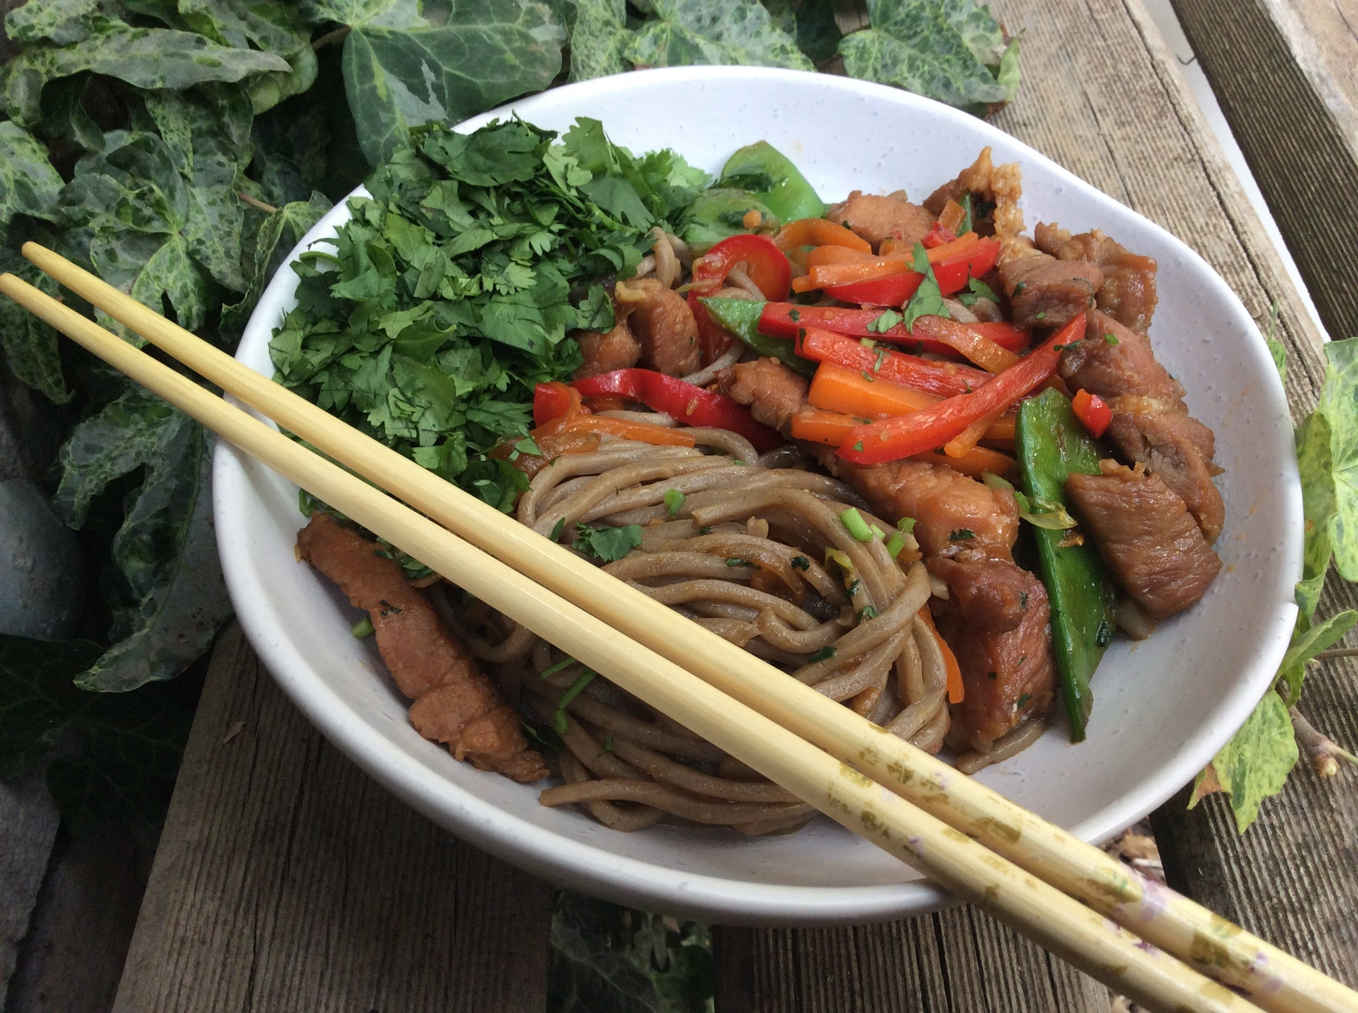
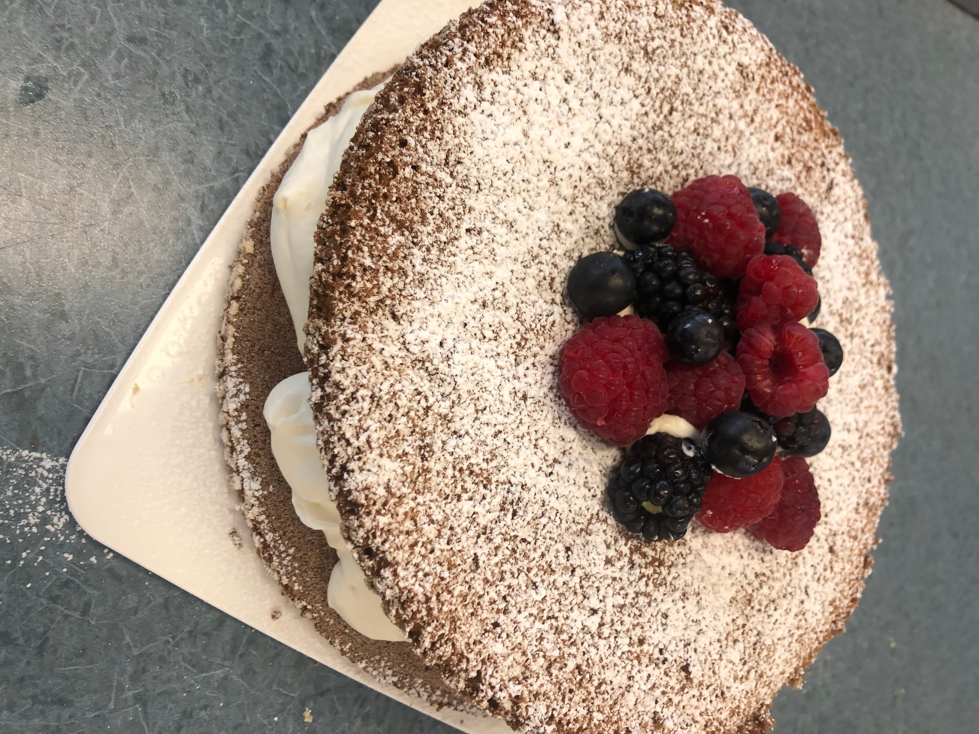
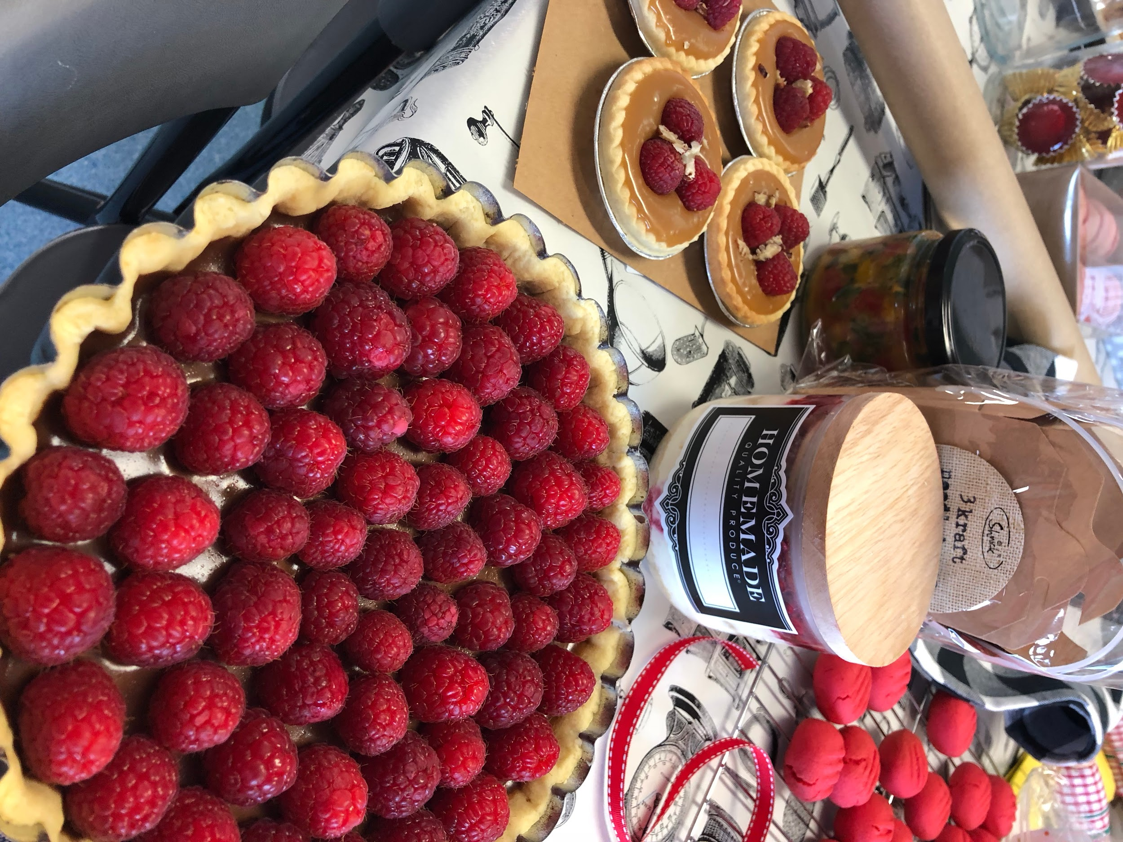
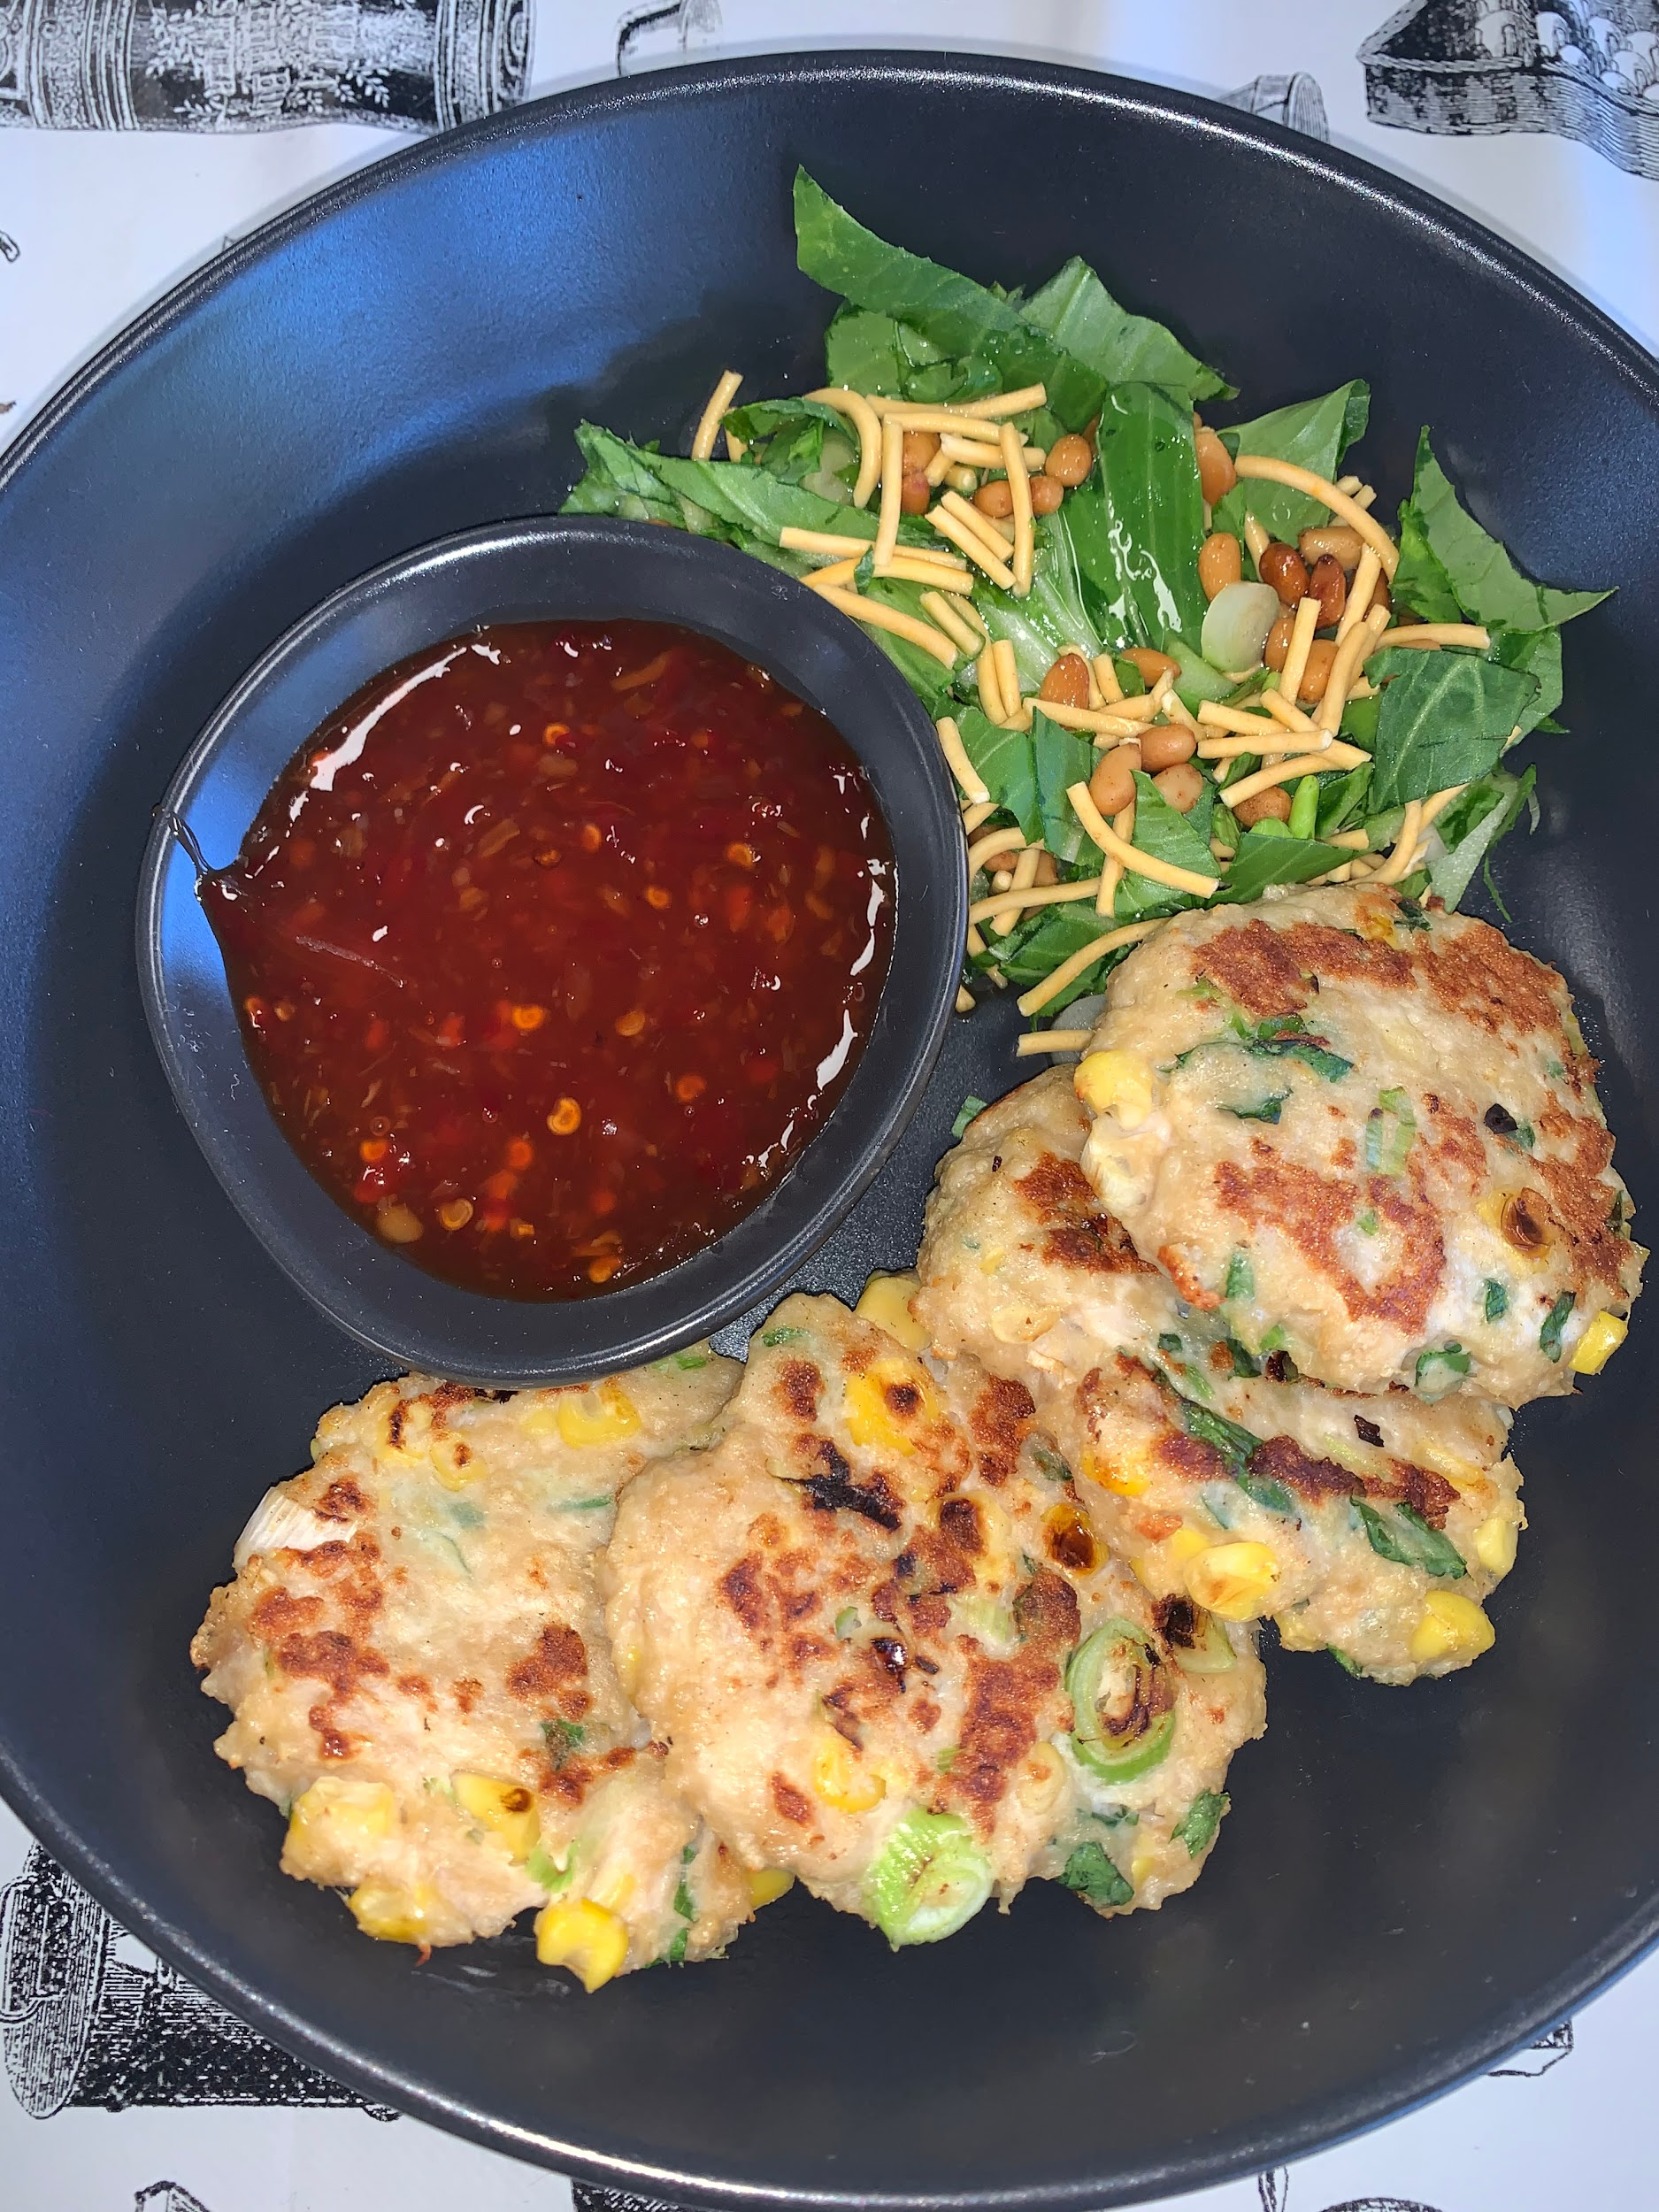
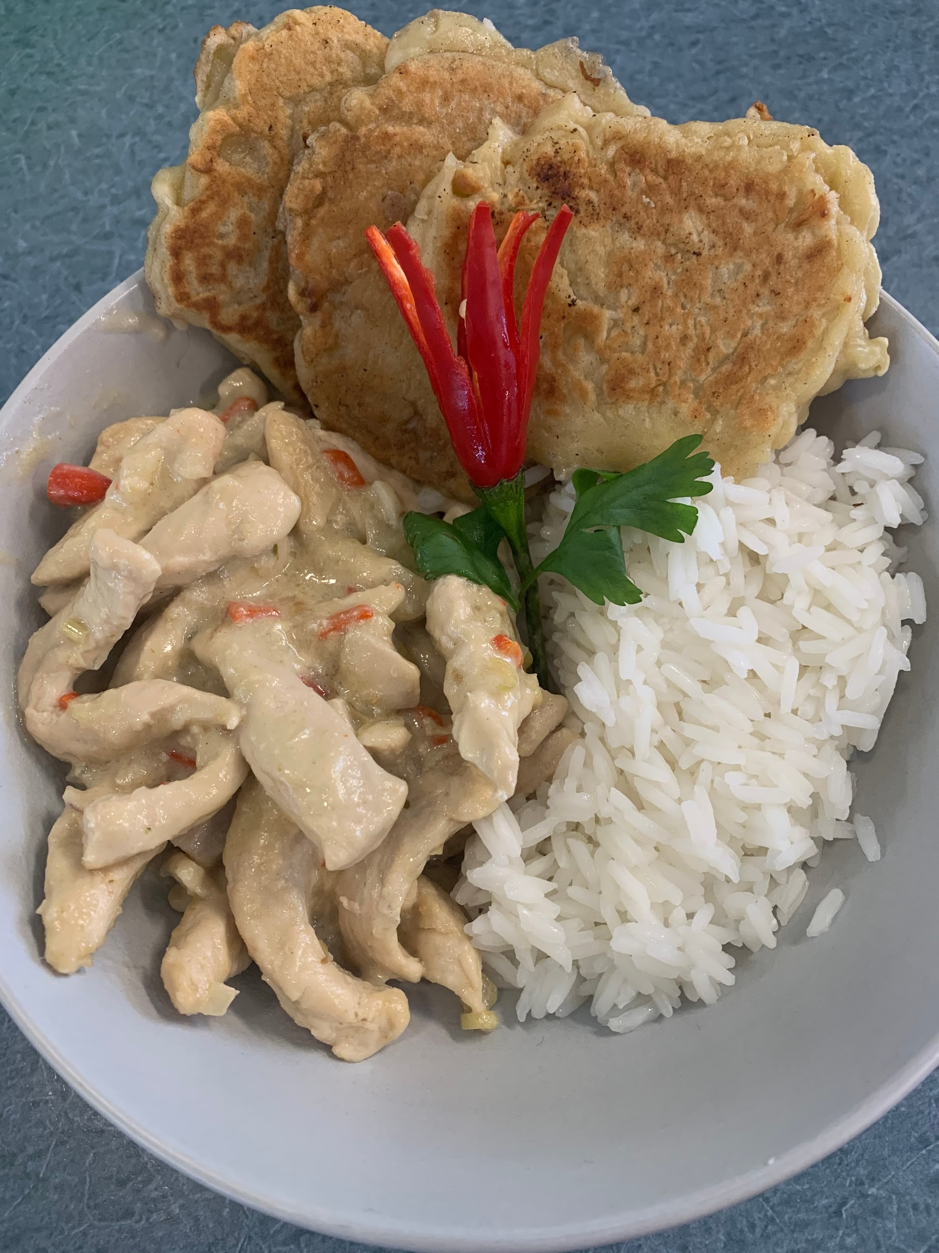
SAMPLE WORK

Slide 5
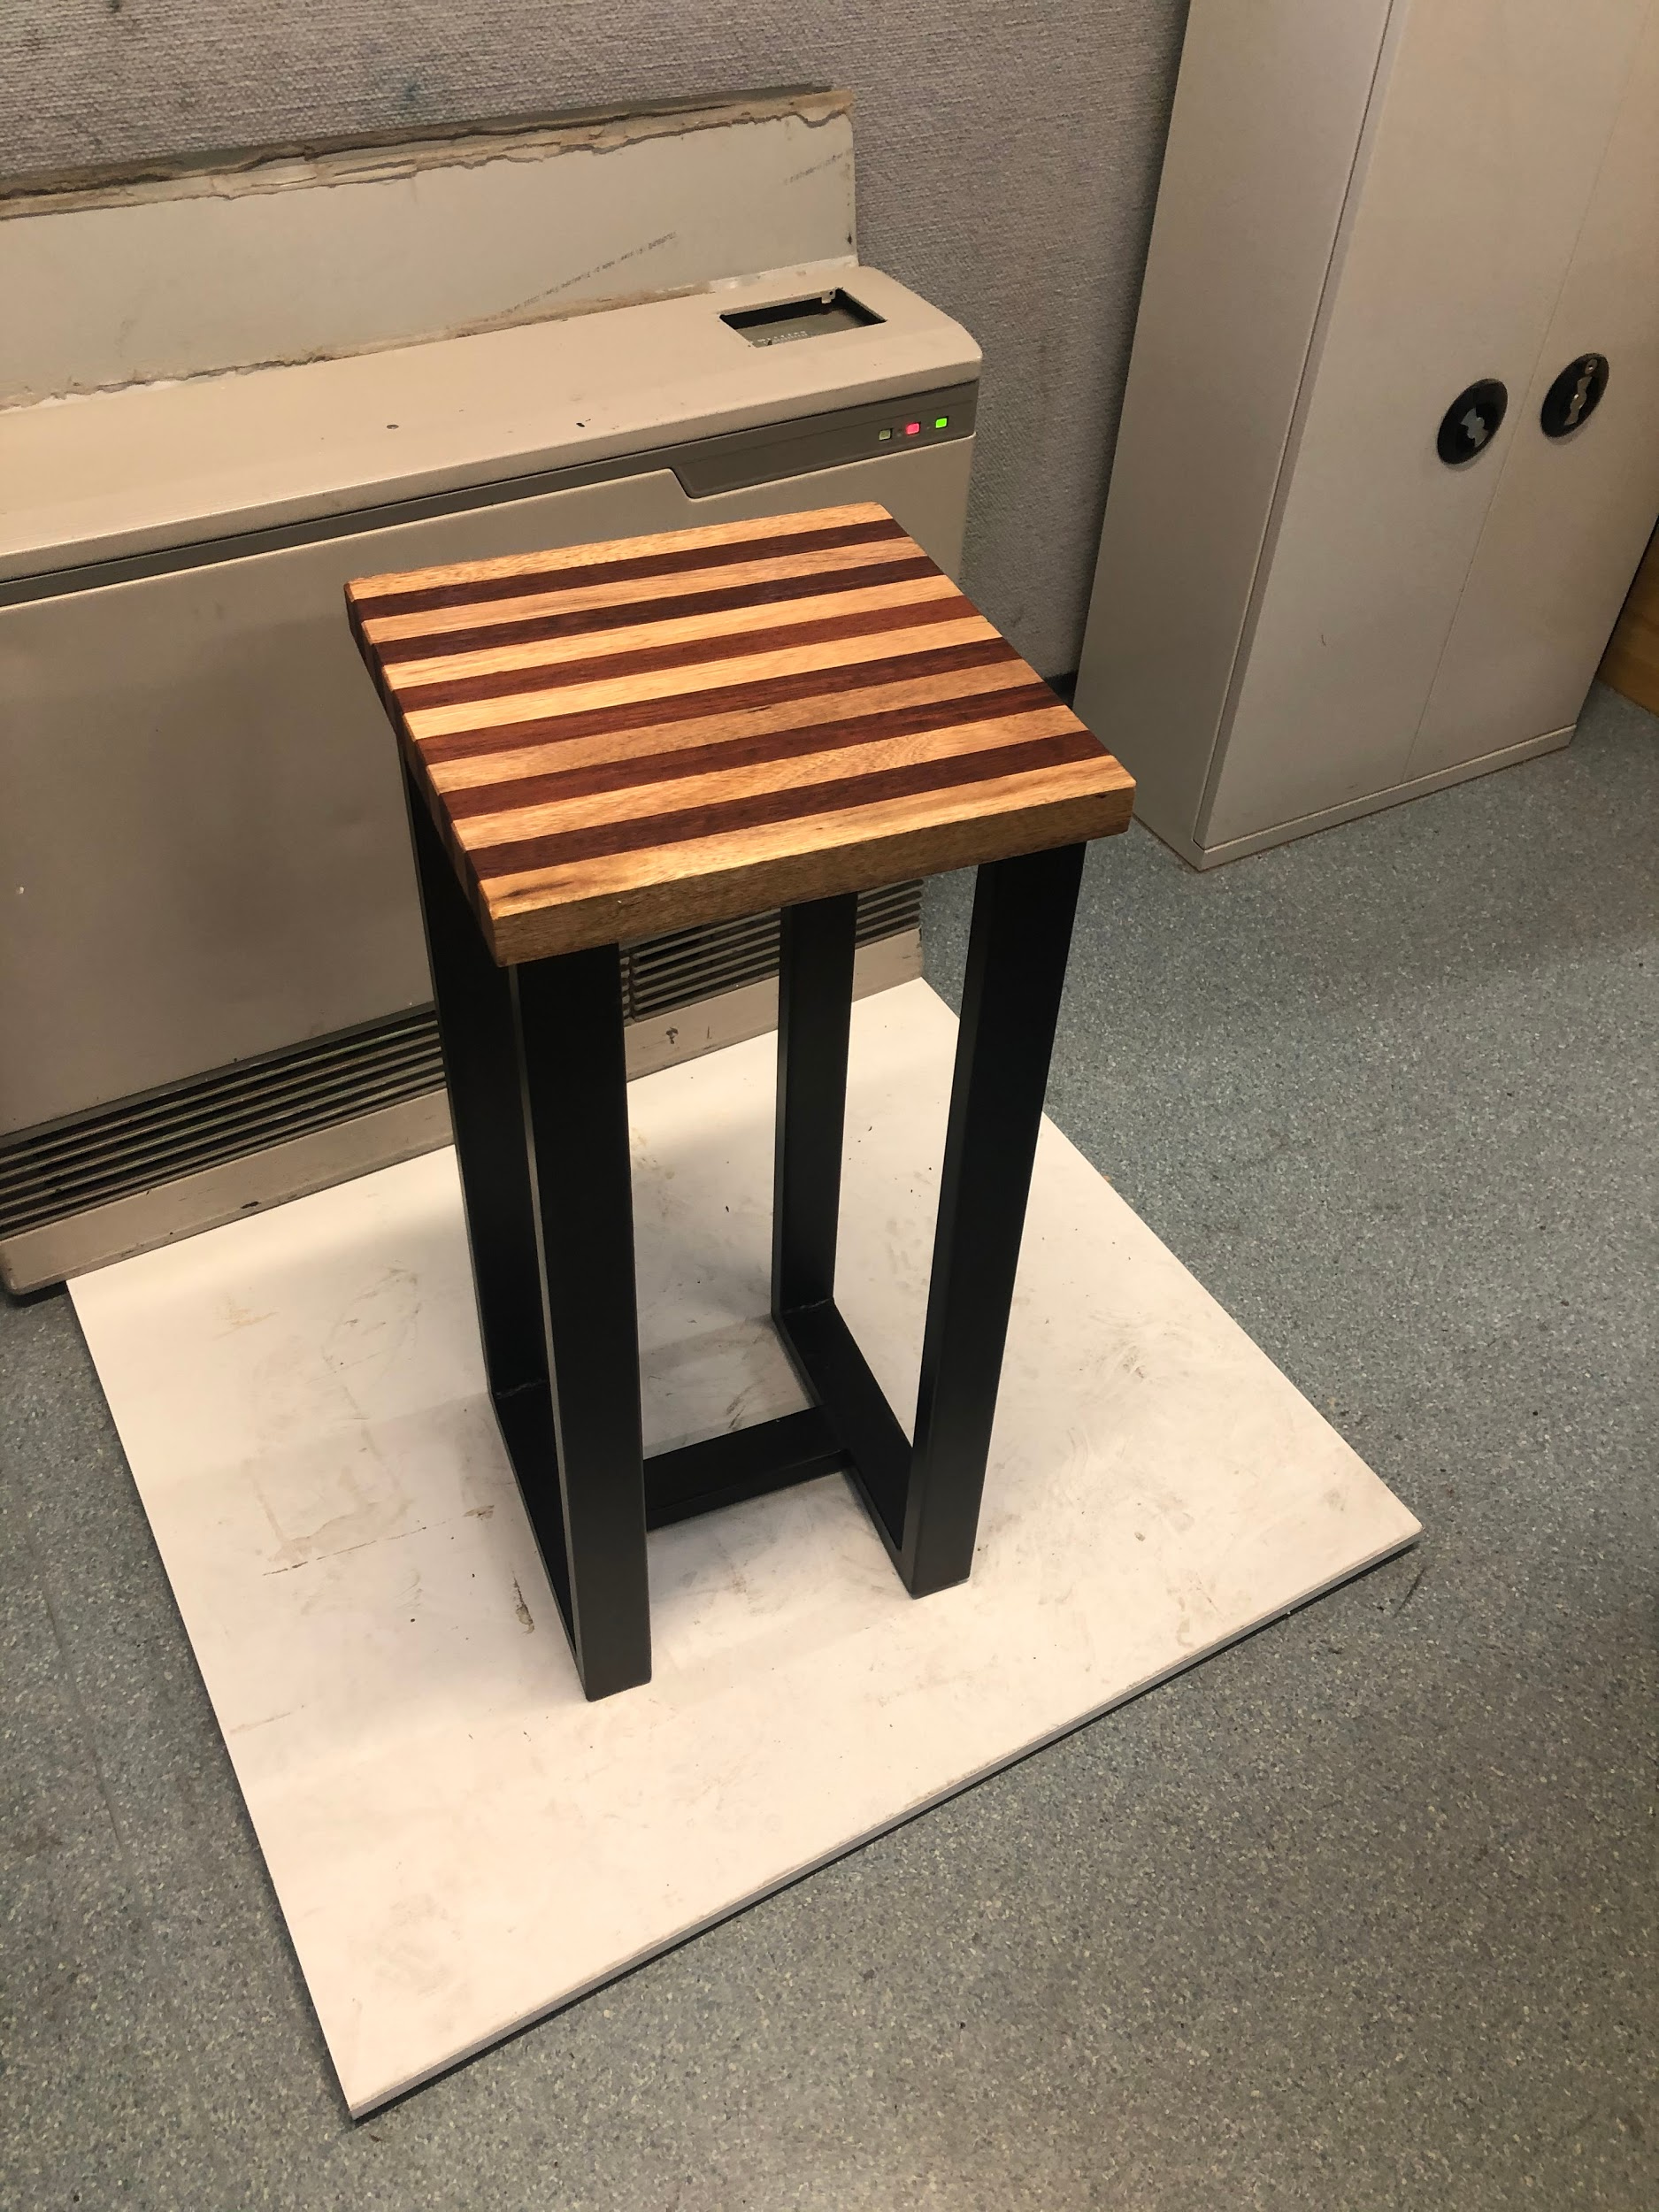
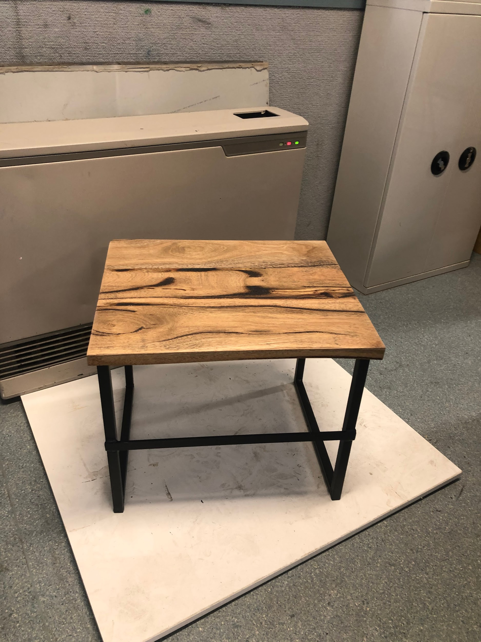
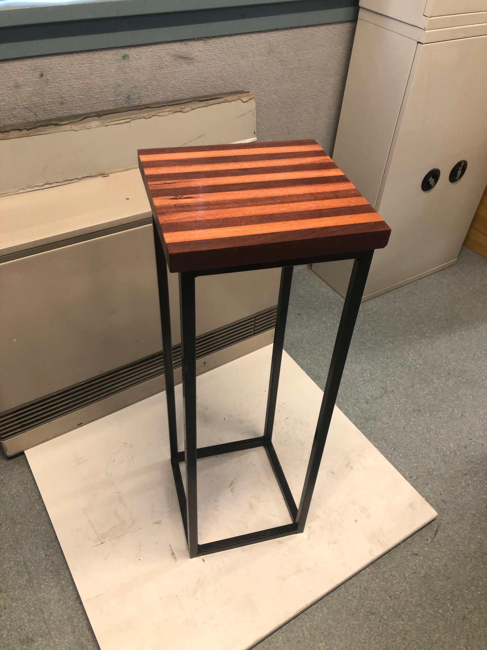
SAMPLE WORK

Slide 6

FURTHER INFORMATION
Megan Shea
Head of Technologies
sheam@mcararat.catholic.edu.au
Speak to: Year 10 Technology Teachers (Mr Peatt, Mrs Shea, Mr Stewart, Mrs Venn, Mrs Spalding)
Refer to: Subject handbooks
Check us out on Instagram: foodandtechatmarianararat

