Slide 1
YEAR 10 Wellbeing
“Oak Wellbeing - Positive Education”.

Slide 2
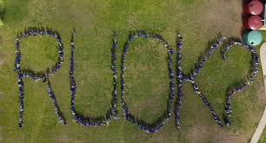
What is Positive Education?
Our Positive Education curriculum is explicitly designed to support your child to establish optimistic habits of mind that propel them forward in their learning, personal development and character. The Wellbeing Curriculum we implement at Year 7 teaches the skills of wellbeing to actively develop within our students optimism, resilience, grit and compassion.

Slide 3
Term 1 Oak Program - Positive Education
In Term 1, students look at how the brain functions and the concept of neuroplasticity - that our brain is adaptable and can be re-rewired through the use of techniques to establish better habits that contribute to your health, success, and well-being. Students also undertake the Elevate Study Program -“Study Sensai”- and listen to presenters speak on the best evidence-based study techniques to use in Year 10. They also undertake modules related to study, avoiding procrastination and note-taking, etc.
Topics covered: The Brain
How to Study Handling Stress Making Sense of Emotions

Slide 4
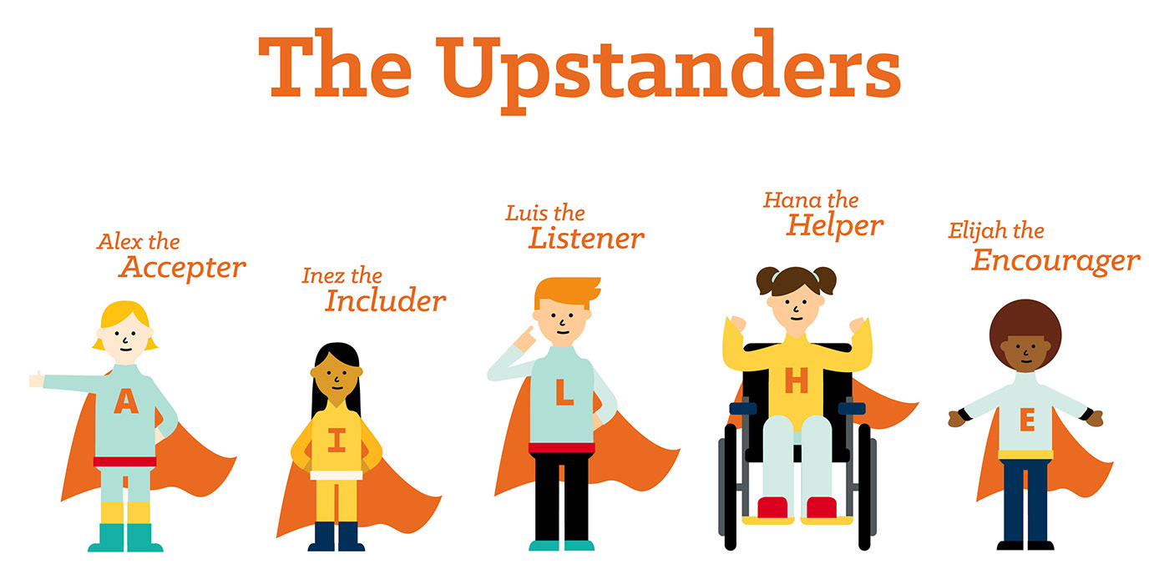
Term 2 Oak Program - Positive Education
In Term 2, students look at leadership qualities, and positive relationships with their peers. They explore the idea of stereotypes and ways of challenging those which they feel are unjust. Students are encouraged to be “upstanders” in life, as opposed to “bystanders”.
Topics covered: Working Together
Kindness
Leadership Bystander
Challenging Stereotypes

Slide 5
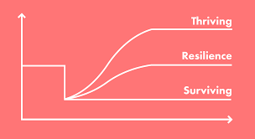
Term 3 Oak Program - Positive Education
This Term, students examine how to overcome adversity, challenge and setbacks to go on to achieve their goals.
Topics covered: Thriving through challenge.

Slide 6
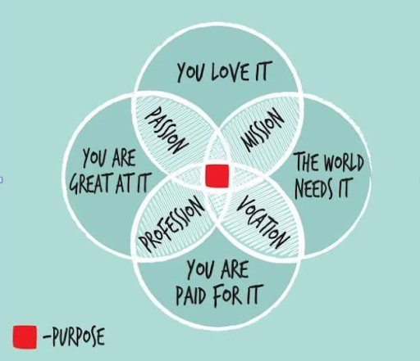
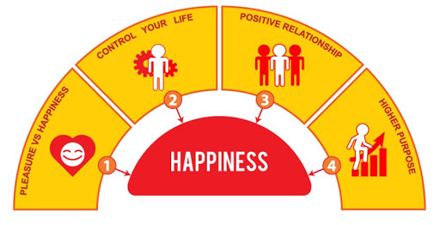
Term 4 Oak Program - Positive Education
In Term 4 students explore the idea of individual purpose and meaning in life.
Topics covered: Character Development
Core Values
Sense of Meaning

Slide 7
At the end of the Year 10 Oak Program - our hopes for our students.
We hope at the end of Year 10, that students enjoyed the experience of Oak Wellbeing and leave the year level understanding their own personal agency and ability to bounce back from adversity or setbacks. We also hope our students start thinking more about their passions, purpose and those areas in life that give them joy.

