Slide 1
YEAR 10 LANGUAGE
CHINESE

Slide 2
Year 10 Elective: Chinese
Chinese is offered as an elective in Semester One and and elective in Semester Two.
Students interested in developing their Chinese are encouraged to choose Chinese for both Semester One and Semester Two.
Semester One: Language and Culture
Semester Two: Pre-VCE

Slide 3
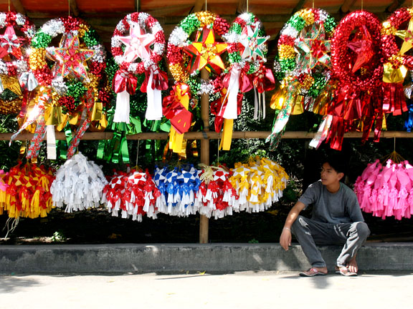
Year 10 Elective: Chinese
Semester One: Language and Culture
Students focus on understanding Chinese culture through the study of Chinese traditions, Chinese modern pop culture and Chinese history as well as developing conversational skills and language.

Slide 4
Year 10 Elective: Chinese
Semester Two: Pre-VCE
This subject focuses on preparing students for VCE requirements. Ideally, students will have completed the Language and Culture Elective in Semester One.
Students will conduct research on virtual communications as well as establishing connections with Chinese communities.
Students will study a variety of Chinese text types and styles.

Slide 5
Year 10 Elective: Chinese
For more information please contact:
Mrs Stephanie Mansell
Head of English and Languages
smansell@mcararat.catholic.edu.au
Students are also encouraged to speak to Ms Guan.

