Slide 1


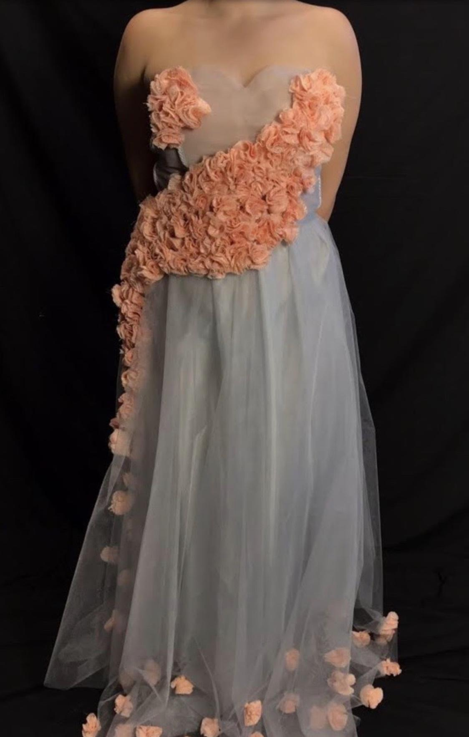
VCE TECHNOLOGIES

Slide 2
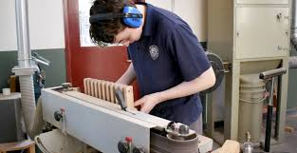
VCE - 2021
For you to complete VCE successfully you must complete 16 units over the two years (Years 11 & 12).
4 of these must be from the English Group.
Please consider two things when making selections:
  What the student enjoys.
  What the student is good at.
Studies that are required (Pre-requisites) and those that could be helpful.

Slide 3

Reference Guides
Strongly recommend that you go to the VCAA website and READ the STUDY DESIGNS for each VCE subject. Be sure to look at the KEY KNOWLEDGE AND KEY SKILLS. VCAA Study Designs
Year 10 guide to VCE subject selection for university entry 2023
Herald Sun VCE planner printed supplement Tuesday 21 July
Course search VTAC Course Search
VTAC Year 10 Guide: VTAC Year 10 Guide
VTAC Year 11 & 12 Guide: Choosing senior school studies for the right reasons VTAC Year 11 & 12 Guide

Slide 4
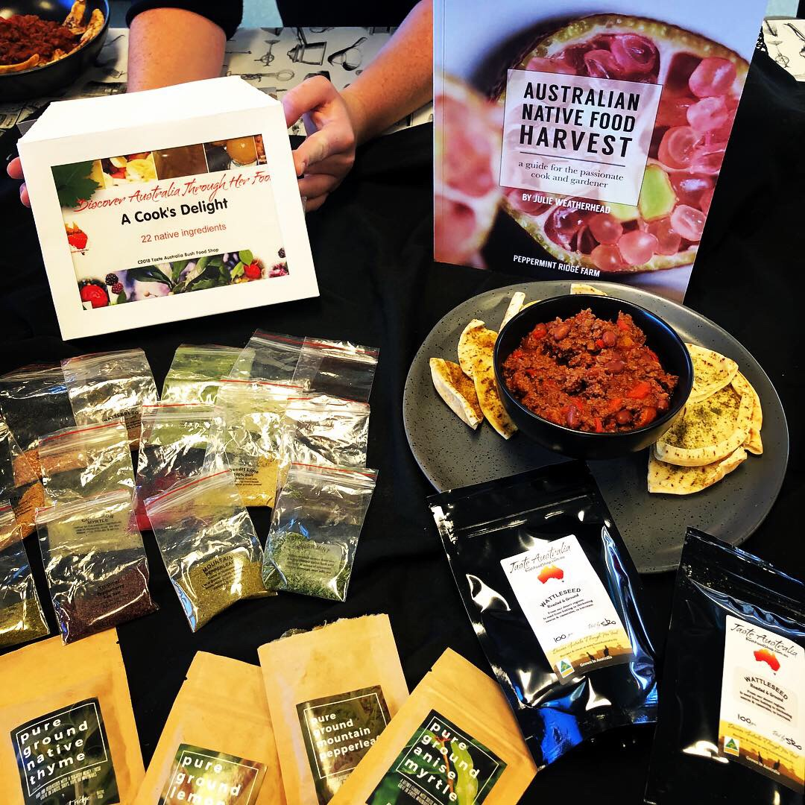
VCE TECHNOLOGIES SUBJECTS - 2021
Product Design and Technology
- Textiles, Fabrics and Fibres
- Wood, Plastic, Metal
Food Studies
Systems Engineering
All Technology subjects require the use of the DESIGN
PROCESS (Investigating/Designing, Producing and Evaluating)

Slide 5

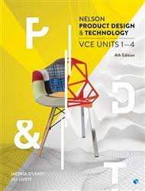
Product Design and Technology
Students may select either:
- Textiles, Fabrics and Fibres; or
- Wood, Plastic, Metal
Both options follow the Product Design Process and require
the completion of a folio Product Design Process

Slide 6
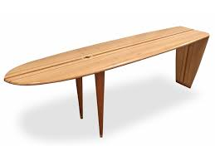
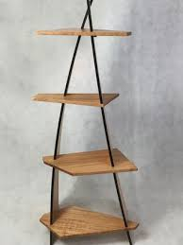
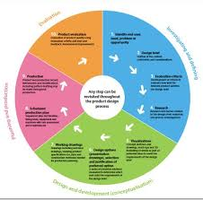
Product Design and Technology: continued
The product design process has four stages:
• Investigating and defining
• Design and development (conceptualisation)
• Planning and production
• Evaluation.

Slide 7
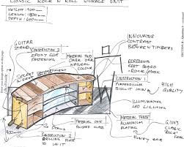
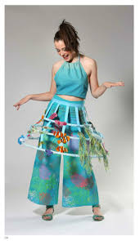
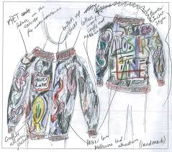
Product Design and Technology: continued
The study is made up of four units:
Unit 1: Sustainable product redevelopment
Unit 2: Collaborative design
Unit 3: Applying the product design process
Unit 4: Product development and evaluation

Slide 8
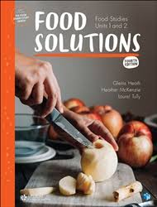
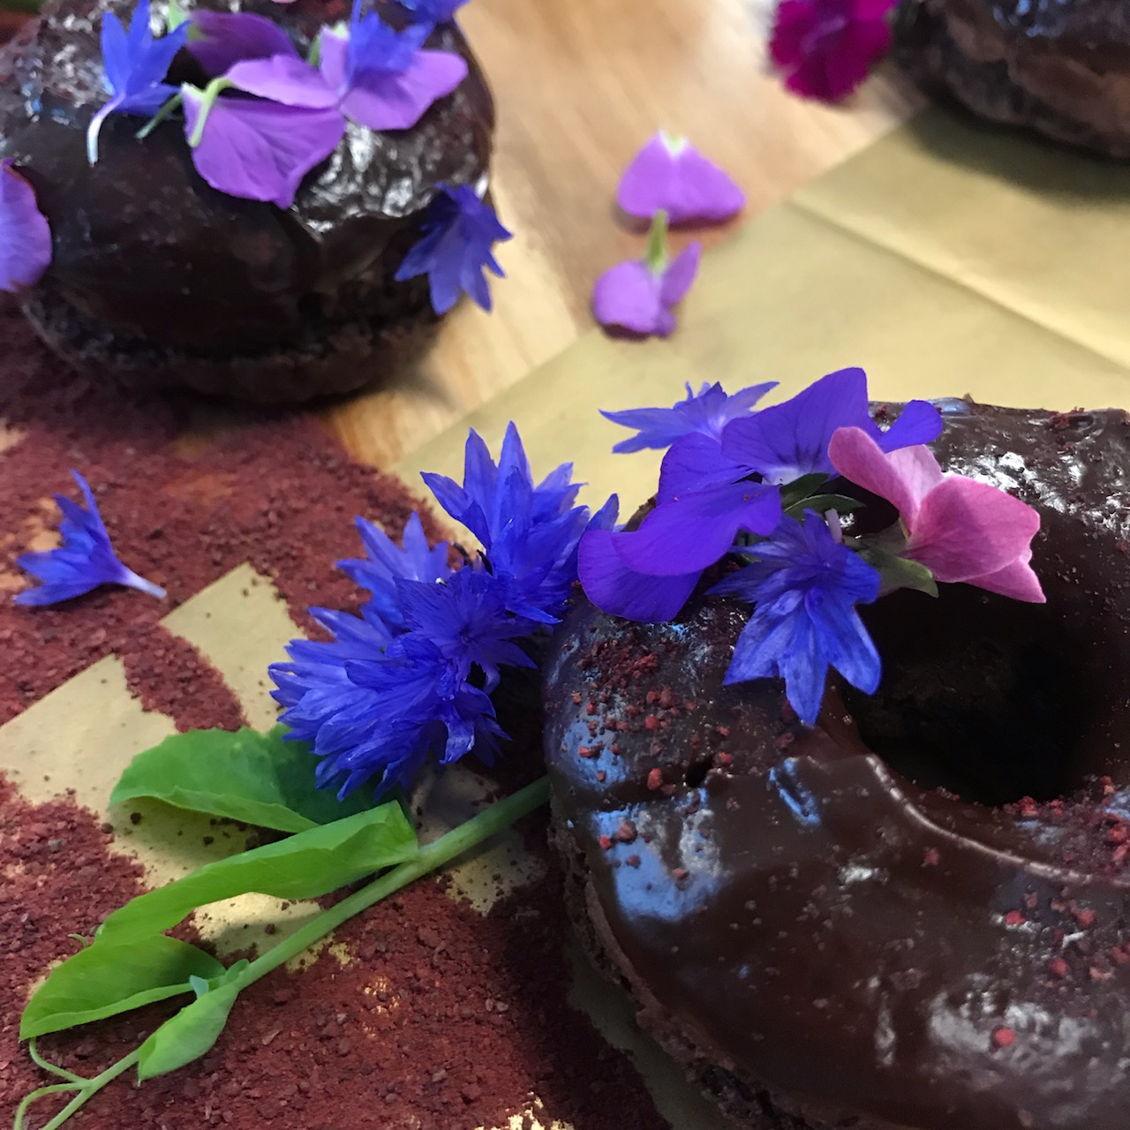
Food Studies
VCE Food Studies takes an interdisciplinary approach to the exploration of food, with an emphasis on extending food knowledge and skills and building individual pathways to health and wellbeing through the application of practical food skills.
Students study past and present patterns of eating, Australian and global food production systems and the many physical and social functions and roles of food.

Slide 9
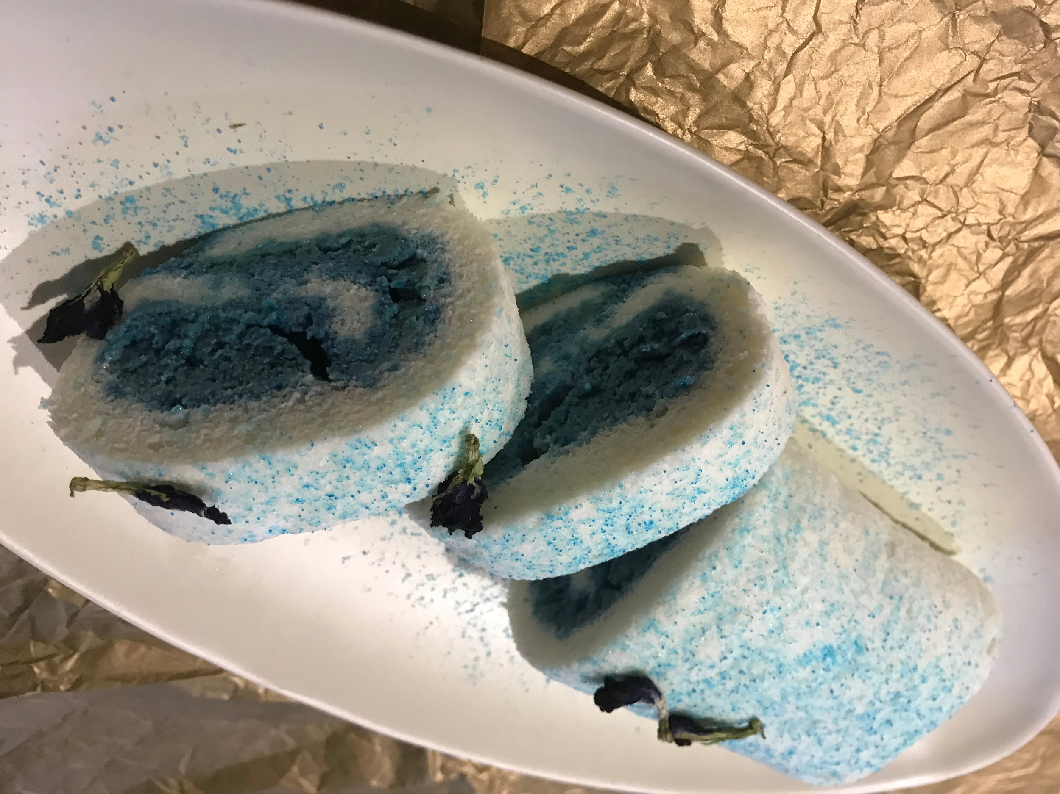
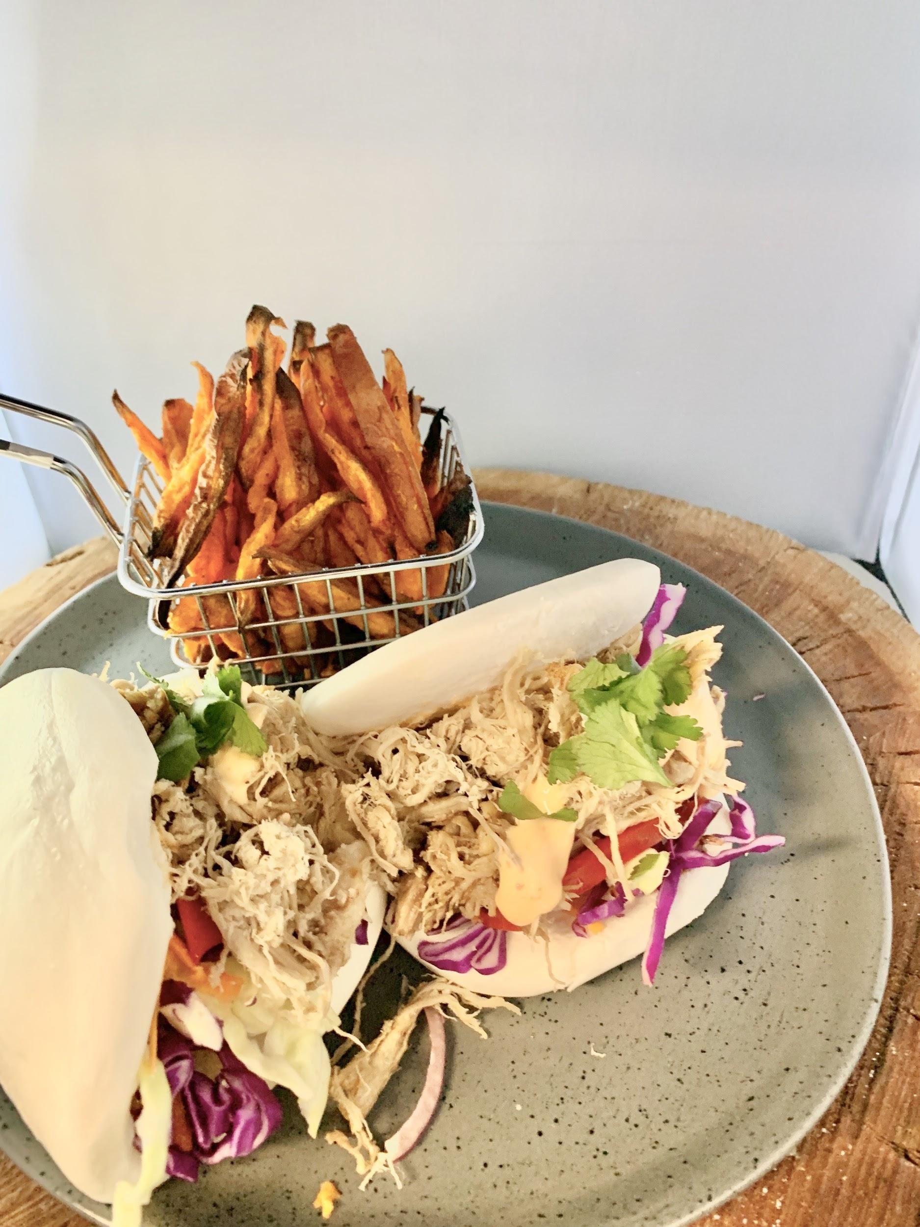
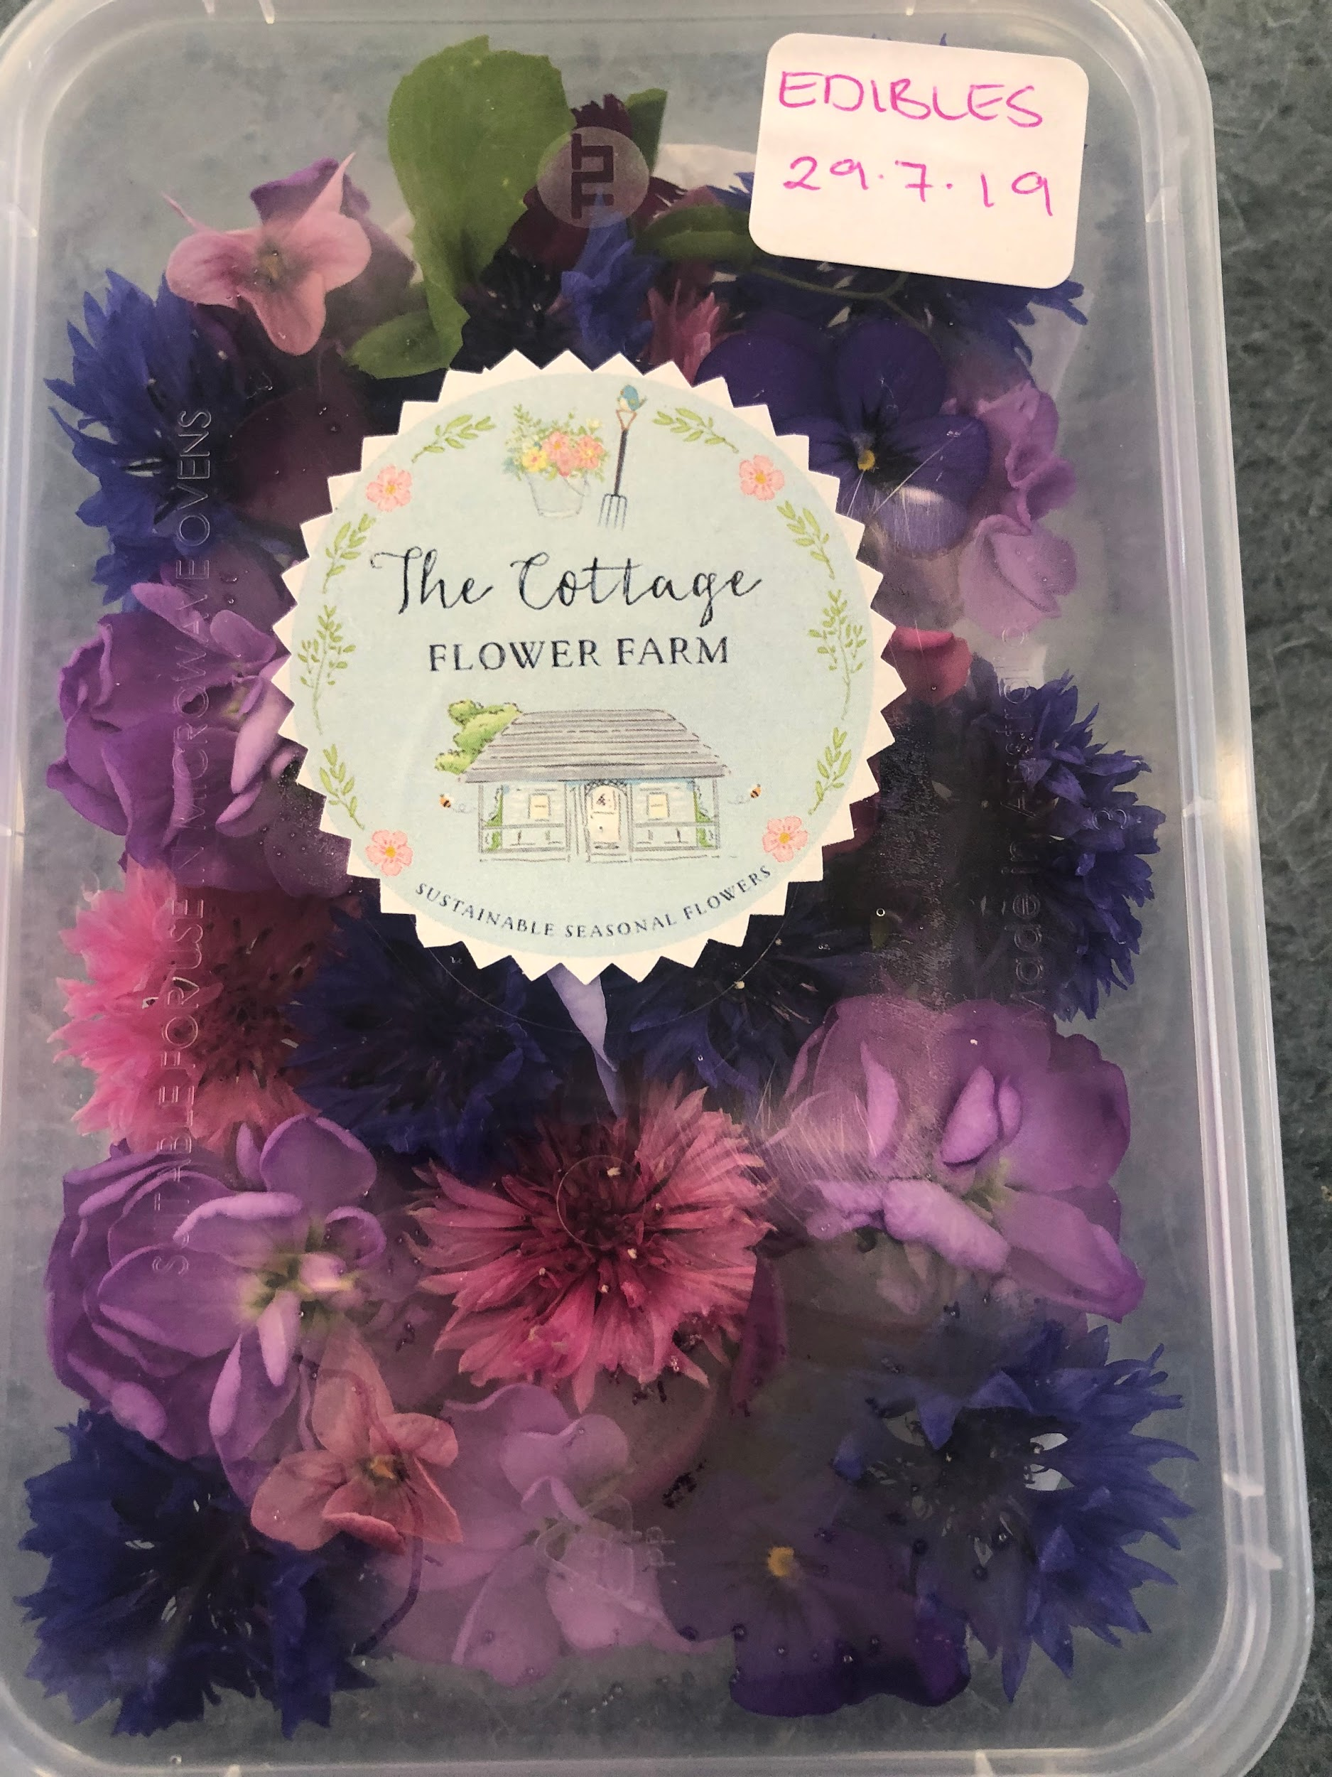
Food Studies: continued
The study is made up of four units:
Unit 1: Food origins
Unit 2: Food makers
Unit 3: Food in daily life
Unit 4: Food issues, challenges and futures

Slide 10
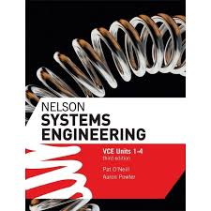
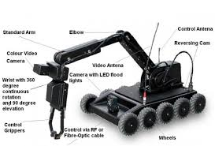
Systems Engineering
VCE Systems Engineering involves the design, production, operation, evaluation and iteration of integrated systems, which mediate and control many aspects of human experience.
Students test and verify that the system is well-built and integrated.
This study can be applied to a diverse range of engineering fields such as manufacturing, transportation, automation, control technologies, mechanisms and mechatronics, electrotechnology, robotics, pneumatics, hydraulics, and energy management.

Slide 11
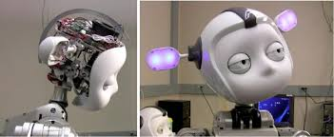
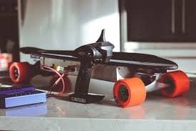
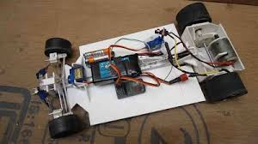
Systems Engineering: continued
The study is made up of four units:
Unit 1: Mechanical systems
Unit 2: Electrotechnological systems
Unit 3: Integrated and controlled systems
Unit 4: Systems control

Slide 12
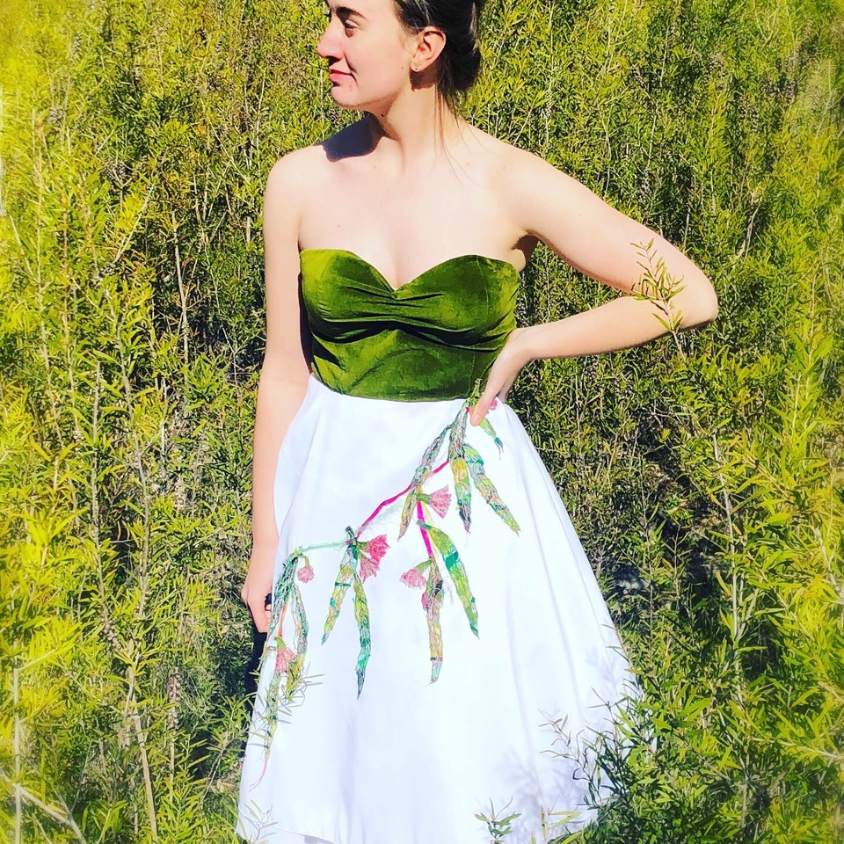

SAMPLE WORK

Slide 13
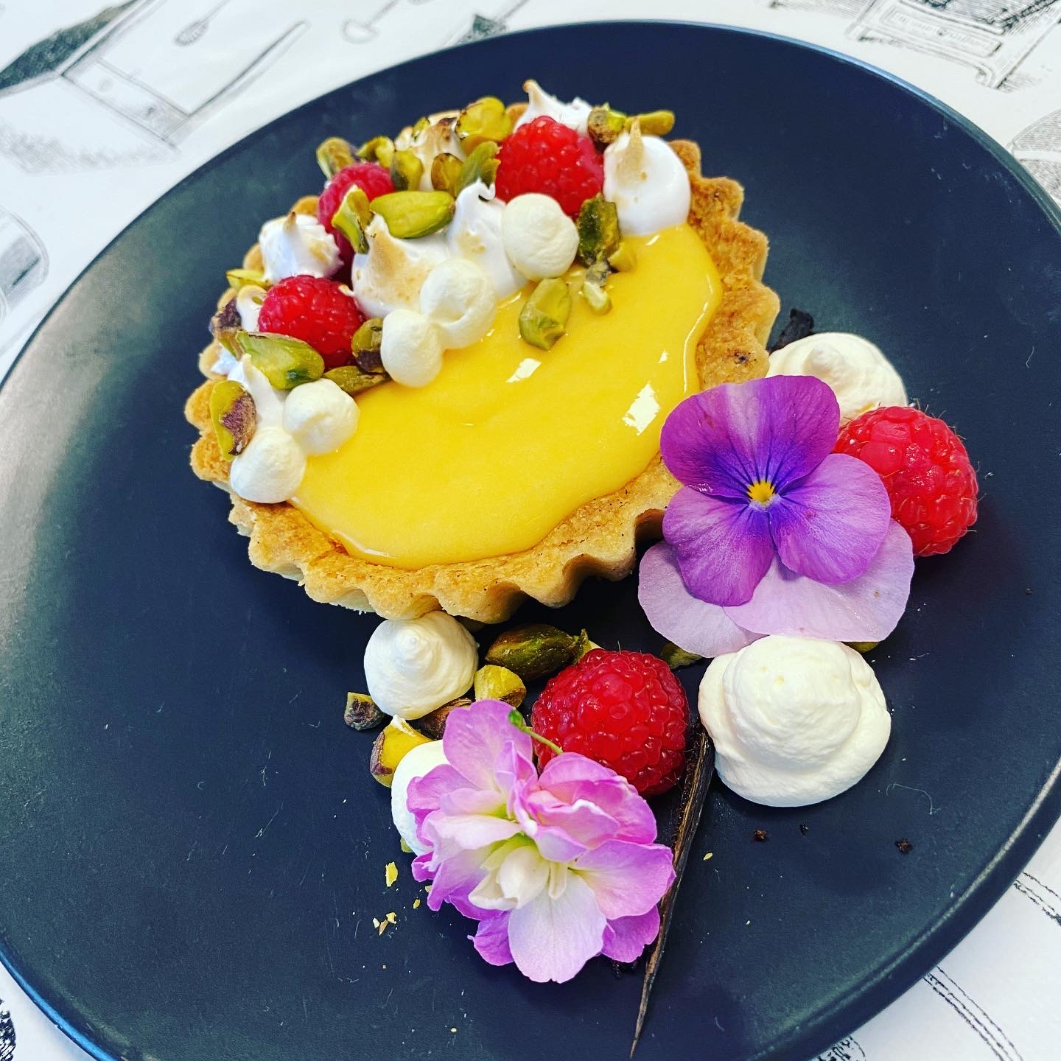
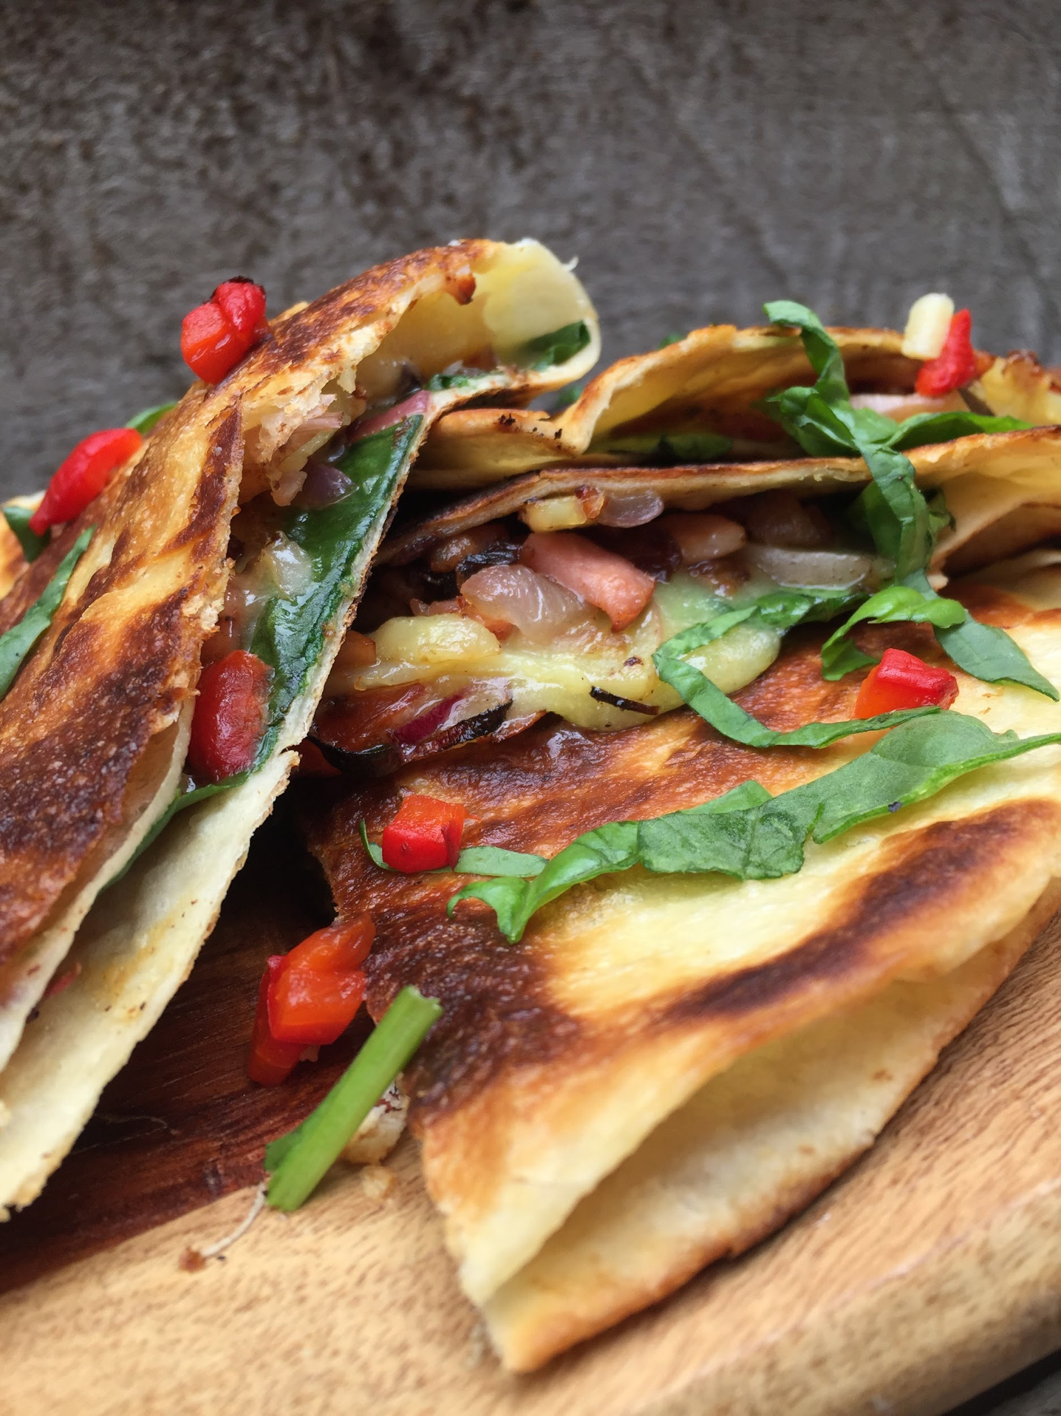
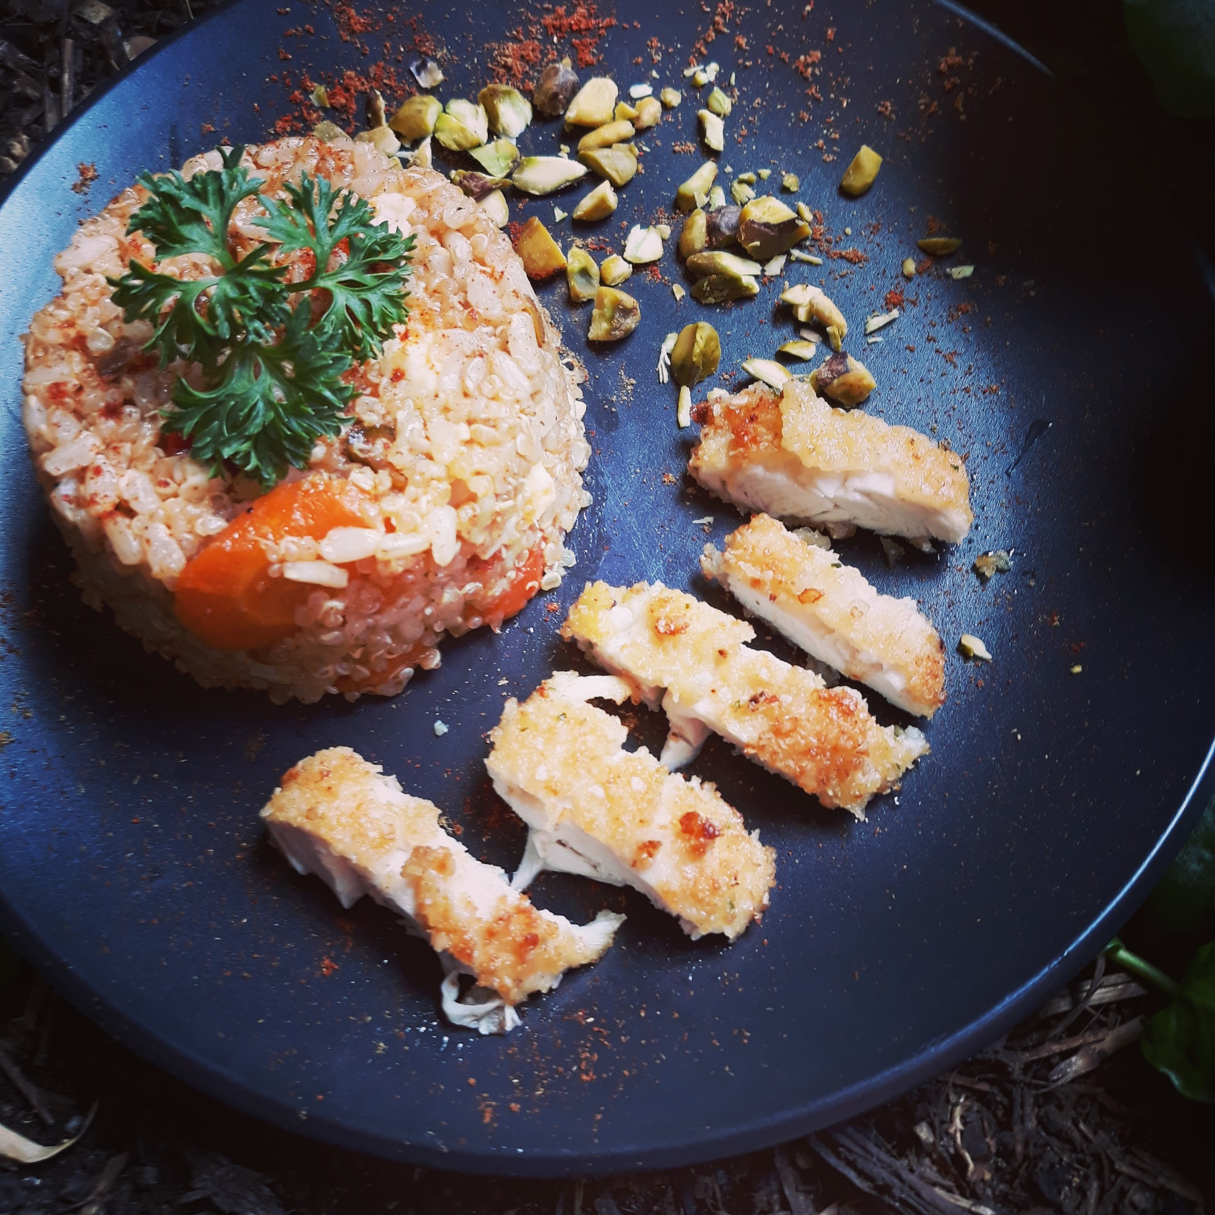
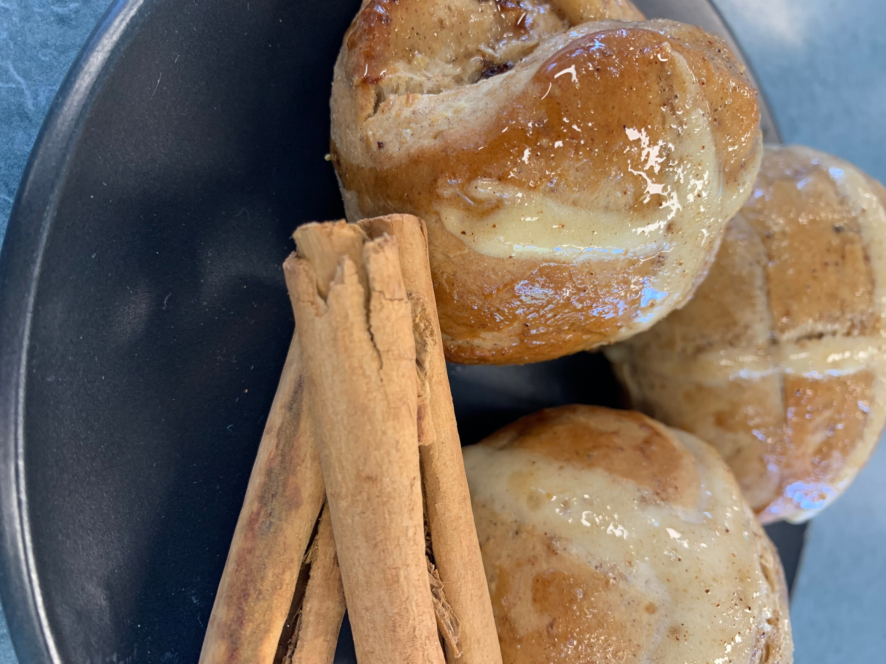
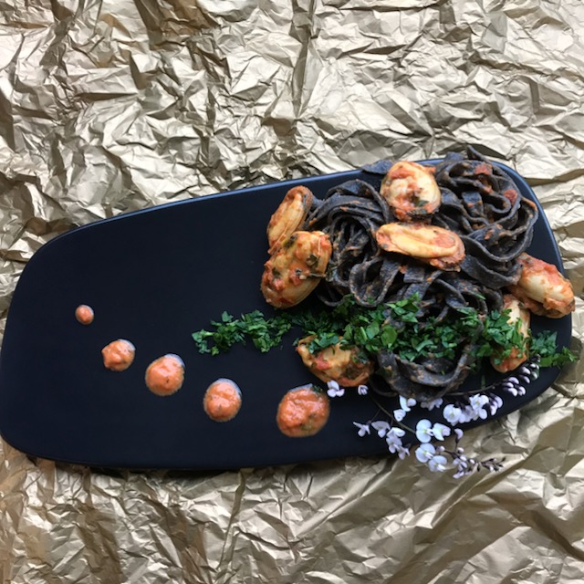
SAMPLE WORK

Slide 14
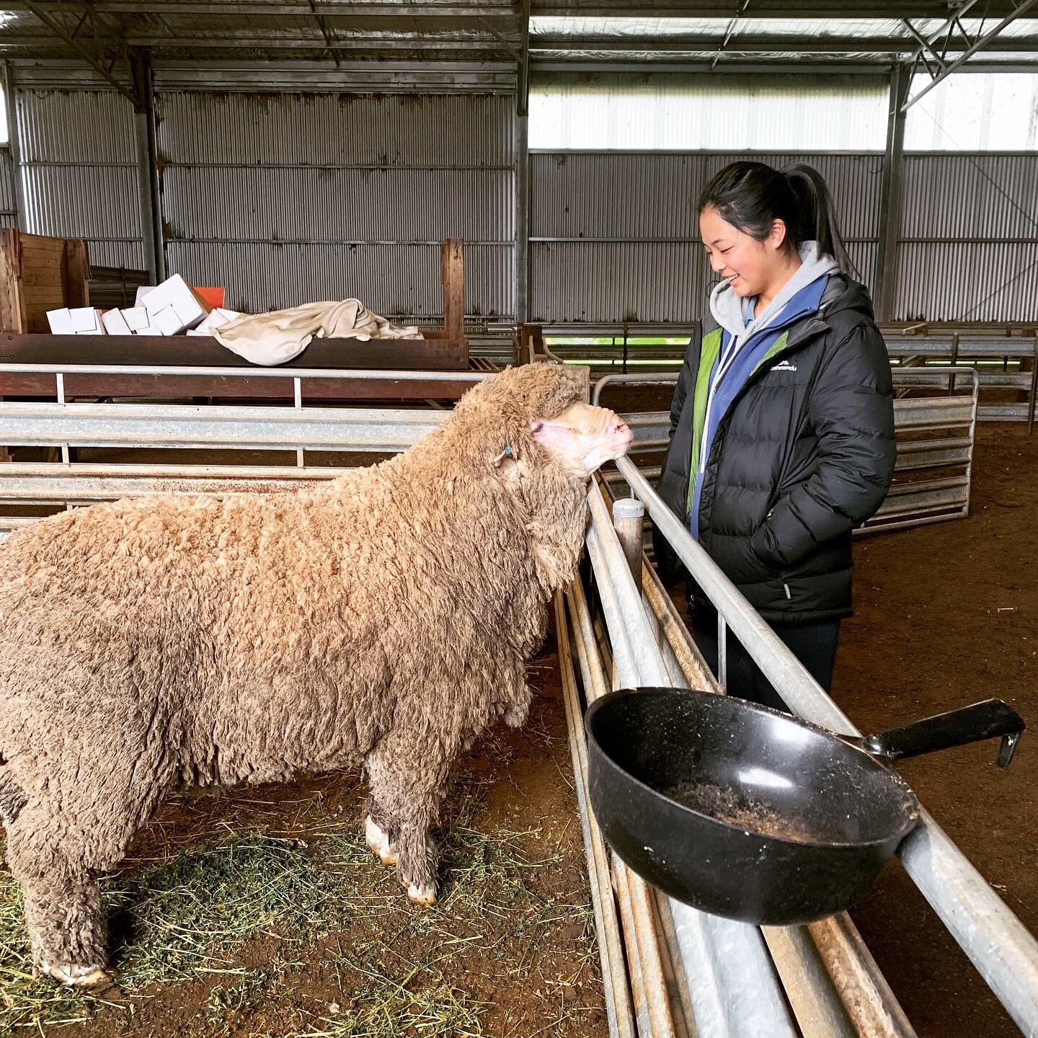
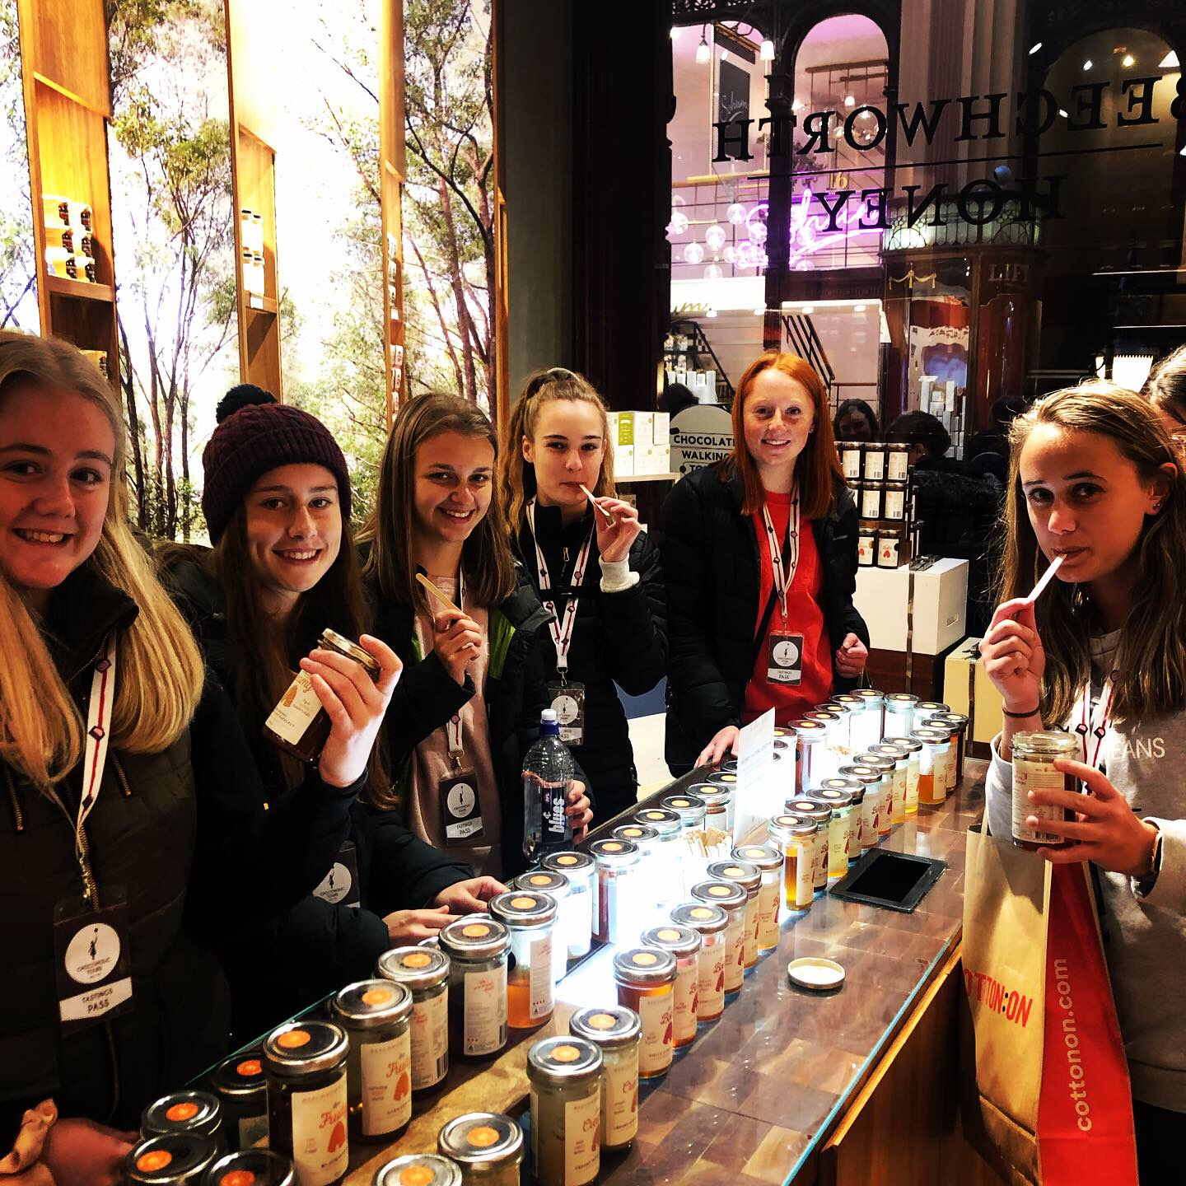
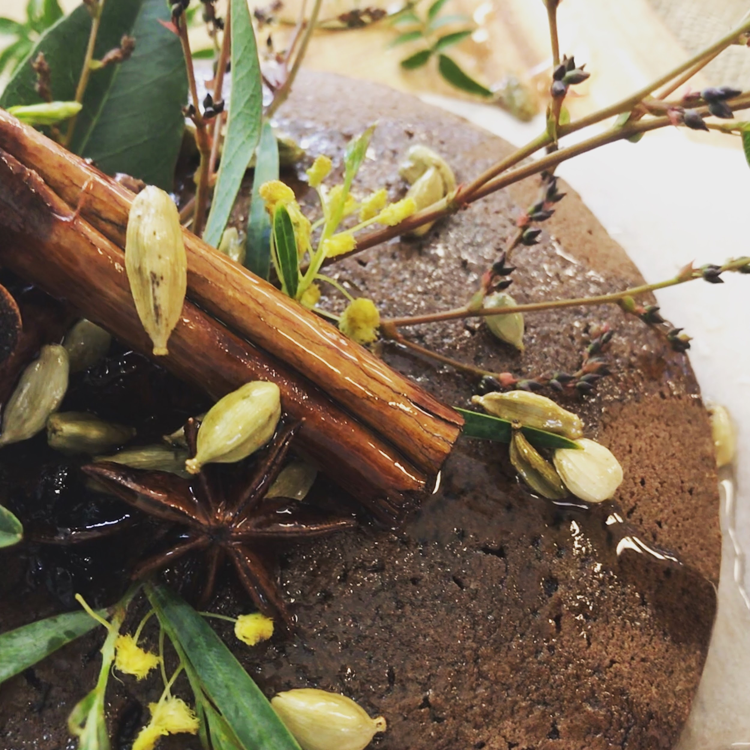
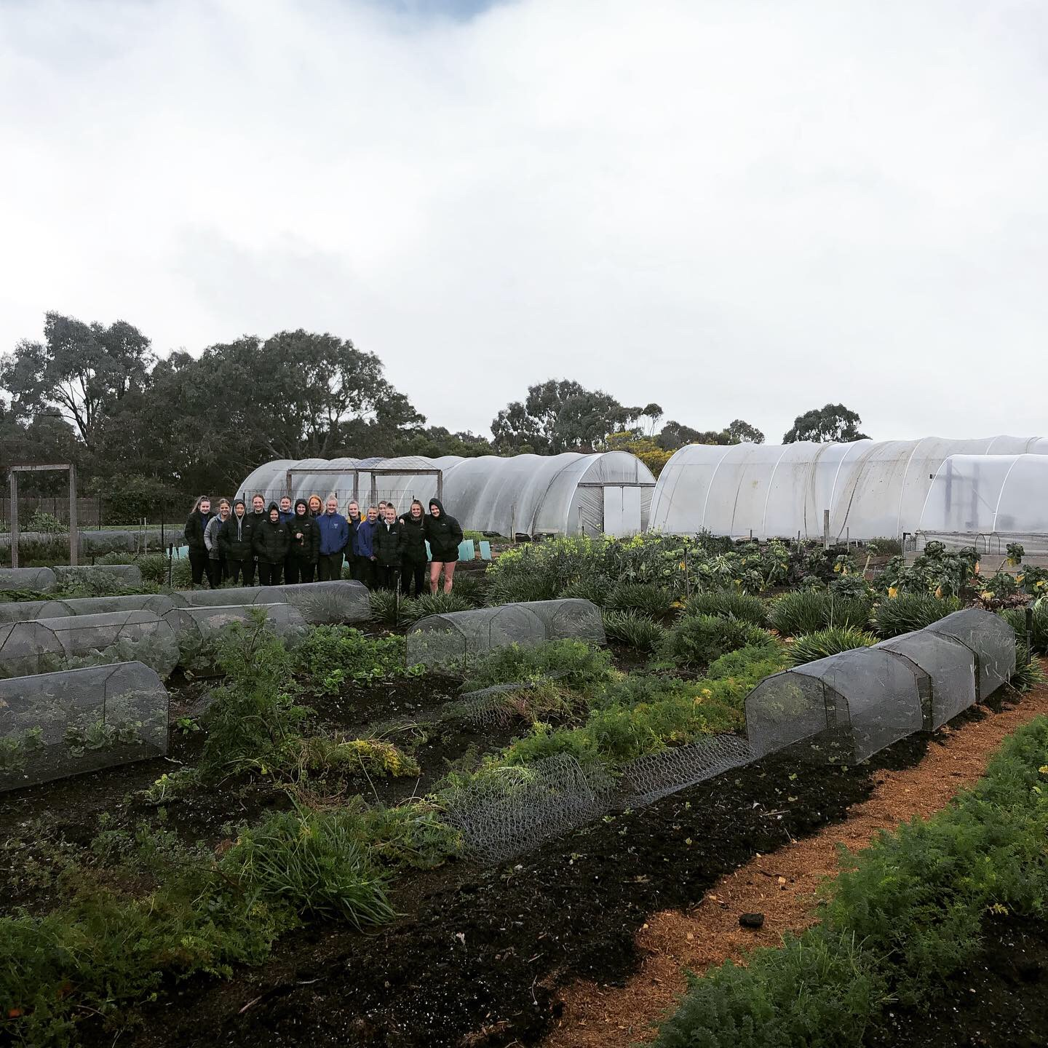
SAMPLE WORK

Slide 15

FURTHER INFORMATION
Megan Shea
Head of Technologies
sheam@mcararat.catholic.edu.au
Speak to: VCE Technology Teachers (Mrs Spalding, Mr Peatt, Mrs Shea, Mrs Venn)
Refer to: Subject handbooks
Check us out on Instagram: foodandtechatmarianararat

