Slide 1


YEAR 12 Arts Faculty
Studio Art

Slide 2
Unit 3: Exploration proposal
Outcome 1
On completion of this unit the student should be able to prepare an exploration proposal that formulates the content and parameters of an individual studio process including a plan of how the proposal will be undertaken.

Slide 3
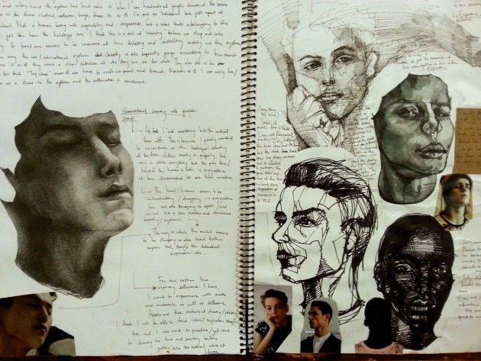
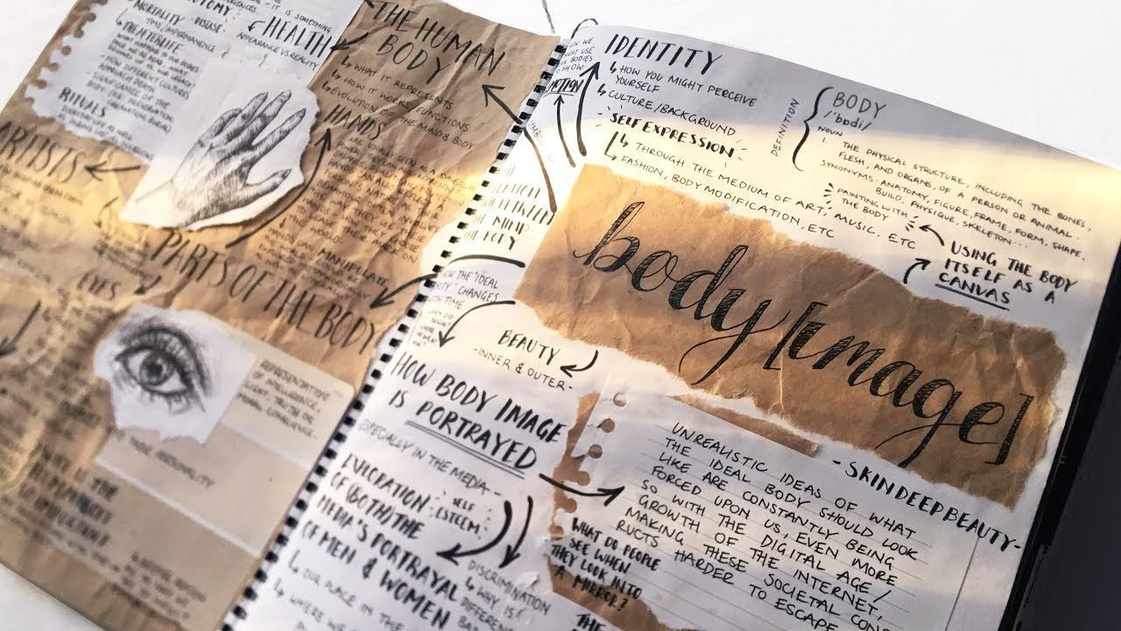
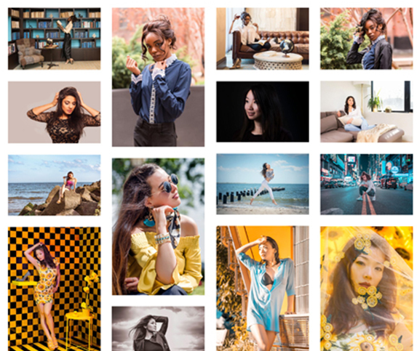
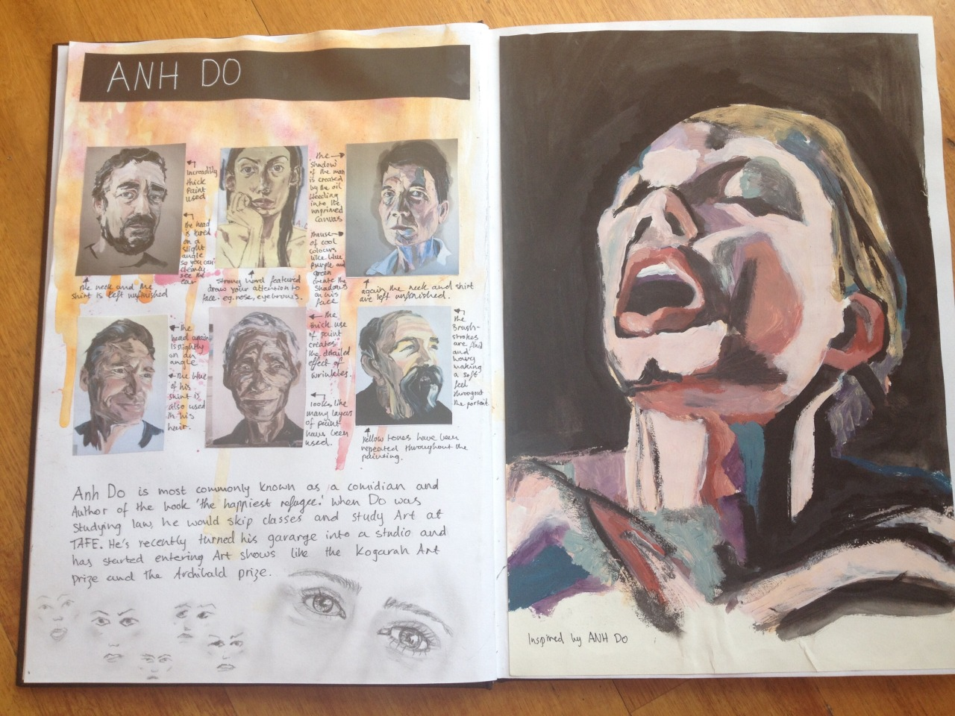
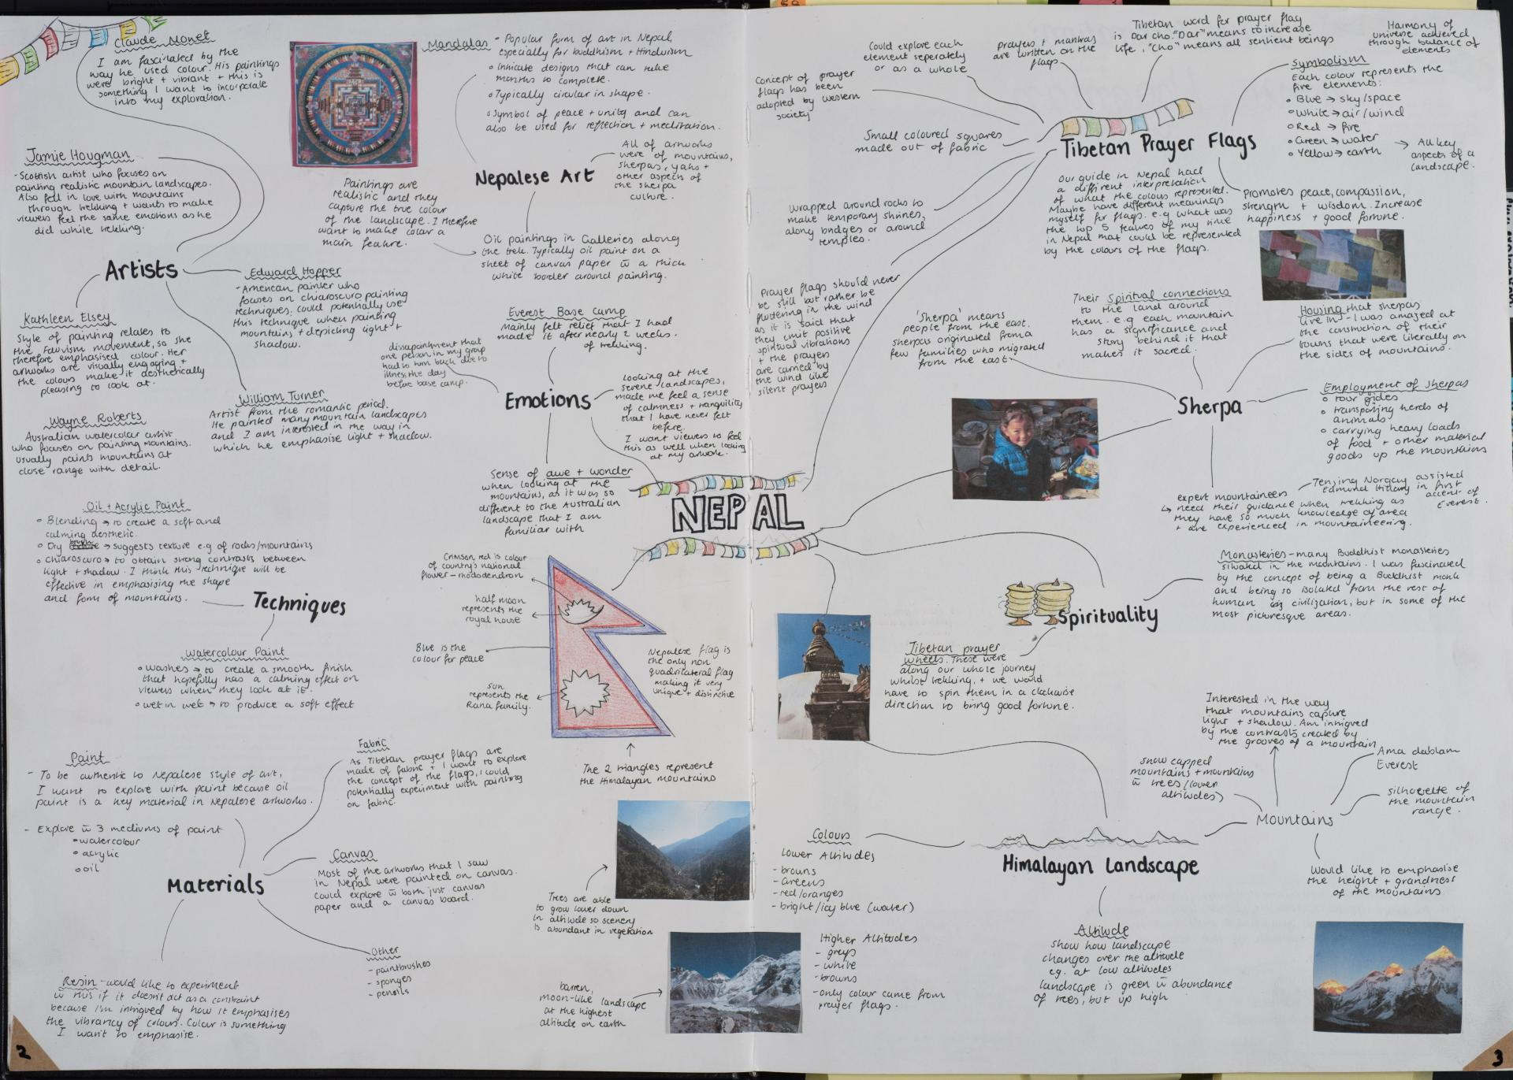
Unit 3:Folio
Outcome 2
On completion of this unit the student should be able to progressively present an individual studio process recorded in written and visual form that produces a range of potential directions, and reflects the concepts and ideas documented in the exploration proposal and work plan.

Slide 4
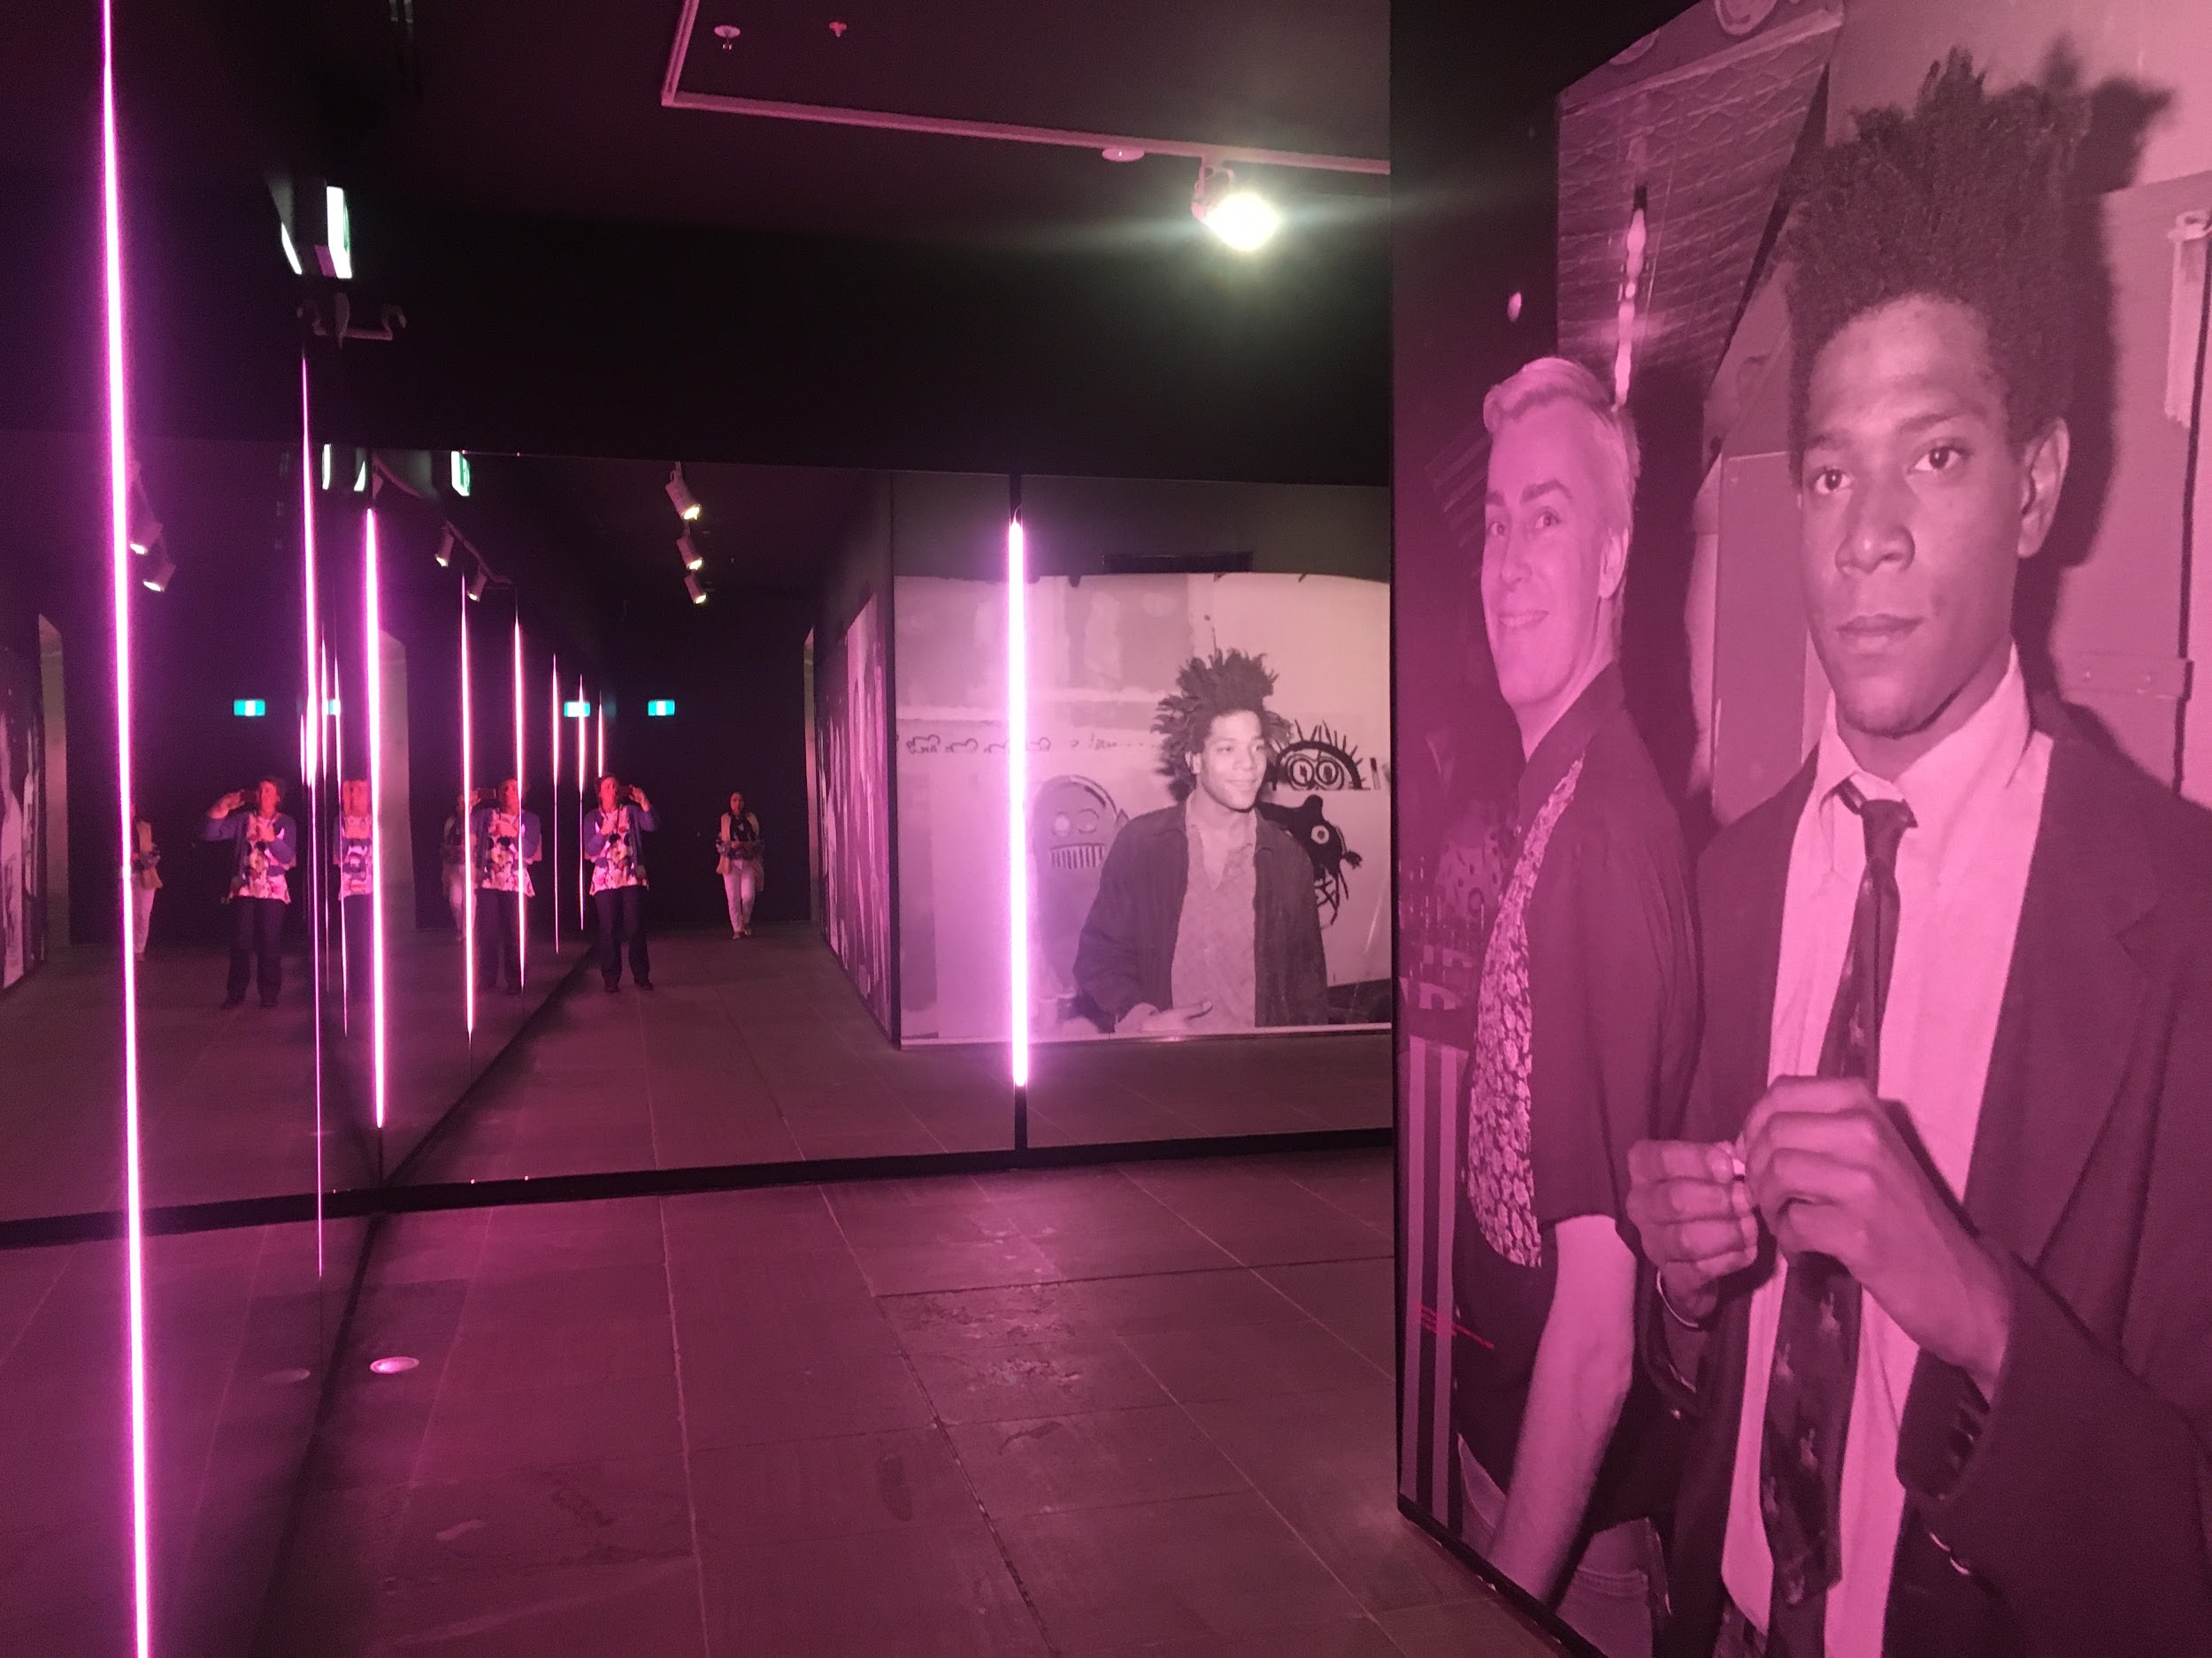
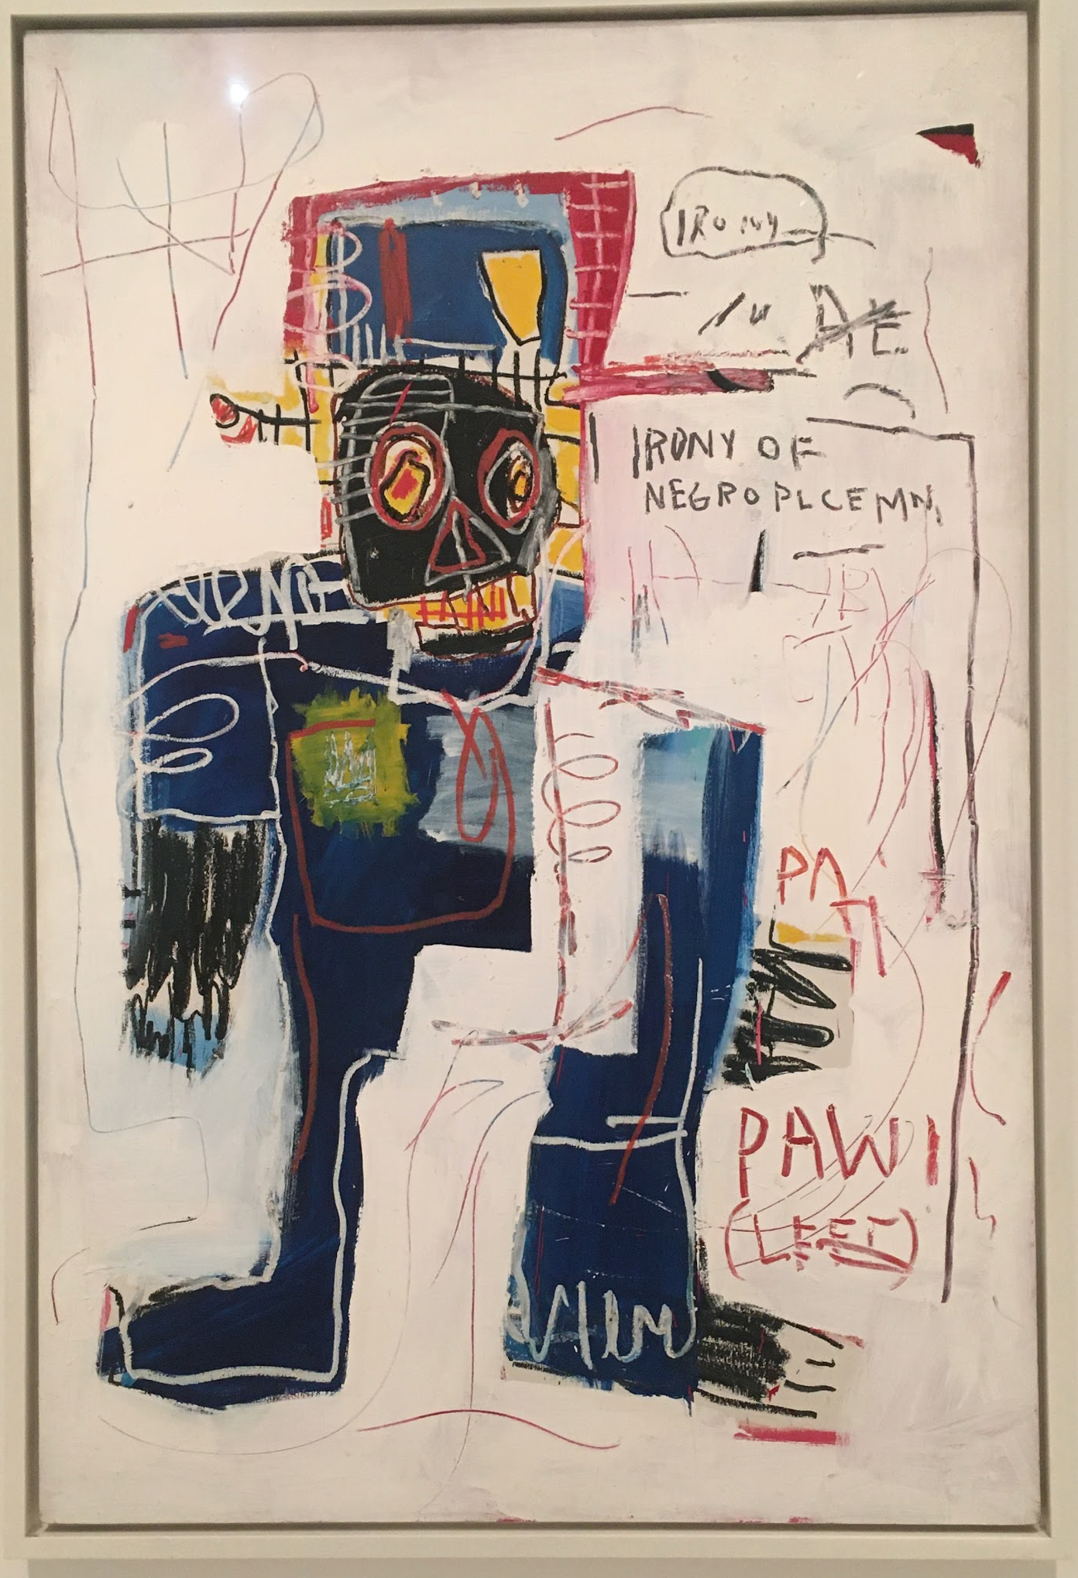
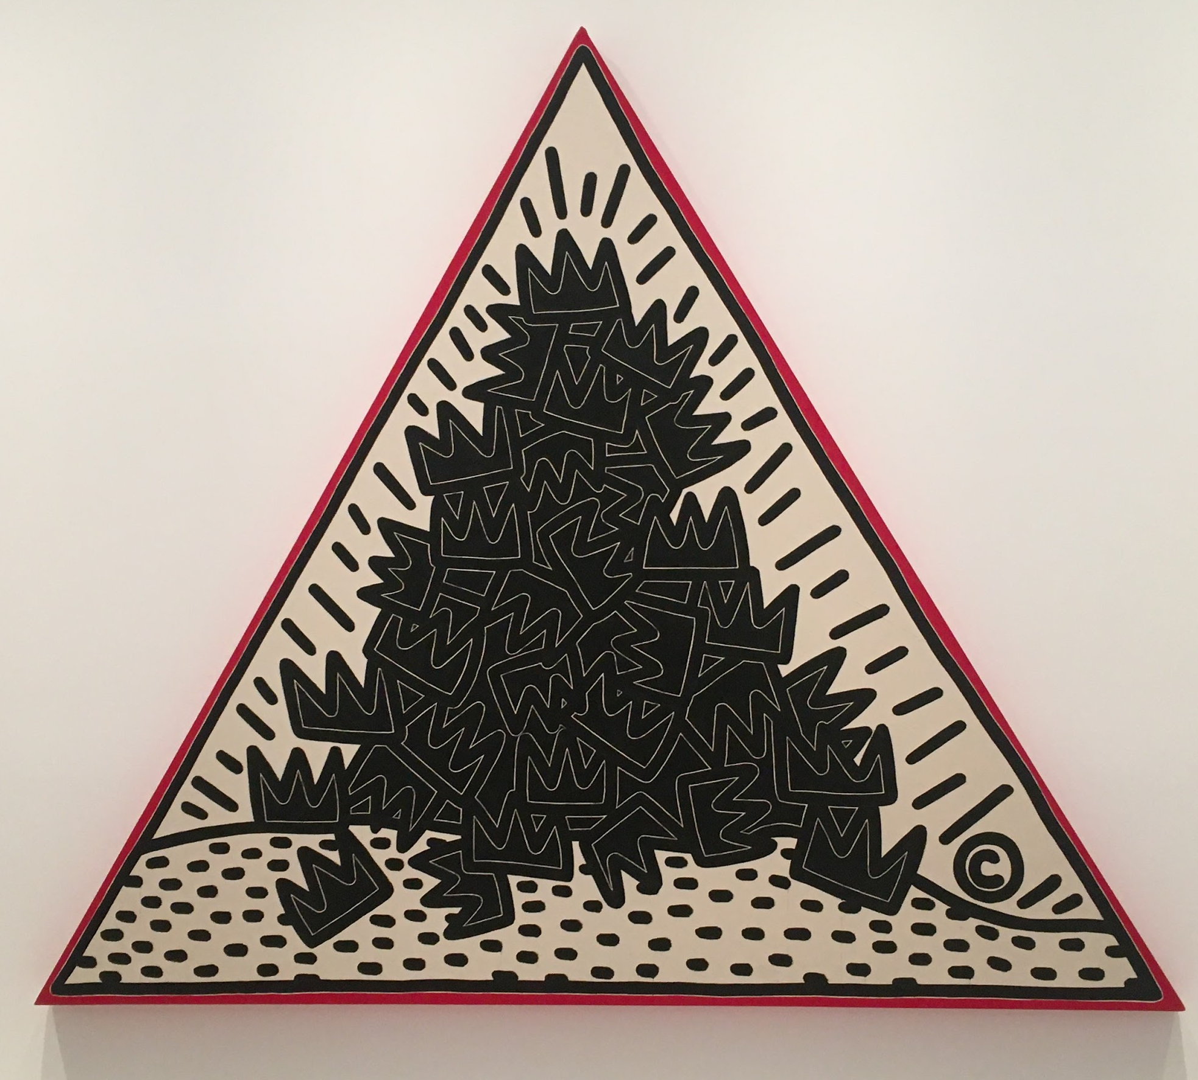
Unit 3: SAC - Two artists, two contexts.
Outcome 3: Exhibitions
On completion of this unit the student should be able to examine the practice of at least two artists, with reference to two artworks by each artist, referencing the different historical and cultural context of each artwork.

Slide 5
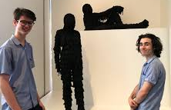
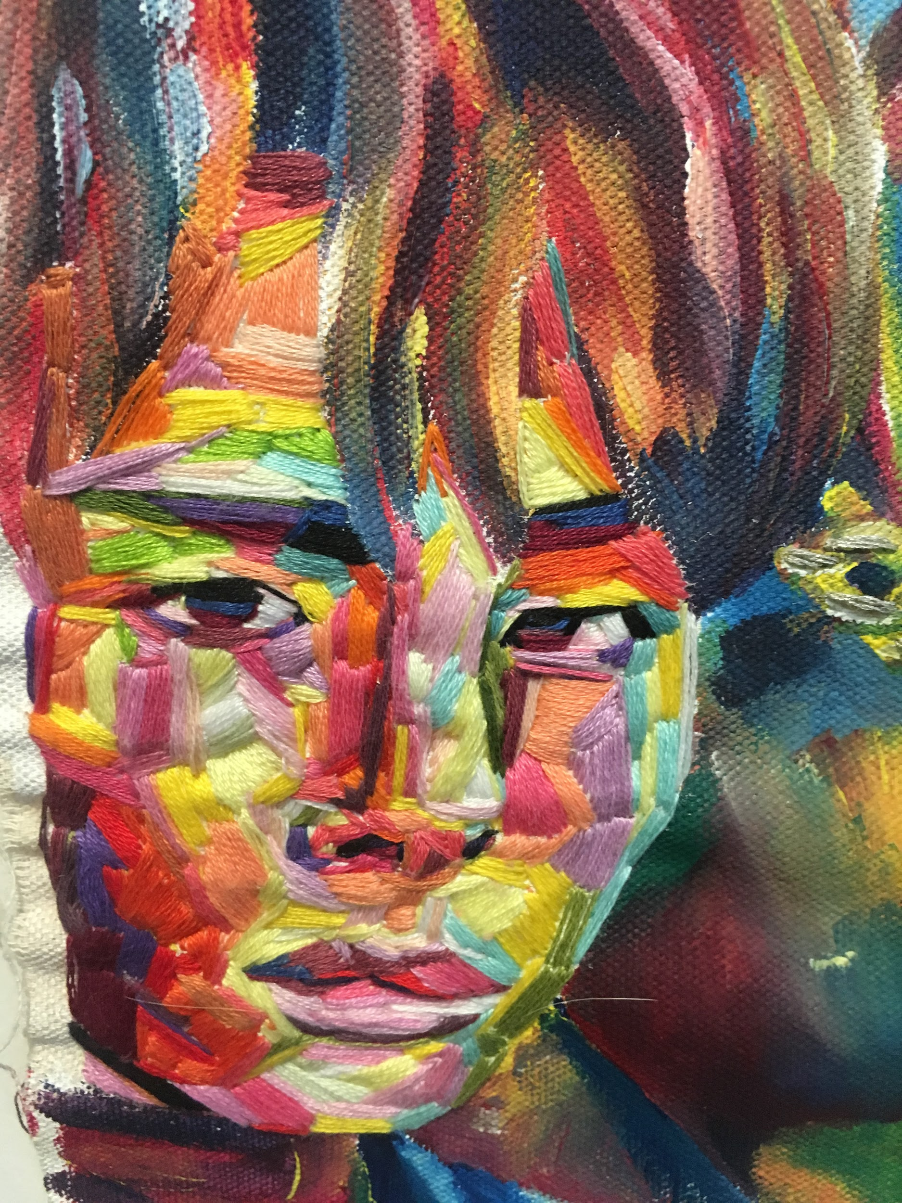
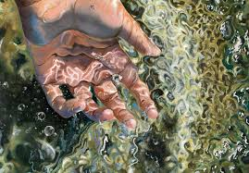
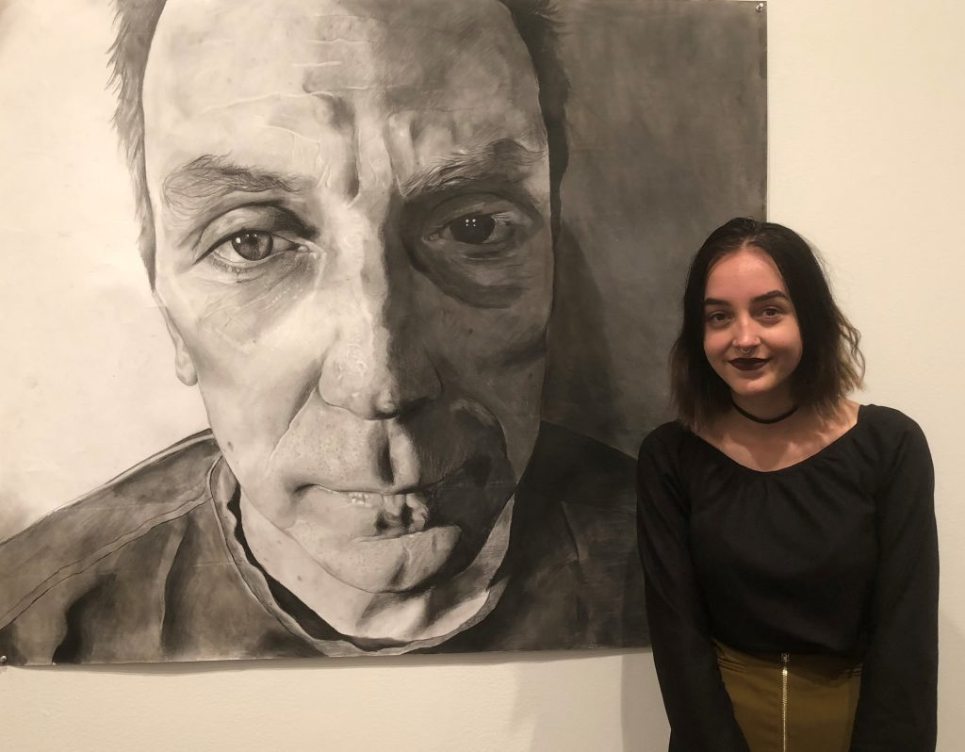
Unit 4: - Finished Artworks
Outcome 1
On completion of this unit the student should be able to present at least two finished artworks based on selected and evaluated potential directions developed through the studio process, which demonstrate refinement and application of materials and techniques, and that realise and communicate the student’s ideas expressed in the exploration proposal.

Slide 6
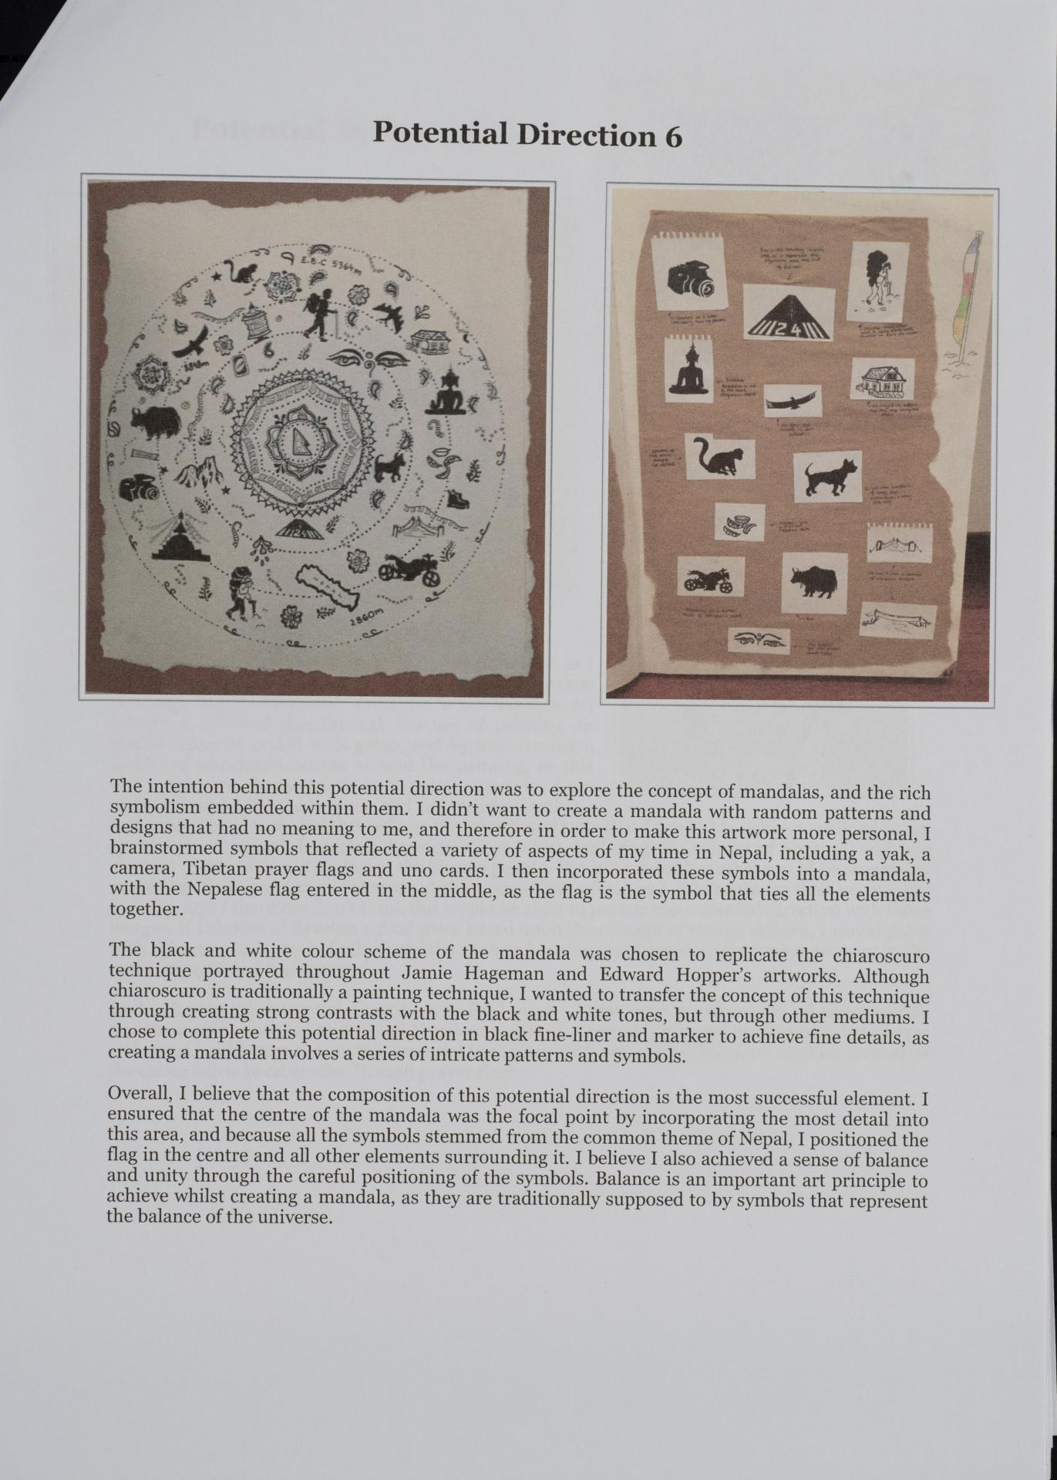
Unit 4- Evaluation
Outcome 2
On completion of this unit the student should be able to provide visual and written documentation that identifies and evaluates the extent to which the artworks reflect the selected potential directions, and effectively demonstrates a cohesive relationship between the works.

Slide 7
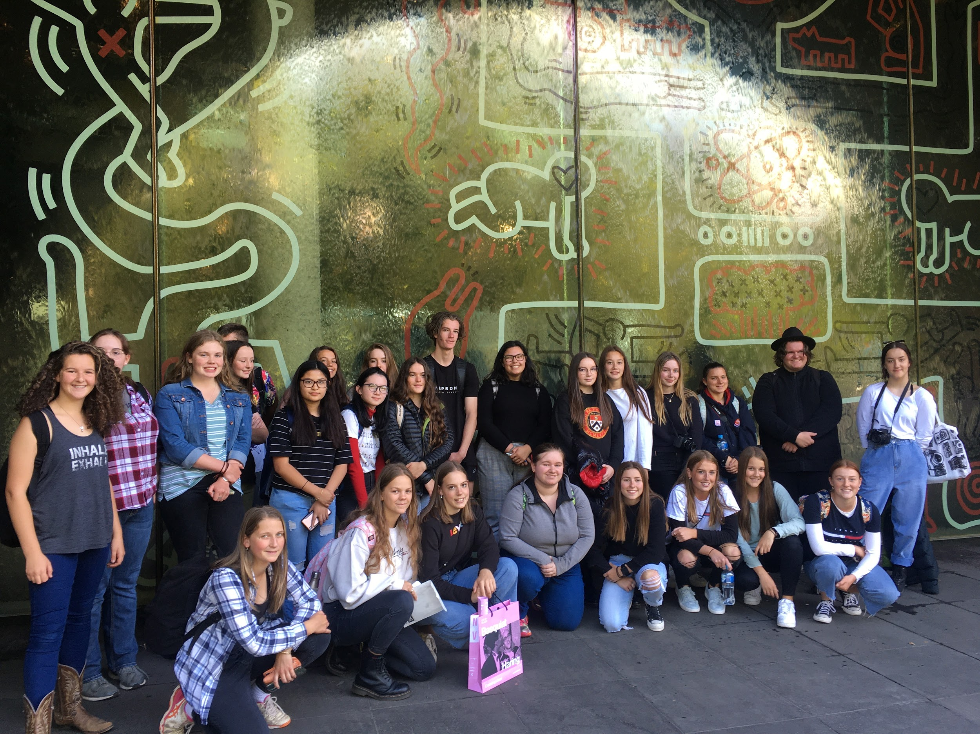
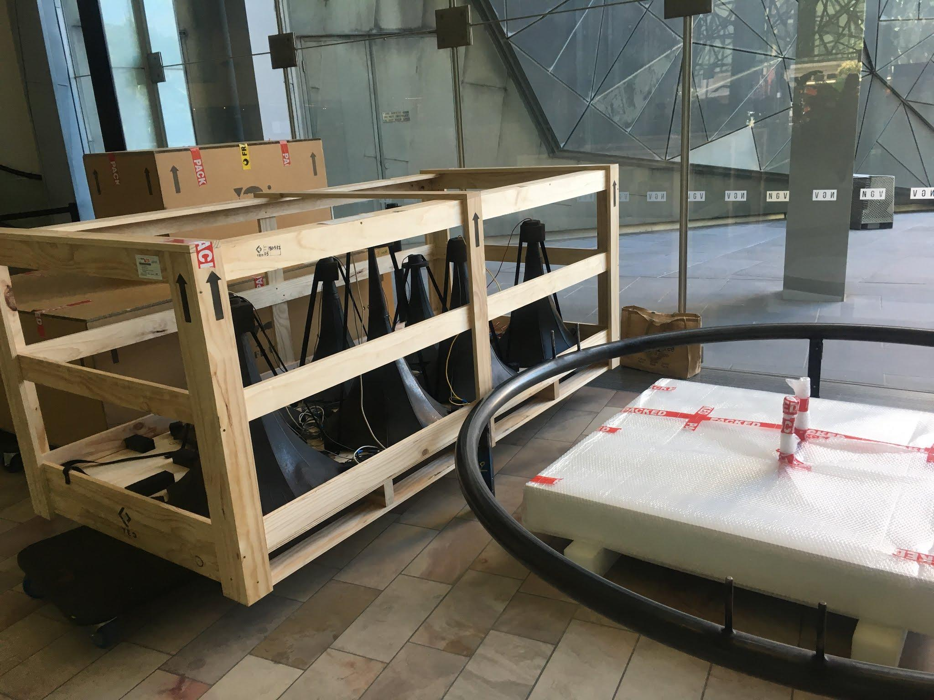
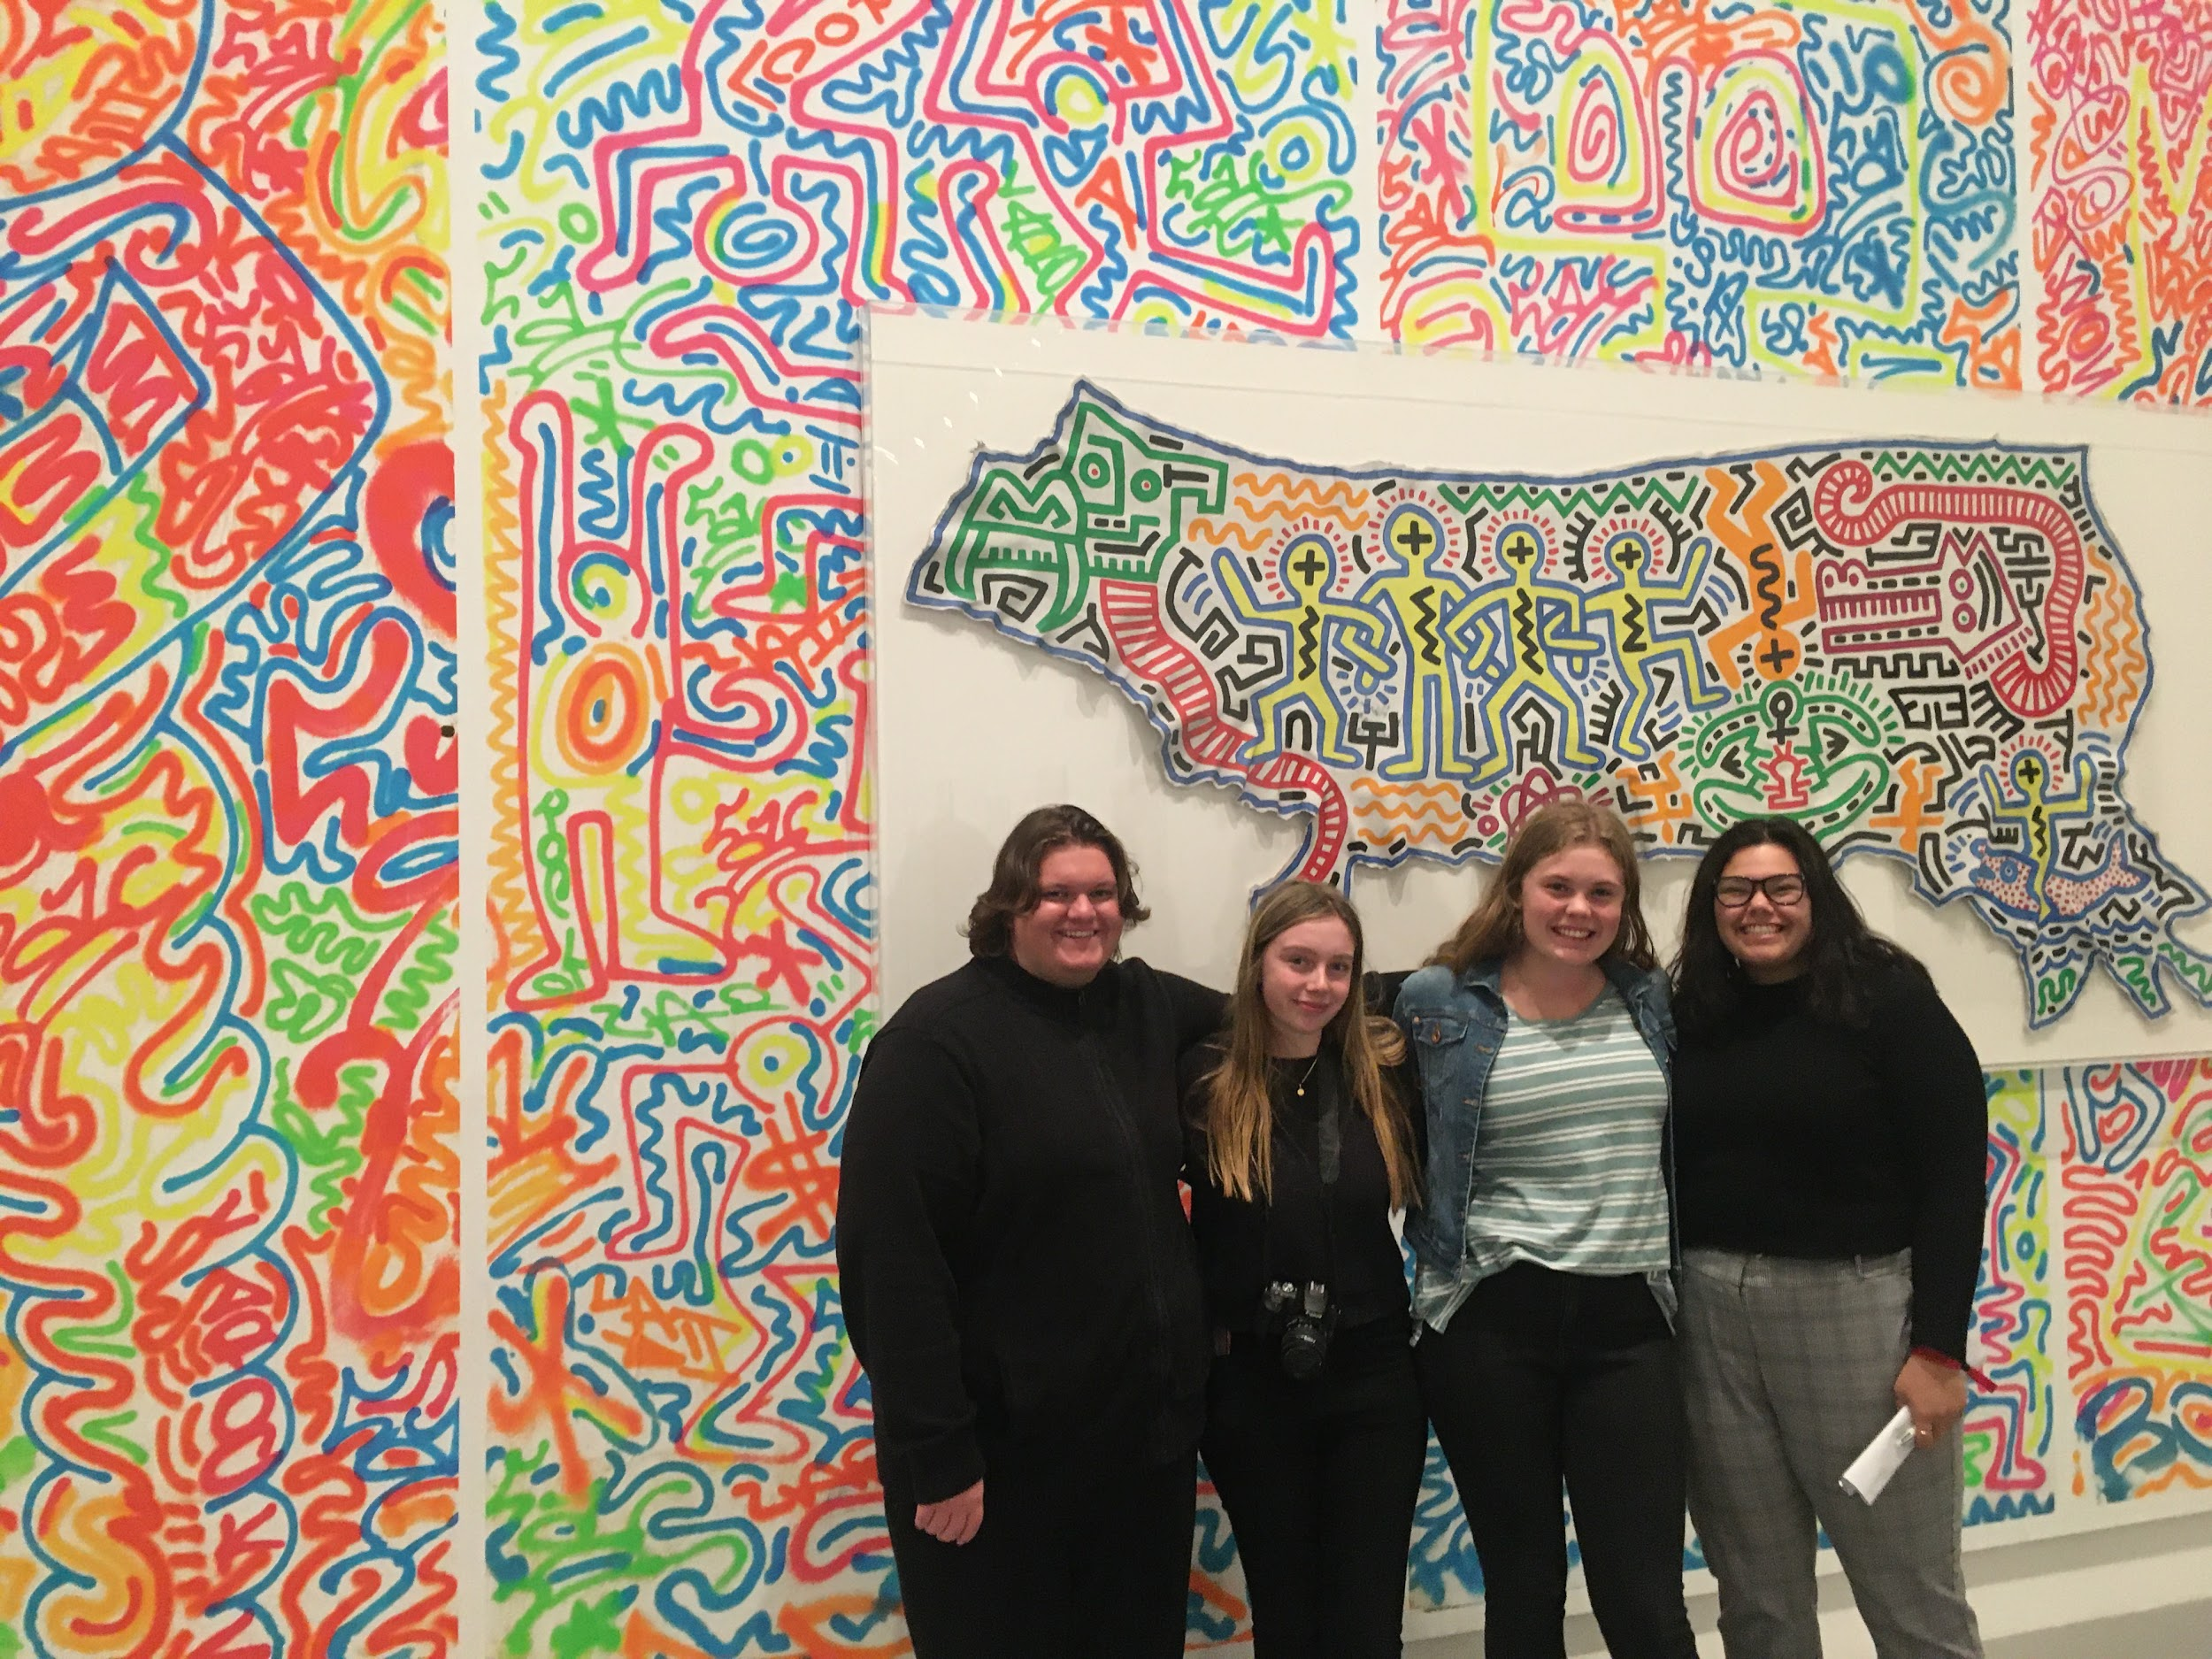
Unit 4 SAC - Two gallery visits
Outcome 3
On completion of this unit the student should be able to compare the methods used by artists and considerations of curators in the preparation, presentation, conservation and promotion of specific artworks in at least two different exhibitions.

Slide 8
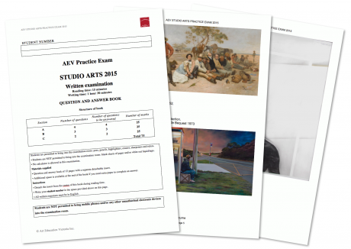
Unit 4 - Exam

Slide 9
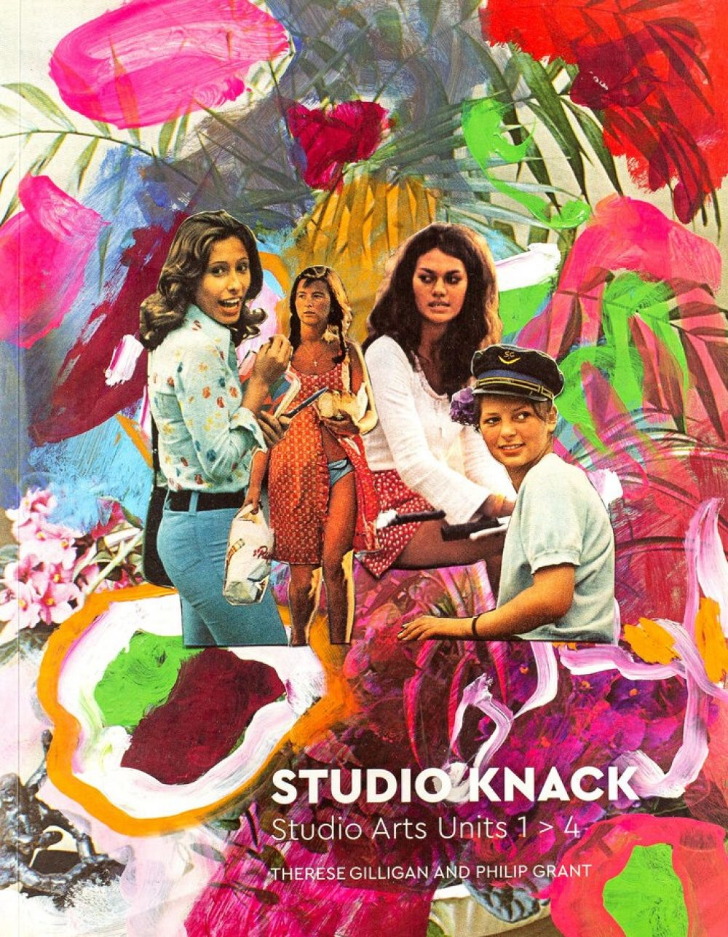
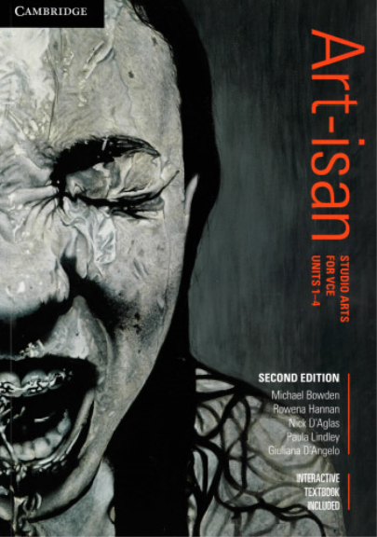
Assessment
SAT - 60%
Exam - 30%
Unit 3 SAC #1 - 5%
Unit 4 SAC#2 - 5%

Slide 10
Year 12 Studio Art
More information?
Barb Venn
Head of Arts
bvenn@mcararat.catholic.edu.au
Arts Faculty teachers.
Subject handbooks on Marian College Website

