Slide 1


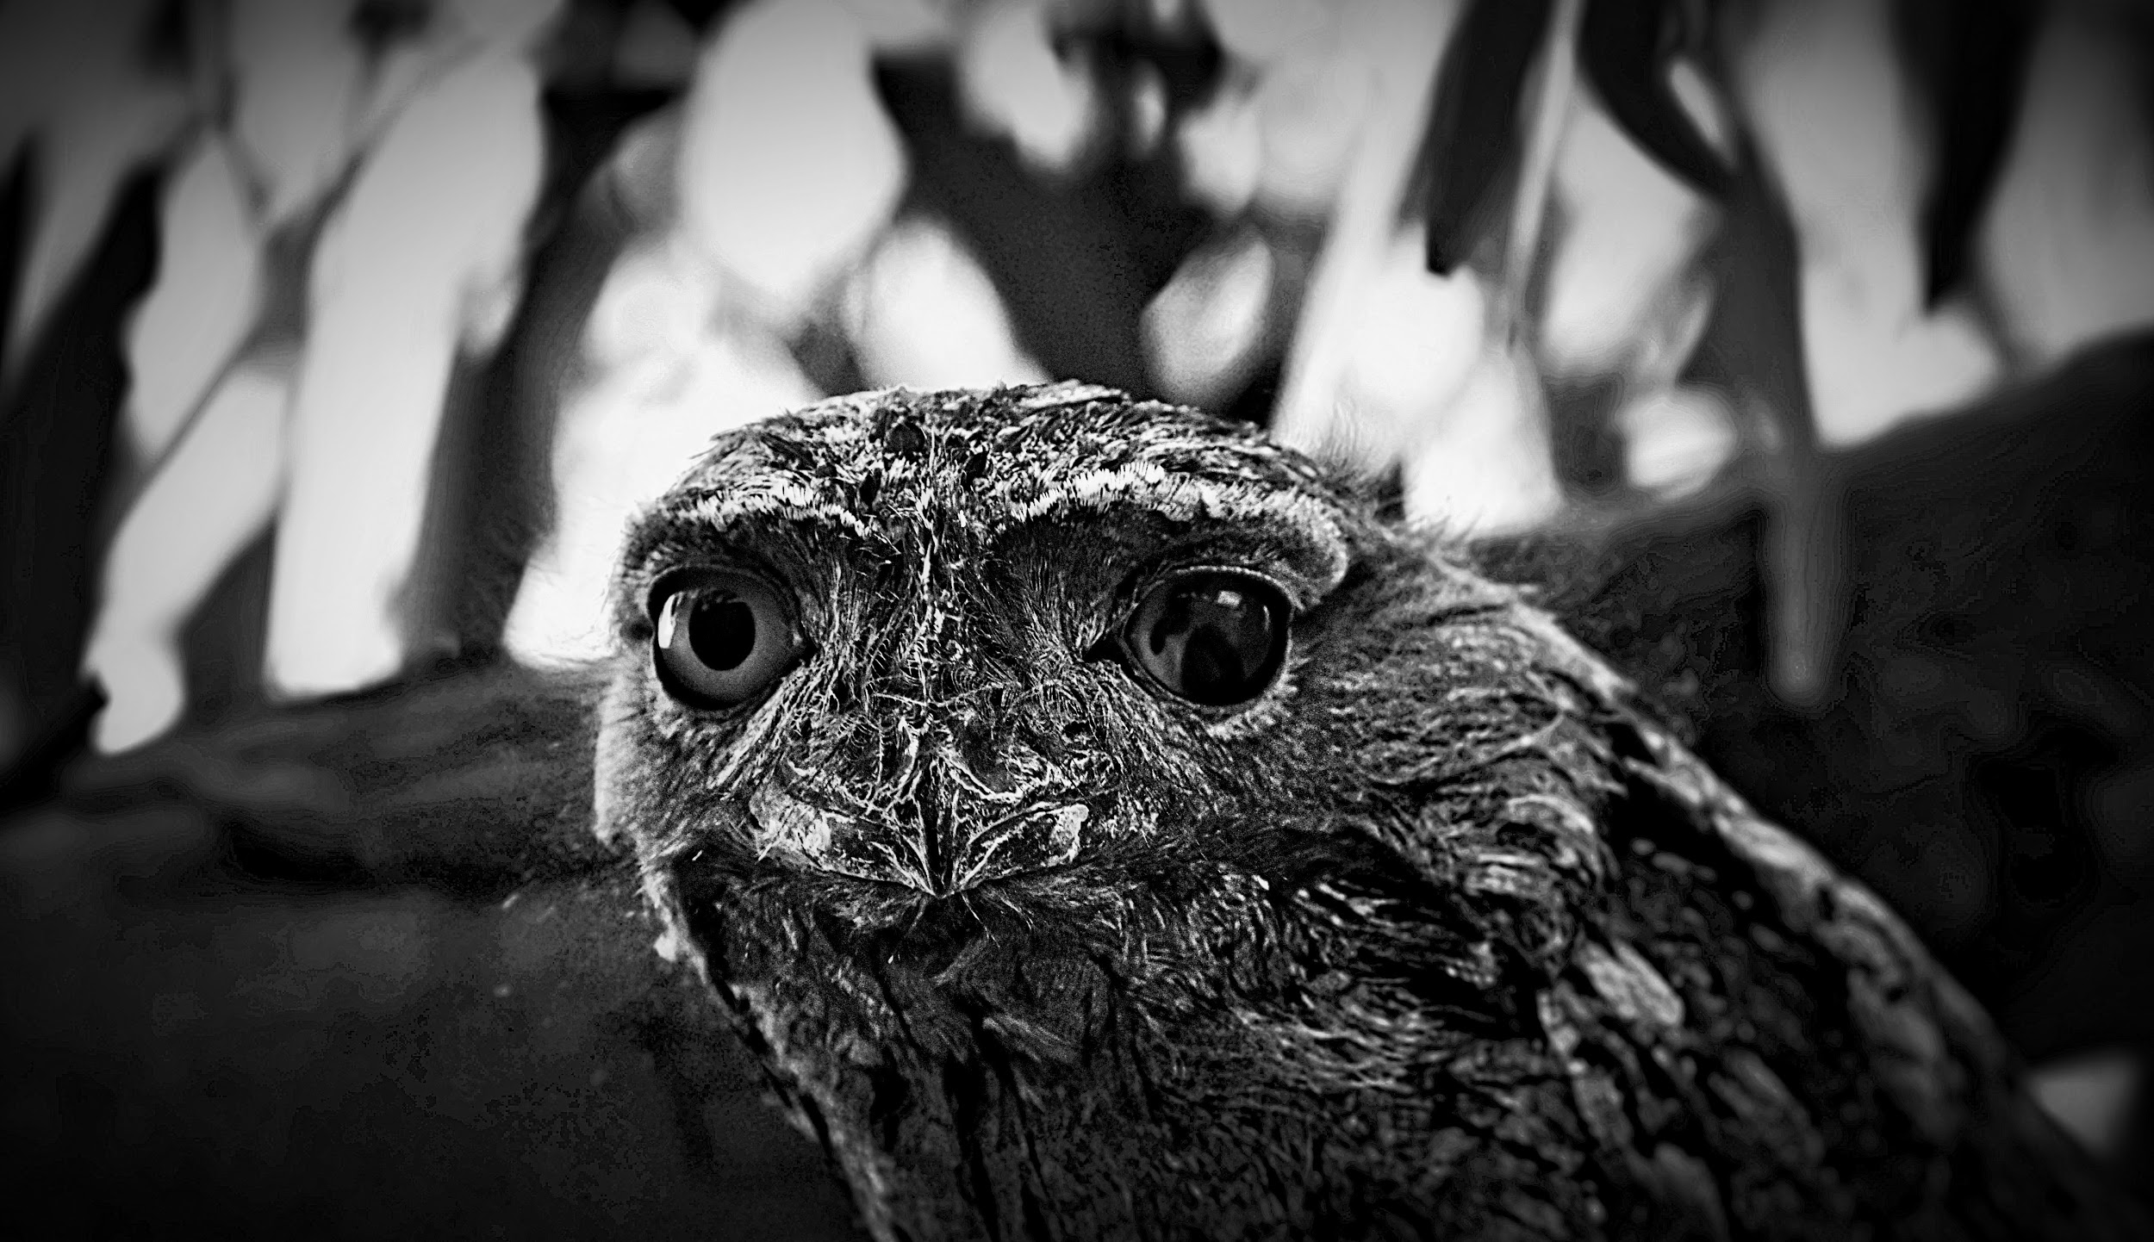
YEAR 11 Arts Faculty
Studio Art

Slide 2
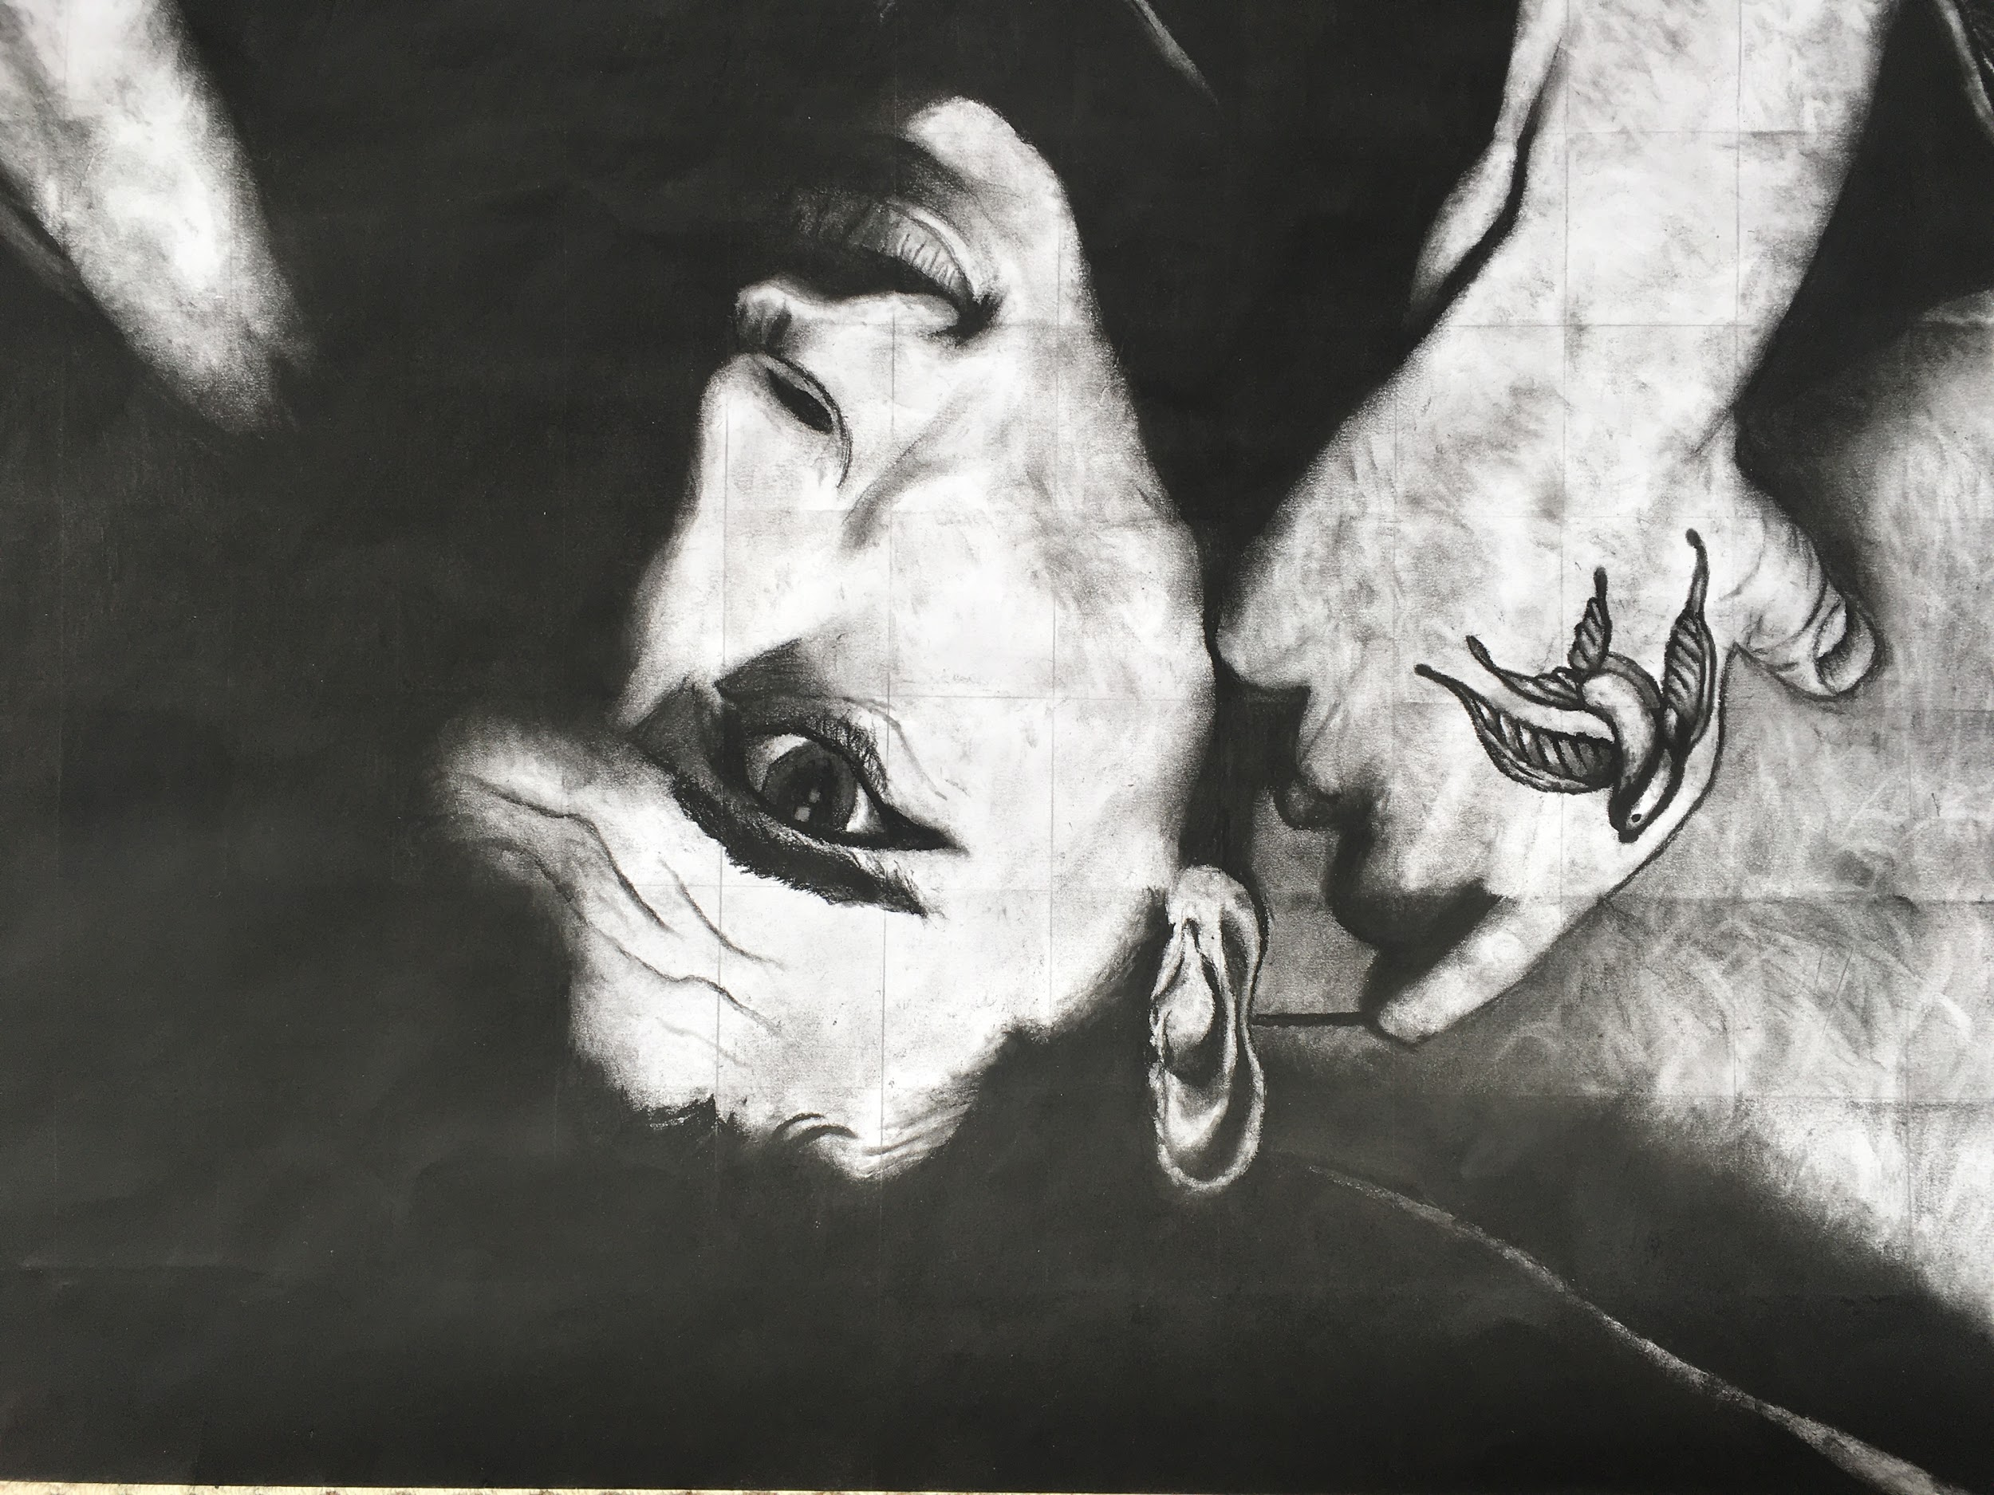
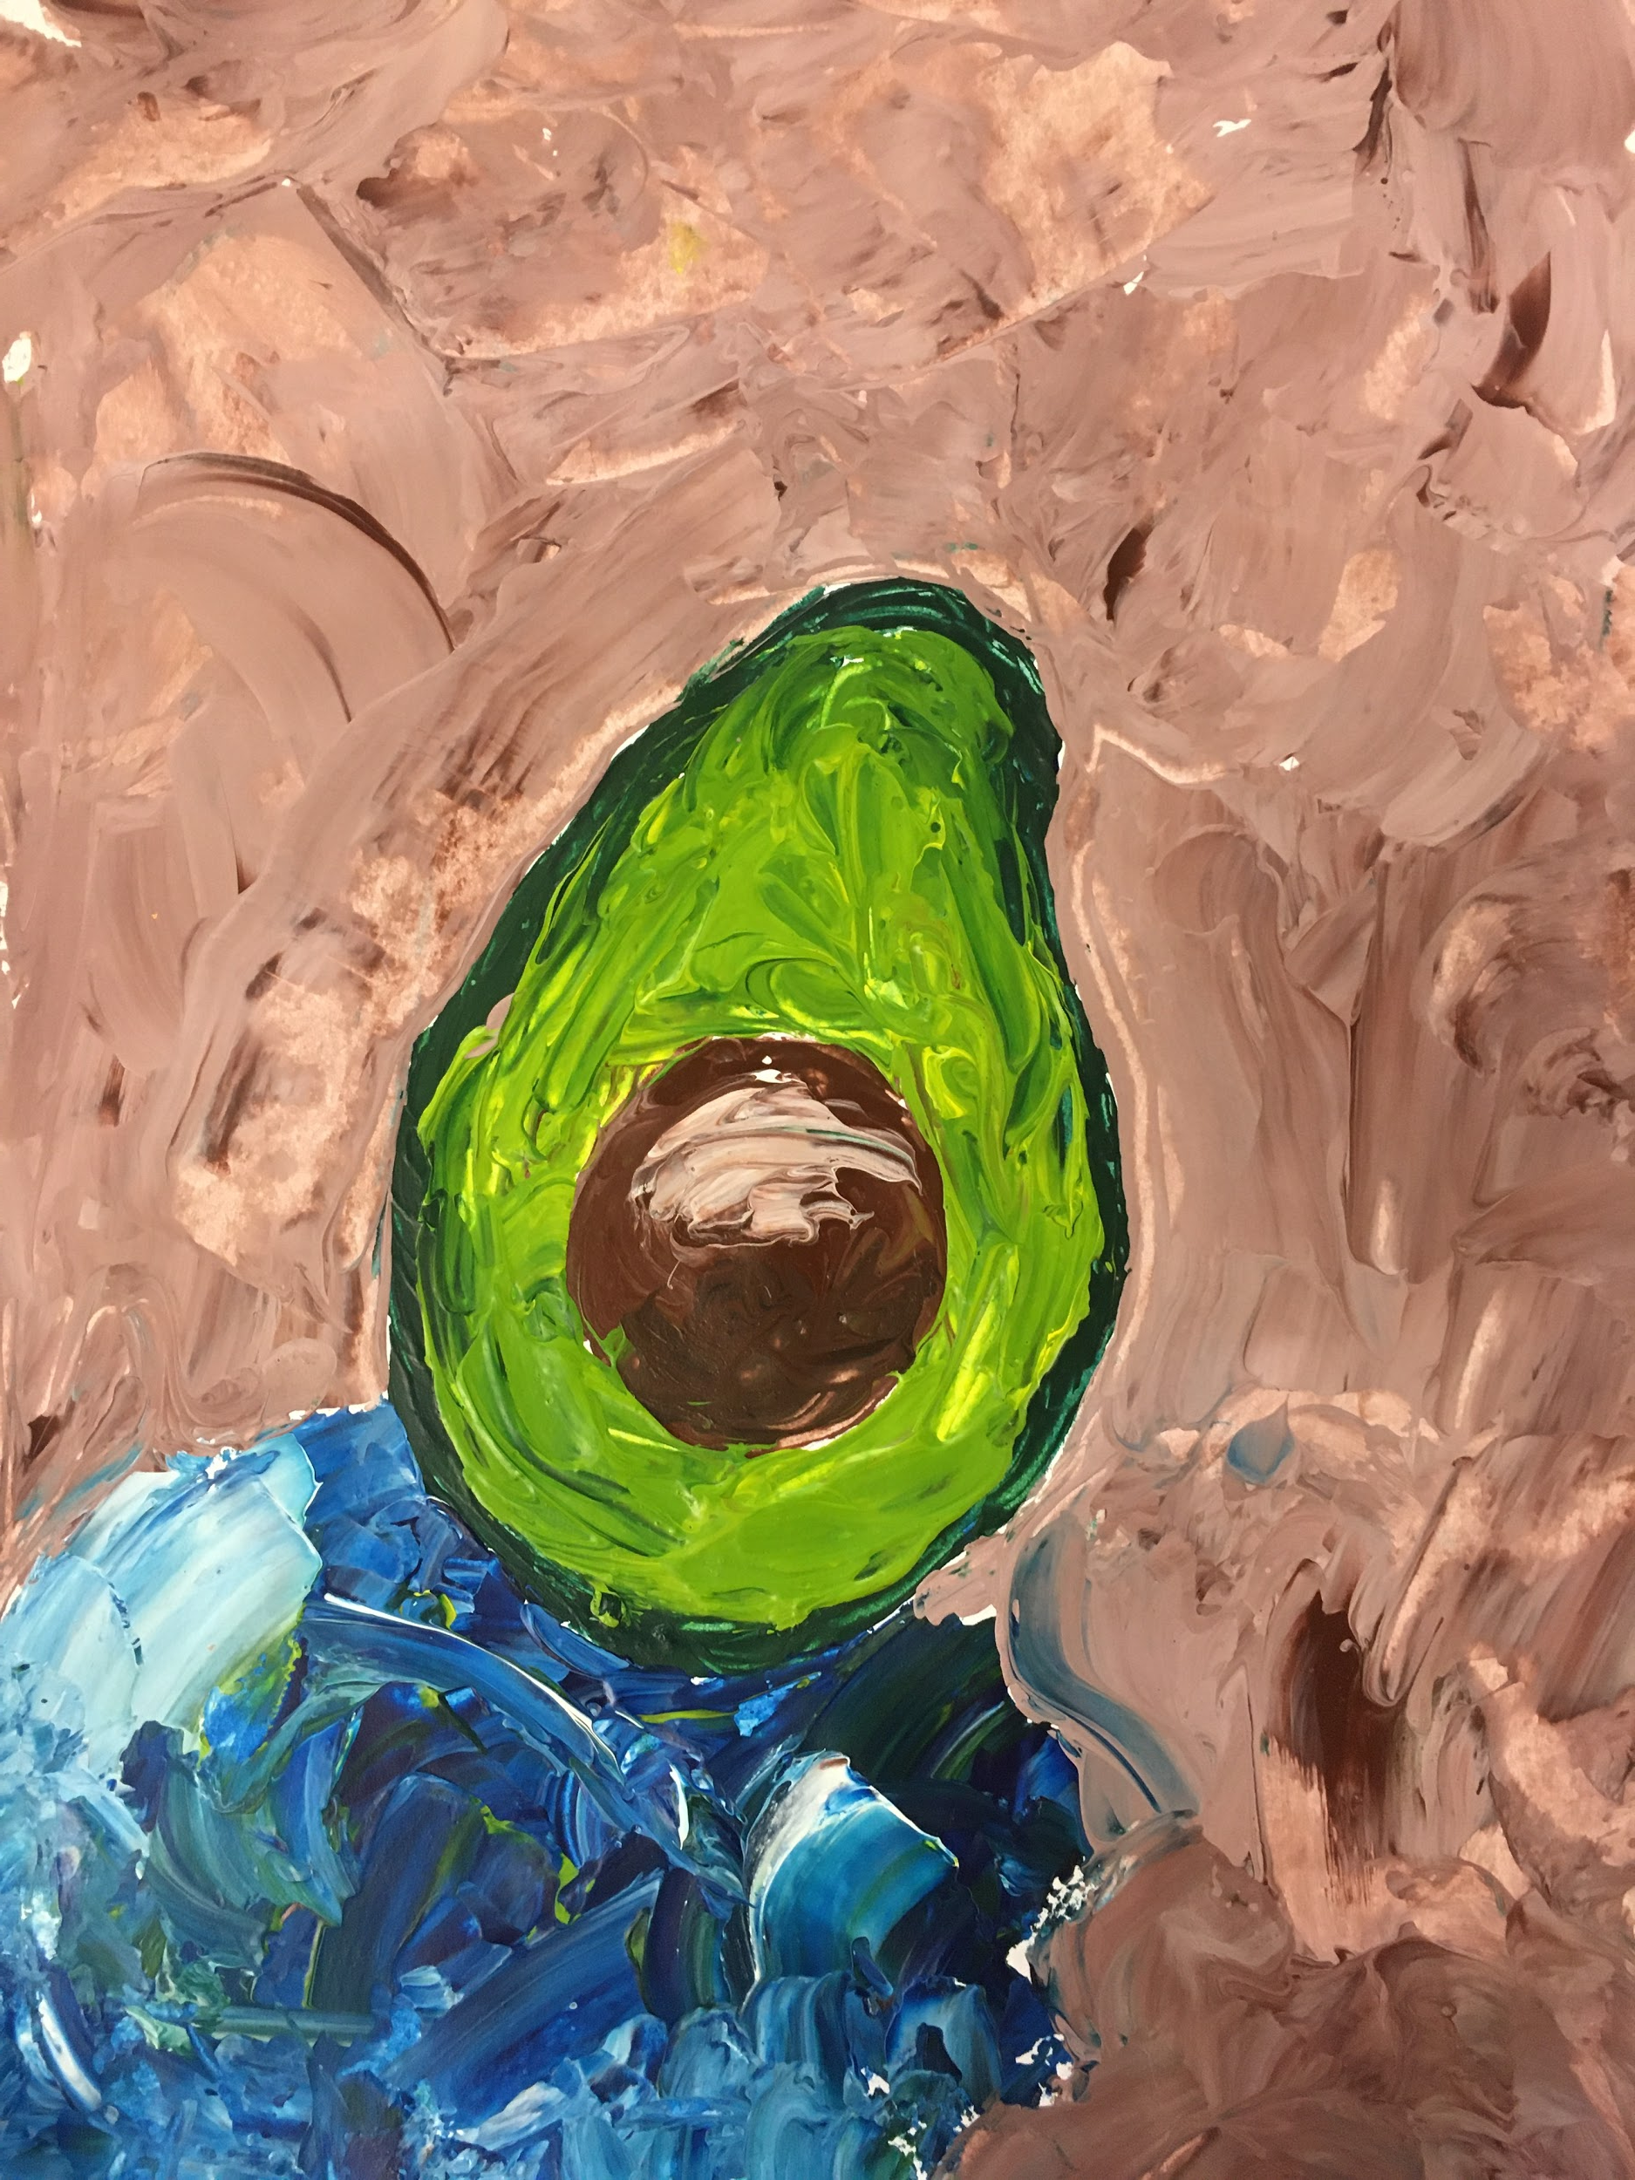
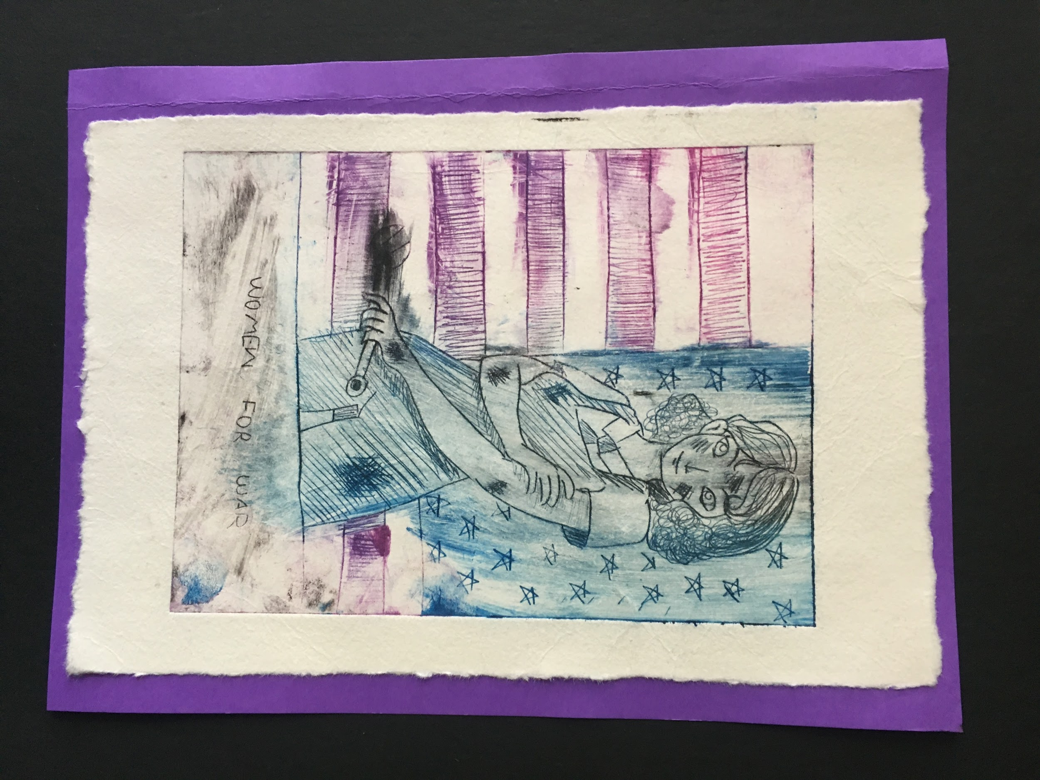
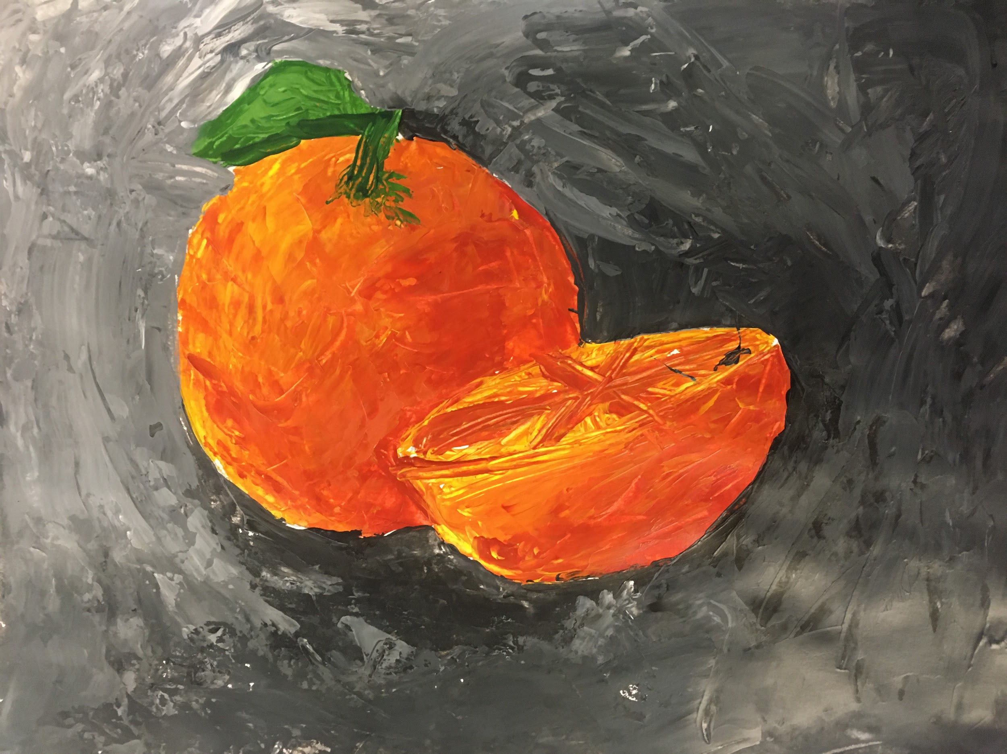
Unit 1: Studio inspiration and techniques
Outcome 1 : FOLIO
On completion of this unit the student should be able to identify sources of inspiration and artistic influences and outline individual ideas, art forms and aesthetic qualities, and translate these into visual language.

Slide 3
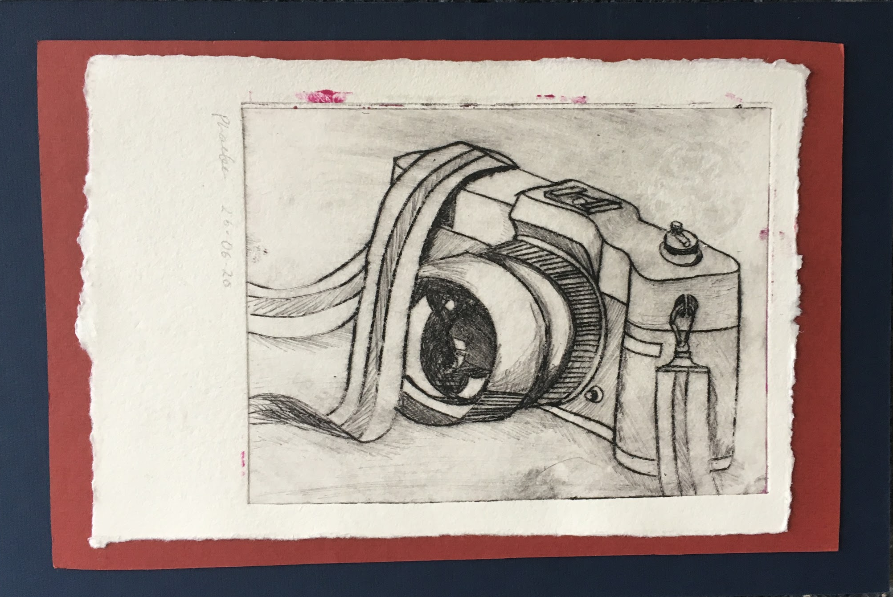
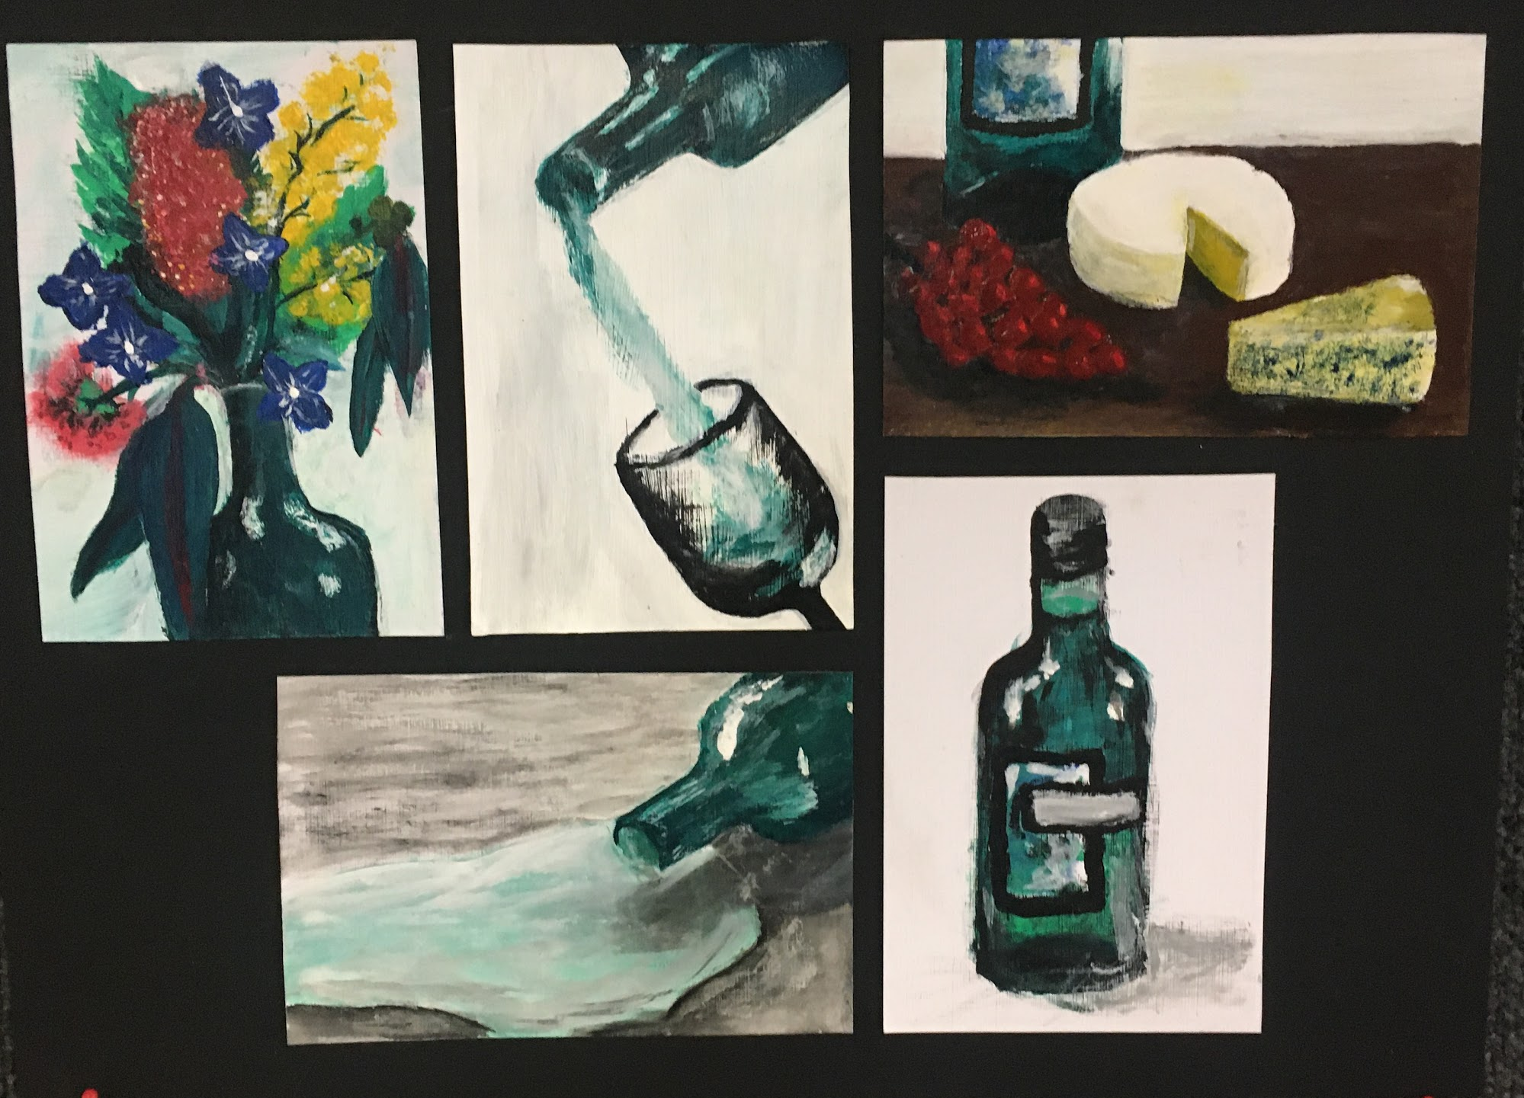
Unit 1: Studio inspiration and techniques
Outcome 2 : Final Artworks
On completion of this unit the student should be able to produce at least one finished artwork and progressively record the development of their studio practice, conveying individual ideas through the exploration of materials and techniques in the selected art form/s.

Slide 4
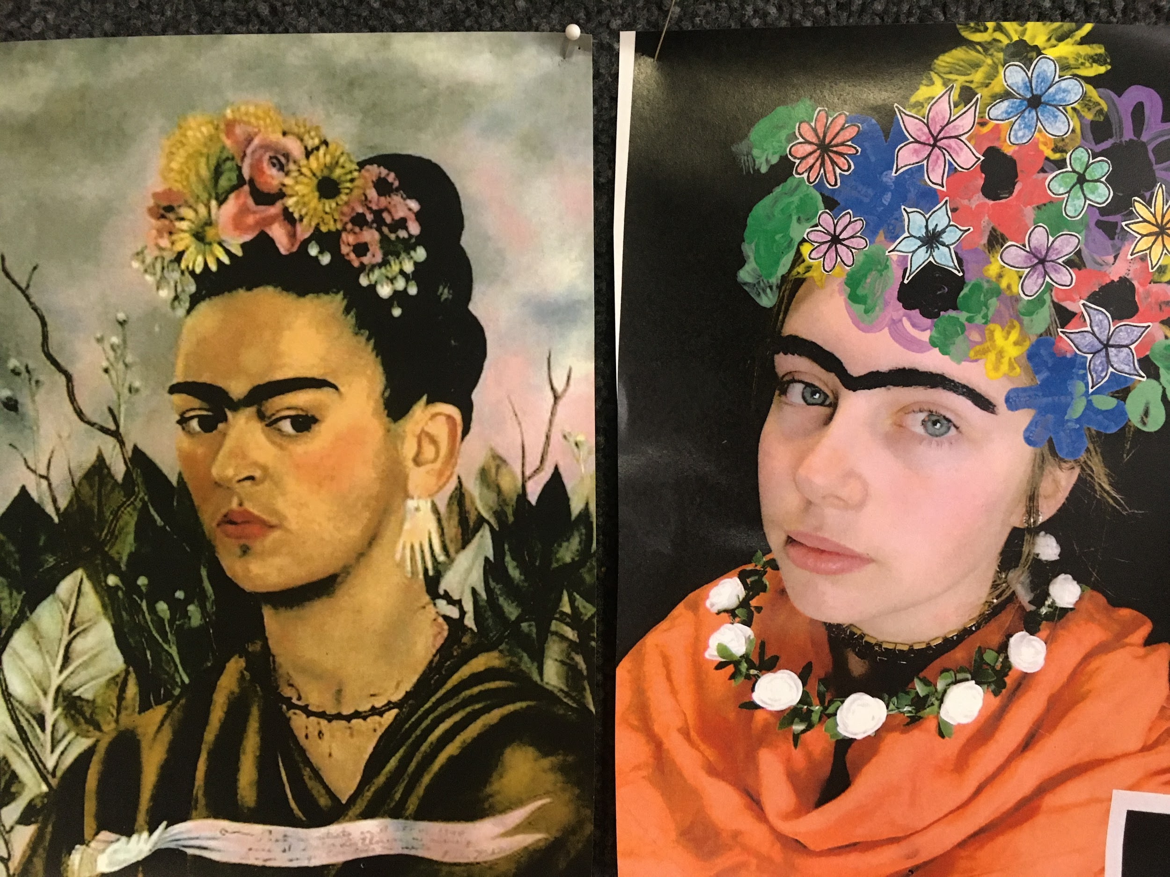
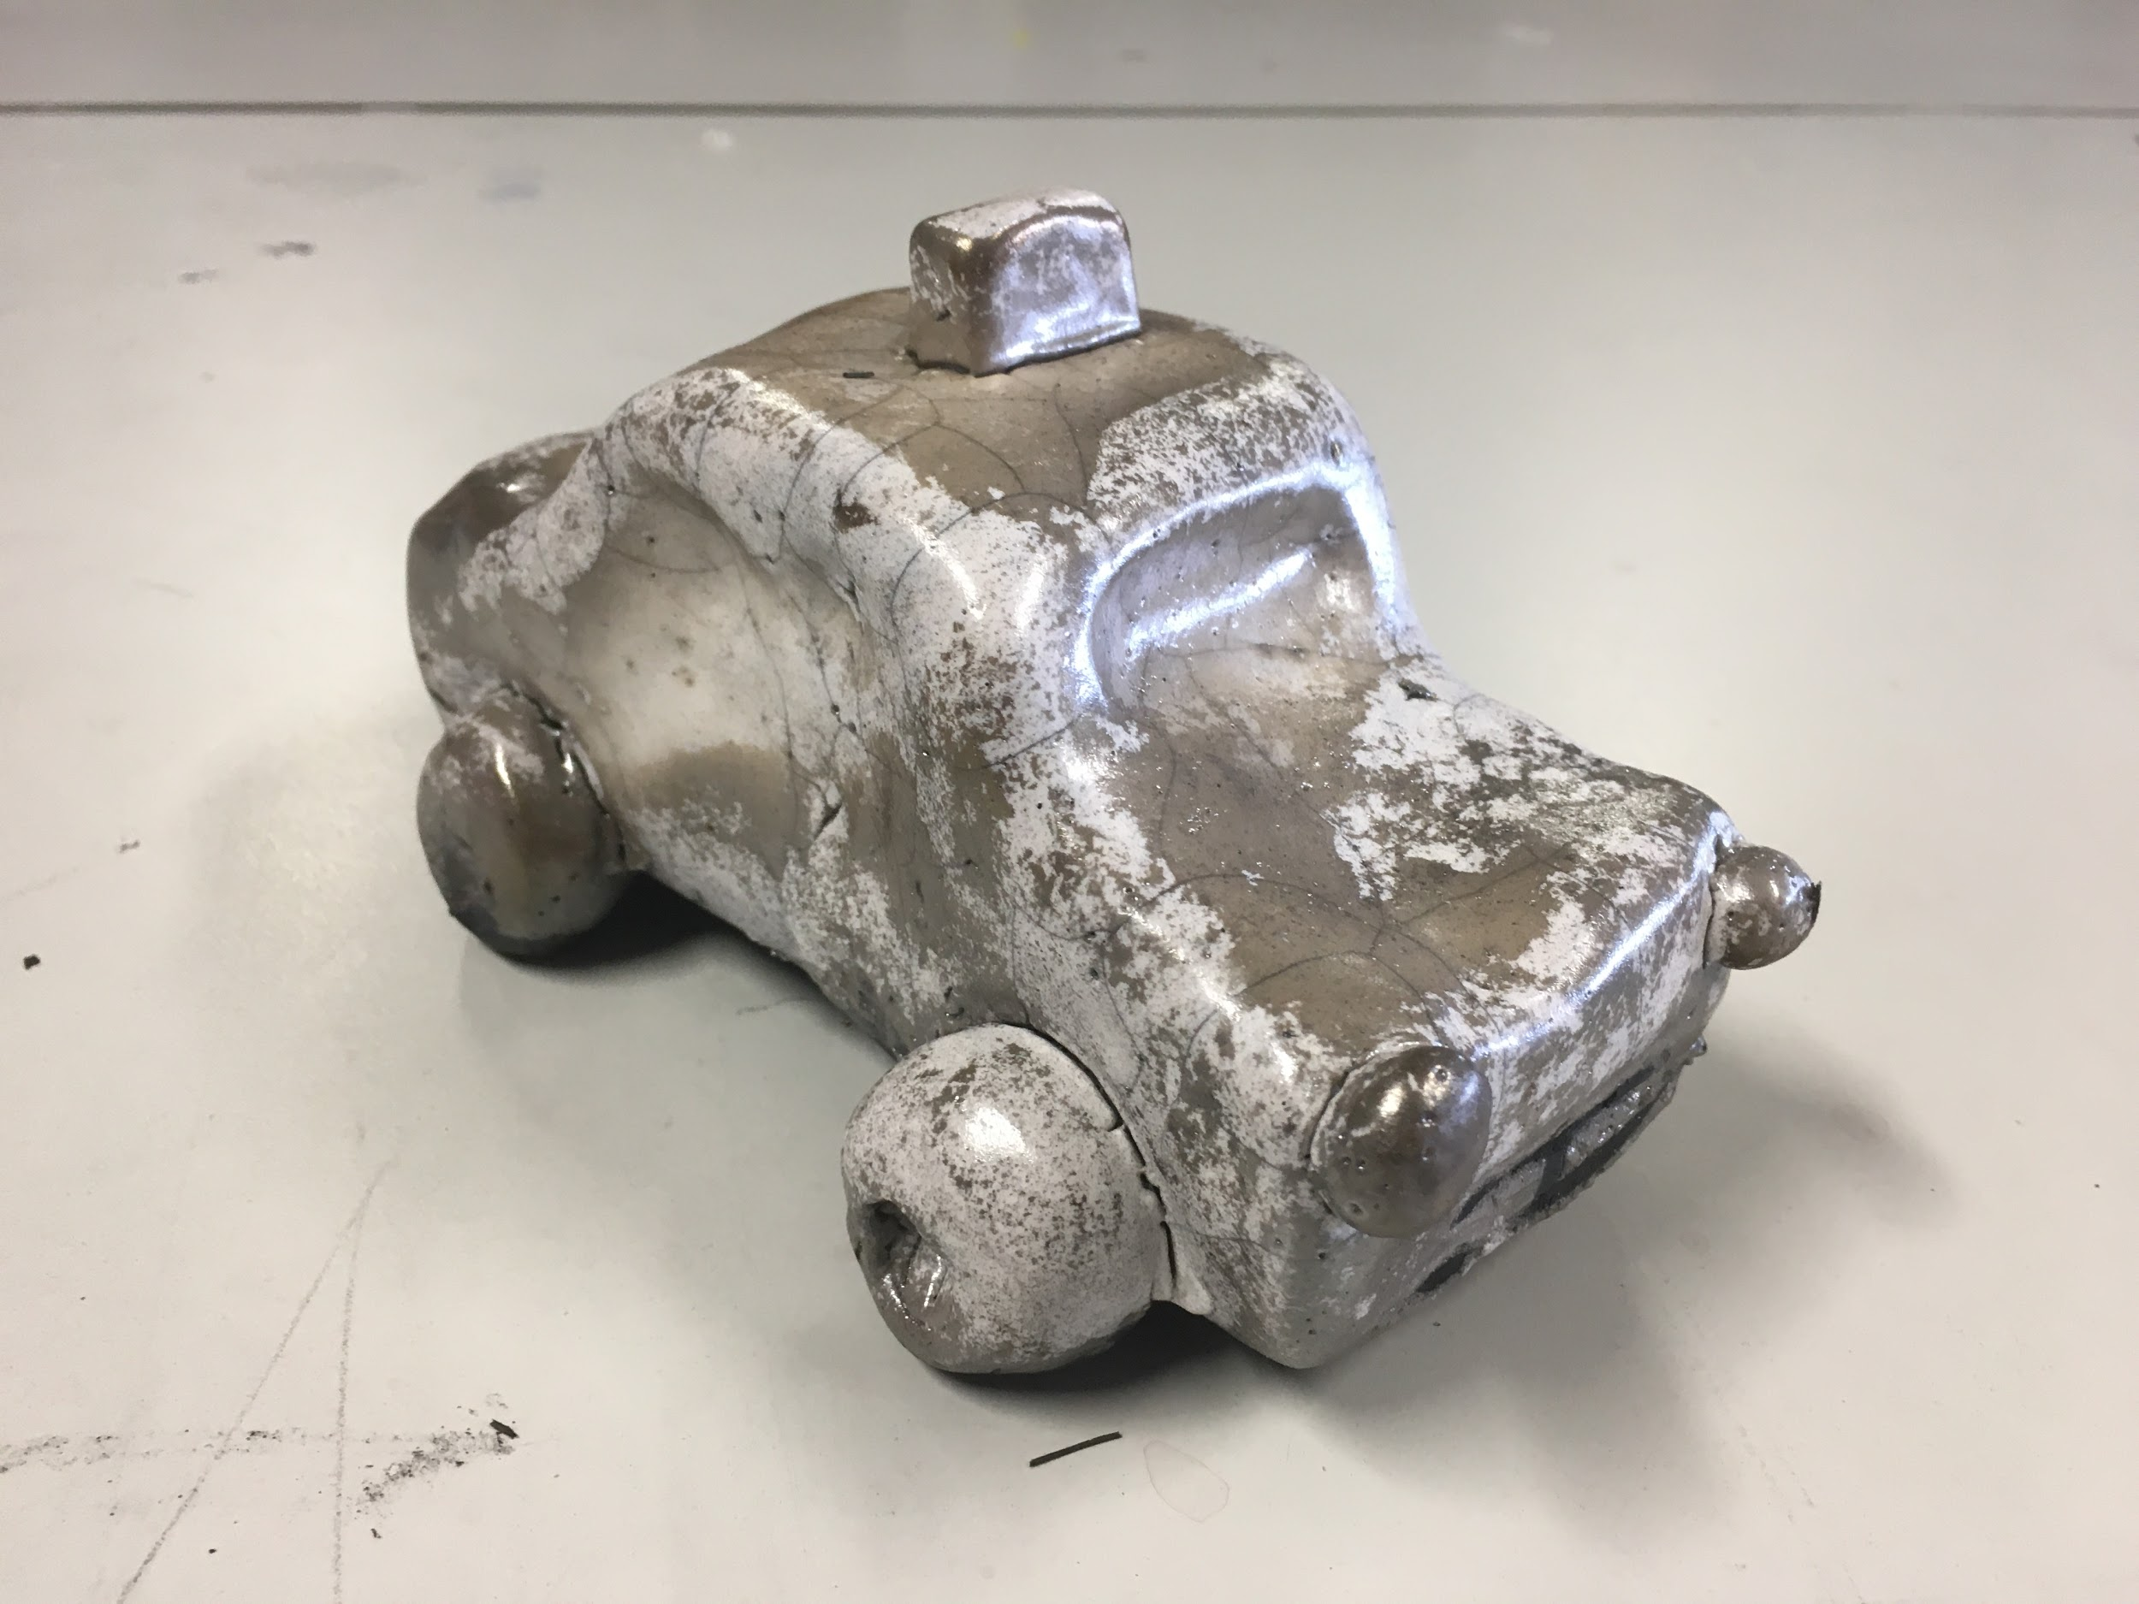
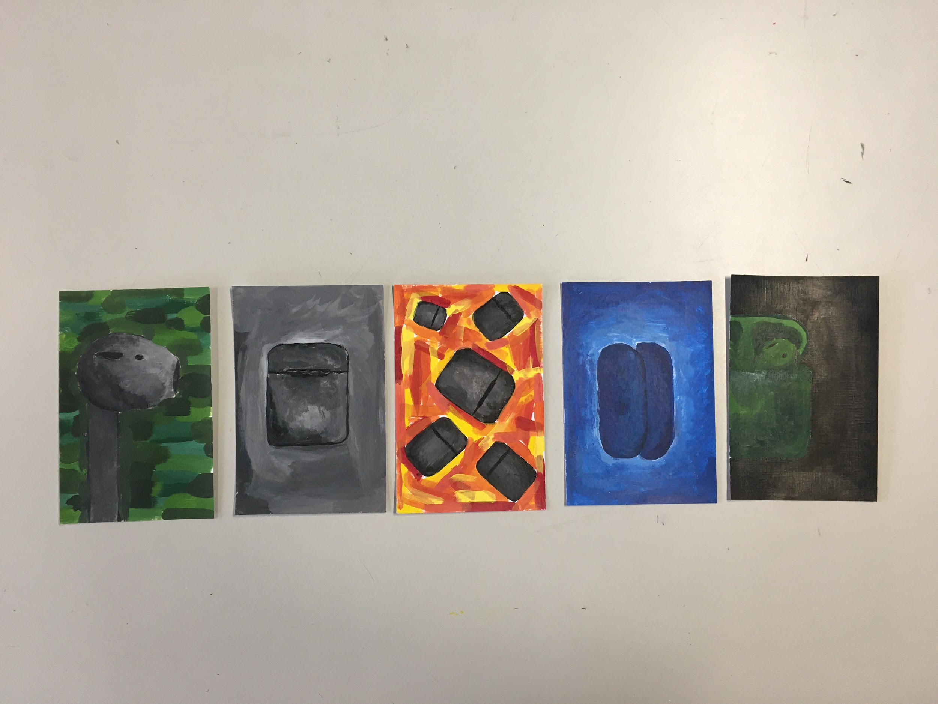
Unit 1: Studio inspiration and techniques
Outcome 3: SAC and Gallery Visits
On completion of this unit the student should be able to discuss the artistic practice of artists from different times and cultures, their sources of inspiration, materials and techniques for at least two artworks by each artist.

Slide 5
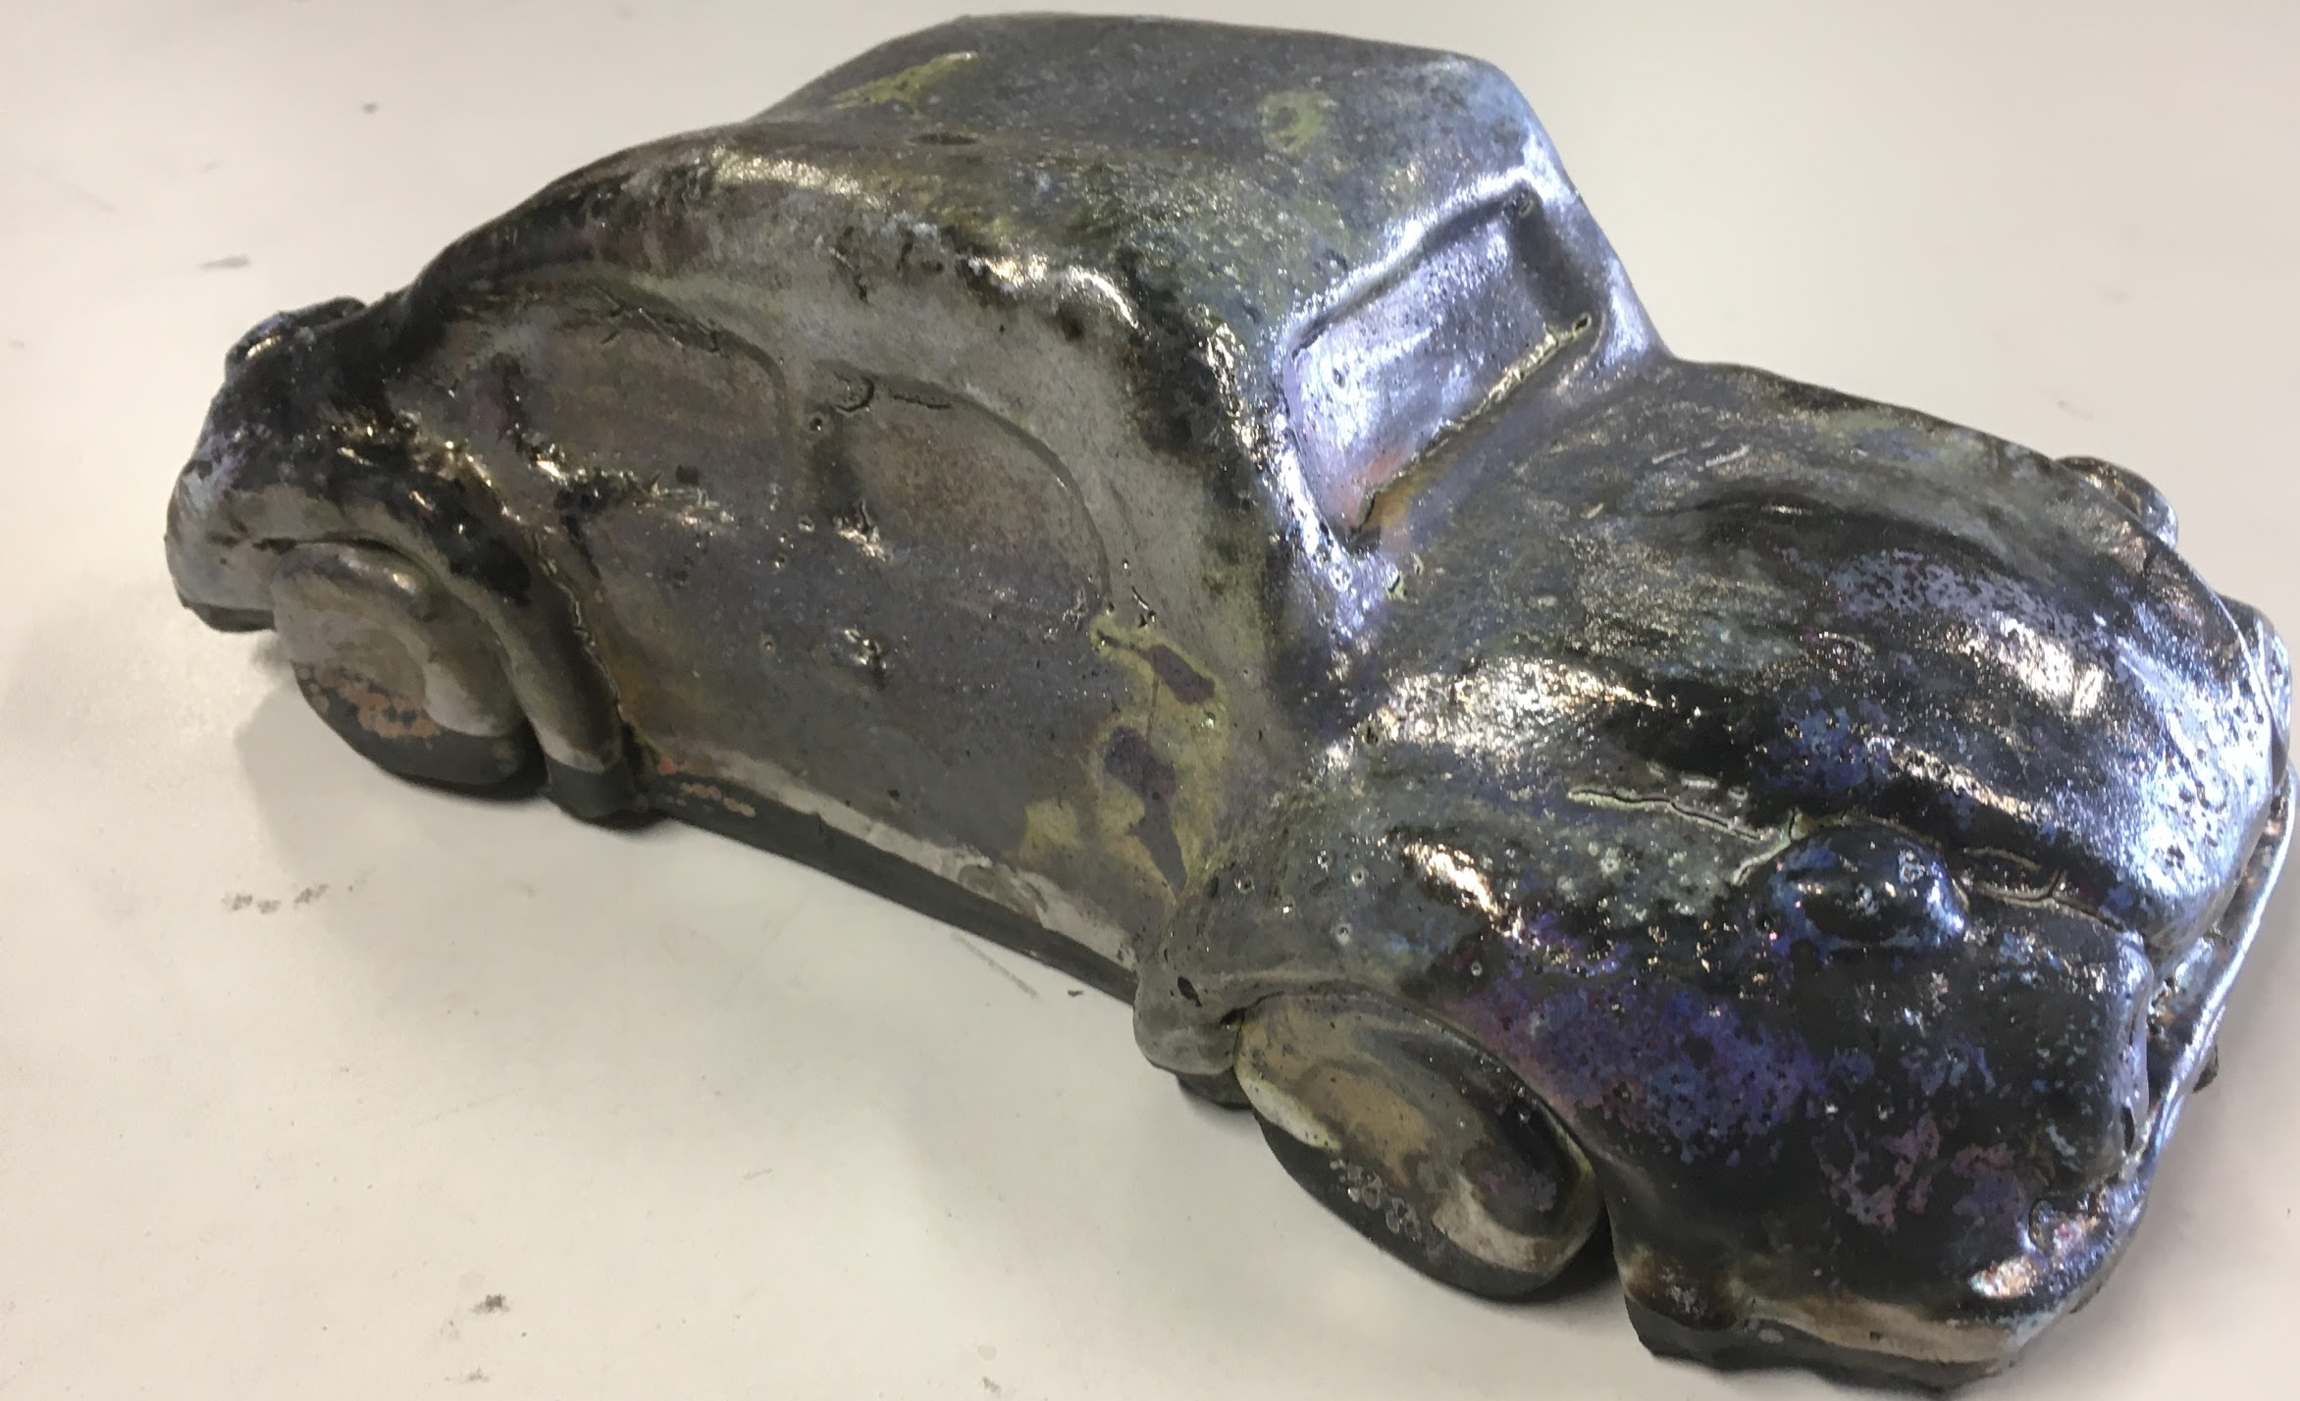
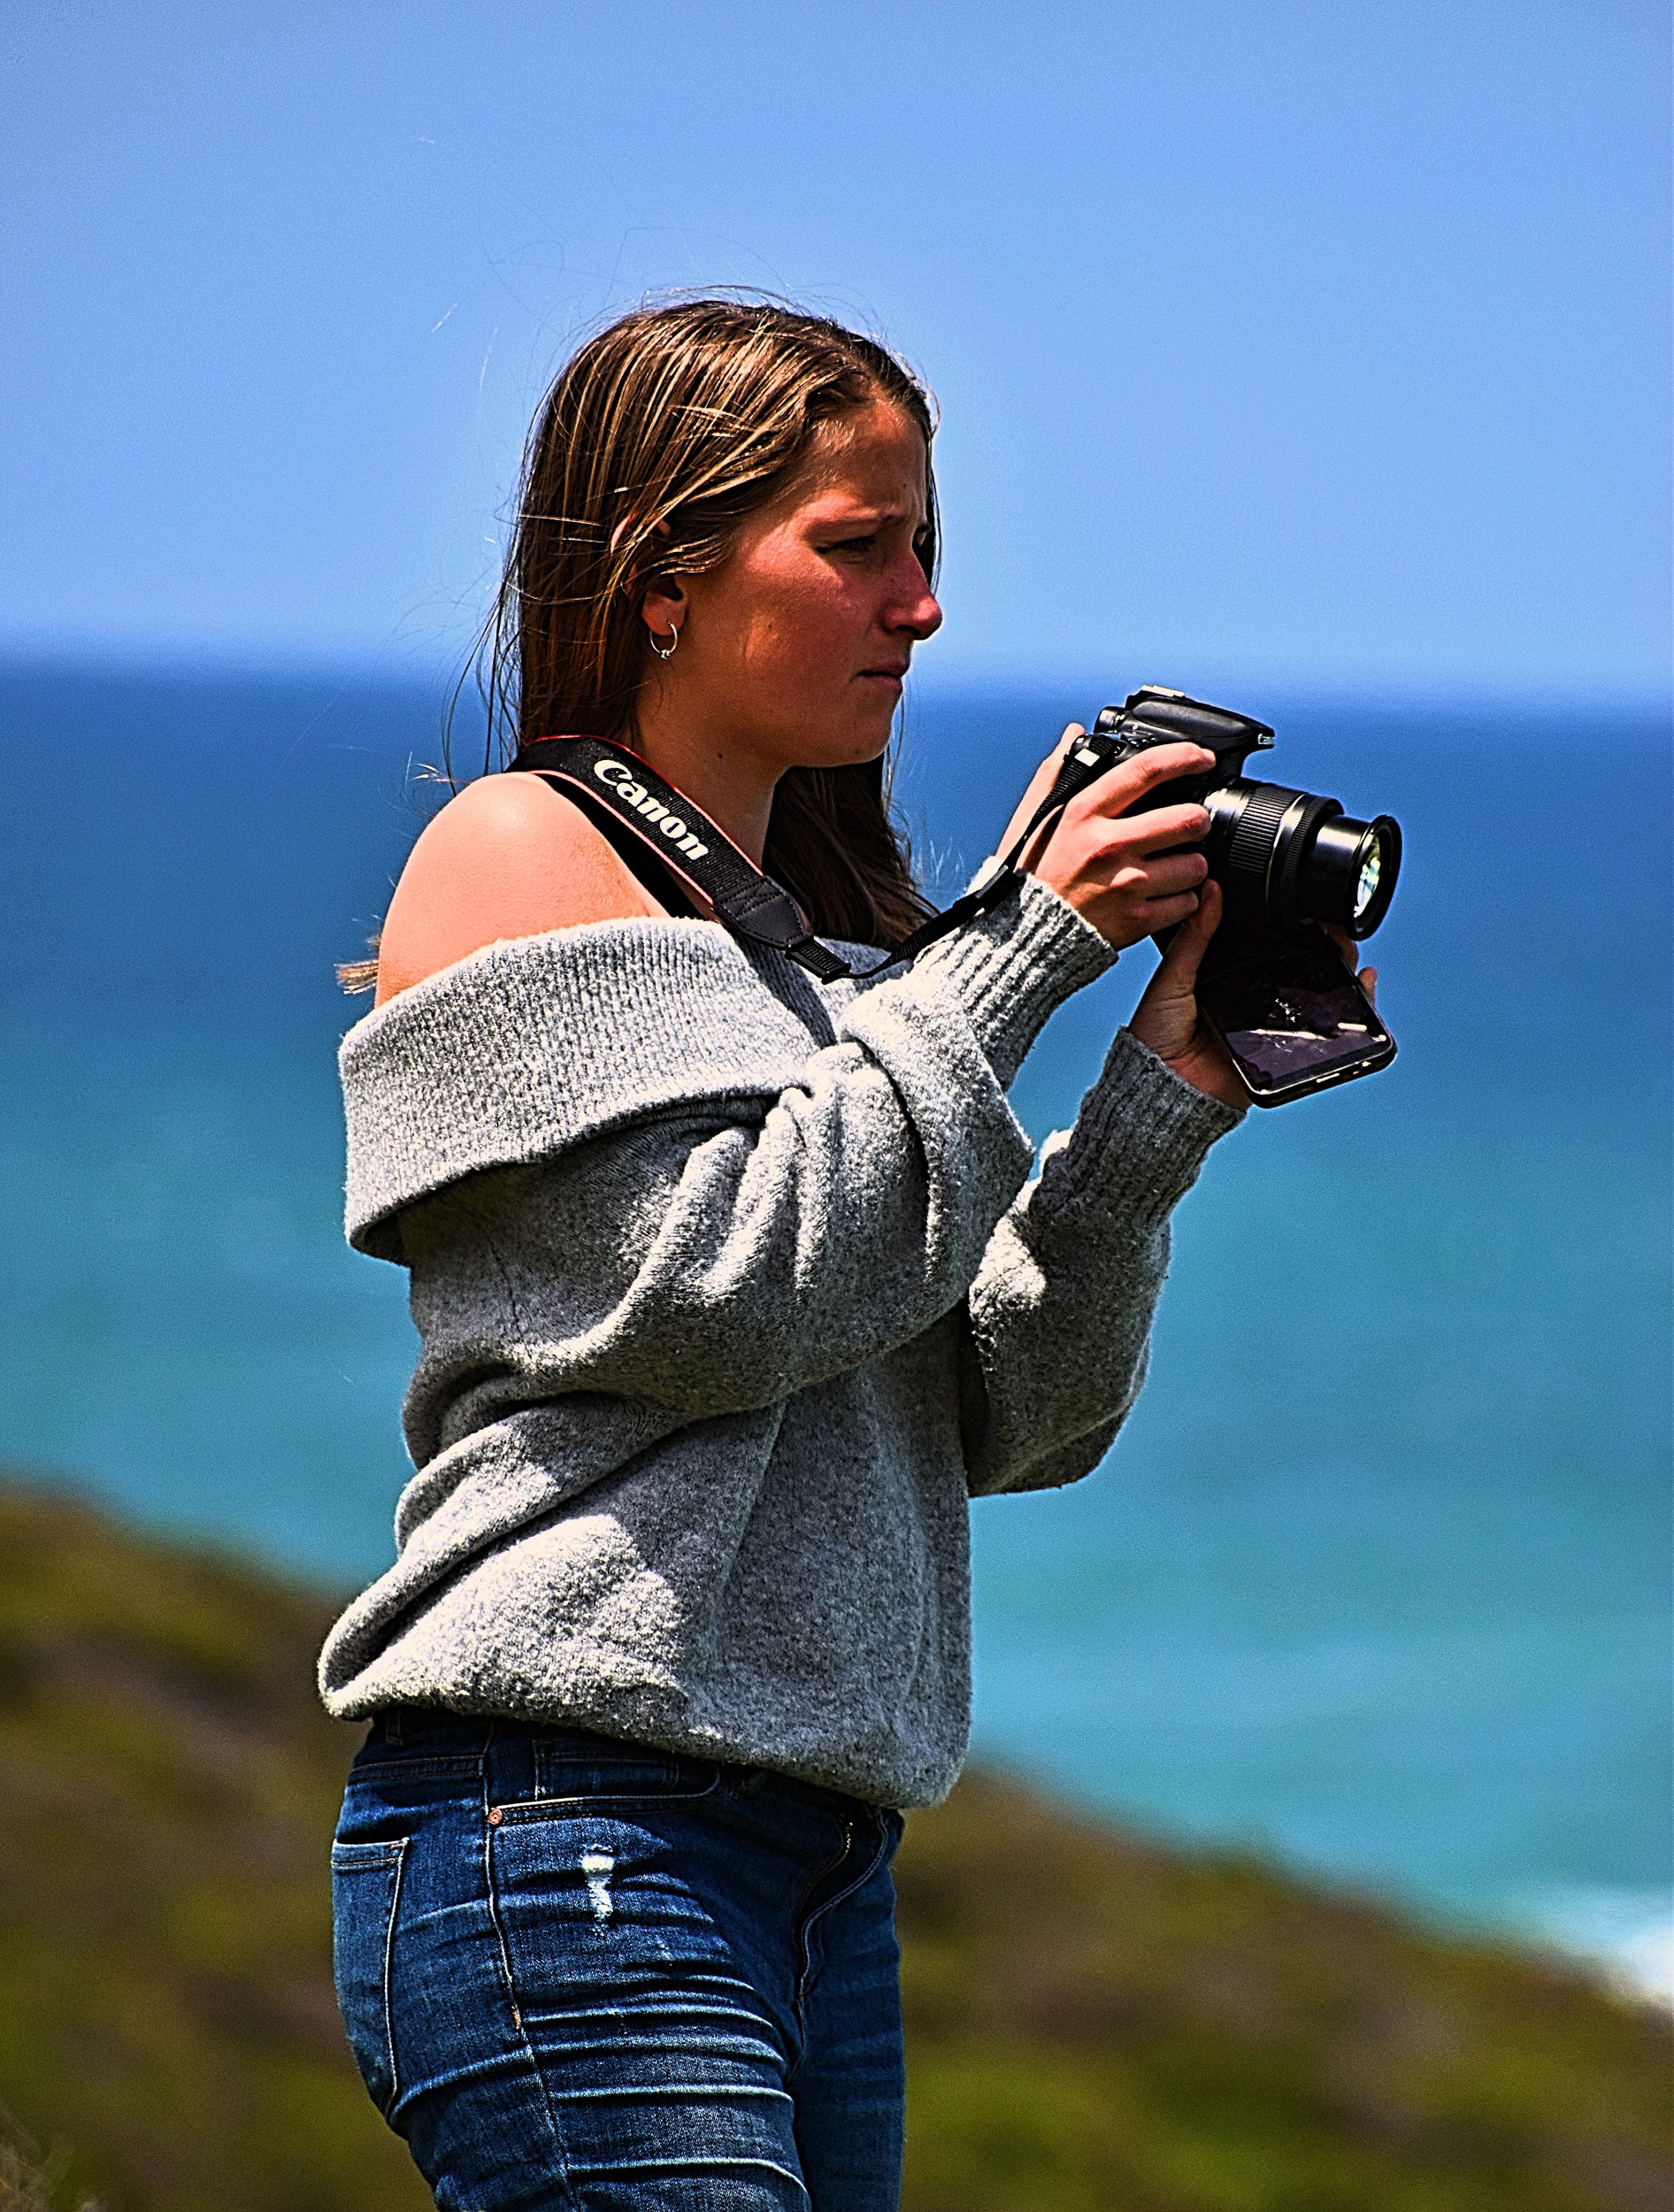
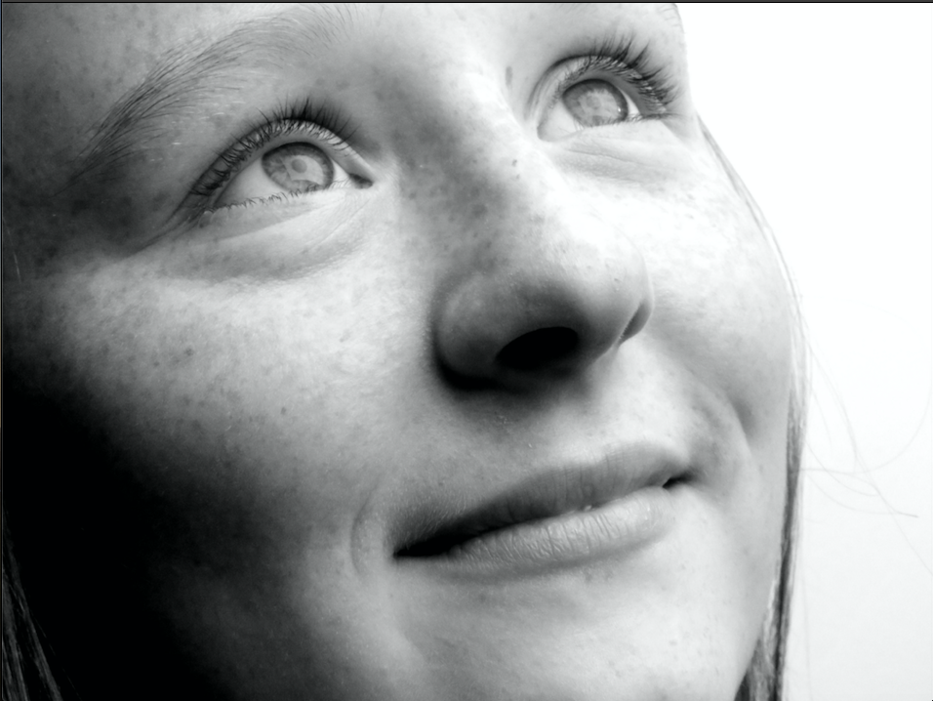
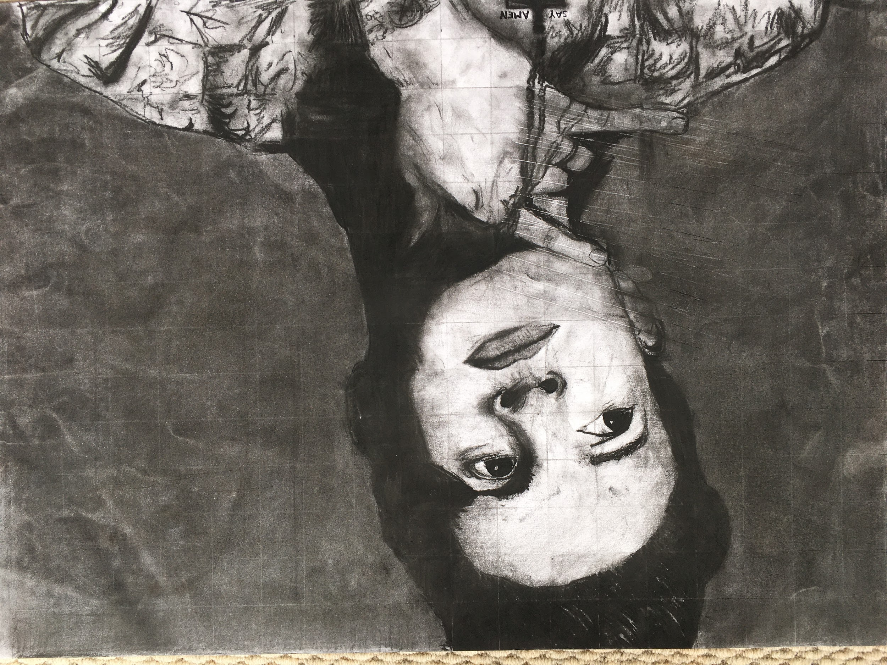
Unit 1: Studio inspiration and techniques
RAKU
Charcoal
Photography
Painting
Printmaking

Slide 6
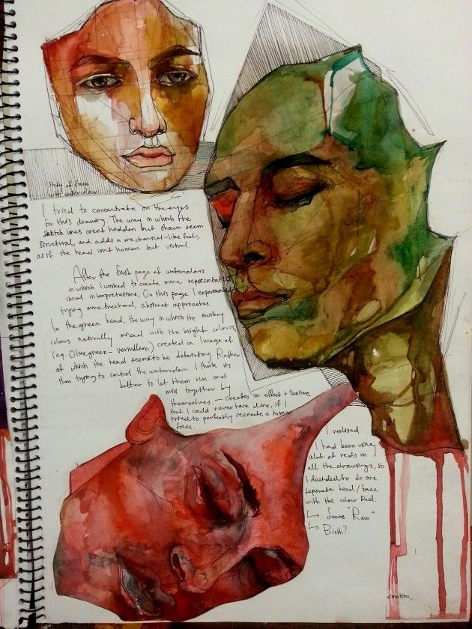
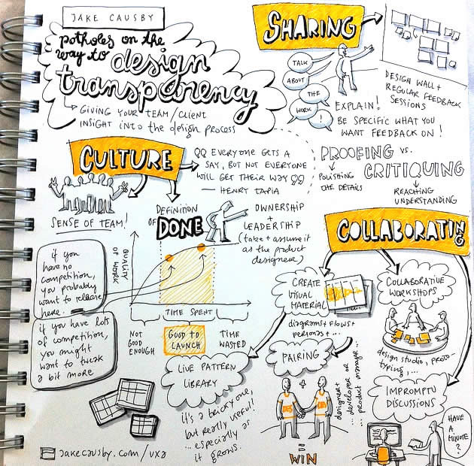
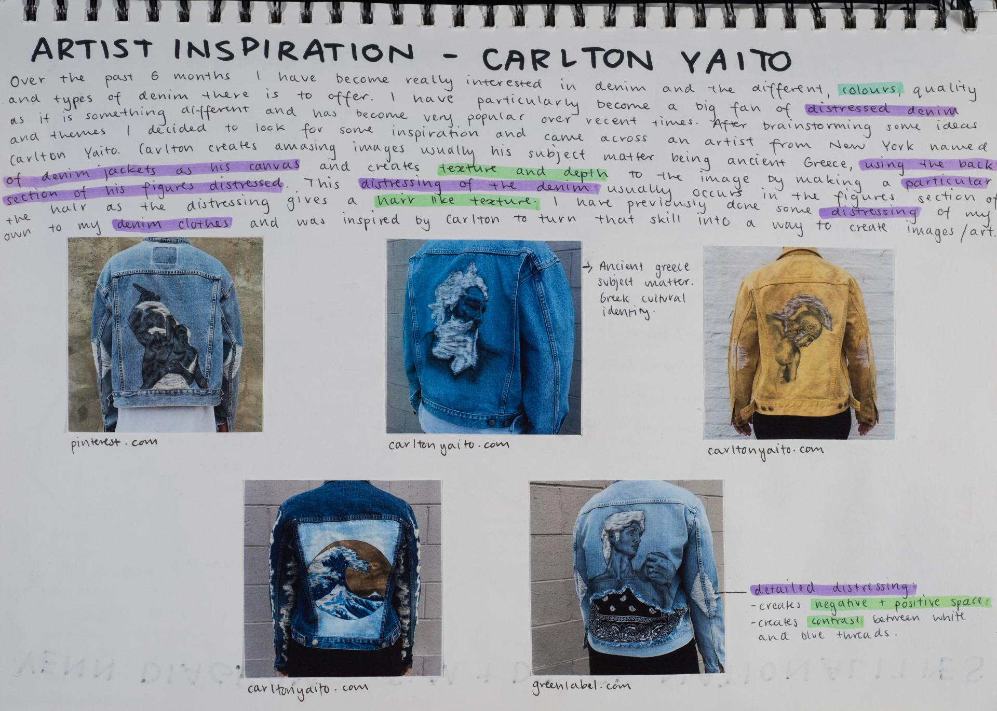
Unit 2: Studio exploration and concepts
Outcome 1 : Visual Diary/FOLIO
On completion of this unit the student should be able to develop an individual exploration proposal to form the basis of a studio process, and from this produce and document a variety of potential directions in a visual diary for at least one artwork.

Slide 7
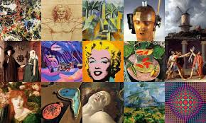
Unit 2: Studio exploration and concepts
Outcome 2: SAC Slideshow
On completion of this unit the student should be able to compare a range of historical and contemporary art periods, styles or movements, and analyse the ways in which artists communicate ideas, develop styles and demonstrate aesthetic qualities in artworks.

Slide 8
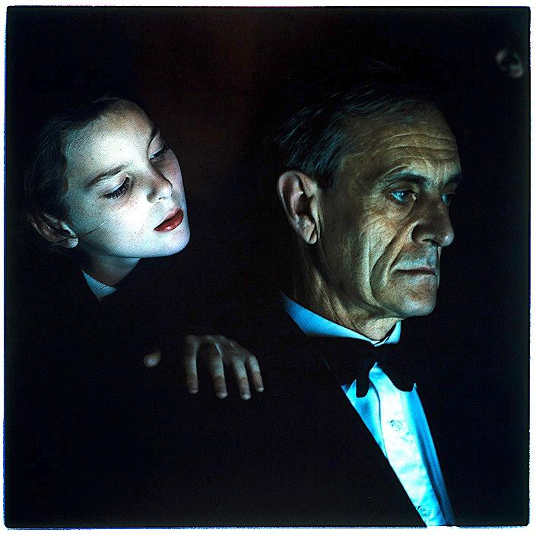
Unit 2: Studio exploration and concepts
Folio
One final Artwork
SAC/Gallery Visits

Slide 9
Year 11 Studio Art
More information?
Barb Venn
Head of Arts
bvenn@mcararat.catholic.edu.au
Arts Faculty teachers.
Subject handbooks on Marian College Website

