Slide 1


YEAR 7 Wellbeing
“Oak Wellbeing - Positive Education”.

Slide 2
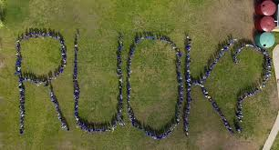
What is Positive Education?
Our Positive Education curriculum is explicitly designed to support your child to establish optimistic habits of mind that propel them forward in their learning, personal development and character. The Wellbeing Curriculum we implement at Year 7 teaches the skills of wellbeing to actively develop within our students optimism, resilience, grit and compassion.

Slide 3

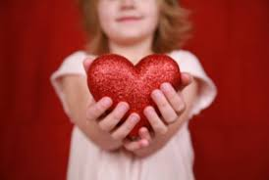

Term 1 Oak Program - Character Strengths
Using everyday examples taken from the wider world, students explore the character strengths of:
Gratitude
Spirituality
Fairness
Kindness
Forgiveness
Love
Social Intelligence
Zest

Slide 4
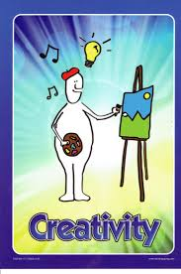

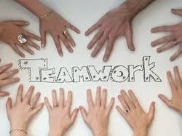
Term 2 Oak Program - Character Strengths
Through a series of fun activities and reflective work, students examine what the following character strengths mean and how to use them in everyday life.
Persistence
Bravery
Honesty
Prudence
Judgement
Self Regulation
Creativity
Humility and Modesty
Teamwork
Humour

Slide 5

Term 3 Oak Program - Character Strengths
To conclude the exploration of Character Strength students explore the following strengths and consider which of them they already possess and which they would like to develop.
Perspective
Love of Learning
Leadership
Appreciation of Beauty and Excellence
Curiosity
Hope

Slide 6
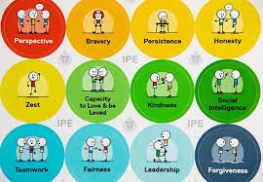
Term 4 Oak Program - Character Strength Project.
In Term 4, when they now grasp the meaning of all the character strengths and their application in everyday life, students undertake a VIA Character Strengths survey and discover what their top 5 character strengths are at this given time.
Students also undertake a special project that enables them to showcase their own strengths in a way of their choosing.

Slide 7
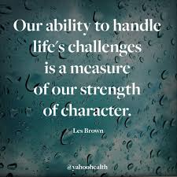
At the end of the Year 7 Program - our hopes for our students.
We hope at the end of Year 7, that students enjoyed the experience of Oak Wellbeing and leave the year level being able to list some of their character strengths. We believe this is an important part of developing a positive self- concept that will put them in good stead - not only during their time at high school - but for life.

