Slide 1
YEAR 9 Science
Victorian Curriculum

Slide 2
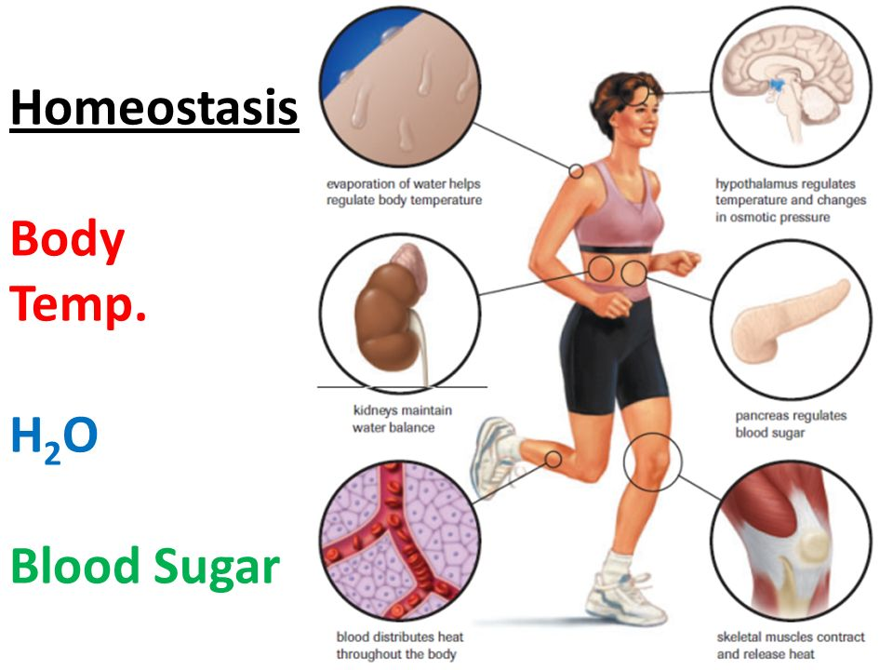
Responding and Control: Homeostasis

Slide 3
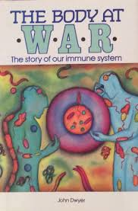
The Body at War

Slide 4
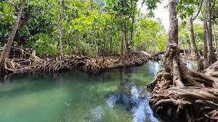
Ecosystems

Slide 5
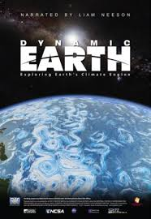
Dynamic Earth

Slide 6
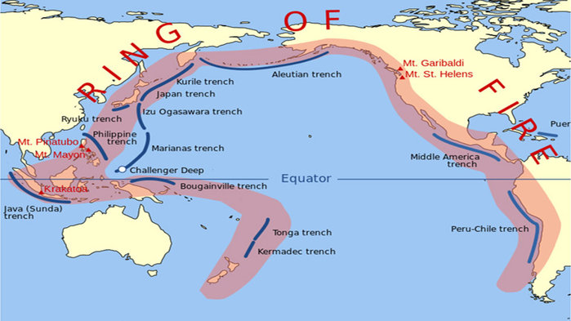
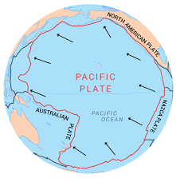

Slide 7
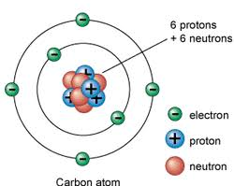
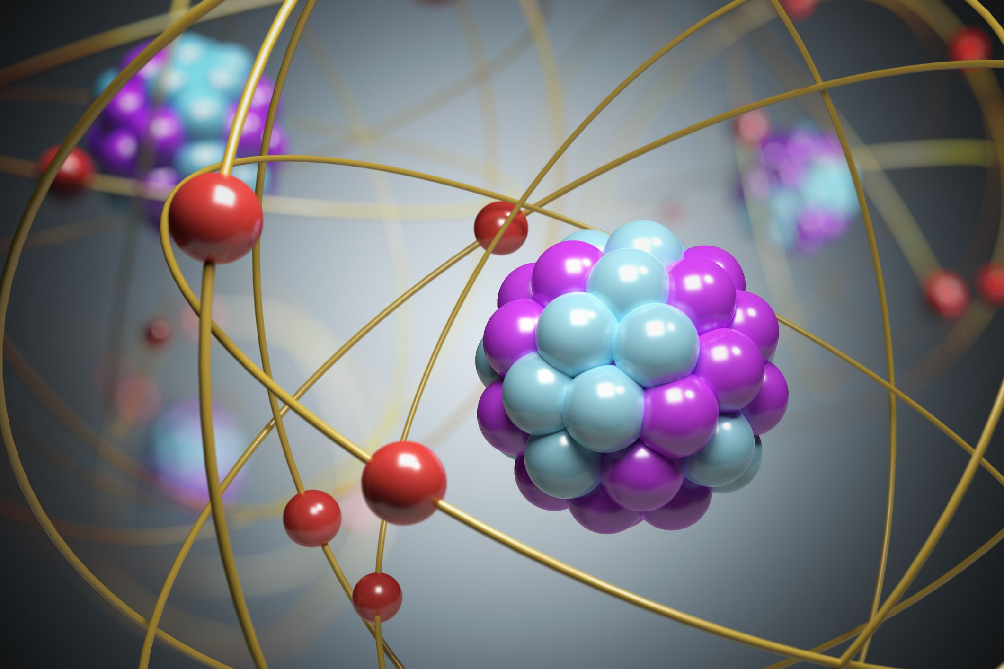
Atomic Theory

Slide 8
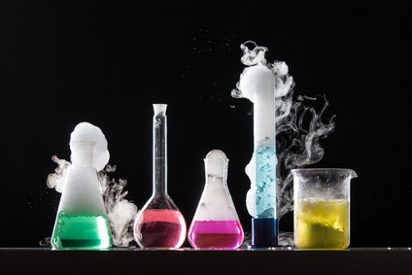
Chemical Reactions

Slide 9
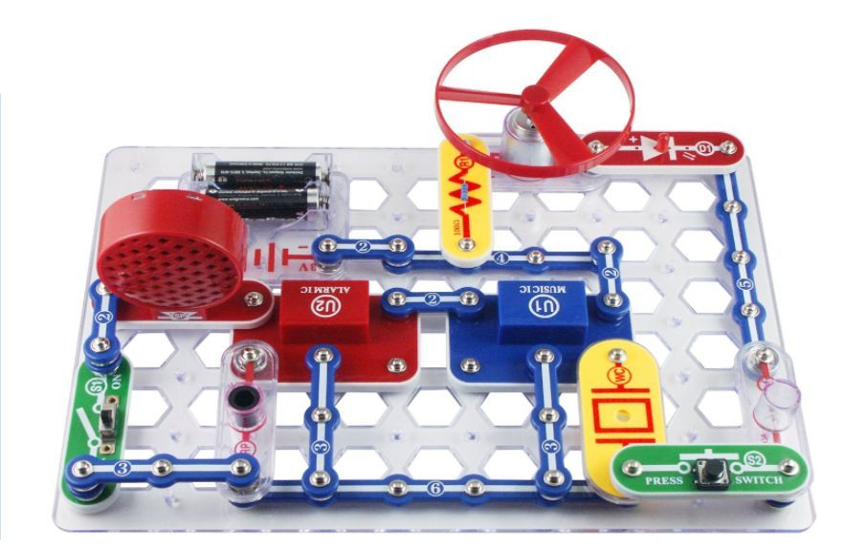
Electric Circuits

Slide 10
Year 10 students often study Unit 1 & 2
Students wishing to maximise their ATAR at the end of year 12 , generally enrol in a VCE subject “early”. This means they study a year 11 subject whilst in year 10 and in turn a year 12 subject whilst in year 11.
This is a proven good strategy for academically oriented students.
Science offers Biology and Psychology for such a pathway, course information can be found in the Year 11 and/or year 12 presentation.

Slide 11
Year 9 Science @ Marian College (Ararat)
Science is taught as a Human Endeavour with students encouraged to develop Enquiring minds that: Question, Predict, Plan, Conduct, Record, Process, Analyse, Evaluate and Communicate their learning.
There are 4 lessons per week, 2 singles and 1 double lesson. The double lesson is utilised for the conducting of experiments (practicals) and investigations.

