Slide 1
YEAR 8 Science
Victorian Curriculum

Slide 2
Cells

Slide 3
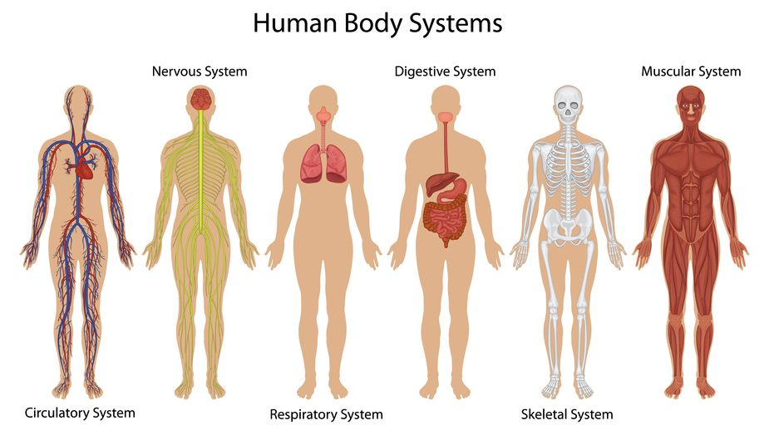
Living Connections

Slide 4
Energy: Heat, Light, Sound, Transfer of energy

Slide 5
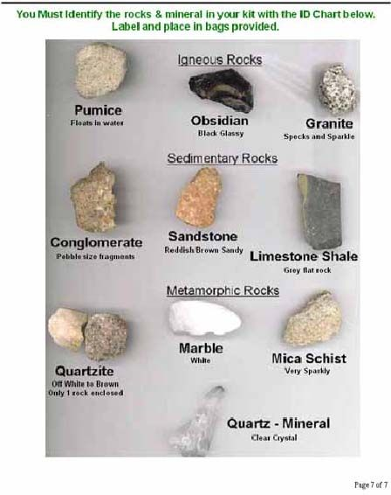
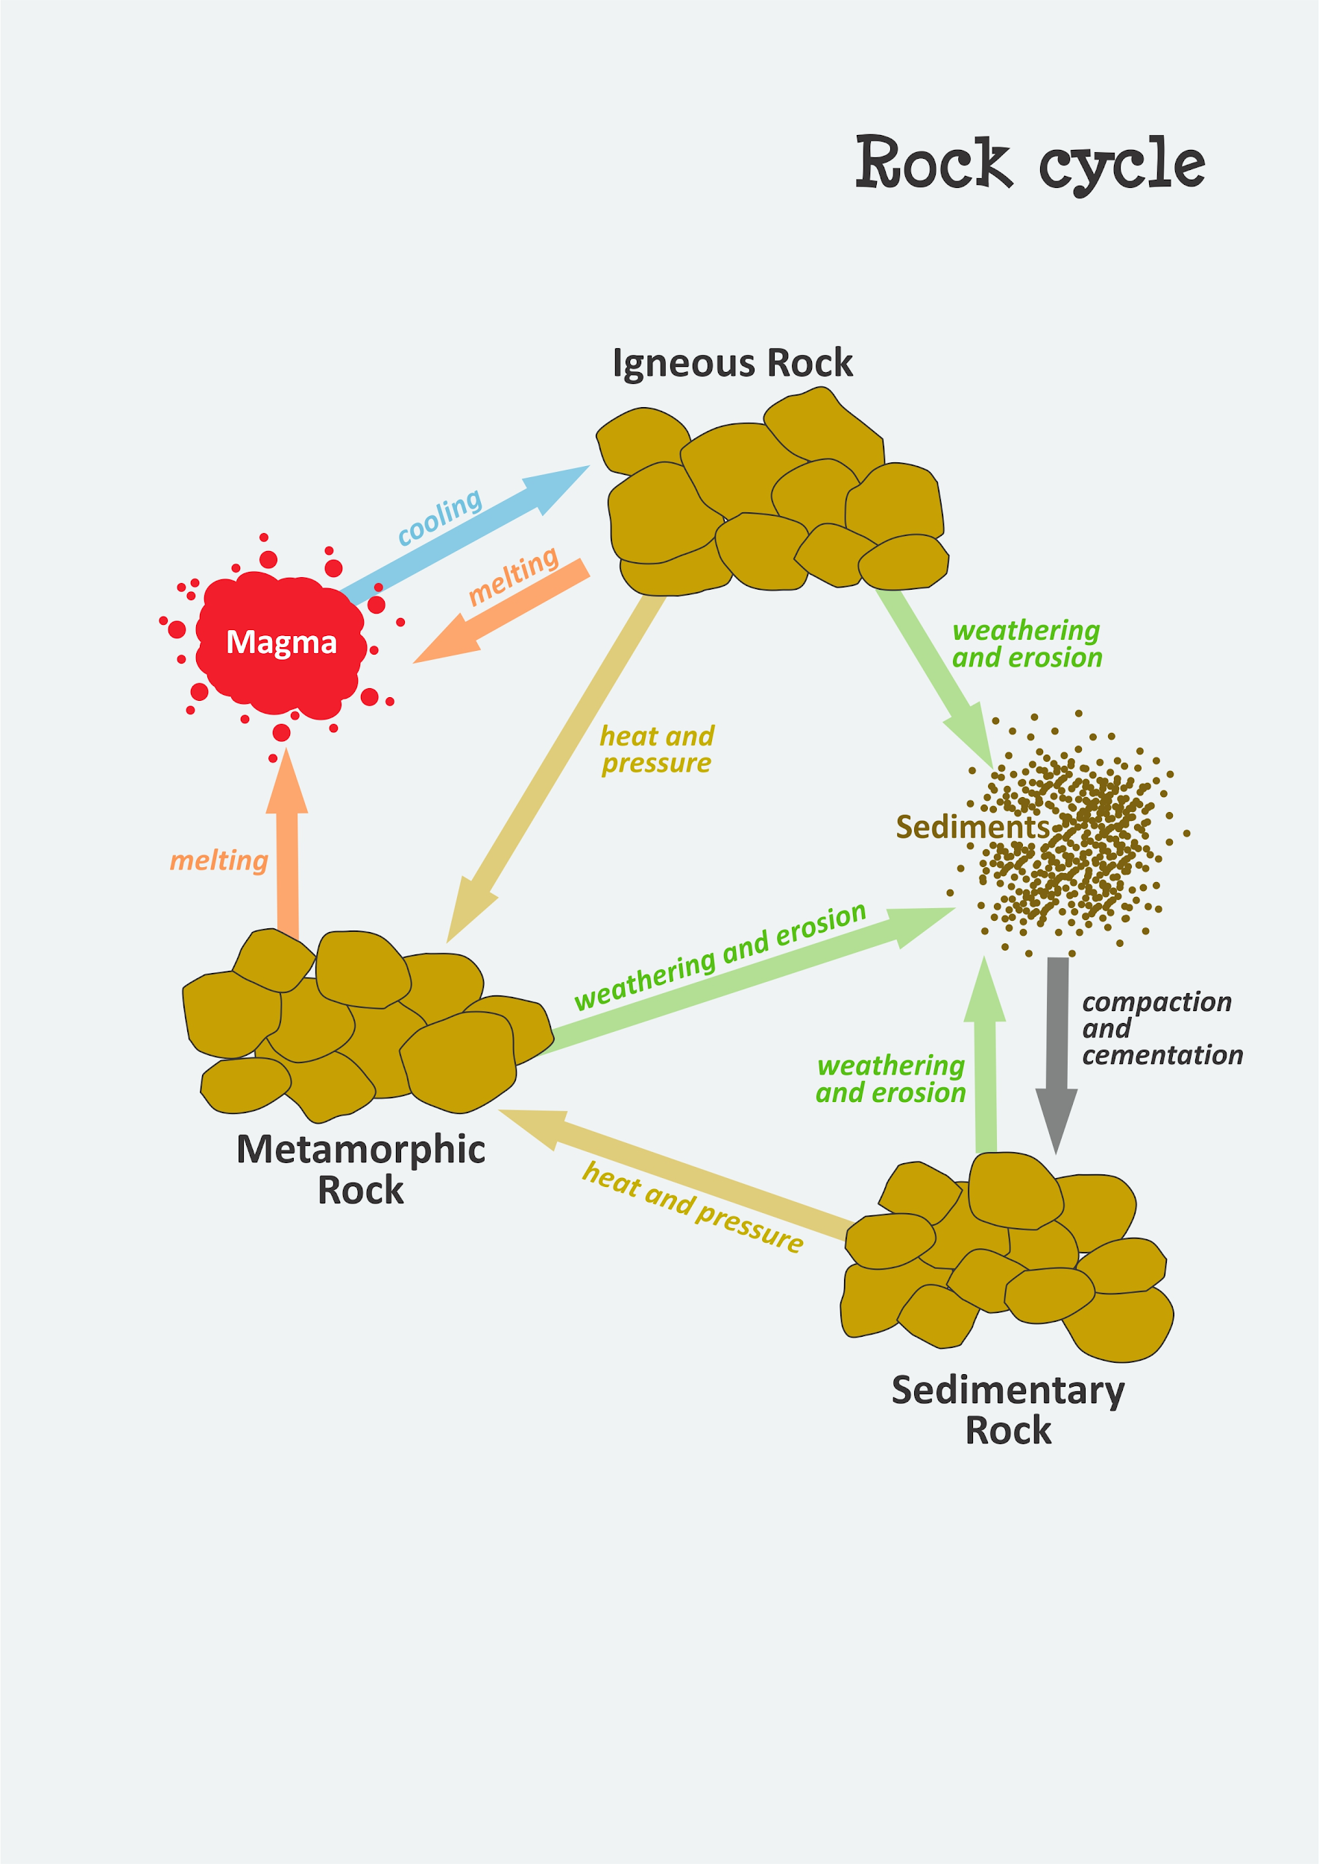
Rocks

Slide 6
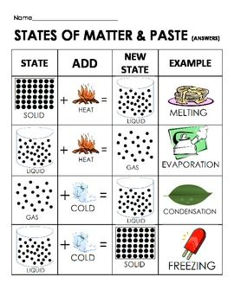
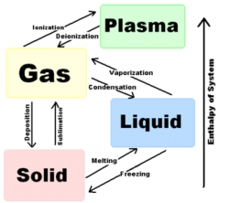
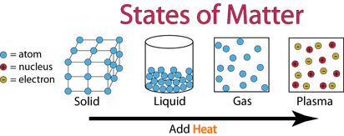
States of Matter

Slide 7
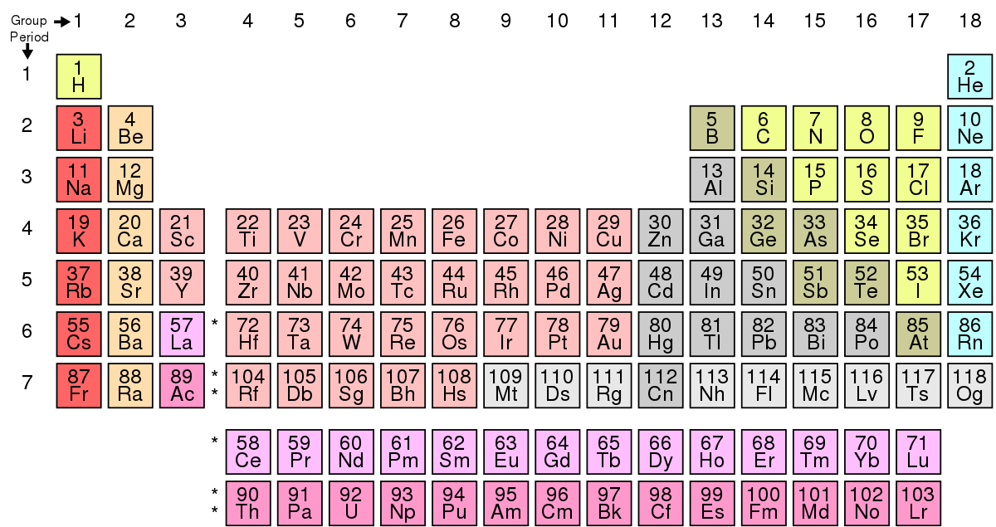
Elements, Compounds and Mixtures

Slide 8
Chemical Change

Slide 9
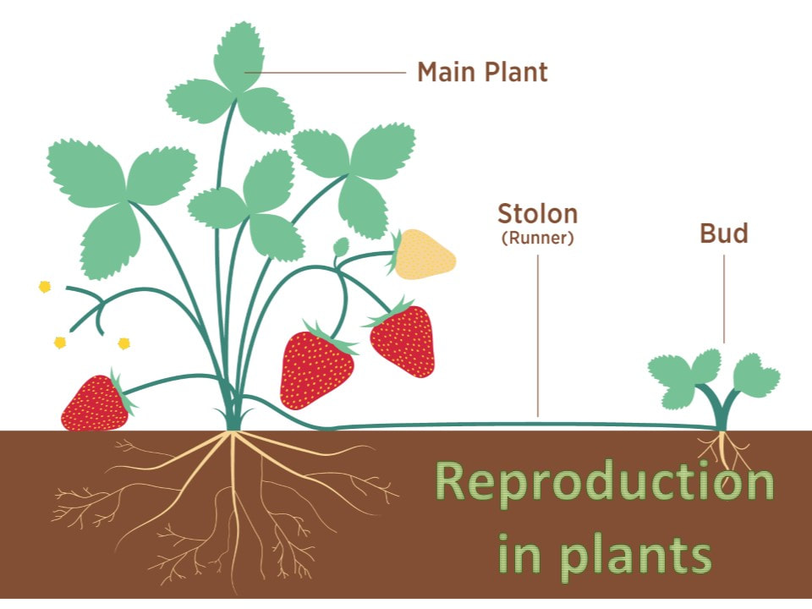
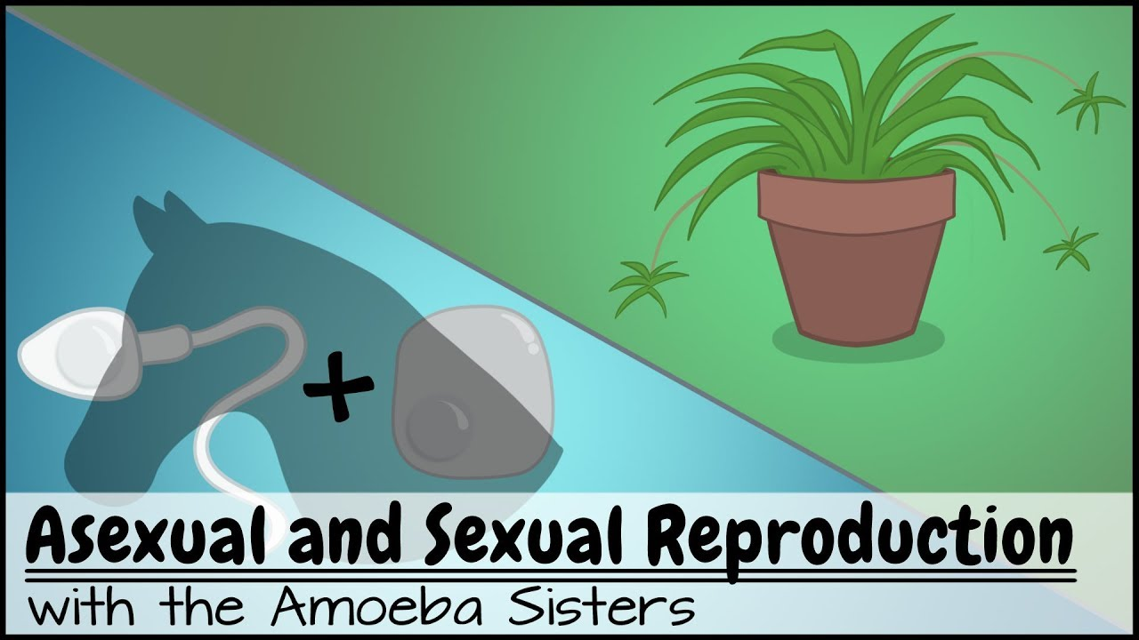
Systems - Reproduction

Slide 10
Year 8 Science @ Marian College (Ararat)
Science is taught as a Human Endeavour with students encouraged to develop Enquiring minds that: Question, Predict, Plan, Conduct, Record, Process, Analyse, Evaluate and Communicate their learning.
There are 3 lessons per week, 1 single and 1 double lesson. The double lesson is utilised for the conducting of experiments (practicals) and investigations.

