Slide 1
YEAR 7 Science
Victorian Curriculum

Slide 2
Introduction to Science @ mc ararat

Slide 3
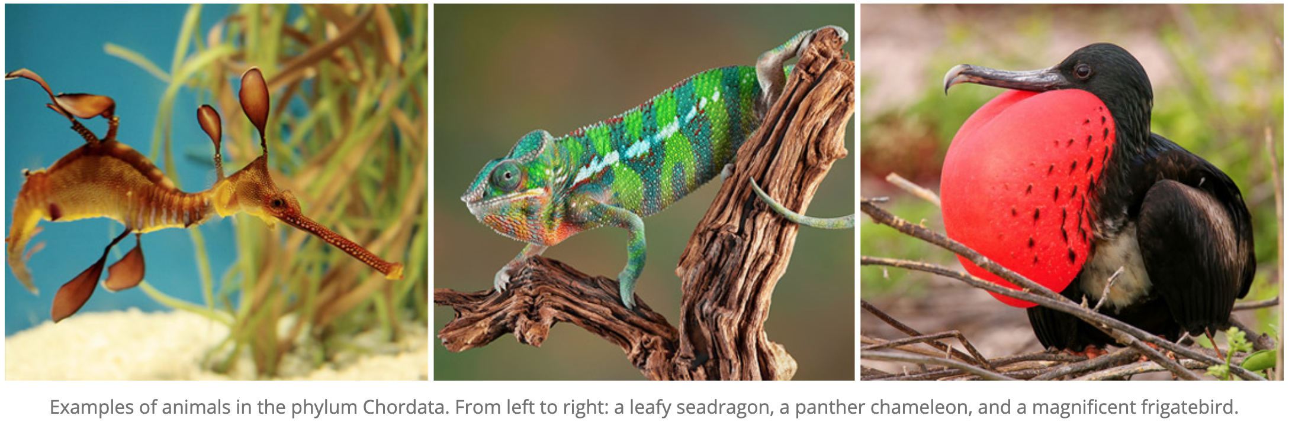
Classification

Slide 4
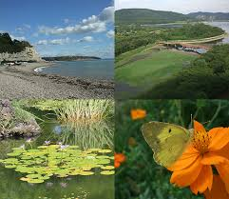
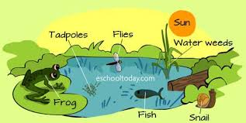
Ecosystems

Slide 5
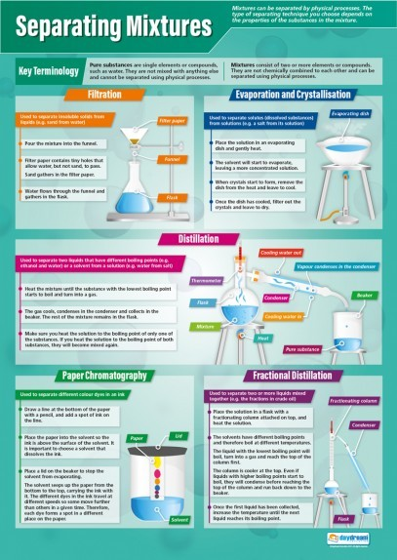
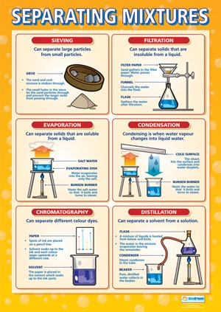

Slide 6
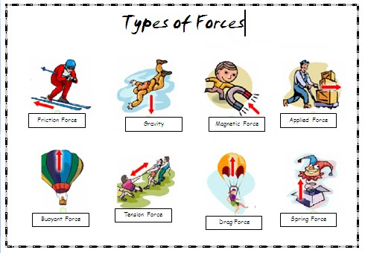
Forces

Slide 7
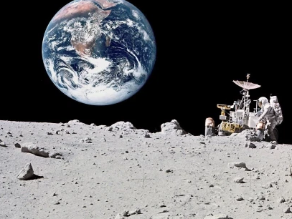
The earth in space

Slide 8
Year 7 Science @ Marian College (Ararat)
Science is taught as a Human Endeavour with students encouraged to develop Enquiring minds that: Question, Predict, Plan, Conduct, Record, Process, Analyse, Evaluate and Communicate their learning.
There are 3 lessons per week, 1 single and 1 double lesson. The double lesson is utilised for the conducting of experiments (practicals) and investigations.

