Slide 1
YEAR 10 Science
Victorian Curriculum

Slide 2
2 Core Semesters and 2 Electives
All students study Biology/Evolution for a semester and all students study Chemistry/Physics for a semester.
There are 2 Electives on offer:
An introduction to Psychology
Healthy Farming

Slide 3
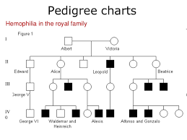
Genetics

Slide 4
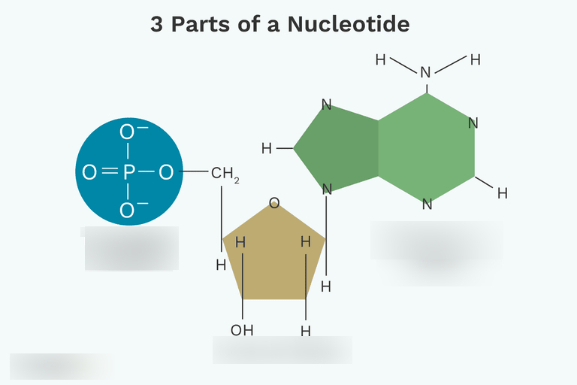
Genetics

Slide 5
Theory of Evolution

Slide 6
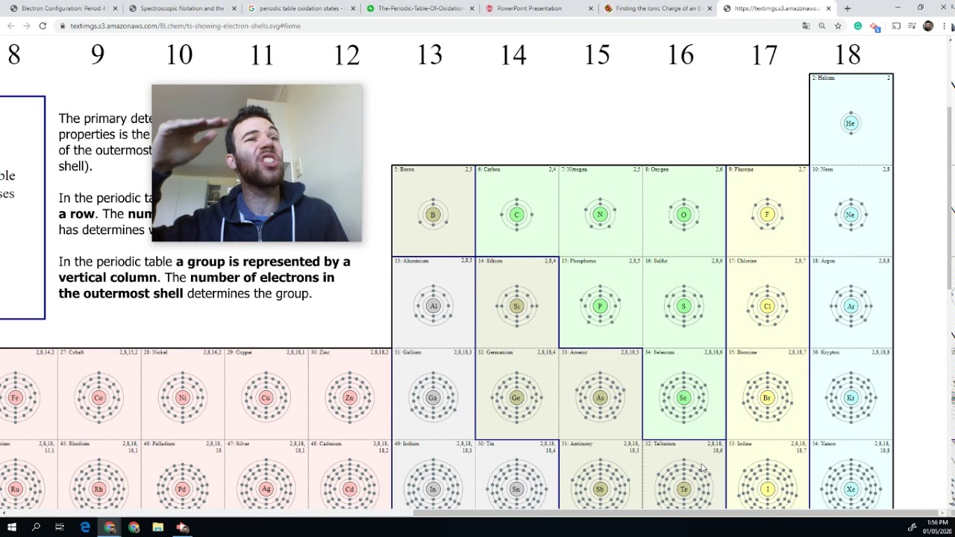
Chemistry: structure

Slide 7
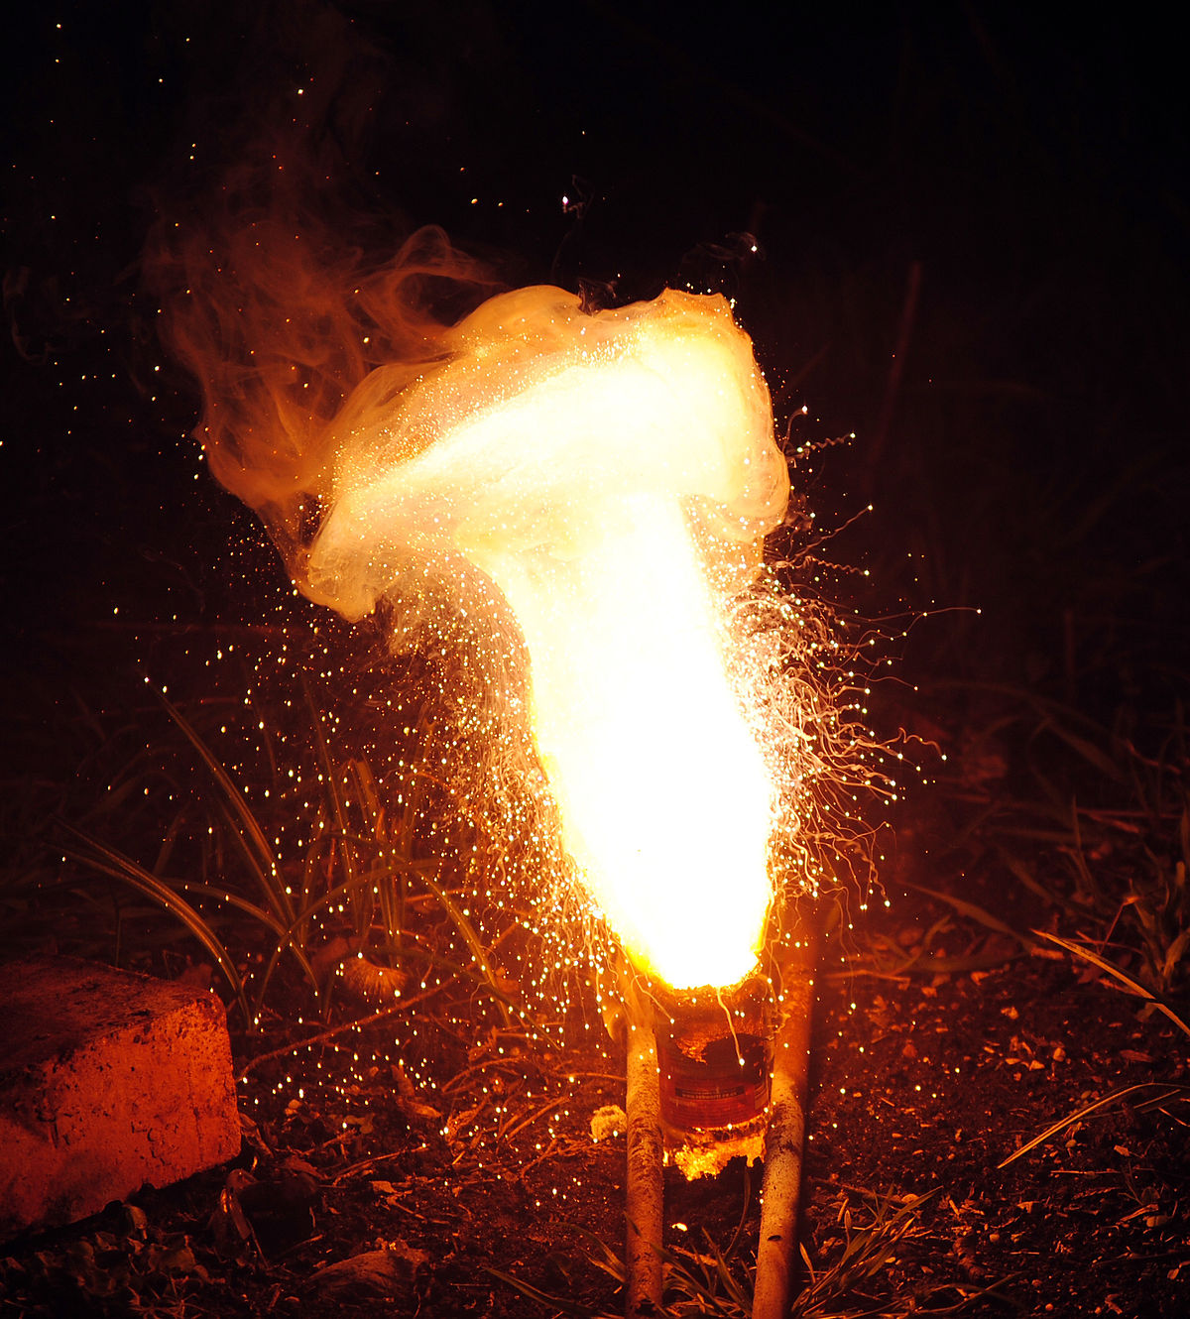
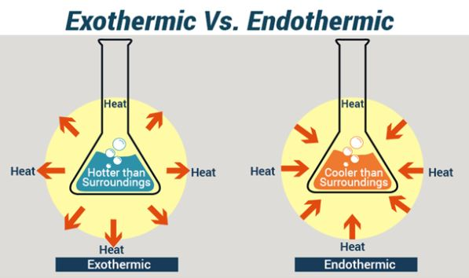
Chemistry: Reactions

Slide 8
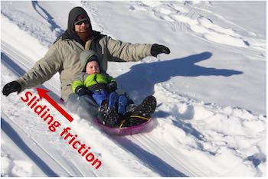
Motion

Slide 9
Introduction to Psychology
A semester course for students
Wishing to do Units 1 & 2 in Year 11.

Slide 10
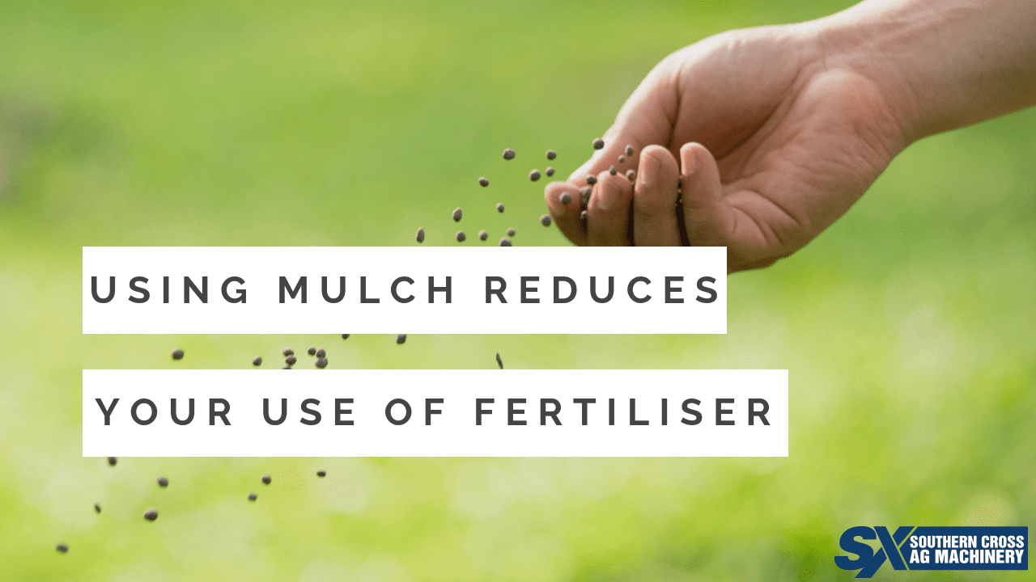
Healthy Farming
Course Content (1 Semester):
Propagation, seed saving
Irrigation
Composting, mulching, fertilising
Pests and diseases
Soil nutrients, hydroponics, hothouses
Canopy maintenance
Industry unit

Slide 11
Year 10 Science @ Marian College (Ararat)
Science is taught as a Human Endeavour with students encouraged to develop Enquiring minds that: Question, Predict, Plan, Conduct, Record, Process, Analyse, Evaluate and Communicate their learning.
There are 4 lessons per week, 2 singles and 1 double lesson. The double lesson is utilised for the conducting of experiments (practicals) and investigations.

