Slide 1
YEAR 7
Health & Physical Education

Slide 2
Year 7 Health & Physical Education
Core Health & Physical Education - All Year 7 students
1 Health Class per week
1 Double Practical PE class per week

Slide 3
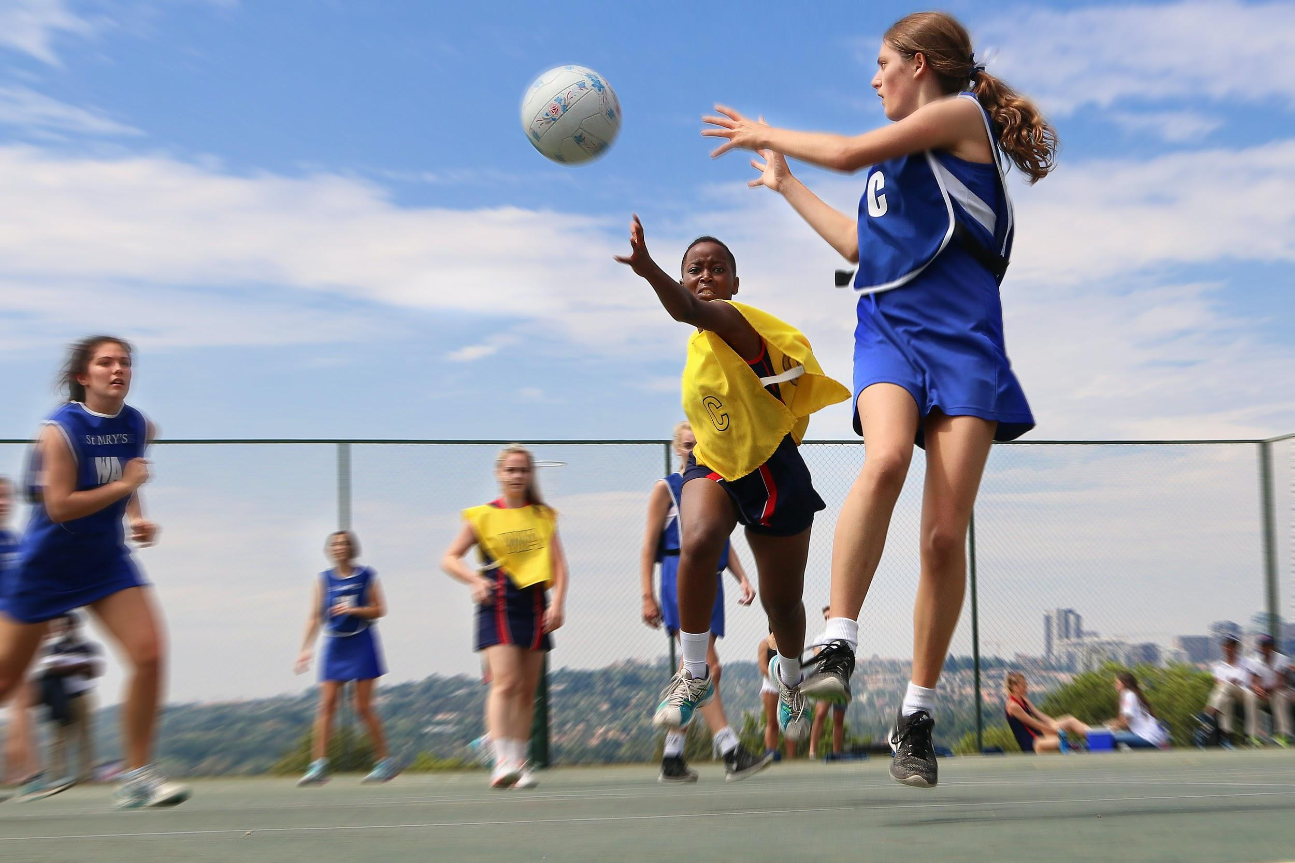
Year 7 Health & Physical Education
Health & Physical Education - Focus areas:
Enjoying being physically active.
Learning life-long skills - physical and social.
Building positive attitudes and knowledge for healthy living.

Slide 4
Health & Physical Education Curriculum
HEALTH (1 lesson/week)
Positive Relationships
Adolescence
Diversity
Promoting active lifestyles
Health strategies and resources
PRACTICAL PE (1 Double lesson/week)
Swimming
Athletics
Fitness
Netball
Basketball
Dance
Pateka
Tee-ball
Cricket

Slide 5
Year 7 Physical Education
More information?
-PE teachers
-Subject handbooks
Paul McLoughlan
Head of Health & Physical Education
mcloughp@mcararat.catholic.edu.au

