Slide 1
YEAR 10
Health & Physical Education

Slide 2
Year 10 options for Health & PE
Core Health & Physical Education - All Year 10 students
plus 2 optional electives:
Outdoor Activities
Exercise Science

Slide 3
Health & Physical Education Curriculum
HEALTH (1 lesson/week)
Positive Relationships
Body systems and anatomy
Promoting active lifestyles
Road Safety
Health strategies and resources
PRACTICAL PE (1 Double lesson/week)
Swimming
Athletics
Fitness
Croquet
Golf
Tchouk ball
Korf ball
Lawn Bowls

Slide 4
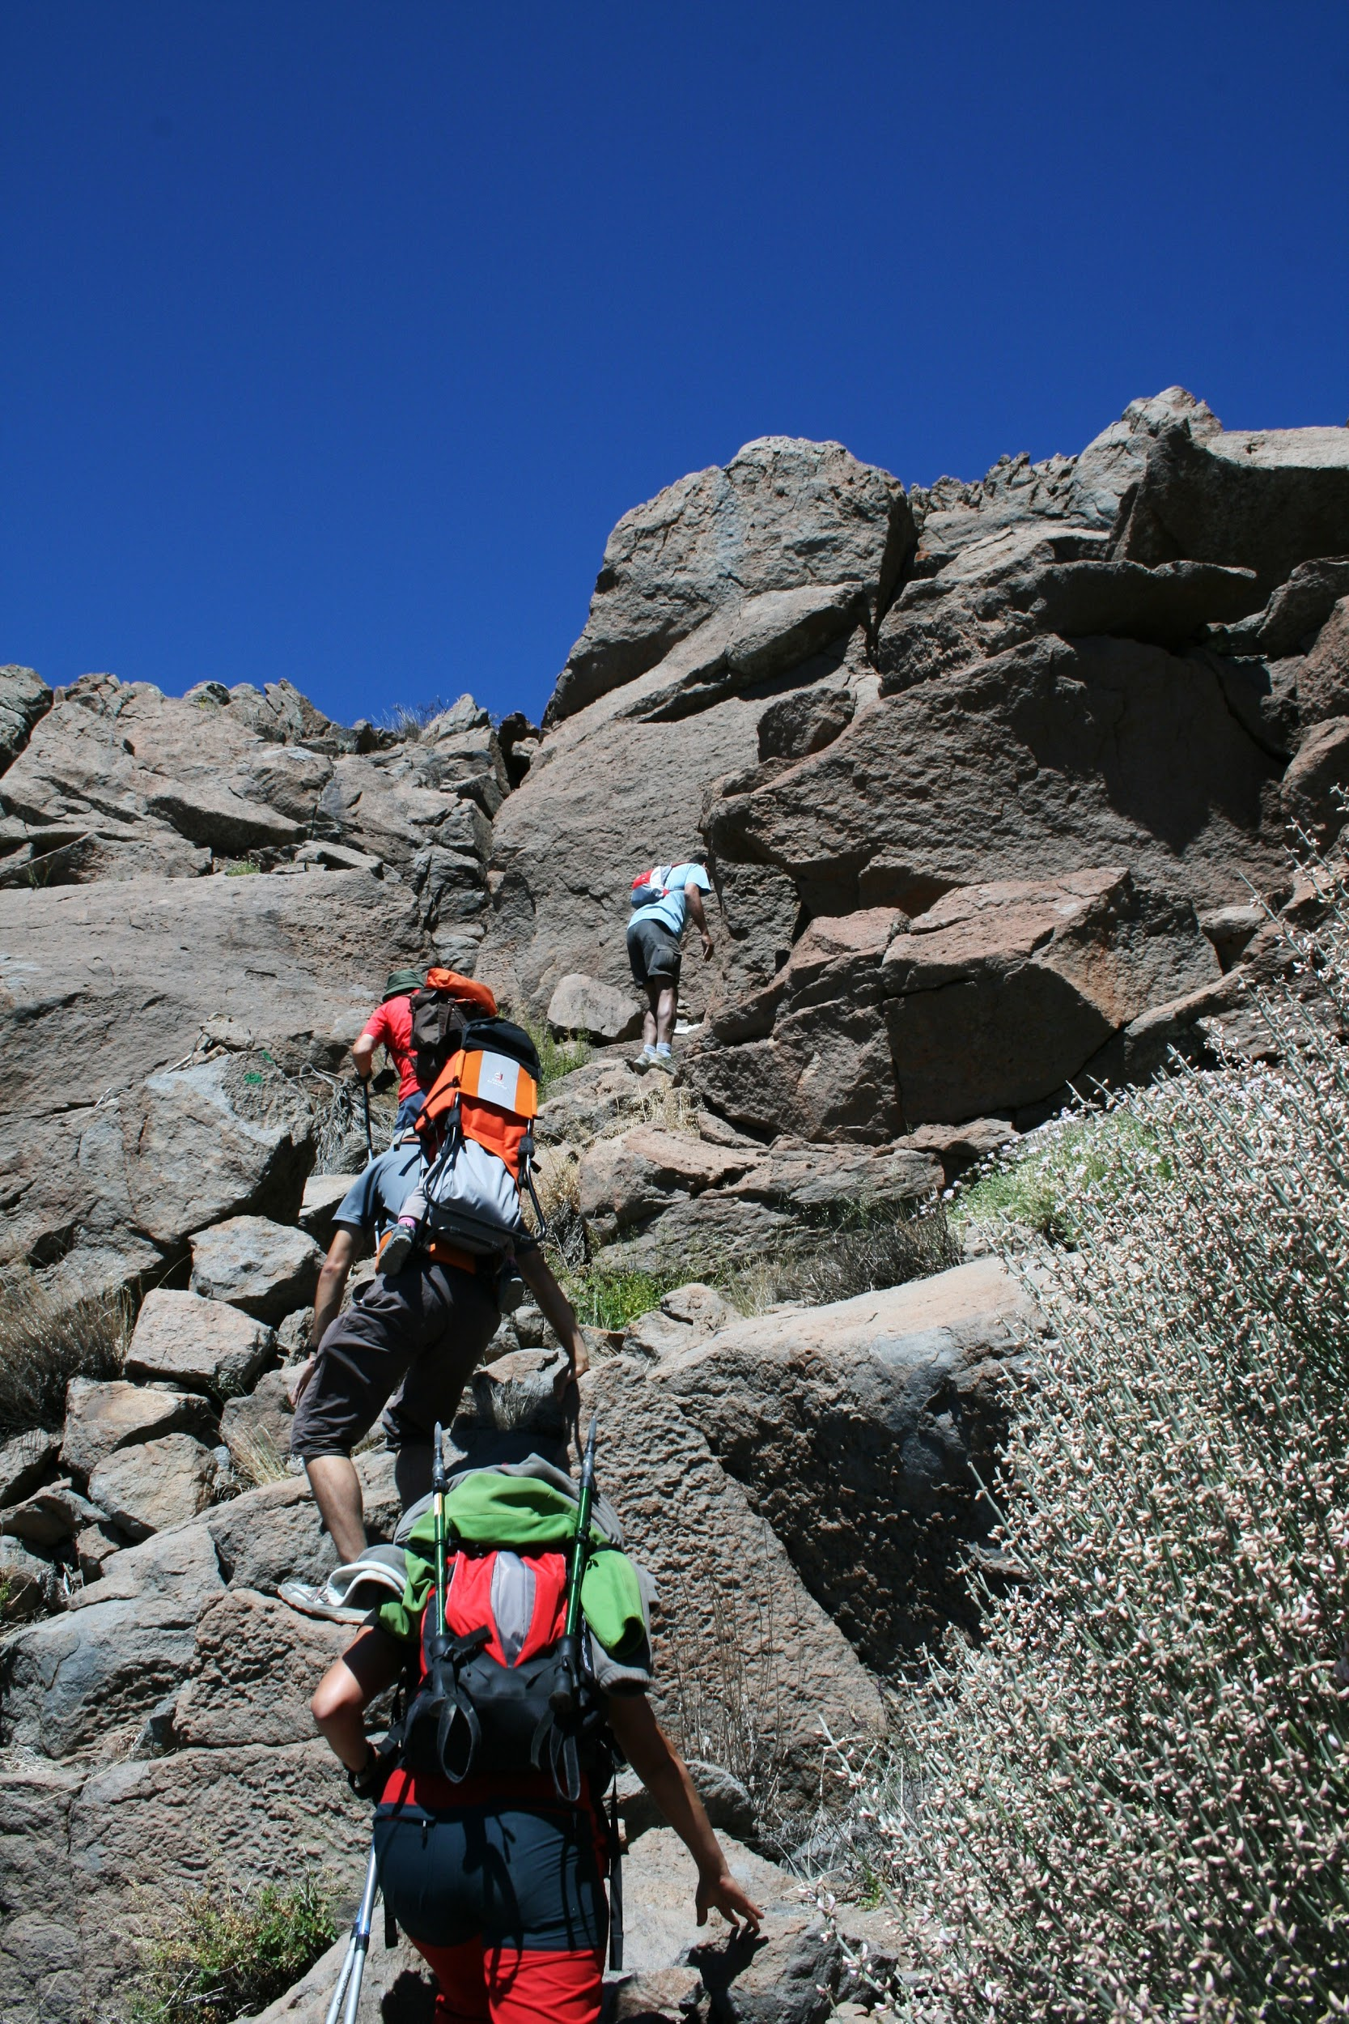
Elective - Outdoor Activities
Navigation & orienteering
Camp planning
Camp cooking
Outdoor activities
Outdoor Ed Camp

Slide 5
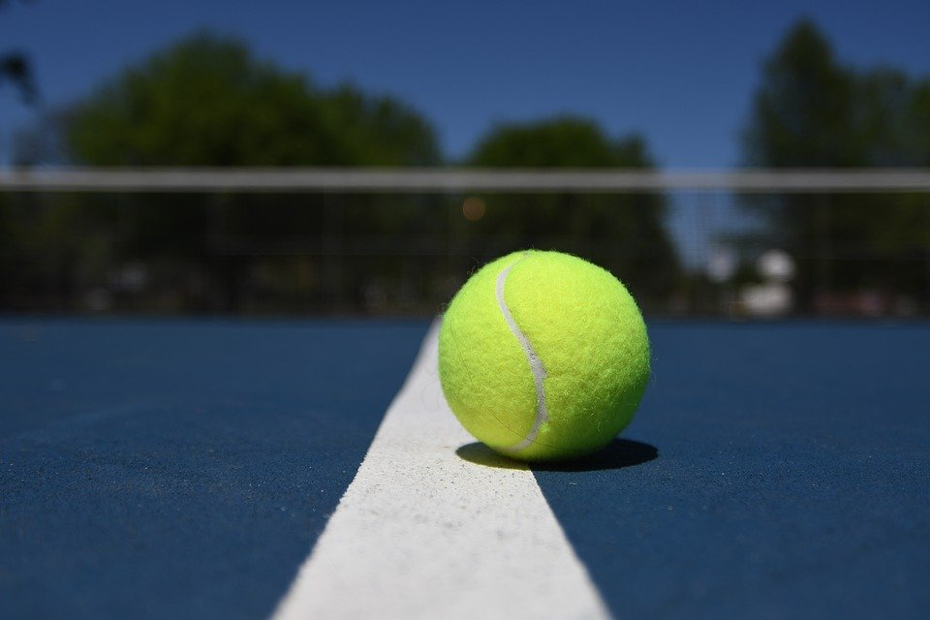
Elective - Exercise Science
Biomechanics
Nutrition
Sport Psychology
Skill acquisition
Training principles
Technology in Sport

Slide 6
Year 10 options for Health & PE
Core Health & Physical Education - All Year 10 students
plus 2 optional electives:
Outdoor Activities
Exercise Science

Slide 7
Year 10 Physical Education
More information?
-PE teachers
-Subject handbook
Paul McLoughlan
Head of Health & Physical Education

