Slide 1
YEAR 12
Health & Human Development
(Unit 3 & 4)

Slide 2
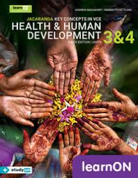
Health & Human Development
Unit 3:Australia’s health in a globalised world
Understanding health & wellbeing
Dimensions of health and wellbeing
Measuring the health status of Australians
Factors influencing health status such as smoking, alcohol, high body mass index and dietary intake
Promoting health and wellbeing
Australia’s health care system (Medicare, PBS, NDIS, Private health insurance)
Dietary guidelines, guide to healthy eating and the work of Nutrition Australia

Slide 3
Health & Human Development
Unit 4:Health and development in a global context
Health and wellbeing in a global context
Characteristics of high, middle and low income countries
Safe water, sanitation, poverty, discrimination and global marketing
Climate change, conflict, world trade and tourism and digital technologies
Health and the Sustainable Development Goals
Sustainable development goals 1-6 and 13.
Non-government organisations
Aid programs

Slide 4
Health & Human Development (3&4)
More information?
-Current students
-HHD teachers
-VCAA study design

