Slide 1
YEAR 11
Unit 1&2 Physical Education

Slide 2
PHYSICAL EDUCATION Units 1 & 2
Practical activity remains a significant component of PE.
Significant theoretical content.
Resources: Textbook & Edrolo

Slide 3
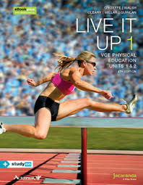
PHYSICAL EDUCATION
Unit 1:The human body in motion
Musculoskeletal system
Cardiorespiratory system
Enablers & barriers to movement
Performance enhancement - legal and illegal

Slide 4
PHYSICAL EDUCATION
Unit 2: Physical activity, sport and society
Types of activity - play, games, sport
Sociocultural influences
Benefits of exercise
Risks of inactivity
Contemporary issues in physical activity & sport

Slide 5
PHYSICAL EDUCATION Units 1 & 2
More information?
-Current students
-PE teachers
-VCAA study design
Paul McLoughlan
mcloughp@mcararat.catholic.edu.au

