Slide 1
Year 8 Mathematics
Core subject

Slide 2
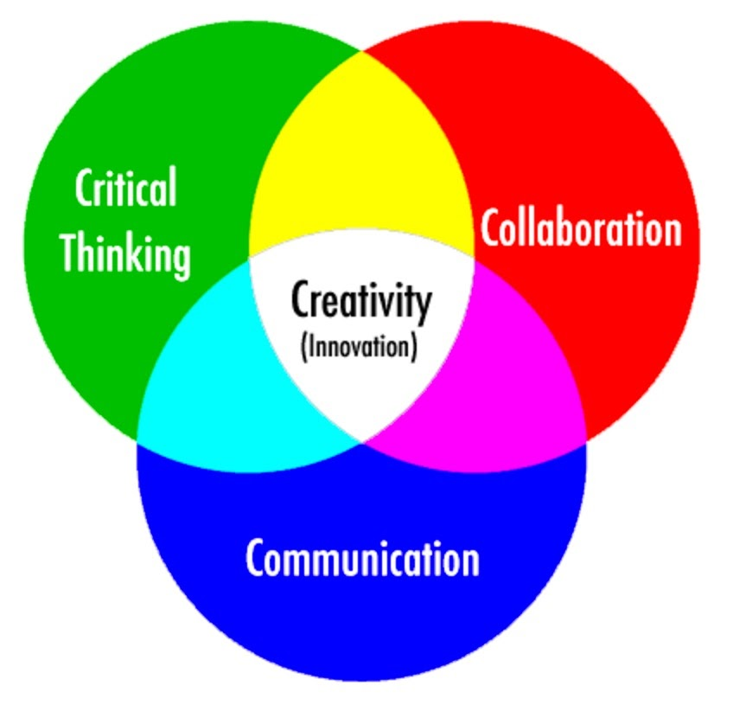
21st century skills

Slide 3
Core subject

Slide 4
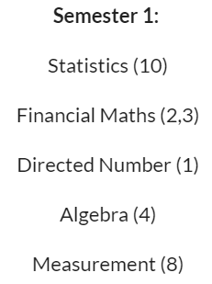
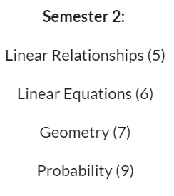
Year 8 Mathematics

Slide 5
½ Mathspace ½ Problem solving
Mathspace Online Program
Plus a Range learning activities

Slide 6
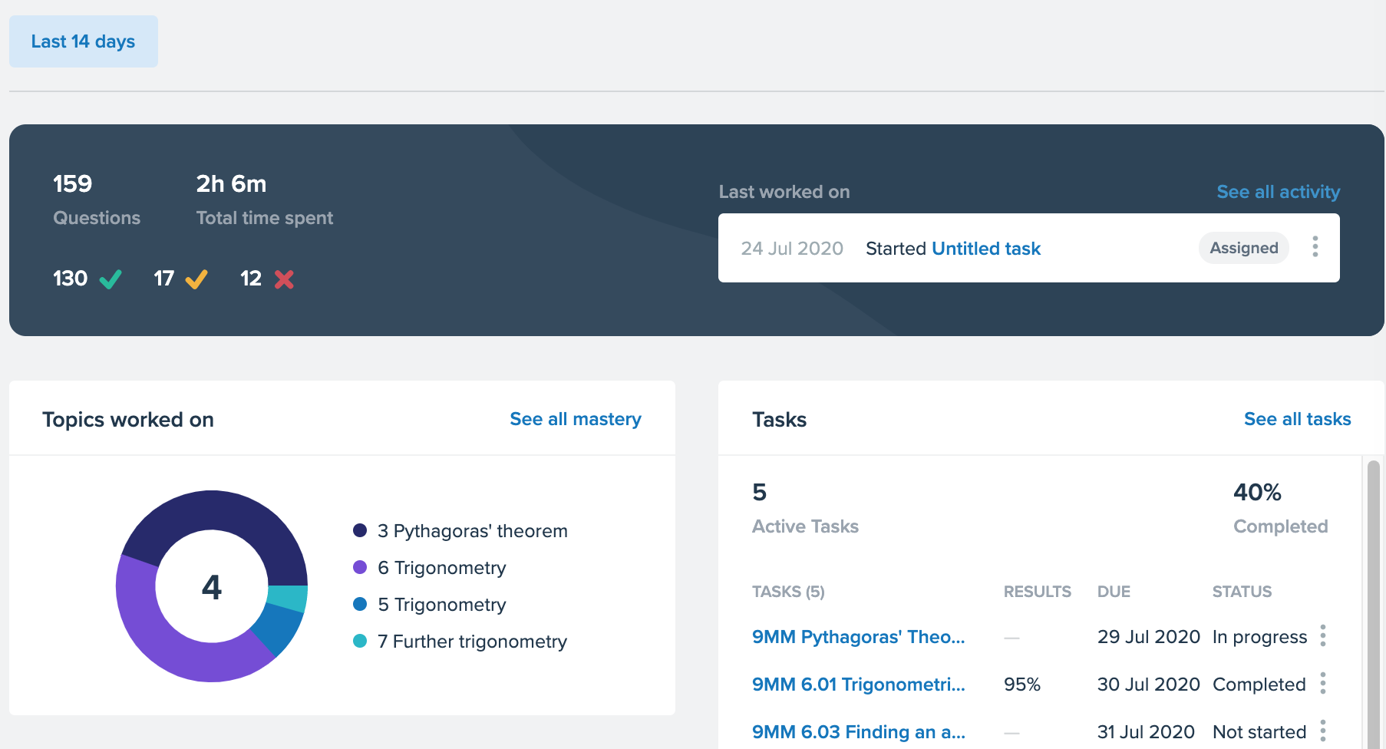
Insight into a student

Slide 7
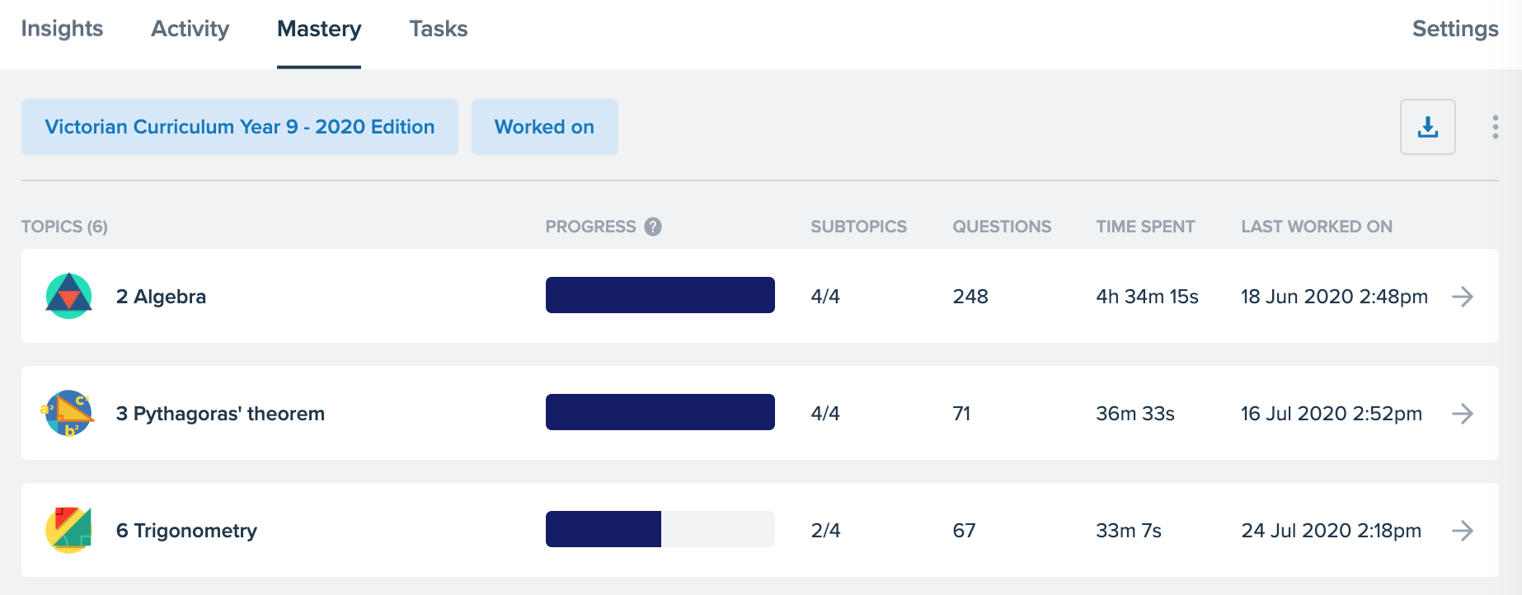
Student Mastery

Slide 8
Year 8 Maths
Assessments
Problem Solving
Tests
Assignments
Any questions
Head of Maths
John Coghlan
coghlanj@mcararat.catholic.edu.au

