Slide 1
Year 12 Mathematics
Further Maths
And / or
Maths Methods
And / or
Specialist Maths
(must do Methods)

Slide 2
Maths Pathways
VCE 1&2 Specialist Maths
VCE 3&4 Specialist Maths
VCE 1&2 Maths Methods
VCE 3&4 Maths Methods
VCE 1&2 General Maths
VCE 3&4 Further Maths
VCAL Numeracy
VCAL Numeracy

Slide 3
Year 12 Maths
Decision: Work Ethic / Prerequisites / Strategy
Specialist Maths (Must do Methods) | Maths Methods | Further Maths
Must also do Methods Material very hard to relate to and often abstract Perseverance | Should be getting B’s minimum Material hard to relate understand / access Perseverance | Most common choice Material easier to understand / access
Useful for Engineering and electronics at university | Check pre-reqs for uni Useful at university. | BEST choice for most students Students more likely to GET a higher score in this.

Slide 4
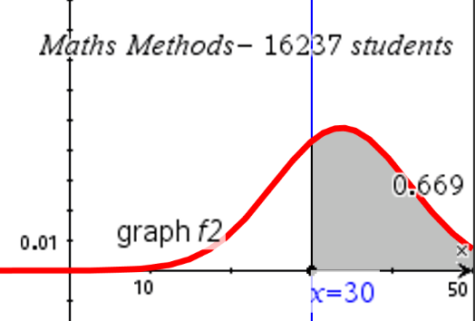
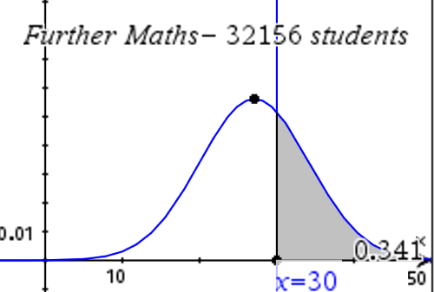
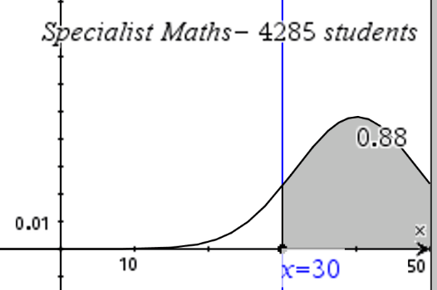
Maths Score Strategy
Specialist Maths (Must do Methods) | Maths Methods | Further Maths
4000 students of the ELITE maths students in 2019 | 16000 of the STRONGEST maths students | 32000 students
Scaled scores 3770 students over 30 | Scaled scores 10862 students over 30 | Scaled scores 10933 students over 30

Slide 5
Year 12 Maths
Assessments
SAC’s
Exams
Any questions
Head of Maths
John Coghlan
coghlanj@mcararat.catholic.edu.au

