Slide 1


VET

Slide 2
VET - VCE and VCAL
How does it work?
You can undertake a VET program alongside your:
• VCE, or
• VCAL
VET programs are usually run over one or two years, which you complete during.

Slide 3
What are the benefits?
• Contribute to the eligibility requirements for VCE or VCAL.
• Contribute to your ATAR score. Some VET options have scored Assessment.
• Develop ‘job ready’ skills and experience in your chosen industry.
• Receive a nationally accredited qualification or units towards a qualification.
• Achieve a pathway and credits towards higher level courses.
• Gain credit into apprenticeships and possibly reduce the duration of an apprenticeship.

Slide 4
VET Scored subjects
At Marian College, we attempt to offer as many diverse VET subjects as possible internally at school.
VCE ATAR scored VET (AS) or 10% toward ATAR offered for next year are:-
Cert III in Sport & Recreation (AS) Cert II in Engineering Studies (AS)
Cert II in Automotive (10%) Cert II in Building and Construction (10%)
Cert II in Community Services (AS) Cert II and III in Music (AS)
Cert II in Furniture Making (AS) Cert III in Early Childhood (10%)

Slide 5
VET - Non scored subjects - VCAL only
We offer other VET subjects for students partaking in VCAL and who need industry specific skills for their future careers.
Usually these VET subjects require 120 hours of work placement for successful completion. These consist of:-
Cert II in Business
Cert III in Fitness

Slide 6
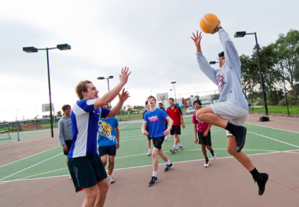
Cert III in Sport & Recreation - 2 Years
Students will develop the skills and knowledge required to support the operation of facilities and assist in conducting sport and recreation programs as well as developing a comprehensive understanding of the Sport and Recreation industry.
This program is examinable at the end of the Unit 3/4 sequence for ATAR.

Slide 7

Cert II in Engineering - 2 Years
Certificate II in Engineering Studies prepares students for an engineering apprenticeship which can lead into a range of careers in the engineering and manufacturing industries, including roles in conception, design, manufacture, assembly, installation, repair, replacement, packaging and sales of a wide range of products.
This program is examinable at the end of the Unit 3/4 sequence for ATAR. Use this link for further information and a short video.

Slide 8
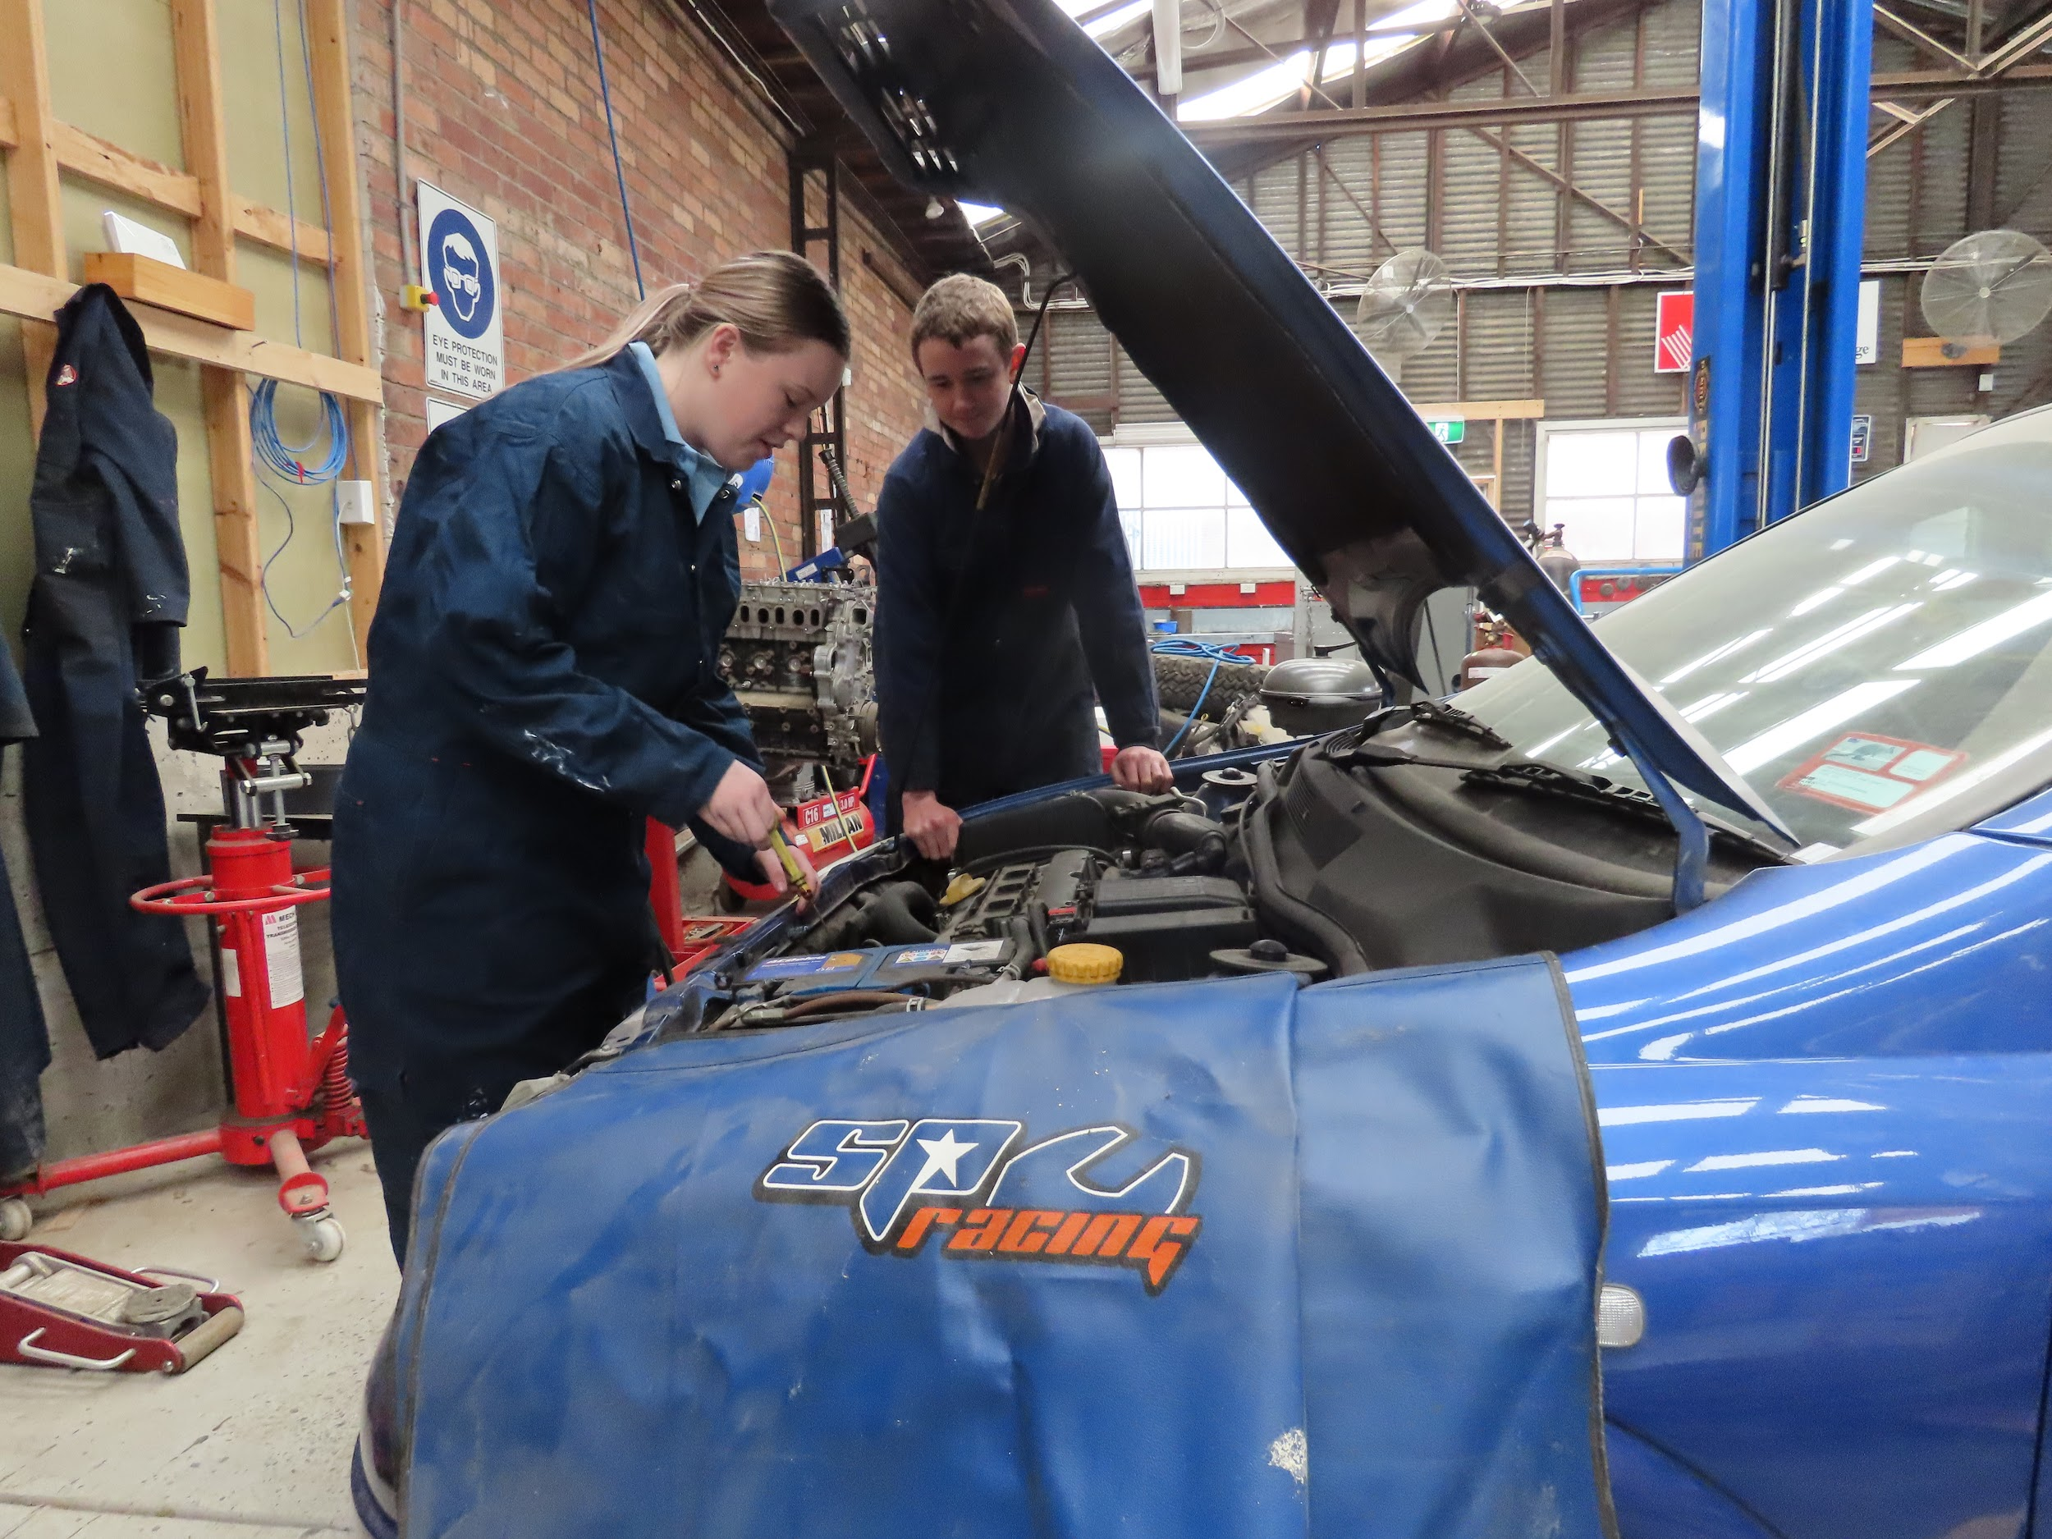
Cert II in Automotive - 2 Years
Provides students with ‘work ready’ and basic operational knowledge of a range of automotive technologies, the ability to apply a range of skills appropriate to enter the automotive industry and to apply solutions to a range of problems.
10% contribution to ATAR.

Slide 9
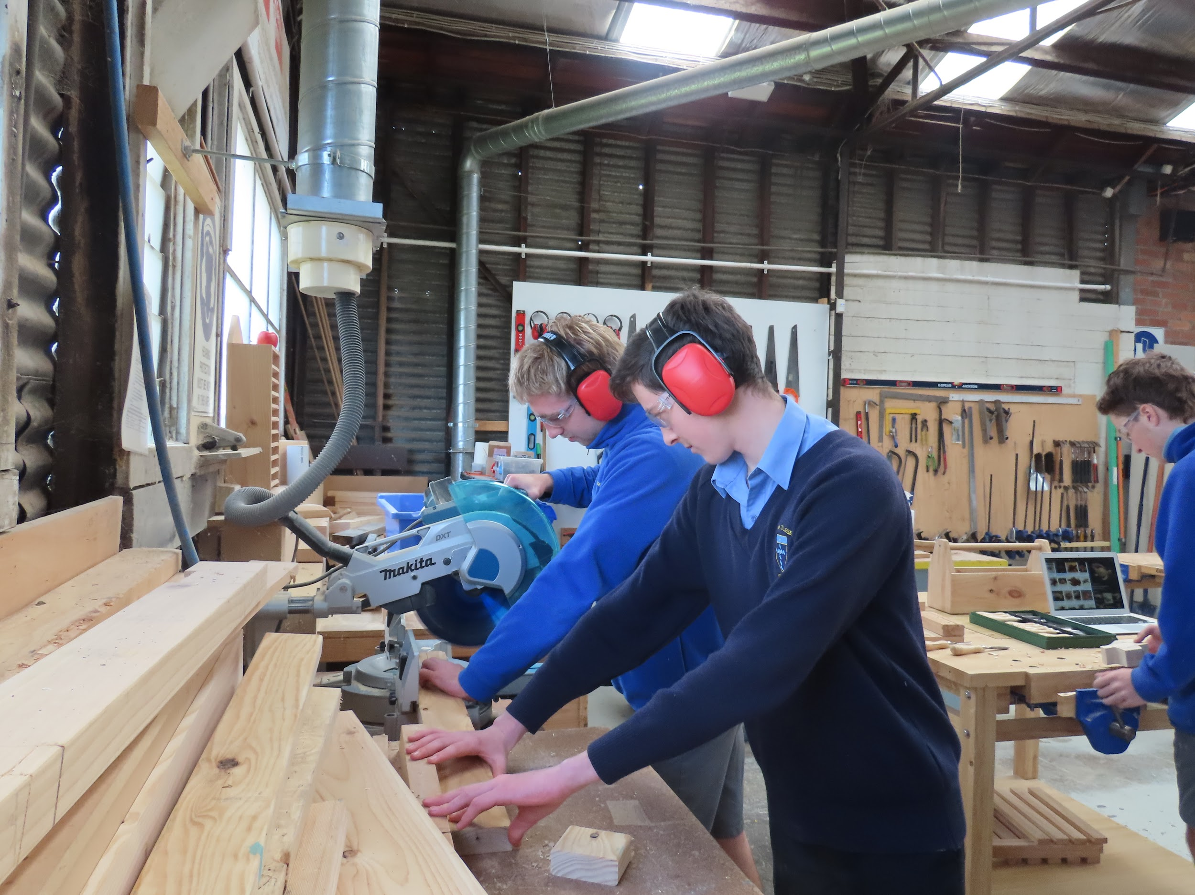
Cert II in Building and Construction - 2 Years
Provides students with knowledge and skill development to enhance their employment prospects within the building and construction industry - Carpentry specifically. This will enable students to gain a recognised credential and to make a more informed choice of vocation or career paths.
10% contribution to ATAR.

Slide 10
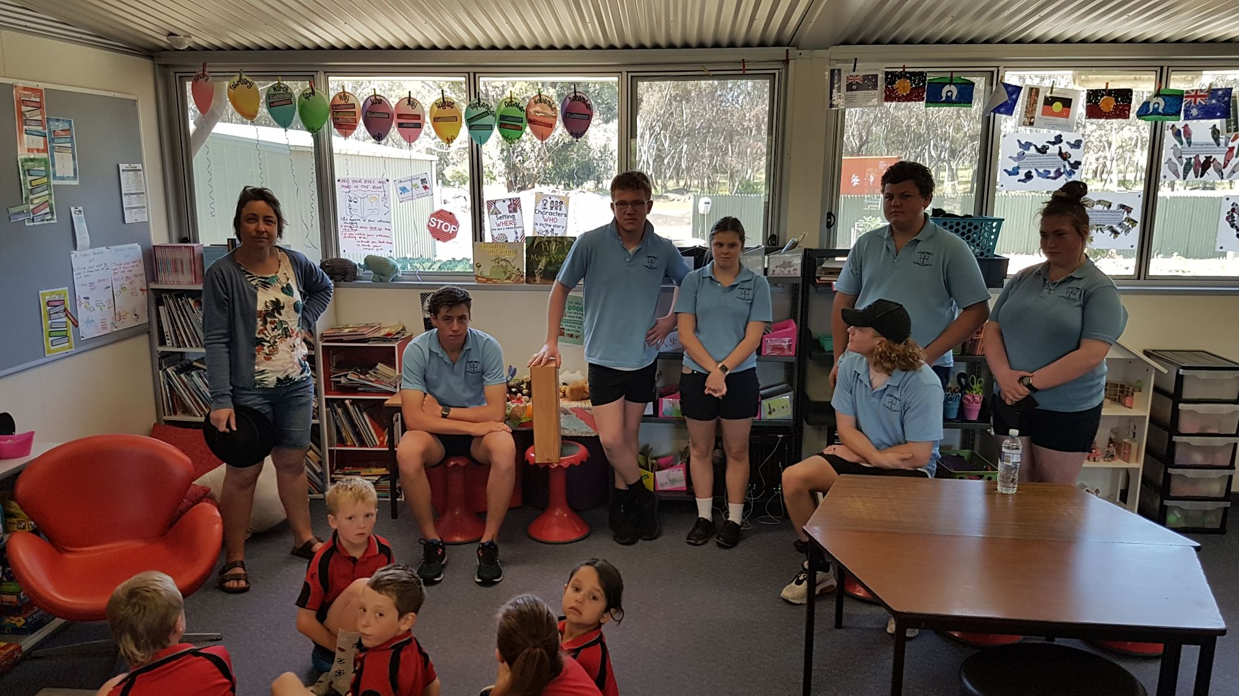
Cert II in Community Service - 2 Years
This course allows students to develop the skills and knowledge to undertake community services work. This includes providing support and assistance to a variety of clients from different sectors, including childcare, disability and aged care sectors.
This program is examinable at the end of the Unit 3/4 sequence for ATAR.

Slide 11

Cert II and III In Music - 2 Years
Certificate II in Music provides students with the foundation knowledge and skills required for entry into the music industry. This includes developing and updating industry knowledge, participating in work, health and safety processes and working effectively with others.
This program is examinable at the end of the Unit 3/4 sequence for ATAR.

Slide 12
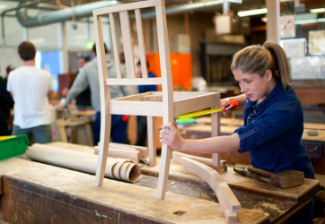
Cert II in Furniture Making - 2 Years
This course will equip you with the basic skills and knowledge to enter the furnishing, cabinet making and joinery industries. The program covers the skills and knowledge required to work in a production environment in both the manufacturing of free-standing furniture or built-in cabinets, and to provide on-site assistance in the installation of these items.
This program is examinable at the end of the Unit 3/4 sequence for ATAR.

Slide 13
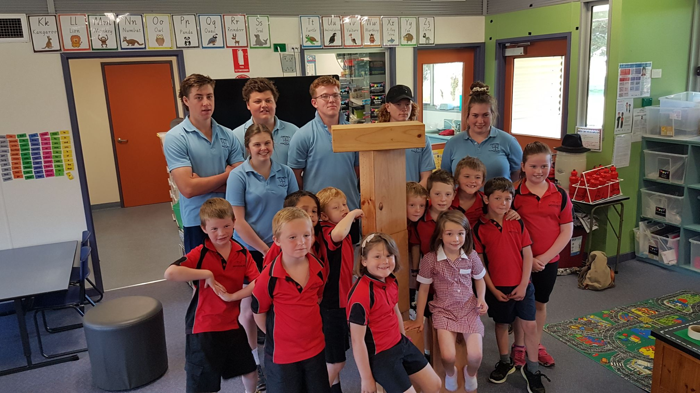
Cert III in Early Childhood - 2 Years
This course is for students seeking roles in a range of early childhood education settings. Students gain a range of knowledge and skills including caring for children, developing relationships with babies and toddlers, keeping children safe as well as supporting children’s play and learning.
10% contribution to ATAR.

Slide 14
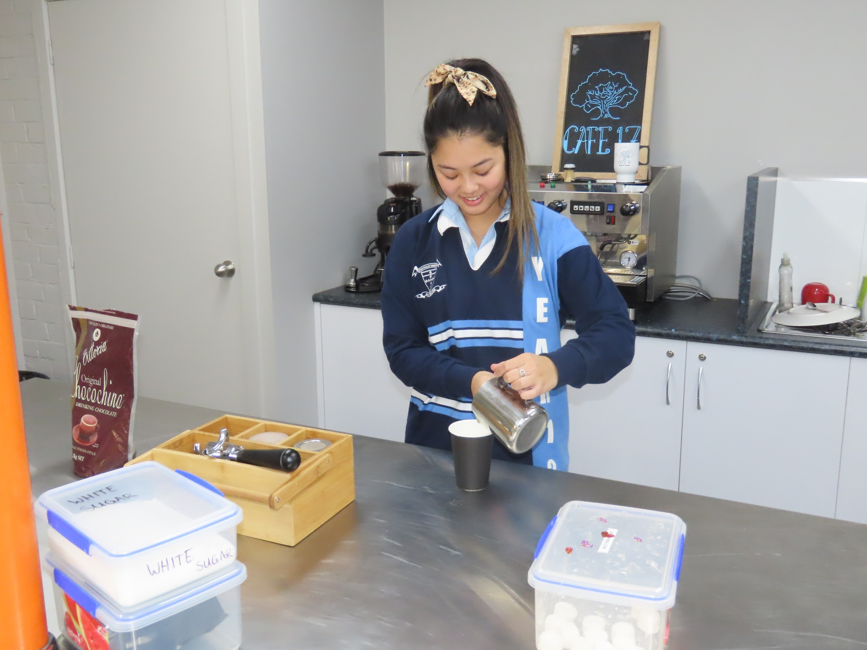
Cert II in Business Studies - 1 Year
VCAL Students only
The certificate II in Business (VCAL) allows students to gain a variety of skills and knowledge needed to undertake administrative roles in a business environment. This course is contextualized for school’s intermediate VCAL program and is designed to blend in and support WRS curriculum.

Slide 15
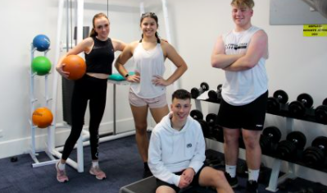
Cert III in Fitness
VCAL Students only
The Certificate III in Fitness will enable students to undertake work in a range of fitness environments dependent on the specialisation chosen. This may be Group Exercise Instruction or Gym Instruction. This course is contextualized for school’s VCAL program and is designed to blend in and support WRS curriculum.

Slide 16
External VET - Outside of Marian College
Currently Ararat College offer VET Hospitality VET Allied Health and Stawell Secondary offer VET Hair and Beauty. Both school’s are a part of a cluster and so no further fees apply. These courses will run all day on a Wednesday.
You can get further information on school VET programs via the VCAA website.
There are other VET courses available in both Ballarat and Horsham, however parents must pay these fees in full - as we are not funded for them and students will have to make own travel arrangements.
Feel free to contact me for further information and fee costs.

Slide 17
Further course information
The VCAA website have a wide range of VET subject specific videos.
If you would like further information on a VET program - please follow the link below.
VCAA - VET VIDEOS

Slide 18
Contact
Please feel free to contact me - Mrs Smith
Call the School
Students can call by by office in ALC
Email
whited@mcararat.catholic.edu.au

